Slide 1
What is the market for apprenticeships at Level 4+? A qualitative inquiry
John Higton, Associate Director, CFE Research

Slide 2
The questions of interest
What place can higher and degree level (L4+) apprenticeships occupy in the vocational landscape?
What are the market opportunities that exist for L4+ apprenticeships?

Slide 3
To whet your appetite
By volume, L4+ apprenticeships currently occupy a couple of occupational niches – some are successful
L4+ apprenticeships need to be good enough to challenge the reputation of academic routes
Most existing L4+ apprenticeship / vocational programmes related to associate professional occupations are tiny compared to higher education programmes

Slide 4
CFE has completed a number of studies on L4+ apprenticeships and equivalent vocational programmes UUK – advocates HEIs developing degree level apprenticeships as broadens income stream and helps student opportunity (WP) Some development in new occupational standards within traditional FE providers able to align themselves to Trailblazer groups
A little background

Slide 5
Apprenticeship standards are based on occupations, so which are more suitable for initial development?

Slide 6
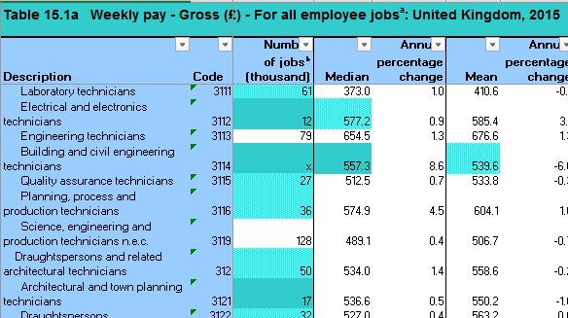
We took four data sources
ONS descriptions of associate professional occupations to identify those that typically require some form of higher qualification for entry.
1
Data from the Annual Survey of Hours and Earnings (ASHE) to derive the overall size of occupational market – the number of jobs in the UK economy by occupation.
2

Slide 7
Data on the number of Level 4+ aims listed on the Individualised Learner Record (ILR) for 2013/14. We also have a “supply” figure for Level 3. The data was aggregated by subject (SSA Tier 2).
3
Data from HESA for equivalent years that describes subject level student number in higher education (JACS code).
4

Slide 8
Then we processed. A lot. And ended up with the following qualitative analysis

Slide 9
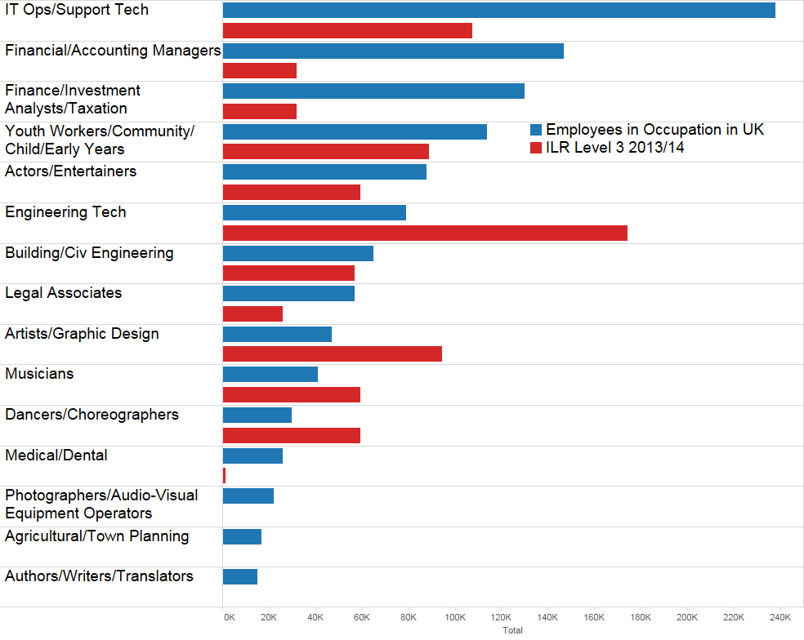
Supply
Lots of Level 3 students (A Level, Advanced Apprenticeships, etc.) for Engineering Tech occupations and the arts.
Fewer for IT and financial associate professional occupations.

Slide 10
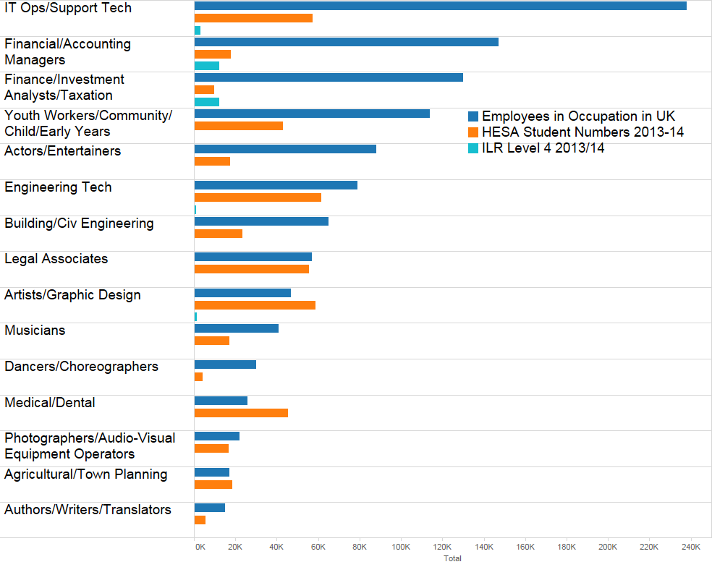
Supply
The relative numbers of L4+ on the ILR in 2013/14 was tiny compared to those on equivalent academic programmes.
Accountancy is one of the two better established vocational L4+ routes (the generic “management” is the other).
Arguable over-supply of students towards the foot of the chart.

Slide 11
There are several ways of thinking about potential market opportunities

Slide 12
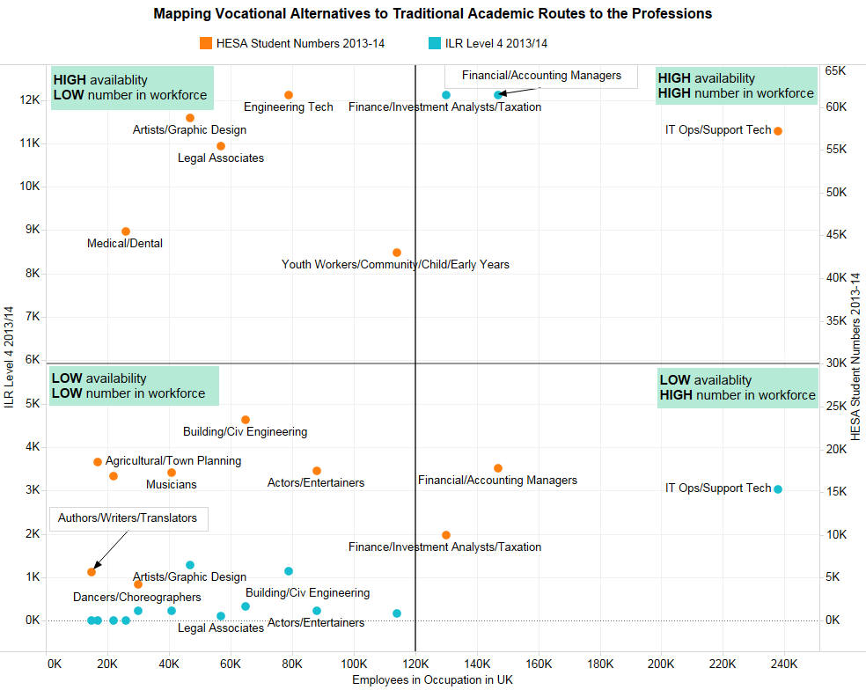
Relatively large supply, low associate professional numbers.
But progression to professional roles in some cases.
Moreover, apprenticeships attract a salary whereas HE typically doesn’t across all years of study (Sandwich courses aside).
“Replacement” growth for L4+ apprenticeships?

Slide 13
This might illustrate why artists and the like struggle in a garret.
Again, some potential for movement into professional careers in some groups.
Potential attitudinal issue for legal associates?
Limited growth potential for L4+ apprenticeships?
But students *relative* to UK employees worth looking at.

Slide 14
Large number of jobs and an equivalent supply of students.
Accounting courses are those that currently have a history for L4+ vocational provision.
Potential big opportunity for IT courses – would probably need associated vendor accreditation to get traction.
A review of existing L4+ vocational provision and why it is successful would be of value.

Slide 15
Large number of jobs but fewer students.
Underlines the potential for IT training – would probably need associated vendor accreditation to get traction.
Also some potential in relation to youth and community work occupations.
A review of existing L4+ vocational provision and why it is *less* successful would be of value.

Slide 16
A last line about L4+ Apprenticeship Standards “approved for delivery”; July 2016
Engineering (11)
Digital (9)
Finance (5)
Service (4)
Technician (4)
Management (3)
Broadcasting (3)
Health (3)
Skilled (2)

Slide 17
Any questions?
John Higton; Associate Director
CFE Research
John.Higton@cfe.org.uk

