Slide 4
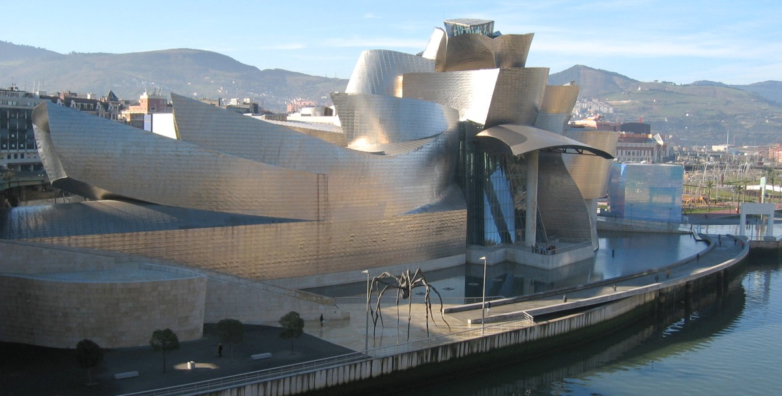

Slide 5
SCHOOL
AND ENVIROMENT

Slide 23
Thanks everybody¡¡¡¡
Information, suggestions and possible partners:
rafael.pilar@sjcalasanz.com
www.sjcalasanz.com

