Slide 1
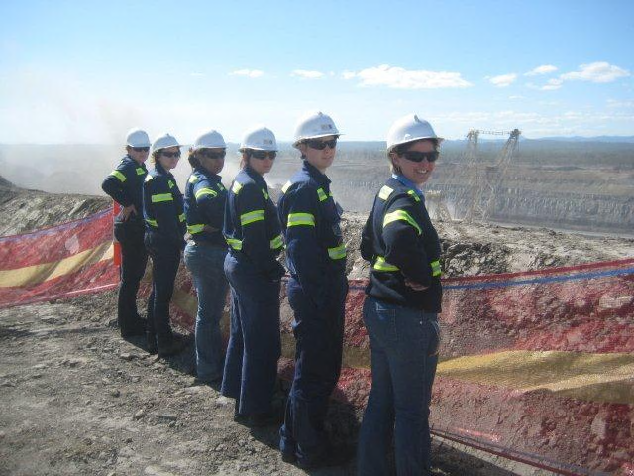
Industry-School Partnerships: Boundary crossing to enable school-to-work transitions across three targeted industries

Slide 3
Defining Industry-School Partnerships
ISPs are a systematic targeted approach, supported by government policy that provide exposure for students interested in pursuing a career in a specific industry.
ISPs are a platform for industries to promote themselves and may facilitate school-to-work transition

Slide 4
Terminology
Joint ventures
Public-private partnerships
School-enterprise
Cooperation
Networks
Coalitions
Collaborations
Co-makership
Social partnerships
Business-school relationships
School-business partnerships
Community-school partnerships
Industry-school engagement
Industry-school partnerships

Slide 5
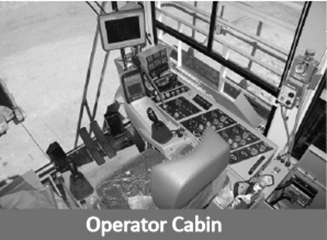
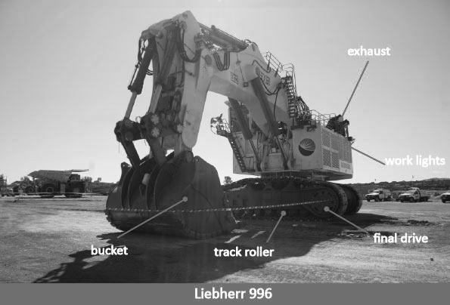
ISP Benefits
Reduce education sector costs to governments & address skill-shortages
Help supply education to geographically dispersed locations
Keep pace with knowledge innovation, new work practices/products with innovative educational solutions

Slide 6
Research purpose
Report on three Industry-School Partnerships
Minerals and energy
Building and construction
Aerospace
Aim – to understand and compare the dynamics of each industry sector using boundary crossing theory.
Acknowledgement
This research was supported under Australian Research Council's Linkage Projects funding scheme (project number LP100200052: Industry school partnerships project: A strategy to enhance education and training opportunities).

Slide 7
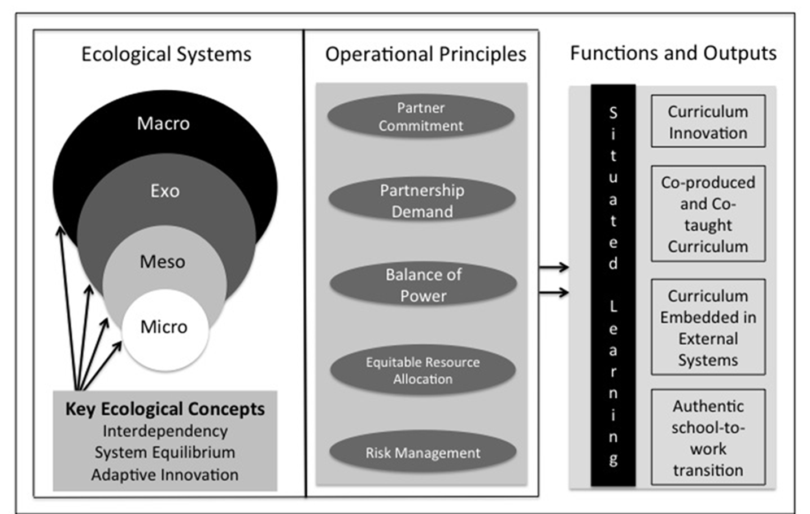
ISP Theoretical framework

Slide 8
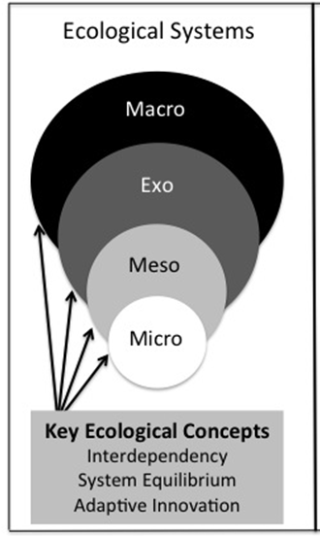
Boundary crossing framework
Akkerman & Bakker (2011)

Slide 9
Boundary Identification mechanism
Factors to consider:
Process of delineating differences between two partners
Verify & understand demand & source for ISP
Cultural compatibility of partners
Roles and responsibilities
Skills & training systems offered
Models of operation

Slide 10
Boundary coordination mechanism
Factors to consider:
Repeated interactions facilitate the permeation of boundaries between partners
Agreements, formal/informal
Linkages, direct/indirect btw partners
Co-produced curriculum processes
Coordination models, individual vs. Team
Geography – close proximity

Slide 11
Boundary reflection mechanism
Factors to consider:
Realising & clarifying differences & learning about own & others practices
Initiated by either partner
Negotiation of new actions
Strengthening / changing existing arrangements
Culture, curriculum, industry standards

Slide 12
Boundary transformation
Evidence of change in current practices leading to effectiveness in the overall ISP system
Factors to consider:
Occurs progressively as an outcome of the previous three mechanisms
Institutionalised activities external to the ISP

Slide 13
Research methodology
Qualitative case study
Data sources - semi-structured interviews & documents
Purposive sampling method, 50 interviews
Thematic analysis – priori theoretical framework
Notes:
Qualitative - why. I am looking to discover, gain insight and understand from the perspectives of the participants because I believe that this approach is more likely to contribute to new knowledge on ISPs. The proposed study will be conducted in a real-world context with no control over participants as is the case in quantitative studies.
I am looking to apply adaptive theory where prior theoretical models can suggest patterns that emerge as well as respond to order that emerges from the data (Layder, 1998).
Qualitative researcher - I am personally comfortable being the primary instrument for collecting data. I envisaged visiting schools, industry, government departments and industry bodies to observe, interview and interpret ISPs. My extensive experience in public and private sector roles(15 years) has given me the confidence to function effectively. I have held project manager roles in government and have had my consultancy and Registered Training Organisation where I have worked intimately with the Resources Industry to develop learning and assessment strategies.
I am aware that I will need to closely watch my personal bias.
I have selected a single case study as the appropriate method to answer my research questions. Robert Yin argues that case studies are appropriate when a researcher is asking how and why questions.
My case is bounded to the QMEA and two SHS that participate within the QMEA. The two schools will provide independent data.
I have delineated the case into four units of analysis to determine how the QMEA functions.
The UofA are
influence and interconnection - analysing these two concepts will help me to understand ISP from an ecological perspective. IAnalysis of these two concepts will allow me to look at how interdependent the entire ISP system is.
Trust - is a necessary element of all effective partnerships
Innovation - I have not raised innovation previously in this presentation. I believe it is a critical - this is about analysing whether the QMEA ISP has been able to realise outputs and to adapt (innovate) when the system is at threat.

Slide 14
Findings on identification mechanism
Aerospace | Building & Construction | Minerals & Energy
Demand – strong demand identified by Boeing, QANTAS & Virgin | Demand – State government identified need & contracted Hutchinson Builders to develop & deliver training | Demand – State government identified need & approached Queensland Resources Council
Model – partnership between 24 schools & industry | Model – Hutchinson Builders identified 73 partner schools in six clusters | Model – partnership between 34 schools & 17 multinational companies.

Slide 15
Findings on coordination mechanism
Aerospace | Building & Construction | Minerals & Energy
Documented agreements – future goal | Documented agreements – not formalised | Documented agreement– multiple formal arrangements over 6 year.
Coordination model – sole project officer | Coordination model – dedicated school coordinator between school & industry | Queensland Minerals & Energy Academy (Lead Broker). Board, Director & project team

Slide 16
Findings on coordination mechanism
Aerospace | Building & Construction | Minerals & Energy
Geography – close proximity to Brisbane airport & schools | Geography - school clusters in close proximity to infrastructure projects | Geography – close school proximity to mining communities
Curriculum – co-production process | Curriculum – co-production process | Curriculum – co-production process

Slide 17
Findings on reflection mechanism
Aerospace | Building & Construction | Minerals & Energy
As industry priorities change the nature of the partnership changes. F11 phased out, curriculum changed. | School leavers over-qualified for apprenticeship | Economic fluctuation impacts on partnership sustainability
Program focus dependent on project coordinator experience and perspective | Training programs need to be mobile to enable delivery where infrastructure projects are located | Shortage of school teachers with industry-based knowledge to contextualise curriculum

Slide 18
Findings on transformation mechanism
Aerospace | Building & Construction | Minerals & Energy
Institutionalised curriculum – approved by State government | Institutionalised curriculum – approved by State government | Institutionalised curriculum – approved by State government
European Aviation Safety Agency approval as training organisation | Australian vocational system approval | Australian vocational system approval
Australian vocational system approval | Contextualised maths, English, Science. Certificate I & II Building & Construction. | Contextualised maths, science& Certificate I & II in Resources Industry

Slide 19
Industry-school partnership propositions
ISP partners need to identify and understand the types of boundaries and common interfaces that exist between schools and specific industries.
Effective ISP coordination models across partner boundaries is dependent on the geographical scope of activity.

Slide 20
Industry-school partnership propositions
ISPs who practice reflection and address challenges transparently can expect to develop innovative and sustainable programs.
ISPs who seek to integrate programs into existing external systems will transform and realise school-to-work transitions that meet the needs of all partners and ultimately the end beneficiary – the school student.

Slide 21
Common elements across industries
Employ boundary crossing
Co-produce curriculum
Co-teach/train innovative educational programs
Embed in external systems
Enact school-to-work transition

Slide 22
Questions

