Slide 1
“They told me I was going to have to wait for the baby boomers to die” A textual analysis of young adults’ perceptions of the value of school-mediated workplace exposure
Dr Steven Jones (University of Manchester)
Dr Anthony Mann (Education and Employers Taskforce)

Slide 2
Employer engagement in education: becoming a norm of education policy
The English work experience requirement
After years of employer engagement becoming ever more commonplace within British secondary education, with the introduction of the Wolf reforms in 2013, a period of work experience has become a legal requirement of all (English) educational provision at 16-19.
International endorsement: OECD
“Individual career guidance should be a part of a comprehensive career guidance framework, including a systematic career education programme to inform students about the world of work and career opportunities. This means that schools should encourage an understanding of the world of work from the earliest years, backed by visits to workplaces and workplace experience. Partnerships between schools and local firms allow both teachers and students to spend time in workplaces.” (OECD 2010, 85)

Slide 3
Why engage employers in education?
Primarily, to improve the labour market prospects of young people:
Scottish Executive (2007)
Determined to Succeed (2004) calls for a ‘major commitment’ from Scotland’s employers to help young people get ready for work and go on ‘to be successful employees, employers and entrepreneurs’
Welsh Assembly Government (2004)
statutory requirement to work-related education designed to provide ‘opportunities for learners to improve their knowledge and understanding of, and skills for, the world of work, enterprise and entrepreneurship’
English Department for Children, Schools and Families (2008) work-related learning at Key Stage 4 to help young people aged 14 to 16 ‘to develop their “employability skills” that make them attractive to their future employers’

Slide 4
Research studies: suggest school-age employer contacts linked to comparative success in early labour market
Four US longitudinal studies of learning programmes with control groups rich in employer engagement and work related learning : early adult labour market wage premiums of 6.5% to 25% one to six years after leaving high school (Jobs for the Future 1998; Applied Research Unit of Montgomery County Public Schools 2001; MacAullum et al. 2002; Kemple with Willner 2008).
Mann and Percy (2013), young adults aged 19-24 in full-time employment enjoy wage premiums of up to 18% linked to higher volumes of school-mediate employer contacts
Percy and Mann (2014), young adults aged 19-24 with higher levels of school-age employer contacts experience NEET rates up to 20% lower than comparable peers with low level of engagement.
Crawford et al (2011), young people who combine FT education with PT work at 16/17 do better in employment at 18/19 than peers who just study PT
Teenage access to networks of people in employment correlated with better employment outcomes as young adults in US (McDonald et al., 2007) and Finnish studies (Jokisaari & Nurmi, 2005).

Slide 5
Politicians agree, researchers endorse, but lack of certainty why and how employer engagement in education should be a good thing
US studies typically vague on causes of premiums observed. They could be…
improved ‘career awareness and development activities’ (Kemple and Willner 2008, 40).
‘enhanced career preparation’ which allow programme graduates to ‘make immediate tangible steps towards careers goals’ (MacAullum et al. 2002, 11, 13).

Slide 6
Three theories of change
Human, social and cultural capital theory offering potential explanatory frameworks for assessing school-mediated employer engagement, providing potential means of understanding both how employer engagements are experienced and how they might influence potential economic outcomes.
Stanley, J. & Mann, A. (2014) “A theoretical framework for employer engagement” in Mann, A., Stanley, J. & Archer, L. eds. Understanding employer engagement in education: theories and evidence (London: Routledge)

Slide 7
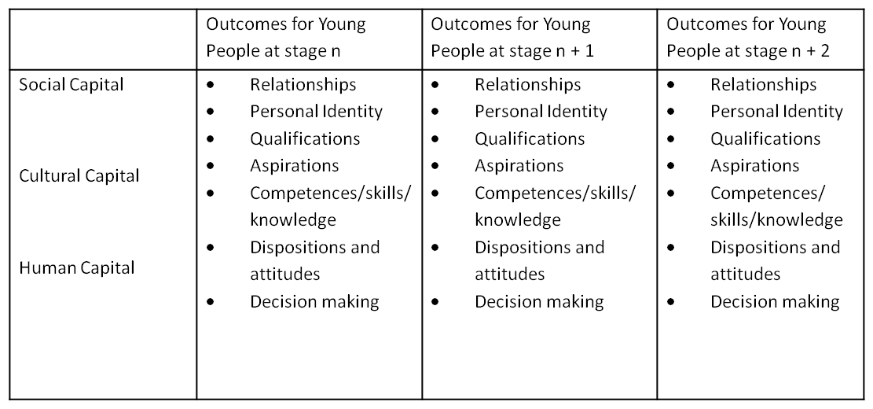
Environmental factors contributing to capital formation
Family
Peer Group
Locality
Gender
Ethnicity
Other institutions
School
Work
Educational Career
Employer interventions contributing to capital formation
Employer Engagement 1
Employer Engagement 2
Employer Engagement 3

Slide 8
Human capital (Becker)
Human capital accumulation
That as a result of the employer engagement, young people improve their ability to contribute to the production of goods and services in employment.
This may include:
Development of technical skills
Development of employability skills (UKCES definition):
Self-management
Thinking and solving problems
Working together and communicating
Understanding the business
Using numbers effectively
Using language effectively
Using IT effectively
Demonstrating a positive approach
Department for Education (2013) Post-16 work experience as part of 16 to 19 study programmes
“In her review of vocational education Professor Wolf described the unique role that time spent with an employer can have in helping young people develop employability skills and the value that employers place on this when they are assessing young people for employment in the future.”

Slide 9
Social capital (Granovetter, Portes)
Social capital accumulation
That as a result of the employer engagement, young people come into contact with another individual or group of individuals creating a social relationship which in some way afford or constrain the ability of the young person to achieve goals of economic relevance.
This may include:
Gaining access to new information about employment opportunities and recruitment demands (non-redundant trusted information)
Validating/confirming previously held perspectives on employment opportunities and recruitment demands
Securing new access to economic opportunities through newly formed or strengthened social relations
Raffo & Reeves (2000) on extended work experience
“the process of developing social capital through trustworthy reciprocal social relations within individualized networks, young people are provided with an opportunity to gain information, observe, ape and then conﬁrm decisions and actions with signiﬁcant others and peers.”

Slide 10
Cultural capital (Bourdieu)
Cultural capital accumulation
That as a result of the employer engagement, young people experience change in their attitudes about themselves and the lives they expect to lead.
This may include:
Examples of changes in ‘habitus’: attitudes, dispositions – feelings that career paths are or are not ‘for me’
Examples where the employer engagement leads to a changed perspective about the value and point of education/schooling and qualifications
Clarke & Zukas (2013), A Bourdieusian approach to understanding employability: becoming a ‘fish in water’ Journal of Vocational Education and Training
King’s College/Louise Archer, ASPIRES (2013) – science ‘for me’ / ‘not for me’
Miller (1998), Green & Rogers (1997), mentoring and changed attitudes to education

Slide 11
Research Questions
Can the testimonies of young British adults shed light on which, if any, of these theories of change help to explain what may happen when a young person engages with employers as part of their educational experiences?
Do the testimonies of young British adults help us understand how social background influences experience of employer engagements?
Can theories of symbolic capital help to shape policy and allow more young people to benefit from employer engagement?

Slide 12
Data and Method
Of the 1,002 total YouGov respondents, 488 responded to:
Thinking back to your time in school or college, what would you say you got out of employers being involved in your education? It could be in terms of changing the way you thought about school or college, providing useful information or encouragement for thinking about possible jobs or careers, helping to get actual jobs either through people you got to know or giving you something useful for job applications or interviews, or in getting into a course at college or university you really wanted. Or maybe you got nothing out of it at all. Either way, please tell us more. (150 words max)
Of these 488, 380 indicated in their comments that they had had some contact with employers at school.
Of these 380, 190 (50.0%) indicated that they had found this contact helpful in some way

Slide 13
Useful Employer Contact?

Slide 14
School Type Coding
Non-Selective State Schools
Grammar Schools and Selective State Schools
Independent Schools

Slide 15
Positives (across all school types): # Social Capital – networks and contacts
Gained contacts.
Personal contacts were helpful.
It was useful to talk to employers.
The ability to network and make contacts.
Notes:
Could note that the verb to ‘network’ is only used by those from an Independent School

Slide 16
Positives (across all school types): # Social Capital - “Authentic” Guidance
Told us from experience. Told us straight.
Opportunity to ask questions without prejudice.
You got advice that seemed more genuine.
I trusted the word of someone in the working world as opposed to a careers advisor or teacher ‘telling’ you what to do.
They told me that I was going to have to wait for the baby boomers to die.
Notes:
Worth dwelling on, I think – strong argument for work experience in general.

Slide 17
Positives (across all school types): # Cultural Capital: Enhanced Personal Confidence
Making you feel more confident.
Helped me a lot by boosting my confidence.
Helped develop my confidence.
The excitement of being independent.
Notes:
Broad structure: begin with stuff all respondents said, then zoom in on the type of comments made only by some respondents.

Slide 18
Positives (particular to Grammar Schools, Selective State Schools and Independent Schools) # Human Capital: Links to Higher Education
Helped me to gain experience which I used in my university application.
Helped get into university.
Context for what university courses you should look for.
Helped me to better prepare for my interviews for university.
Helped me when I went on to a degree.
Notes:
I may digress briefly here to talk about my work on personal statements – same findings from a different perspective.

Slide 19
Positives (particular to Non-Selective State Schools) # Cultural Capital: Elimination of Options
Made me realise what profession I did not want to go into.
I did work experience at a hairdressers. It made me realise that I wanted to go to university so that I got a good job and didn’t have to fall back on boring jobs like hairdressing.
It made me realise which types of job I didn’t want…
Showed my which careers I definitely did not want to do.
Helped me to decide that it wasn’t what I wanted to go into.

Slide 20
Positives (particular to Non-Selective State Schools) # Cultural Capital: Academic Motivation
My work experience placement made me determined to work hard in education and aim for a worthwhile job I will enjoy.
I found my work experience horrible, which is why I made an effort to get a better education and a better job.
It stopped me from leaving school early.
Notes:
Relating nicely to previous slide.

Slide 21
Positives (particular to Independent Schools) # Social Capital: access to advantageous labour market experience
Following my work experience placement I obtained permanent part-time work at the same business. This steady job helped as a stepping stone into the working world.
It definitely helped me get summer internships during my degree, which will give me an advantage in the job market when I finish.
Notes:
Possible explanation for different outcomes in the job market. Those from Independent Schools seem much better at turning the experience into a career.

Slide 22
% likelihood of different capitals being referenced in statements

Slide 23
Negatives (across all school types): # Lack of Relevance
Wasn’t linked to the career I was interested in.
Never in the field I wanted to work in.
I worked in a bookshop doing the jobs no-one else wanted. This did not affect my decision to become a diagnostic radiographer.
I folded letters and put them into envelopes for a solicitors. I now do a PhD in astrophysics.
Notes:
This is the only across-the-board negative I could see.

Slide 24
Negatives (particular to Non-Selective State Schools) # Under-stimulation/Exploitation
The only experience I had was when I was 15 with Woolworths. It was rubbish. I stacked shelves and that was it.
[My placement] was in Mickey D’s. Hell personified.
It was more an excuse to have somebody work for them for free.
I worked in a shoe shop and had to do all of the rubbish jobs for free.
The employer just used me as free labour.

Slide 25
Wider issues raised by those from Non-Selective State Schools
I gained very little from the types of employer contact we had at school, as they were very much targeted towards people who were not academically capable and who wouldn’t be going on to university.
Focused on business/vocations, not on the professions (e.g. law, medicine, accountancy).
[I gained] nothing, as those that visited were recruiting from the army.
Misbehaved children were given the opportunity to do more work placements so they could build up their CV … [This] often left well-behaved children feeling like if you misbehaved you were rewarded.
Notes:
I think these points are worth making. They raise valid issues about how work experience is managed in Non-Selective State Schools. I’m not sure whether they could be better integrated into an argument though.

Slide 26
Useful Theoretical Perspectives
Life-course Analysis (Pallas 2003):
Not all young people are equally equipped to deploy their work experience as a “launch pad” (Evans, Schoon and Weale, 2010: 38) for HE entry, career building, etc.
Social Capital ‘Donors’ (Portes 1998):
Differences arise between those who provide resources (‘donors’), possibly leading to different conceptualisations of employer engagement.
Class-matching or Class-reproducing Activity (Hatcher & Le Gallais 2008):
Recurring perception that school-mediated employer engagement focuses less on academic routes and tends to operate outside of the professions.

Slide 27
Rethinking ‘Capital’?
Authenticity (trusted routes to social and cultural capital):
Strong, widely-shared perception that workplace staff communicate more directly and truthfully about labour market realities: “trustworthy reciprocal social relations” (Raffo & Reeves, 2000).
Game-playing insights (‘socialised’ human capital):
Accumulation of ‘invisible’ human capital more common than direct, technical skills (Kemple and Willner 2008, 40).
Elimination and Motivation (‘negatively accumulated’ cultural capital):
Enhanced agency to reject some vocational options and re-engage with academic routes, especially for those in the non-selective state sector.

Slide 28
Policy Perspectives?
Employability and technical skills: can’t be assumed
It should not be taken for granted that young people will build – or feel that they can describe - any human capital development gained through their employer engagements. What is the optimal way to deliver work-relevant skills?
Self-conceptions: start early
Young people form and change attitudes about themselves and their places in the world through their youth – beginning exposure to potential futures at a young age is likely to increase opportunity to gain insights of value to emerging self-conceptions and sense of agency.
You don’t know what you don’t know: more is more
Employer engagement often highly effective in influencing young people ruling in and ruling out potential pathways. Preceding attitudes influence patterns of engagement, calling for managed experiences, where broader early exposure is mandated and later focused exploration is facilitated.

Slide 29
Thank you
Steve Jones
SJ@manchester.ac.uk
Anthony Mann
Anthony.Mann@educationandemployers.org

