Slide 1
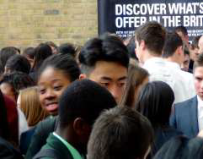
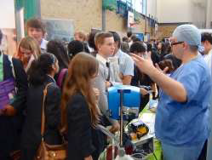
How young people and schools benefit from effective partnerships between education and employers
www.inspiringthefuture.org

Slide 2
An independent charity: Established in 2009
Our vision: to ensure that every school and college has an effective partnership with employers to provide its young people with the inspiration, motivation, knowledge, skills and opportunities they need to help them achieve their potential and so to secure the UK's future prosperity.
Our Partnerships Board
Senior representatives of the national organisations representing schools and colleges;
...and employers;
Notes:
Context;
Charity set up to ensure every school has an effective partnership with employers- COMPLETELY FREE SERVICE TO SCHOOLS
A lot of debate at the moment around careers in schools.
Ofsted report due in June.
Minister responded to a report on Tuesday add a quick synopsis.

Slide 3
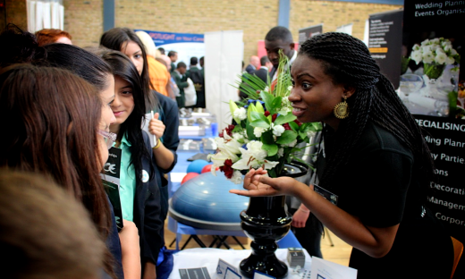
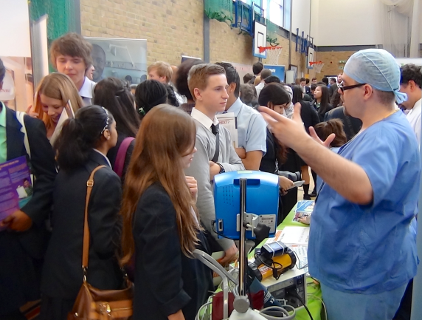
What we do:
Free services like ‘Inspiring the Future’ – working in partnership with schools
Research
Practical Solutions

Slide 4
Taskforce/YouGov 2011 survey, 986 young adults (19-24):
Q1: How many different occasions do you remember employer involvement (work experience, mentoring, enterprise competitions, career advice, CV or interview practice) when you were at school?
Number of Occasions | 0 | 1 | 2 | 3 | 4 or more
NEET | 26% | 23% | 17% | 16% | 4%
Source: It’s who you meet, 2012

Slide 5
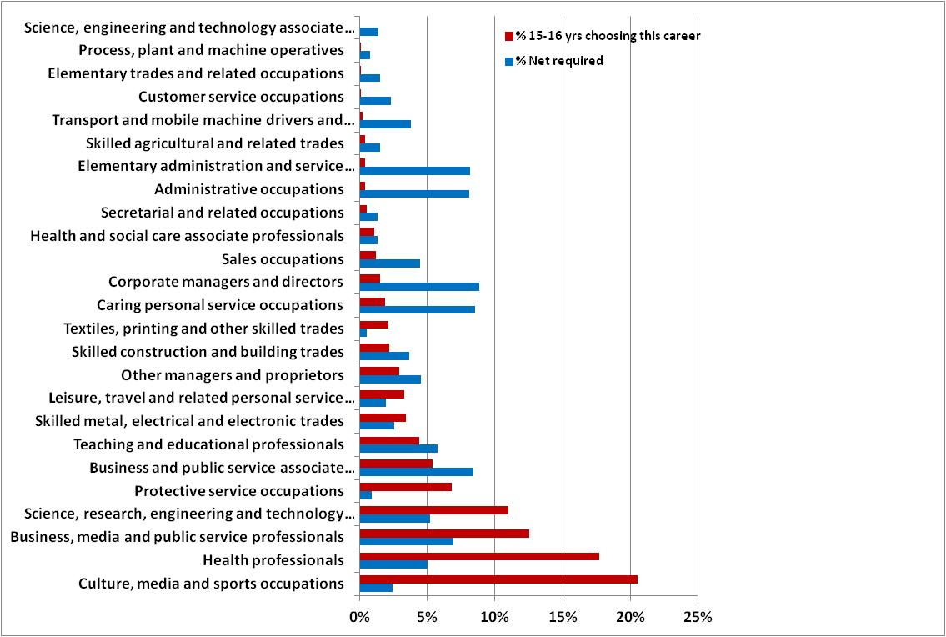
...against teenage aspirations

Slide 6
What is Inspiring the Future?
Built around a secure online system, Inspiring
the Future is a free service which has nearly
10,000 volunteers from all sectors and
professions from apprentices to CEOs who
have pledged one hour per year to go
into schools and colleges to give short talks
about their jobs, careers and the education
route they took

Slide 7
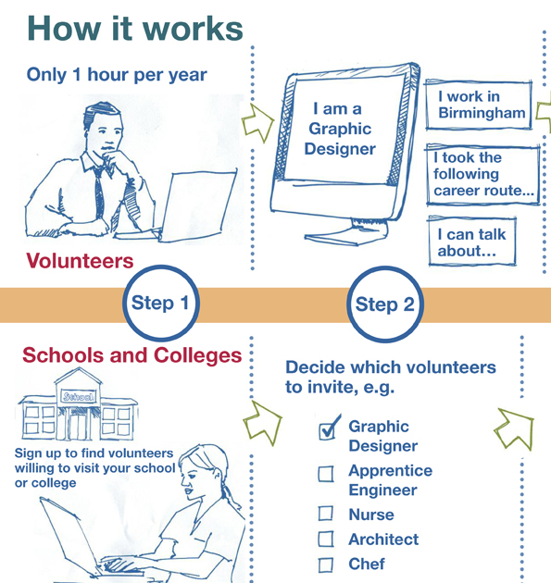
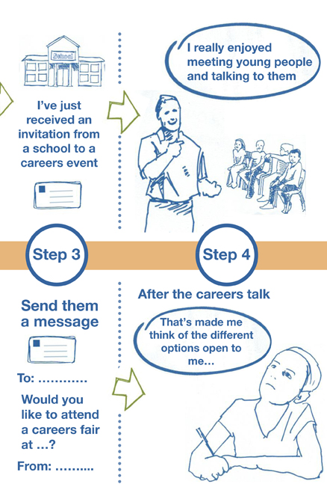

Slide 8
How can schools use Inspiring the Future?
A huge national network of diverse volunteers waiting for teachers to invite them to talk to pupils
Volunteers who are happy to come into the classroom to speak about jobs related to particular subjects, or to take part in careers talks either to a small group or at large career fairs
Connect with people from all walks of life - Apprentices, Entrepreneurs, Graduate Trainees, CEO’s - they are all one click away
Types of Events you could run
Careers Fairs
Careers Networking
Options Evenings
‘Career Insight’ Talks
CV & Interview Technique Workshops
What’s my line?
‘Enterprise Insight Talks’
School Assemblies
Curriculum Enrichment
Lunchtime Events

Slide 9
Signing up to Inspiring the Future

Slide 10
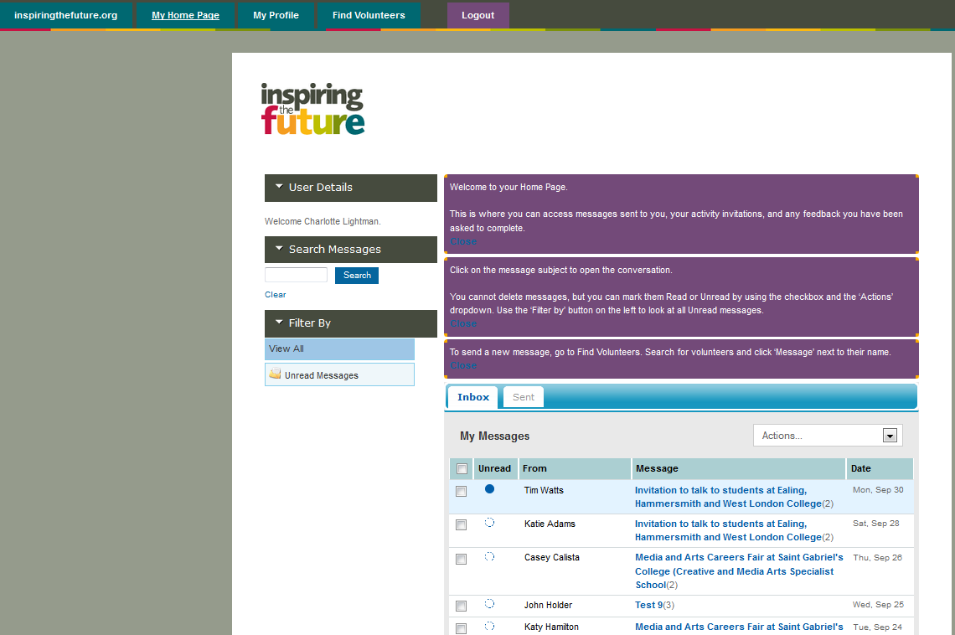
Getting started - Finding volunteers
Log in and choose the ‘Find Volunteers’ tab to find potential volunteers.

Slide 11
Setting up your search
Step 1 - The local authority will automatically be selected for your school or college
Step 2 – Use the drop down menu on the right to select activities and subject specialism/ sectors.
Step 3 - You can also choose whether to sort the volunteer list alphabetically or by newest volunteer first

Slide 12
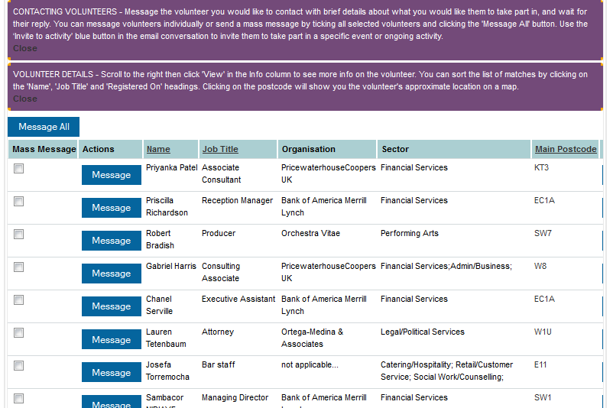
Viewing potential matches

Slide 13
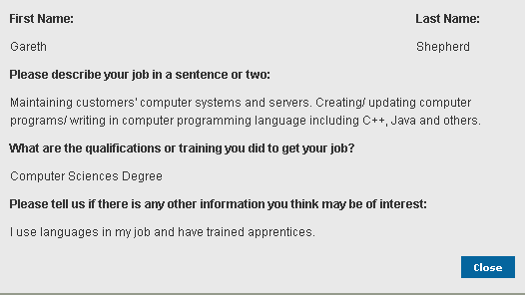
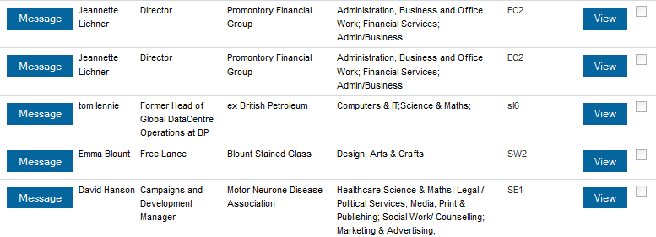
Finding out more about a volunteer
Under the ‘Info’ heading click on ‘View’ on any volunteer to see more information about them (as seen in the pop-up box on the right). This will help you make a decision about which volunteer to approach for your activity.

Slide 14
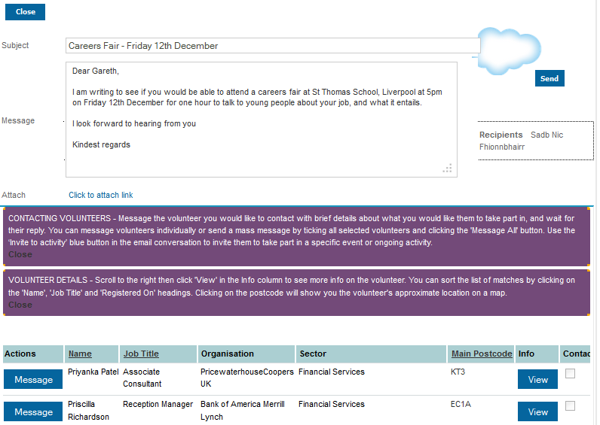
Messaging your chosen volunteer
Once you have decided which volunteer to approach, click on the ‘Message’ button next to their name
Under ‘Actions’. Write a brief message to the volunteer in the Message box introducing yourself, and let them know about the activity you have in mind.
Once you have finished drafting the message, click ‘Send’.
Mass Message
To message more than one volunteer at a time. Simply click in the box under the heading ‘Mass Message’ by all the volunteers you would like to select, and then click ‘Message All’.
You will then create a message in the usual way,
but when you click ‘Send’ it will go to all the
volunteers you have selected without the need
to send individual messages.

Slide 15
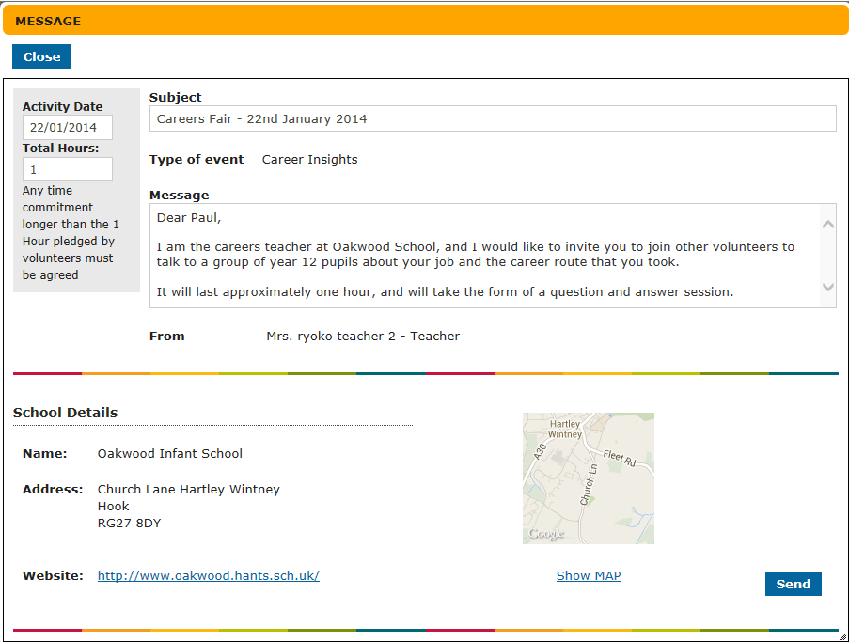
Sending a message

Slide 16
Receiving a message
Once your message has been sent, your chosen volunteer will be notified.
When they reply, you will be notified by email and asked to log in to your profile. You’ll see the new message on your home page, in the ‘My Messages’ section. To view the reply simply click on the message subject.

Slide 17
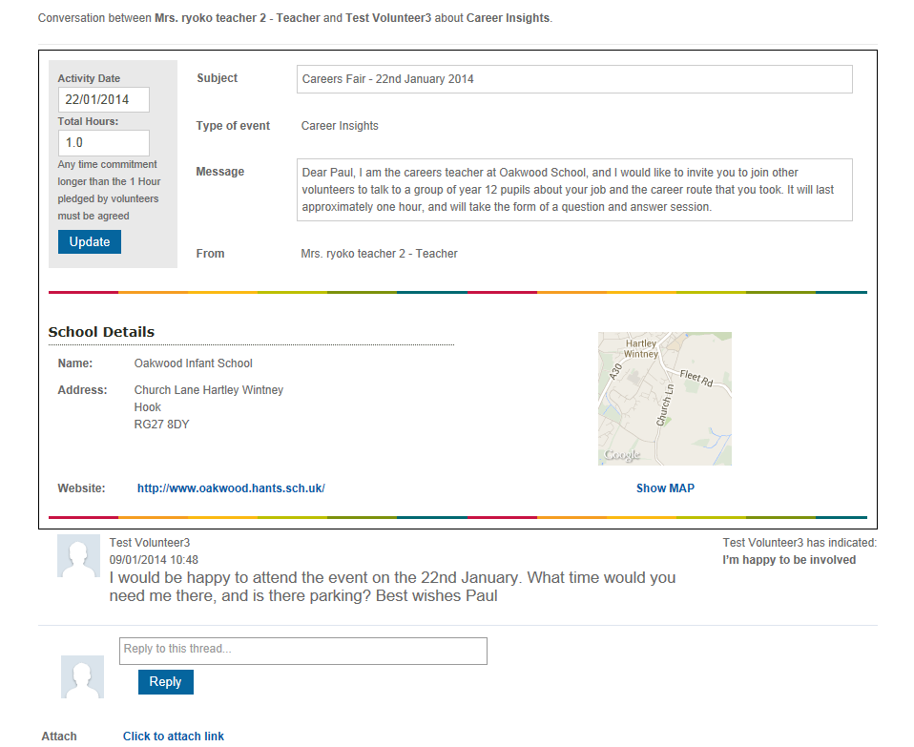
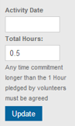
Viewing your message
If you wish to send another message to the volunteer you can do so by typing in the reply box and then clicking ‘Reply’.
If you want to come back to the message another time you can mark it as unread, by clicking the ‘Mark as Unread’ button.
If you have to send a message prior to knowing the event date, you can add the date later but you need to click ‘Update’

Slide 18
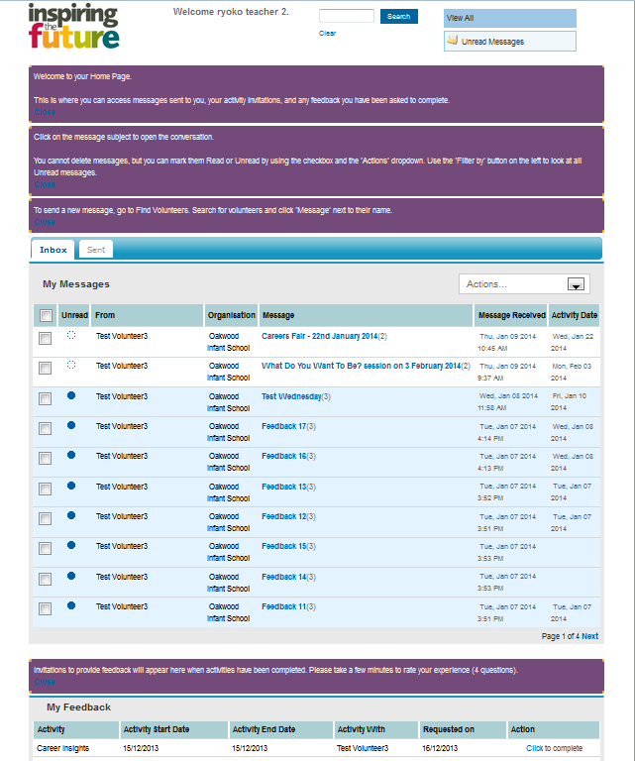
Viewing an activity
The message thread will appear on your home page under ‘My Messages’. Click on the message name on your home to view the details.

Slide 19
Completing your feedback
24 hours after the event takes place, you will get an email notifications asking you to log in and complete the ‘My Feedback’ section of the home page.
Simply click on the ’Click to complete’ link.

Slide 20
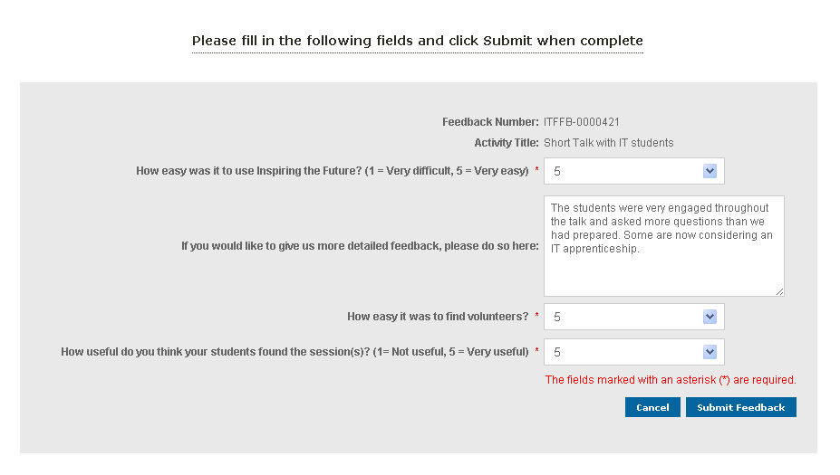
Completing your feedback
Once you have completed the relevant sections, click on the ‘Submit Feedback’ button, and you’ll be taken back to the home page to find your next volunteer!

Slide 21
Key Contacts
For any queries please contact:
Charlotte Lightman – Schools Liaison Manager
charlotte.lightman@educationandemployers.org
Tel: 020 3206 0510
Sophie Greaves – Schools Liaison Assistant
sophie.greaves@educationandemployers.org
Tel: 020 3206 0510

