Slide 1
Do educational pathways matter? Educational trajectories and job satisfaction
An analysis of the British Household Panel Survey from the ESRC-funded project:
“Education and Social Outcomes for Young People: Promoting Success”
Emma Salter and Dr Ricardo Sabates, Centre for International Education

Slide 2
Outline
1.0 Background and theoretical model
2.0 The dataset and method
3.0 Descriptive analysis
4.0 Trends
5.0 Results
6.0 Conclusion

Slide 3
1.1 Background
Gaps in research on education and job satisfaction:
  Inconclusive
  Lack of differentiation between type of education
  Lack of evidence on changes across the life course
  More analysis needed of component factors rather than overall satisfaction

Slide 4
1.2 Theoretical model
Self esteem
(Employability) skills
Pay
Autonomy
Intrinsic Extrinsic
Education
Labour market context
(+ & -)
Overall job satisfaction

Slide 5
2.1 The dataset
British Household Panel Survey (BHPS)
  annual household panel survey started in 1991
  10,264 individuals in 5,505 households
  still collecting data – most recent available is 2010
19 years (waves) of data (1991-2010) from the adult questionnaire (16+)

Slide 6
2.2 Method
Identify individuals’ educational trajectories
Explore the socio-demographics of people in each category
Analyse job-related outcomes by educational category

Slide 7
3.1 Trajectories of 16-40 year olds in
BHPS (n=10,640)

Slide 8
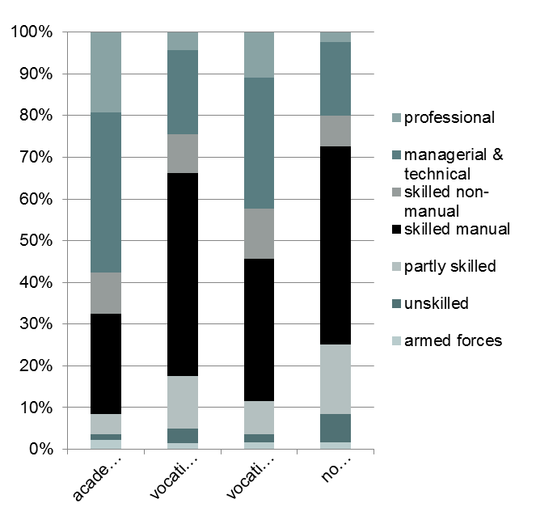
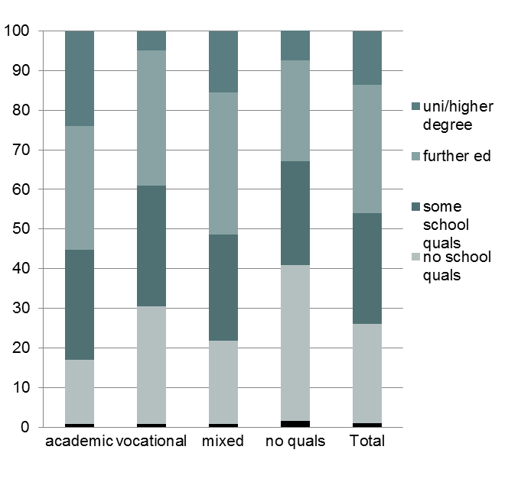
3.2 Descriptive analysis
Paternal occupational class
Paternal education

Slide 9
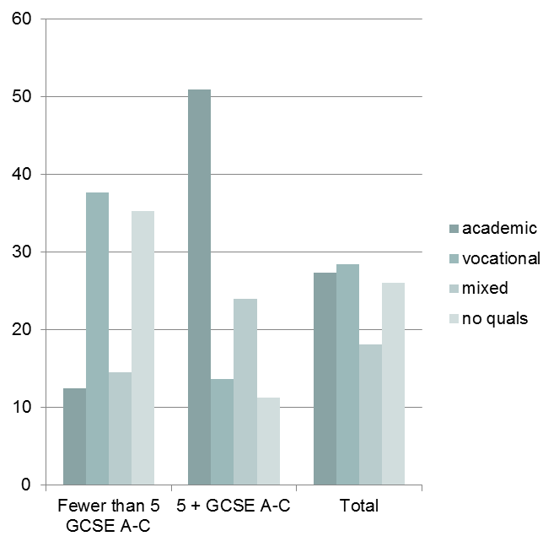
3.3 Descriptive analysis
Tenure at age 16
GCSE attainment

Slide 10
4.1 Trends: Education and overall job satisfaction

Slide 11
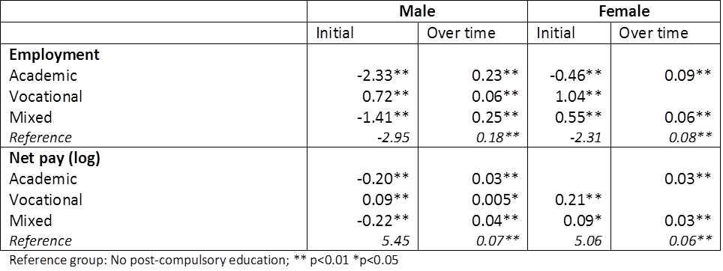
5.1 Results: income and employment

Slide 12
5.2 Results: Intrinsic factors

Slide 13
5.3 Results III: extrinsic factors

Slide 14
6.0 Conclusions
Education generally has a positive effect on employment and income over time
Education has very little effect on job satisfaction
Clear gender differences

Slide 15
Thank you!
e.j.salter@sussex.ac.uk

