Slide 1

#NAFNext2014

Slide 2

What difference does it make? Reviewing evidence on school-employer partnerships
Dr Anthony Mann www.educationandemployers.org/research
#NAFNext2014

Slide 3
“If school was like this,
I’d love it.”

Slide 4
Employer engagement in education
“the process through which a young person engages with members of the economic community, under the auspices of their school, with the aim of influencing their educational achievement, engagement and/or progression out of education into ultimate employment.”
Supplementary to conventional teaching (reading partners)
Complementary in offering alternative means to reach learning outcomes (mentoring)
Additional in providing learning outcomes not routinely delivered by schools (enterprise/employability)

Slide 5
www.educationandemployer.org/research
Work experience
Careers activities
Workplace visits
Business mentoring
Enterprise competitions
Curriculum enrichment
Increased achievement
Improved transitions

Slide 6
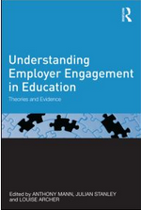
www.educationandemployer.org/research
Conceptualising EE in E
Social/economic contexts
Equity and access
Economic impact
#NAFNext2014

Slide 7
Employer engagement in education
What difference does it make?
Why does it make a difference?
Why is it more important than ever?
How can we deliver it at scale at cost?
#NAFNext2014

Slide 8
What difference does it make?

Slide 9
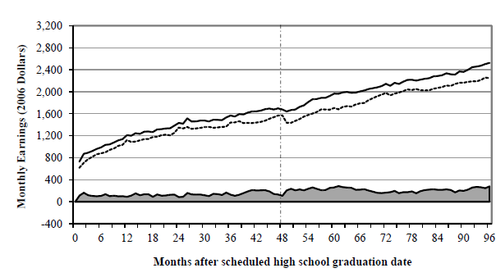
Career Academies: I love you!
Kemple, J. J. with Willner, C. J. (2008), Career Academies Long-Term Impacts on Labor Market Outcomes, Educational Attainment, and Transitions to Adulthood. MDRC

Slide 10
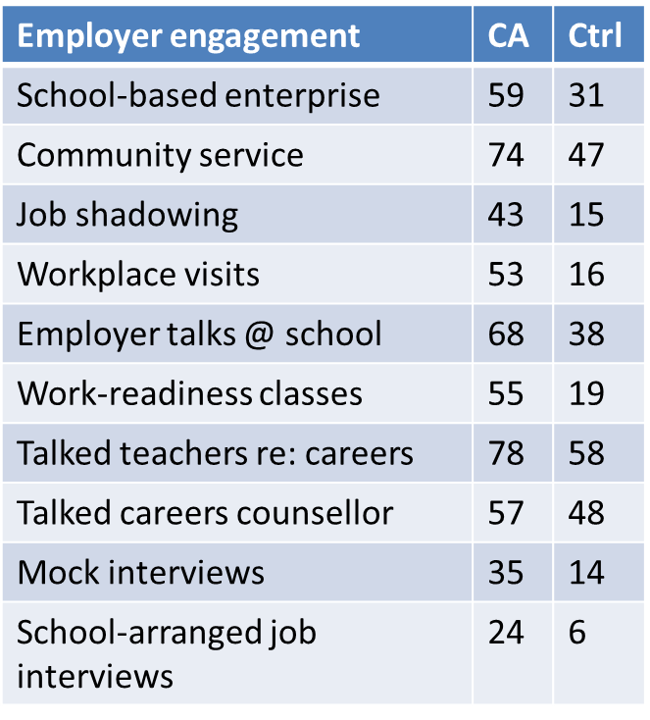
Because employer engagement makes you special
Orr et al (2007) “National Academies Foundation Career Academies” in Neumark D. Ed. Improving School-to-work transitions, 190-191

Slide 11
Study | Wage premium | Controls
Kemple (2008) Career Academies | 11% At Age 26 | Student demographic and family characteristics, educational attainment, including gender, ethnicity, socio-economic status, middle school attendance rates, geographic location of academy, graduation cohort, duration of employment, hours worked per week, weeks worked per month, hourly wage.
MacAullum – Lansing AMP (2002) | 26% At age 20 | Duration of employment, hourly wages
Jobs for the Future (1999) Boston | 20% Age 24 (?) | Unclear
Montgomery Schools, Arizona (1999, 2001) CTE | Higher At age 25 | Background characteristics, post secondary college and work activities, months worked, income

Slide 12
Study | Wage premium | Controls
Mann and Percy (2013) Volume of employer contacts | Up to 18% Ages 19-24 | Highest level of qualification; school type attended; age; region; gender; full-time earnings
Percy and Kashefpakdel Volume of employer career talks | Up to 7.2% At age 26 | Academic attainment; Socio-economic status; Early home learning environment; Demographics (social characteristics)

Slide 13
Why does it make a difference?

Slide 14
What does employer engagement do?
‘Human Capital’ – skills
  literacy and numeracy skills
  employability skills and attitudes
  work experience that supports entry to higher education
  internships
‘Social Capital’ - people
  Roles, relationships and practical support, e.g. Job offers through work experience, references
  ‘hot knowledge’, trusted others
Cultural Capital - values
  Identity, e.g. providing models of future careers, supporting aspirations
  Qualifications, e.g. giving recognition to qualifications

Slide 15
% likelihood of different capitals being referenced in statements

Slide 16
Positives (across all school types):
# Social Capital - “Authentic” Guidance
Told us from experience. Told us straight.
Opportunity to ask questions without prejudice.
You got advice that seemed more genuine.
I trusted the word of someone in the working world as opposed to a careers advisor or teacher ‘telling’ you what to do.
They told me that I was going to have to wait for the baby boomers to die.
Notes:
Worth dwelling on, I think – strong argument for work experience in general.

Slide 17
Positives (across all school types):
# Cultural Capital: Enhanced Personal Confidence
Making you feel more confident.
Helped me a lot by boosting my confidence.
Helped develop my confidence.
The excitement of being independent.
Notes:
Broad structure: begin with stuff all respondents said, then zoom in on the type of comments made only by some respondents.

Slide 18
Employer engagement can modify the distribution of human capital (technical and employability skills), social capital (useful networks) and cultural capital (attitudes and identities). The impact of employer engagement is itself shaped by prior levels of human, social and cultural capital.

Slide 19
Why is it more important than ever?
Due to globalisation, liberal labour regulation,
and especially technological change, for
young people the labour market is
increasingly:

Slide 20
Complex – with shifts in distribution of employment, jobs growth in new economic areas and significant change in working practice in traditional areas
Fractured – with churns between employment (PT, FT, temporary), education, training, unemployment, NEET commonplace
Demanding – higher quals, personal adaptability and effectiveness (employability skills) at a premium in service/knowledge economy
Schools matter more than ever because: * evidence on scarring clear; * costs of education and training to individual higher than ever; * teenage part-time employment is drying up

Slide 21
That employer engagement in education should not just be a concern of the Department for Education
That as engagement appears to relate as much to cultural and social capital development as human capital development, we should:
  Start young: employer engagement is also about breadth and realism of aspirations which relate to identity development (pre-14 contacts are comparatively rare)
  Do a lot: higher volume of interventions especially in run up to decision making points (only 15% of young adults recall 3+ contacts)
  Do different things: different activities relate to different outcomes (intensive and extensive)
  Integrate into decision making journey: from exploration to validation, confirmation and supported progression
  Recognise disadvantage: challenge social reproduction, don’t strengthen it

Slide 22
How can we deliver it at scale at cost?

Slide 23

Make it easy, free and trustworthy for schools to connect with employers in ways that best suit them
www.inspiringthefuture.org

Slide 24



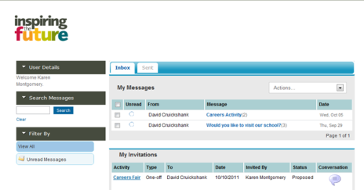


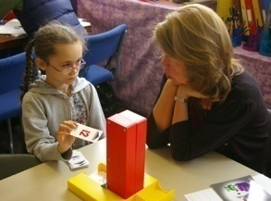

How it works
Step 1: Organisations promote Inspiring the Future as part of volunteering scheme, or to members and contacts
Step 2: Employees register their skills and interests on www.inspiringthefuture.org
Step 3: Website matches opportunities, and education staff contact volunteers through the site
Step 5: Employees and schools provide feedback
Step 4: Employees volunteer at schools

Slide 25
At end of year 2
70% of secondary schools registered
15,000 volunteers from 3,500 workplaces
35,000 invitations
500,000 young people engaging

Slide 26
Look out for…
Organisation for Economic Co-operation
And Development
Learning for Jobs

Slide 27
Thank you
Visit www.educationandemployers.org/research
to access free library and sign up for research e-bulletins.
Anthony.Mann@educationandemployers.org
www.inspiringthefuture.org

