Slide 1
PISA 2012
Students and Money
Financial literacy skills
9 July 2014
Launch
Notes:
I need to remind you that the material remains under embargo until Wednesday 9 July 2014, 10AM Paris Time.

Slide 2
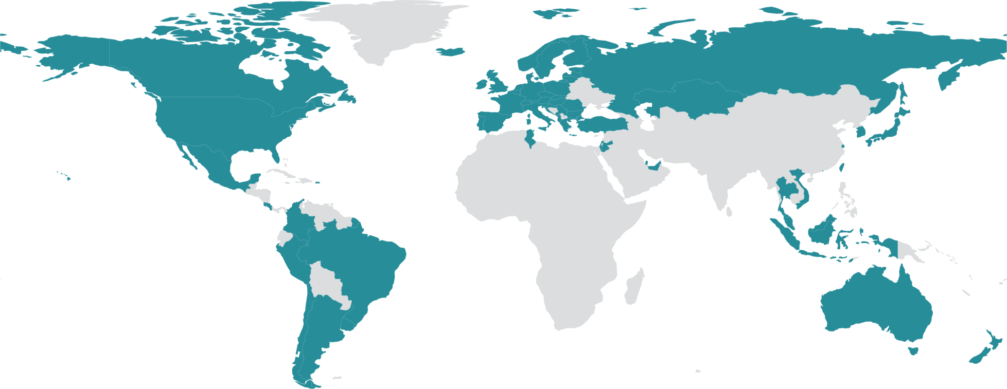
PISA in brief
29 000 of these students in 18 economies took the PISA test on financial literacy
Over half a million students…
  representing 28 million 15-year-olds in 65 countries/economies
… took an internationally agreed 2-hour test…
  Goes beyond testing whether students can
  reproduce what they were taught…
  … to assess students’ capacity to extrapolate from what they know and creatively apply their knowledge in novel situations
  Mathematics, reading, science, problem solving (financial literacy)
… and responded to questions on…
  their personal background, their schools
  and their engagement with learning and school
Parents, principals and system leaders provided data on…
  school policies, practices, resources and institutional factors that
  help explain performance differences .
…“knowledge and understanding of financial concepts and risks, and the skills, motivation and confidence to apply such knowledge and understanding in order to make effective decisions across a range of financial contexts … to enable participation in economic life”.
Notes:
“Financial literacy in PISA is primarily conceived of as personal financial literacy, distinguished from economic literacy, which includes both broader concepts, such as the theories of demand and supply, market structures and so on. Financial literacy is concerned with the way individuals understand, manage and plan their own and their households’ financial affairs, and with their awareness and understanding of the overall financial and economic landscape they live in. It is also recognised that good understanding, management and planning on the part of individuals has some collective impact on the wider society in contributing to national and even global stability, productivity and development.”

Slide 3
Big decisions at a young age: e.g. continuing education vs working
Shrinking welfare systems; increased personal responsibility
Shifting demographics- increased longevity
Changing labour-markets and reduced job security
Access to financial products at young ages
Increasingly complex financial markets
Why is financial literacy relevant for
15-year-old students?
Why is financial literacy relevant for
15-year-old students?

Slide 4
% of students with a bank account
%

Slide 5
% with a prepaid debit card
%

Slide 6
And many teenagers are managing their mobile phone costs
In 2010 75% of 12-17 year olds in the US owned a cell phone
18% of phone users had a prepaid or pay-as-you-go plan
10% had their own contract
Large differences by socio-economic factors
Among teens in households with incomes <USD30 000 only 31% were on a household contract
21% of teens who did not otherwise go online accessed the internet from their mobile
69% had a phone that was part of a household contract
http://www.pewinternet.org/2010/04/20/teens-and-mobile-phones/
Notes:
And many have a phone contract or pay as you go to manage

Slide 7
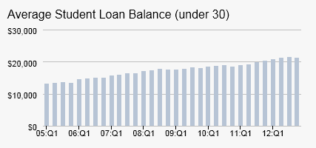
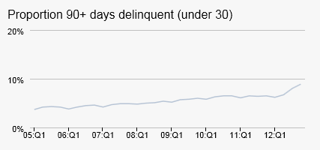
Reliance on student loans
More students are
enrolling into
higher education.
In the US young
adults owed more
in 2012 than before the financial crisis
And they were
more likely to be
falling into arrears
(% of all loans- some of which are not yet in
repayment phase)
Source: http://www.newyorkfed.org/studentloandebt/

Slide 8
PISA financial literacy assessment framework
8
Content
Money and transactions
Planning and managing finances
Processes
Identifying financial information
Analyse information in a financial context
Contexts
Risk and reward
Financial landscape
Evaluate financial issues
Apply financial knowledge and understanding
Education and work
Home and family
Individual
Societal

Slide 9
PISA financial literacy assessment framework
9
Content
Money and transactions
Planning and managing finances
Risk and reward
Financial landscape
Coins and notes
Different ways of making payments
Understanding bank statements
Saving and spending
Credit and debt
Financial decision making
Investment and saving
Diversification
Using credit
Volatility of the market
Exchange rates
Consumer rights and responsibilities
Understanding of the wider financial, economic and social system

Slide 10
PISA financial literacy assessment framework
10
Contracts, advertisements,
charts, tables, forms and instructions.
e.g. identify the features of a purchase invoice, or recognise the balance on a bank statement
Processes
Identifying financial information
Analyse information in a financial context
Evaluate financial issues
Apply financial knowledge and understanding
e.g. Compare the terms offered by
different mobile phone contracts
Draw on knowledge, logic and
plausible reasoning to make sense of,
and form a view about, a finance-
related problem
e.g. Work out whether purchasing
power will decline or increase over time when prices are changing at a given
rate.

Slide 11
PISA financial literacy assessment framework
11
Contexts
Education and work
Home and family
Individual
Societal
e.g. Tasks around payslips, planning to save for tertiary study, participating in workplace savings schemes
e.g. Buying household items or family groceries, keeping records of family
spending
e.g. Choosing products and services
such as clothing, toiletries or haircuts, or buying consumer goods such as
electronic or sports equipment
e.g Being informed about consumer
rights and responsibilities, and
understanding the purpose of taxes

Slide 12
Examples of what this might mean for 15 year olds
Balance their priority and plan what to spend
money on
…if they go to the cinema, will they still have enough money for the bus fare home? Or would it be better to buy pizza and invite friends home?
Remember that some of the purchases have ongoing costs
…a games console will need new games, a motorbike will need fuel and tyres and services and so on.
Being alert
to possible fraud
…Some emails that look like they came from their bank might not be legitimate, they should know what to do if they are not sure
Knowing what risk is and what insurance is meant for
…If their phone gets stolen, they should ask their parents if it is covered by their household insurance
Make an informed decision about credit
…they should know that if they buy a computer on credit they will have to pay interest on the loan as well as paying the advertised price for the computer
…and they will realise that the less they repay of that loan each month, the more they will pay in interest
Notes:
In practice a 15-year-olds’ might…
- Estimate the amount of change they should get when they pay for something in cash, and remember to check
- Make decisions about what to spend their money on, taking into account the things that they might really need to pay for. For example, if they go to the cinema, will they still have enough money for the bus fare home? If not, maybe they should buy pizza and invite friends round to theirs to watch a DVD instead?
- Remember that some of the things that they buy will have ongoing costs. A games console will need new games, a motorbike will need fuel and tyres and services and so on.
- Some emails that look like they came from their bank might not be legitimate , but they will know what to do if they are not sure.
- If their phone gets stolen, they will ask their parents if it is covered by their household insurance
- Make an informed decision about credit: (those with higher levels of proficiency) …will know that if they use credit to buy a computer, they will have to pay interest on the loan as well as paying the advertised price for the computer. ..and they will realise that the less they repay of that loan each month, the more they will pay in interest
- Understand risk diversification …they will be able to explain why the saying ‘don’t put all your eggs in one basket’ might apply to investment.
Realise that buying something on credit is likely to make an item cost more in the long run. They will understand why the saying ‘don’t put all your eggs in one basket’ might apply to investment.

Slide 13
Sample Question: INVOICE
Sara receives this invoice in the mail
This is an easy item – Level 1 on the financial literacy scale (below baseline)
Question 1: Why was this invoice sent to Sarah?
A. Because Sarah needs to pay the money to Breezy Clothing.
B. Because Breezy Clothing needs to pay the money to Sarah.
C. Because Sarah has paid the money to Breezy Clothing.
D. Because Breezy Clothing has paid the money to Sarah.

Slide 14
Sample Question: INVOICE
Sara receives this invoice in the mail
This is baseline item – Level 2 on the financial literacy scale
Question 2: How much has Breezy Clothing charged for delivering the clothes?
Delivery charge in zeds:
…….............................……………………………………………...
10 zeds

Slide 15
Sample Question: INVOICE
Sara receives this invoice in the mail
This is a hard item – Level 5 on the financial literacy scale
131
zeds
Question 3:
Sara notices that Breezy Clothing made a mistake in the
invoice. Sara ordered and received two T-shirts, not three. The postage fee is a fixed charged.
What will be the total of the new invoice?

Slide 16
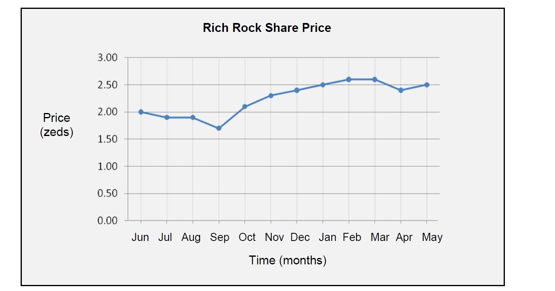
Sample Question: SHARES
This graph shows the price of one Rich Rock share over a 12-month period.
The main task is to analyse a graph, identify the most advantageous price to buy shares, and estimate the increase in value
Content: Risk and reward, it involves the ability to identifying ways of managing, balancing and covering risks and an understanding of the potential for financial gains or losses in a financial context
Process: Analyse information in a financial context, it requires interpreting, comparing and contrasting, synthesising and extrapolating from information that is provided, it also involves recognising something that is not explicit
This is relatively hard item – Level 3 on the financial literacy scale
Question : Which statements about the graph are true?
The best month to buy the shares was September. True/False
The share price increased by about 50% over the year. True/False

Slide 17
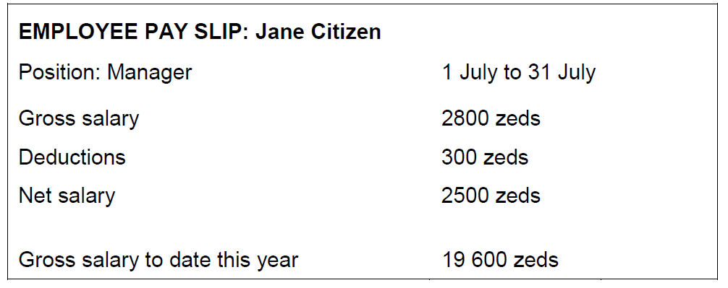
Sample Question: PAY SLIP
Each month, Jane’s salary is paid into her bank account. This is Jane’s pay slip for July
The main task is read the pay slip and to recognise that Jane’s employer will only pay net salary into her bank
Content: Money and transactions and the context is education and work
Process: Identify financial information
Question 2: How much money did Jane’s employer pay into her bank account
on 31 July?
300 zeds
2500 zeds
2800 zeds
19600 zeds
This is a relatively hard item – Level 4 on the financial literacy scale

Slide 18
Sample Question: NEW OFFER
NEW OFFER
Mrs Jones has a loan of 8000 zeds with FirstZed Finance. The annual interest rate on the loan is 15%. Her repayments each month are 150 zeds.
After one year Mrs Jones still owes 7400 zeds.
Another finance company called Zedbest will give Mrs Jones a lona for 10 000 zeds with an annual interest rate of 13%. Her repayments each month would also be 150 zeds
NEW OFFER- Question 1.
If she takes the Zedbest loan, Mrs Jones will immediately pay off her existing loan.
What are two other financial benefits for Mrs Jones if she takes the Zedbest loan?
1. …………………………………………………………………………………………………
2. …………………………………………………………………………………………………
She will be paying lower interests
She will have more money available

Slide 19
How well prepared are young people to make complex financial decisions?
19

Slide 20
Strong performance in
financial literacy
20
Average performance
of 15-year-olds in financial literacy
Figure VI.2.2
Low performance in financial literacy
Notes:
This chart illustrates the financial literacy scale, from below the OECD average, marked in red, to around the OECD average, marked in yellow, to high performance, marked in green

Slide 21
Distribution of performance
21
Students can apply their understanding of a wide range of financial terms and concepts to contexts that may only become relevant to their lives in the long term. They can analyse
complex financial products and can take into account features of financial documents that are significant but unstated or not immediately evident, such as transaction costs. They can work with a high level of accuracy and solve non-routine financial problems, and they can describe the potential outcomes of financial decisions, showing an understanding of the
wider financial landscape, such as income tax.
Financial literacy
Performance levels
Students can apply their understanding of commonly used financial concepts, terms and
products to situations that are relevant to them. They begin to consider the consequences of financial decisions and they can make simple financial plans in familiar contexts. They
can make straightforward interpretations of a range of financial documents and can apply a range of basic numerical operations, including calculating percentages. They can choose
the numerical operations needed to solve routine problems in relatively common financial
literacy contexts, such as budget calculations..
Level 5
Top performers
Level 4
Students can identify common financial products and terms and interpret information
relating to basic financial concepts. They can recognise the difference between needs and
wants and can make simple decisions on everyday spending. They can recognise the
purpose of everyday financial documents such as an invoice and apply single and basic
numerical operations (addition, subtraction or multiplication) in financial contexts that they are likely to have experienced personally.
Level 3
Level 2
Level 1
or below
Baseline

Slide 22
Distribution of performance
22
Students can apply their understanding of a wide range of financial terms and concepts to contexts that may only become relevant to their lives in the long term. They can analyse
complex financial products and can take into account features of financial documents that are significant but unstated or not immediately evident, such as transaction costs. They can work with a high level of accuracy and solve non-routine financial problems, and they can describe the potential outcomes of financial decisions, showing an understanding of the
wider financial landscape, such as income tax.
Students can apply their understanding of less common financial concepts and terms to
contexts that will be relevant to them as they move towards adulthood, such as bank
account management and compound interest in saving products. They can interpret and
evaluate a range of detailed financial documents, such as bank statements, and explain the functions of less commonly used financial products. They can make financial decisions
taking into account longer-term consequences, such as understanding the overall cost
implication of paying back a loan over a longer period, and they can solve routine
problems in less common financial contexts.
Financial literacy
Performance levels
Students can apply their understanding of commonly used financial concepts, terms and
products to situations that are relevant to them. They begin to consider the consequences of financial decisions and they can make simple financial plans in familiar contexts. They
can make straightforward interpretations of a range of financial documents and can apply a range of basic numerical operations, including calculating percentages. They can choose
the numerical operations needed to solve routine problems in relatively common financial
literacy contexts, such as budget calculations..
Level 5
Students begin to apply their knowledge of common financial products and commonly used financial terms and concepts. They can use given information to make financial decisions in contexts that are immediately relevant to them. They can recognise the value of a simple budget and can interpret prominent features of everyday financial documents. They can apply single basic numerical operations, including division, to answer financial questions. They show an understanding of the relationships between different financial elements, such as the amount of use and the costs incurred.
Top performers
Level 4
Students can identify common financial products and terms and interpret information
relating to basic financial concepts. They can recognise the difference between needs and
wants and can make simple decisions on everyday spending. They can recognise the
purpose of everyday financial documents such as an invoice and apply single and basic
numerical operations (addition, subtraction or multiplication) in financial contexts that they are likely to have experienced personally.
Level 3
Level 2
Level 1
or below
Baseline

Slide 23
Distribution of performance
23
Financial literacy
performance levels
Level 5
Top performers
Level 4
Level 3
Level 2
Level 1
or below
Baseline

Slide 24
Distribution of performance
24
Financial literacy
performance levels
Level 5
Top performers
Level 4
Level 3
Level 2
Baseline
Level 1
or below

Slide 25
Top performers in financial literacy, by gender
Tab V.4.6
9.7% of students are top performers in financial literacy(OECD average): they can solve problems such as sample task NEW OFFER– and possibly harder problems as well
Boys are more likely to be top performers than girls, particularly in New Zealand, Israel, Poland, France and the Flemish Community (Belgium)
Percentage of top performers
in financial literacy and at least
in one other domain

Slide 26
Percentage of low-performing students in financial literacy
26
Tab V.2.1
Across the OECD on average, 15% of students do not reach the baseline level of financial literacy – meaning that they can solve only simple tasks such as sample task INVOICE (if any)
Boys are more likely to be low performers than girls, particularly in France, Israel, Slovenia and the Slovak Republic

Slide 27
Are there gender differences in financial literacy?
27
On average there are no gender differences (except in Italy) but fewer girls at top and bottom
Notes:
And, among students with comparable performance in mathematics and reading, boys perform better than girls in financial literacy in 11 out of 18 countries and economies.

Slide 28
Skill gaps within countries
28
Top
Bottom
Countries ranked by 10th percentile of financial literacy performance

Slide 29
How does financial literacy relate to mathematics and reading?
29

Slide 30
Strength of the relationship between...
30
Correlation between performance in financial literacy and curricular domains

Slide 31
Strength of the relationship between...
Correlation between performance in financial literacy and curricular domains

Slide 32
Financial literacy and core skills
32
Variation in performance in financial literacy associated with mathematics and reading performance

Slide 33
Patterns of relative performance in financial literacy
33
Financial literacy performance relative to mathematics performance
Australia performs better-than-expected in financial literacy. The difference between observed and expected performance is larger among strong performers in mathematics
Average relationship between financial literacy and mathematics performance
Students in Israel perform as expected in financial literacy at all levels of mathematics performance
The Czech Republic perform better-than-expected in financial literacy. The difference between observed and expected performance is larger among low achievers in mathematics
France’s performance is lower-than-expected in financial literacy. The gap between observed and expected performance is similar at all levels of mathematics performance.
Italy’s performance is lower-than-expected in financial literacy. The gap between observed and expected performance is wider among high achievers in mathematics.
Mathematics performance

Slide 34
Relative performance in financial literacy
34
Taking performance in mathematics and reading into account
Students' performance in financial is higher than their expected performance
Students' performance in financial literacy is lower than their expected performance

Slide 35
Financial literacy and disciplinary skills
35
Variation in performance in financial literacy associated with mathematics and reading performance

Slide 36
Between school differences
Between-school differences in financial literacy, mathematics and reading performance
%

Slide 37
Differences between / within schools
Between- and within-school differences that are unique to financial literacy
or that are shared with mathematics and reading performance
As a percentage of the total variation in performance

Slide 38
Differences between schools
Between-school differences that are unique to financial literacy, or that are shared
with mathematics and reading performance
As a percentage of the total variation in performance
Variation between
schools

Slide 39
Differences within schools
Between-school differences that are unique to financial literacy, or that are shared
with mathematics and reading performance
As a percentage of the total variation in performance
Variation within
schools

Slide 40
How are learning opportunities distributed?
40

Slide 41
Relationship between socio-economic status and performance in financial literacy, mathematics and reading
Figure VI.3.6
Notes:
DELETED NOTE WHICH WAS ALL PROBLEM SOLVING

Slide 42
What can be done to enhance financial literacy
Improving the quantity/quality of teaching of…
…conceptual foundations of math ?
…applied math ?
…financial literacy as a cross-curricular domain ?
…financial literacy education as a separate subject ?
…other types of education?
…or is it all about out-of-school experiences?

Slide 43
Financial literacy by bank account holding (accounting for socio-demographic status)
43
Table VI.4.26
On average across OECD countries and economies, students who hold a bank account score 21 points higher than students with similar socio-economic
status who do not.

Slide 44
Socioeconomic differences in access
44
% of students holding a bank account by quartiles of socioeconomic status

Slide 45
Student exposure to financial education
45
Notes:
Note these are based on reports from school principals in the schools that participated and decided to answer the school questionnaire.

Slide 46
School curriculum
46
Financial education taught as a cross-curricular subject
Financial literacy taught as a separate subject
Notes:
Note these are based on reports from school principals in the schools that participated and decided to answer the school questionnaire.

Slide 47
Development of national strategies
for financial education
Australia - adopted in 2011 and reviewed in 2013
Czech Republic – adopted in 2010
Estonia – launched in 2013
New Zealand – launched in 2008
Russian Federation – launched in 2011
Slovenia – approved in 2010
Spain - launched in 2008 and revised in 2013

Slide 48
Financial education in schools
48
Introduction of financial education through a cross-curricular approach
In Australia, financial literacy was first introduced within the mathematics, English and science curricula, and is also included in the draft economics and business curricula
In Estonia, the new curricula adopted by the government in 2010 incorporates monetary and finance-related topics in primary and lower secondary school for instance in mathematics and social studies.
In New Zealand financial literacy is included in the curriculum as a theme that schools can use for cross-curricular teaching, as it provides a context for linking learning areas
Notes:
Some countries that have introduced financial education in the curriculum using a cross-curricular approach. This means integrating financial literacy into other subjects and existing courses. This approach makes it possible to use financial literacy to reinforce other skills, such as reading and mathematics, and provides a real-life application for other learning areas.

Slide 49
Financial education in schools
49
Standards for financial literacy, to define the content to be taught and the skills to be fostered
In the Czech Republic financial literacy standards were developed in 2007. Financial literacy standards for secondary schools focus on topics such as money, household budget management, financial products and consumer rights.
In New Zealand Financial literacy curriculum-based learning outcomes were first developed in 2007 and then revised in 2013. Learning outcomes are grouped into three broad areas including manage money and income, set goals, manage risk.
Notes:
Some countries that have introduced financial education in the curriculum using a cross-curricular approach. This means integrating financial literacy into other subjects and existing courses. This approach makes it possible to use financial literacy to reinforce other skills, such as reading and mathematics, and provides a real-life application for other learning areas.

Slide 50
Exposure and financial literacy
50
Performance in financial literacy
% of students in schools where the principal reports that financial literacy is available for at least 2 years
Notes:
% of students in schools where the principal reports that financial literacy is available for at least 2 years

Slide 51
Exposure and relative performance
51
Students' performance in financial is higher than their expected performance
Relative performance in financial literacy, taking
performance in mathematics and reading into account
Students' performance in financial literacy is lower than their expected performance

Slide 52
Exposure and financial literacy
52
Performance in financial literacy
Average % of students in schools where principals report students receive no instruction
in financial literacy as a separate course or in other courses
Notes:
Average % of students in schools where principals report students receive no instruction in financial literacy as a separate course or in other courses

Slide 53
Exposure and relative performance
53
Students' performance in financial is higher than their expected performance
Relative performance in financial literacy, taking
performance in mathematics and reading into account
Students' performance in financial literacy is lower than their expected performance

Slide 54
Providers of financial education in schools
54
Notes:
Note these are based on reports from school principals.

Slide 55
Teachers professional development
55

Slide 56
Thank you !
  Find out more about PISA at www.pisa.oecd.org
    All national and international publications
    The complete micro-level database
  Email: Andreas.Schleicher@oecd.org

