Slide 1
Understanding Employer Engagement in Education
Theories and Evidence
20 June 2014
Julian Stanley and Anthony Mann

Slide 2
Introduction
Research did not keep up with policy
Research attached to particular programmes at particular times – difficult to support learning between policy makers, practitioners and research community
Employer engagement immensely popular – among schools, employers, governments and young people; but impact and delivery not well understood
Research not well connected to the rest of social science

Slide 3
Structure
Insights from 17 chapters:
Universities of Bath, Glasgow, Warwick, Oxford, Manchester, Alberta, Louisville, King’s College, Birmingham City University, Harvard University, Education and Employers Taskforce, OECD, UKCES.
Impact: what difference does it make to student outcomes?
Understanding: why do we think it makes a difference?
Equity: how fairly is employer engagement distributed?
Implications: for practice and policy?

Slide 4
What it is and how it sits within schools
“the process through which a young person engages with members of the economic community, under the auspices of their school, with the aim of influencing their educational achievement, engagement and/or progression out of education into ultimate employment.”
Supplementary to conventional teaching (reading partners)
Complementary in offering alternative means to reach learning outcomes (mentoring)
Additional in providing learning outcomes not routinely delivered by schools (enterprise/employability)

Slide 5
Impact: new evidence 1
Alison Taylor et al (University of Alberta) – school-based youth apprenticeships:
“Our data suggest that enrolling in apprenticeship programs while in high school appears to improve training completion rates and many youth are surpassing the educational and occupational levels of their parents. For a small minority, enrolling in high school apprenticeships was important for them to graduate. In addition, programs provide employment opportunities for many youth who lack contacts in trades.”

Slide 6
Impact: new evidence 2
David Massey (UKCES): work experience
“A fifth (20 per cent) of employers who offer work experience do so because it helps them with recruitment. In fact, more employers have actually recruited young people from their work experience placement than the 20 per cent who said it helped them recruit: 22 per cent of employers take people on straight after the work experience placement, and a further 15 per cent recruit young people once they have finished their course.”

Slide 7
Impact: new evidence 3
Christian Percy and Anthony Mann (Taskforce): employer contacts
“Those with higher levels of employer contacts are less likely to be sceptical that their current activity is useful for their future job ambitions, have 1.0–1.7× better odds of being in education, employment or training and, if in full-time employment, will be earning 10–25 per cent more on average.”

Slide 8
Percy and Mann
Chances of being in Employment, Education or Training (N = 850)
 | No employer contacts | 2+ contacts
Below level 3 | 56% | 74% (32% more likely to EET)
Level 3 and above | 79% | 89% (13% more likely to be EET

Slide 9
Mann and Kashefpakdel

Slide 10
Mann and Kashefpakdel
Significant variations by school type attended – was the work experience you did useful to you in:
 | Non-selective state | Independent
Getting a job after education | 25% (9%) | 36% (13%)
Deciding on a career | 53% (17%) | 83% (39%)
Getting into higher education | 23% (7%) | 43% (14%)

Slide 11
Understanding the Process

Slide 12
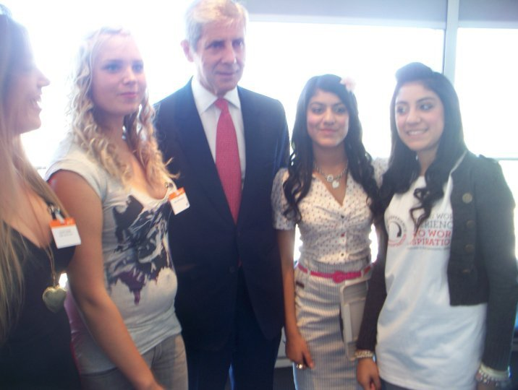
Tina and Anglee Kumar are introduced to Sir Stuart Rose (ex chairman of M&S) at Business in the Community’s ‘Turning Work-Experience into Inspiration’ event
Notes:
Tina and Anglee Kumar introduced to Sir Stuart Rose (ex chairman of M&S) at Business in the Community’s ‘Turning Work-Experience into Inspiration’ event

Slide 13
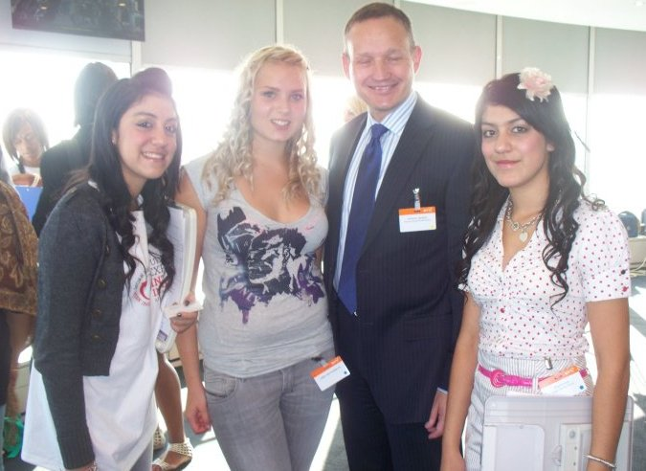
Tina and Anglee are introduced by Sir Michael Rose to Antony Jenkins, Chief Executive of Barclays Bank
Notes:
Tina, Anglee are introduced to Antony Jenkins, Chief Executive Barclays

Slide 14

‘it has given me and my twin, Anglee, a wonderful experience as young entrepreneurs and I have to say I am really proud of myself and Anglee’
Tina Kumar
Tina and Anglee organise a fashion show at school to raise funds for charity. Stuart Rose provides clothes, shoes and press gifts. Antony Jenkins provides work experience placement and personal gift of £100 towards event.

Slide 15
What does employer engagement do?
‘Human Capital’ – skills
  literacy and numeracy skills
  employability skills and attitudes
  work experience that supports entry to higher education (Jones)
  internships (Milburn - Access to Professions)
‘Social Capital’ - people
  Roles, relationships and practical support, e.g. Job offers through work experience, references
  ‘hot knowledge’, trusted others
Cultural Capital - values
  Identity, e.g. providing models of future careers, supporting aspirations
  Qualifications, e.g. giving recognition to qualifications

Slide 16
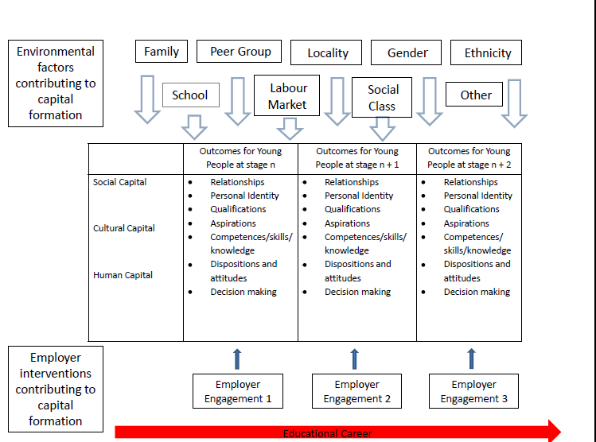

Slide 17
Equity in access: who gets what?
Independent school advantage (Huddleston et al):
“It’s such a good network through the old boys’ association, and the parents; we have sent out a blanket request and people will say yes I’m happy to help.”
(Registrar, Boys’ School F)
“One of the aspects of privilege is, not about how much money you’ve got,
but how you have this contact. . .” (Teacher, Boys’ School E)
“I try and find a way and usually I can find it through a parent contact. If you just call from outside, who are you going to speak to? They don’t have a full time work experience organiser so it’s usually personal.” (Head of Careers, Girls’ School A)

Slide 18
Equity in admissions
Jones:
“It is noticeable in many work-related activities that family and other personal connections play a major part in securing access to the professions. These connections are almost twice as common in the personal statements of private school applicants as those of other applicants.”

Slide 19
Jones: jobs vs. experiences

Slide 20
Aspiration, Access, Information and Confidence 1
“Contrary to assumptions within education policy, existing research evidence suggests that there is no widespread ‘poverty of aspirations’.” (Archer)
“We do not assume that parents from low SES backgrounds do not have high parental aspirations for their children; however, they may not have the social and cultural capital to translate their aspirations into appropriate work placements.” (Hatcher & Le Gallais)

Slide 21
Aspiration, Access, Information and Confidence 2
“Our research with FE students and staff has highlighted the numerous barriers that young people from lower socio-economic backgrounds face when considering education and employment progression. Many of these relate to cultural and social capital, both of which present meaningful obstacles to optimal progression. In particular, we found that FE students have a limited awareness of the reality of local labour market demand, and of the variety of occupational opportunities and the specific routes through which these might be accessed. Moreover, we found that FE colleges lack institutional capital to remedy these disadvantages.
As had been found in previous education research, young people from disadvantaged backgrounds often lack the middle-class ‘habitus’ and other forms of social and cultural capital that dominate higher education and elite career paths. This was strongly illustrated in our research with young people and their teachers, who talked about the lack of role models and the social networks that allow students to easily progress. This was alongside discussion about a broader sense of alienation and inability or unease about replicating middle-class modes of behaviour that are beneficial and even necessary to certain types of progression.” (Norris & Francis)

Slide 22
Conclusion
Employer engagement can modify the distribution of human capital (technical and employability skills), social capital (useful networks) and cultural capital (attitudes and identities). The impact of employer engagement is itself shaped by prior levels of human, social and cultural capital.

Slide 23
Implications – for research
Why are certain kinds of employer engagement particularly effective, e.g. source of ‘hot knowledge’ rather than ‘official’ knowledge
To what extent does employer engagement currently progress or hinder social equity – major concerns with respect to work experience (chapters on Midlands Schools and FE Sector) and HE entry (chapters on independent schools and HE application)
How exactly does employer engagement combine with other ‘interventions’: e.g. aspirations are influenced by school, careers service, peers, families...
If employer engagement can change attitudes, is the impact felt in pupil engagement, motivation and ultimately attainment?

Slide 24
Implications – for practice
Employer engagement in education sitting within career development:
Start young: employer engagement is also about breadth and realism of aspirations which relate to identity development
Do a lot: higher volume of interventions especially in run up to decision making points
Do different things: different activities relate to different outcomes
Recognise disadvantage: challenge social reproduction, don’t strengthen it
Intregrate in decision making journey: from exploration to validation, confirmation and supported progression

Slide 25
Implications – for practice 2
  Three specific insights
  ‘intensive’ and extended experiences such as mentoring and multiple career talks likely to be more effective in developing cultural and social capital
  Work experience for 16-19 year olds could be designed to support equal and widening access policies for HE
  Employer engagement has a role to play in both structured and informal educational programmes

Slide 26
Implications - for policy
  Employer engagement is very likely optimised when sitting with impartial CEIAG, joining up careers thinking to expectations about educational outcomes, family expectations and labour markets
  Work experience commonly leads to employment outcomes, but is it designed to?
  Without intervention employer engagement can become an instrument of social reproduction
  Challenge: how to engage at scale through the education system (only 15% of young adults recall 3+ contacts)

Slide 27
Thank you
J.A.Stanley@warwick.ac.uk
Anthony.Mann@educationandemployers.org
http://www.routledge.com
/books/details/9780415823463/
www.educationandemployers.org/research

