Slide 1
E & E / UKCES 11.09.15
How should our schools and colleges respond to the demands of the twenty first century labour market?
Dr Anthony Mann (Education & Employers) and Prof Prue Huddleston (U. Warwick)
Anthony.Mann@educationandemployers.org
With responses from Brian Lightman (Association of School and College Leaders) and Kate Shoesmith (Recruitment and Employers Confederation)

Slide 2
Overview.
What do employers want from the school curriculum? Responding to the OECD’s 2013 Survey of Adult Skills
November 2013: national leaders from worlds of education and employment come together to consider the findings of the OECD’s Survey of Adult Skills – focusing on the growing gaps between the classroom and workplace and the need for a clearer articulation of what twenty-first employers want of young recruits and how schools and colleges can best prepare young people to thrive through their transitions.

Slide 3
Participants.
Ariel Eckstein, Managing Director LinkedIn EMEA
Brent Hoberman, Internet Entrepreneur and Investor
Brian Lightman, General Secretary, Association of School and College Leaders
Charles Parker, Chief Executive, Baker Dearing Educational Trust
Christine Hodgson, Chairman, Capgemini UK plc
Dame Clara Furse, Chairman, Nomura Bank International
David Cruickshank, Chairman, Deloitte and Education and Employers
David Frost, Chair, LEP Network
Jeremy Newman, Chairman, Audit Commission
John Morgan, Chief executive, Morgan Sindall Plc
Kay Carberry, Assistant General Secretary, Trade Union Congress
Lesley Giles, Deputy Director for Research and Policy, UKCES
Lord Michael Grade
Mark Protherough, Executive Director, ICAEW
Russell Hobby, General Secretary, National Association of Head Teachers
Nick Chambers, Director, Education and Employers Taskforce
Paul Drechsler, Chairman and Chief Executive, Wates
Paul Ryder, Group Co-Head of LTROD, HSBC
Peter Cheese, CEO, CIPD
Peter Dart, Director, WPP
Richard Hardie, Chairman, UBS Ltd
Ron Dennis CBE, Executive Chairman, McLaren Group
Sir Anthony Salz, Executive Vice Chairman, Rothschild
Sir Charlie Mayfield, Chairman, John Lewis Partnership and Chairman of UKCES
Sir Mike Rake, Chairman, BT Group and President of the CBI
Stephen Welton, CEO, Business Growth Fund
Terry Morgan CBE, Chairman, Crossrail
Tim Thomas, Head of Employment Policy, EEF

Slide 4
The opportunity.
How can schools and colleges make best use of the new levels of discretion they have over curriculum delivery – working within the constraints of qualifications frameworks and accountability mechanisms – to better prepare young people for the working world?
What practical advice can be offered to school leaders seeking to optimise the chances of their young people to succeed in the modern labour market?

Slide 5
Methodology and outputs I.
Project led by Anthony Mann (Education and Employers Research) and Prue Huddleston (University of Warwick).
Key questions discussed by a panel at the 2014 Research Conference:
Chris Husbands (IoE), Hugh Lauder (U. Bath) Andreas Schleicher (OECD),
Robert Schwartz (Harvard).
Publication: How should our schools respond to the demands of the
twenty first century labour market? Eight perspectives. (February 2015).
Interviews with leading commentators on the relationship between education and employment: Kay Carberry (TUC), Peter Cheese (CIPD), Prof. Chris Husbands (IoE), Prof. Ewart Keep (Oxford), Prof. Hugh Lauder (Bath and Journal of Education and Work), David Pollard (FSB), Andreas Schleicher (OECD), Prof. Lorna Unwin (IoE and Journal of Vocational Education and Training).
Visit: www.educationandemployers.org/research

Slide 6
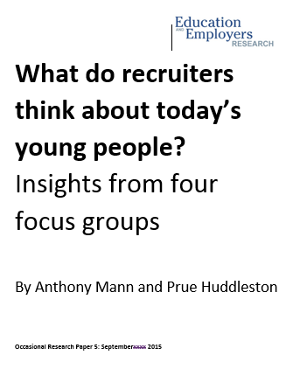
Methodology and outputs II.
Publication: What do recruiters think about today’s young people? Insights from four focus groups with a commentary by Kevin Green, CEO of the Recruitment and Employers Confederation (September 2015)
Discussions with representatives from representatives
from 31 different employers, large and small, public and
private over four sessions in London and the East Midlands.
We are grateful to CIPD and ASCL for help in enabling focus groups.

Slide 7
The context: a long view.

Slide 8
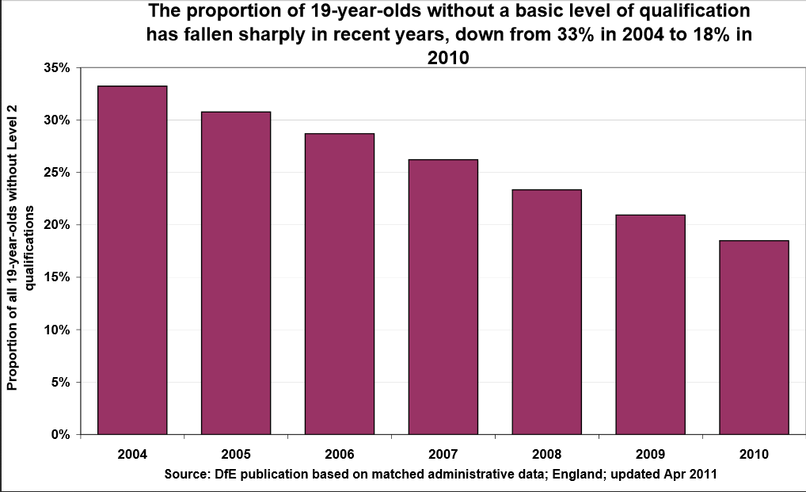
No generation of young people has have ever gone into work more highly qualified and with more years of education under their belts.

Slide 9
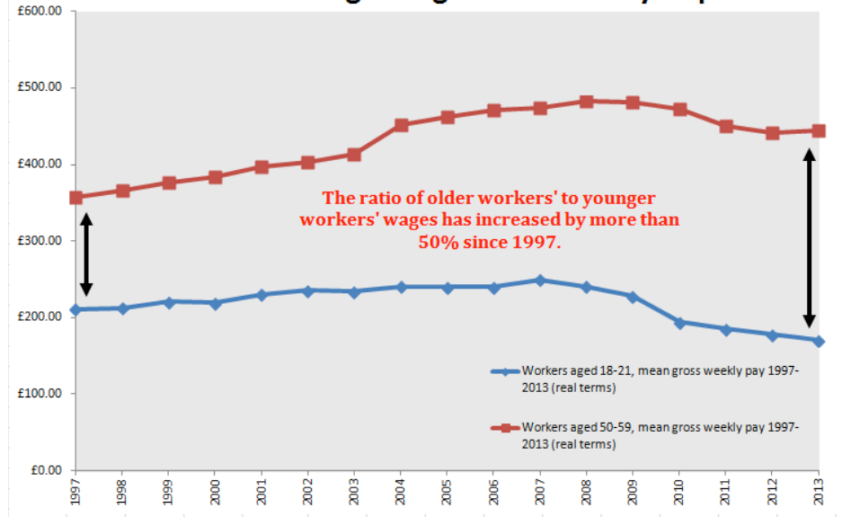
And yet, over the last generation, young people have increasingly struggled in the labour market.
The ratio of youth to adult unemployment worsening in the UK
Young people’s earnings falling behind
Source: Intergenerational Foundation, Squeezed Youth (2013)

Slide 10
Young people losing out…
…in the competition for Apprenticeships.
…in combining part-time employment
with full-time study.
Source: House of Commons Library (2015)

Slide 11
It is not just the least qualified who suffer but but they suffer the most.
% young people unemployed who have left
full-time education by age and highest level
of qualification, 2011
% young people unemployed who have left FT education by age & highest level of qualification, 2011
% recent graduates in high and low skill occupations
Age | GCSE | A level | Degree
16 | 26 | -- | --
17 | 28 | -- | --
18 | 27 | 20 | --
19 | 23 | 16 | --
20 | 21 | 14 | --
21 | 17 | 11 | 25
22 | 13 | 11 | 16
23 | 17 | 9 | 9
24 | 13 | 7 | 5
Source: ONS, Characteristics of young unemployed people (2012)
UKCES, Youth Employment Challenge (2012)

Slide 12
The fact that growing numbers of young people are getting off to a poor start in their working lives matter more than ever because…
..the evidence of scarring is compelling – episodes of youth unemployment depress future earnings.
- OECD (2010), Jobs for Youth, 31-32
…long term young unemployed face higher risk of mental illness
Prince’s Trust (2014) – Survey of 2,161 young people aged 16-25

Slide 13
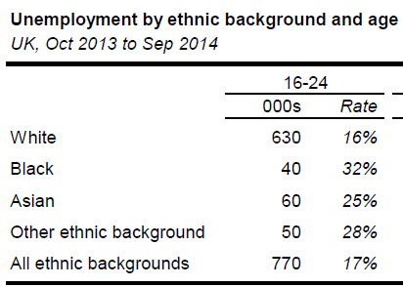
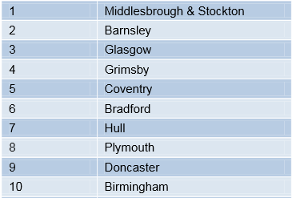
And youth unemployment is social problem with concentrations by…
…ethnicity.
…geography.
Youth unemployment by ethnicity, 2014
Source: House of Commons Library (2015)
Source: Work Foundation, Geography of youth unemployment (2014)

Slide 14
But… those employers who do employ young people think they have been well prepared by education.
UKCES, National Employer Skills Surveys: preparedness of 17-18 year old school and college leavers for work
 | 2005 (1) | 2007 (1) | 2009 (1) | 2013 (2)
Very well prepared | 15 | 17 | 16 | 10-13
Well prepared | 54 | 57 | 58 | 56-61
Poorly prepared | 22 | 17 | 18 | 18-24
Very poorly prepared | 6 | 4 | 3 | 4-5
Note: (1) data relates to UK; (2) England only, results of questions relating to 17-18 year old school and college leavers
The main obstacle to (more) young people getting new jobs is competition in the market place rather than perceptions that young applicants do not have the capability to perform in the job role.
- UKCES, National Employer Skills Survey (2013), 93

Slide 15
And what schools do matters more than ever
One chance at higher education
Funded training to 19
Young people are less likely to receive training in work than in past…
UKCES (2012), Youth Employment Challenge

Slide 16
How the labour market has changed for young people.
Technology: making information/knowledge more accessible; automating lower/middle skilled tasks; changing recruitment practice (Kay Carberry, Hugh Lauder, Peter Cheese, Andreas Schleicher)
Globalisation: semi-skilled, entry level jobs being exported (Hugh Lauder)
Deregulation: reducing employer incentive to invest in training, increasing non-traditional employment patterns (Peter Cheese, Ewart Keep)
Competition: from experienced older workers who are physically capable of extended working lives (Peter Cheese, David Pollard)
Inequality: the hour glass economy generating low skill service sector jobs with weak prospects of progression (Peter Cheese, Ewart Keep)

Slide 17
Three key implications for schools/colleges.
The labour market has become more complex – demanding improved careers guidance enriched by first-hand employer contacts
School to work transitions have become more fractured – requiring schools to improve recruitment skills (and resilience) of young people
‘Good’ employers are more demanding – asking not just for knowledge itself, but the ability to apply knowledge effectively

Slide 18
The labour market has become more complex – demanding improved careers guidance enriched by first-hand employer contacts
One of the weakest aspects of the British economy is the extent of the mismatch found between the qualifications and skills possessed by workers and those demanded by employers. It is a fundamental weakness of the labour market in general and of the youth labour market in particular.
If we think of young people making investment decisions as they decide on the qualifications, training and experience (collectively, the human capital) they plan to accumulate prior to leaving education to optimise their ultimate earnings in the labour market, we need to recognise the importance of access to good information about what that labour market actually wants and demands in order for properly informed decision making to take place.
In the absence of good labour market signalling, it can be no surprise that poor investment decisions will be made and the widely evidenced skills mismatches in the British economy become a predictable result.
(Prof. Hugh Lauder, University of Bath; Editor, Journal of Education and Work)

Slide 19
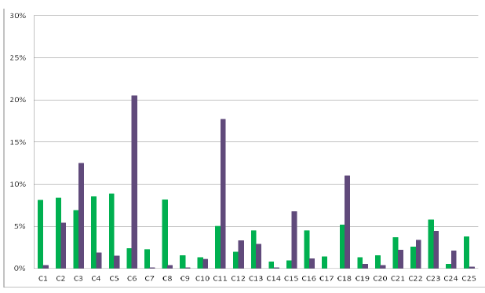
The labour market has become more complex – demanding improved careers guidance enriched by first-hand employer contacts
More complex careers, with more options in both work and learning, are opening up new opportunities for many people. But they are also making decisions harder as young people face a sequence of complex choices over a lifetime of learning and work. Helping young people to make these decisions is the task of career guidance. . . . [Career professionals] need to be able to call on a wide range of information and web-based resources. Strong links between schools and local employers are very important means of introducing young people to the world of work.
OECD, Learning for Work 2010: 16
Illustration
Mapped career aspirations of 15-16 year olds. Source: Mann et al. 2013. Nothing in Common: The career aspirations of young Britons mapped against projected labour market demand. London: UKCES & EET.

Slide 20
The labour market has become more complex – demanding improved careers guidance enriched by first-hand employer contacts
Focus Group recruiters
‘I think college courses are totally disjointed from what’s happening and needed in the workplace. It’s really hard to motivate apprentices because of this disconnect.’
‘Even some post-graduates are spectacularly naïve. They’ve just done years studying mechanical engineering and when it comes to interview it turns out that they are not actually interested in working in mechanical engineering!’
‘Young people do the course which is funded, not the course which is best for the job. The advice they get isn’t smart enough.’
‘They [schools] absolutely need to spend more time on careers. It should be compulsory through the whole year.’
‘Careers should be integrated into the curriculum – giving young people lots of insights, helping them to understand what’s what and make good decisions for themselves.’

Slide 21
School to work transitions have become more fractured – requiring schools to improve recruitment skills (and resilience) of young people
The well-structured pathway (such as graduate entry schemes leading to long term employment) is becoming rarer and rarer – we are in the era of portfolio careers, zero hour contracts, part-time and self-employment, employment growth in small, rather than large employers. These are all trends which demand adeptness and confidence from young people if they are to navigate successfully through choppy waters into rewarding and secure careers.
(Peter Cheese, CIPD)

Slide 22
School to work transitions have become more fractured – requiring schools to improve recruitment skills (and resilience) of young people
“..the transition process from education to work has become more challenging and complex, in terms of not only navigating pathways from education into employment, but also accessing appropriate forms of work. ...When they do enter the labour market, [the futures of school and university leavers] are now likely to be played out in far less patterned ways and they continually have to manage the challenges of working in a flexible labour market context.”
Michael Tomlinson, Education, Work and Identity (2013), 202.
Illustration
Internships, zero hour contracts, temporary and part-time contracts, self-employment
In an analysis of 667 job vacancies requiring limited education and skills in three areas, only 24% were for full-time, day time work.
JRF. 2012. Challenges for disadvantaged young people seeking work

Slide 23
School to work transitions have become more fractured – requiring schools to improve recruitment skills (and resilience) of young people
Focus Group recruiters
‘It should be mandatory for schools to teach young people what they need to know for the transition from school to work. Children should be taught about the importance of being respectful, how to get useful information out of someone, how to listen well.’
‘Schools don’t sit down with them to talk about jobs, what they have to offer and how work works. They don’t understand how to apply for a job, what CVs should look like, how to get themselves a job.’
‘They really need to be getting interview practice before they leave education – it gets them the practice and starts building the resilience they need.’

Slide 24
‘Good’ employers are more demanding – asking not just for knowledge itself, but the ability to apply knowledge effectively
Schools must stop trying to predict the future, but they should try to prepare young people for the change they will experience. Schools need to stop preparing young people for the jobs that existed a generation ago and start preparing them for jobs which do not yet exist. For example, entrepreneurship education is much more important now than it was a generation ago because it teaches those skills and personal attributes which oil the modern labour market. It should not be taught separately but written into every subject.
The art of being enterprising – solution-focused attitudes, spotting opportunities, connecting dots and dealing with uncertainties – has, for example, a very clear and strong relationship with effective maths teaching. The great goal of such teaching is not in ensuring deep conceptual understanding as an end in itself, important as that is, but in fostering the ability of young people to apply the knowledge they have accumulated in new situations. In this way, we give them the confidence and intellectual resource to embrace and deal with the myriad unfamiliar problems they will encounter through life. (Andreas Schleicher, OECD)
For schools, it is a question of pedagogy and use of community based resources. In pedagogic terms, there are tried and tested means of teaching young people to apply emerging knowledge in unfamiliar contexts. Enterprise styles of learning are considerably more effective if they engage real people from real workplaces in their delivery, as is commonly seen in University Technical Colleges. (Prof. Chris Husbands, IoE)

Slide 25
‘Good’ employers are more demanding – asking not just for knowledge itself, but the ability to apply knowledge effectively
‘The world economy no longer pays you for what you know, but for what you can do with what you know.’
‘Young people need the ability to be personally effective in applying knowledge to solve new problems.’
(Andreas Schleicher, OECD)
Illustration
More than 40% of British workers report that their working environment has substantially changed over the previous three years and half had seen the introduction of new processes or technologies into work – one of the highest proportions across the OECD.
- OECD. 2013. Skills Outlook, 51.

Slide 26
‘Good’ employers are more demanding – asking not just for knowledge itself, but the ability to apply knowledge effectively
Focus Group recruiters
‘They need to be able to translate the skills, experience they’ve developed in school, university, volunteering, other work to show how it relates to the job that’s available.’
‘Older people in general are much better at problem-solving. I think it’s because folk just have to solve problems in work much more these days and they get more experience at it and with general life experience too. With young people, where they’ve done lots of things like the Duke of Edinburgh or been in youth organisations, you do see it, you can recognise it. Schools can put on this sort of thing for them.’

Slide 27
Summary
Due to globalisation, liberal labour regulation, and especially technological change, for young people the labour market is increasingly:
Complex – with shifts in distribution of employment, jobs growth in new economic areas and significant change in working practice in traditional areas | For young people, investment choices (what and where to study, how hard to study, experience to accompany qualifications) become more difficult as the labour market becomes more complex. | For schools (primary and especially secondary), CEIAG enriched by extensive employer engagement is more important – especially at key decision points, but through education to confirm value of education. | For employers, need to engage with schools with wide ranging careers provision to improve signalling (Careers talks, workplace visits, job shadowing).
Fractured – with churns between employment (PT, FT, temporary), education, training, unemployment, NEET more commonplace | For young people, understanding of how the labour market works, job seeking skills and personal resilience become more important. | For schools, activities to develop resilience (eg, volunteering, work experience, mindfulness, problem-solving pedagogies) and preparation (CV and interview practice) in context of labour market operation become more important. Where possible, schools can help put pathways from education into work in place. | For employers, need to support development of recruitment skills, labour market knowledge and resilience (CV and interview practice, work experience placements, mentoring).
Demanding – personal adaptability and effectiveness (employability skills) at a premium in service/knowledge economy/work-related technology | For young people, ability to apply their knowledge in unfamiliar situations becomes more important. | For schools, experiential learning becomes more important (enterprise education) as do pedagogies which value problem-solving and applied learning. | For employers, need to support schools in provision of applied and experiential learning (Enterprise competitions, curriculum content).

Slide 28
Questions and comments please
Kate Shoesmith, Recruitment & Employment Confederation
Brian Lightman, General Secretary, Association of School and College Leaders
Thank you.
Dr. Anthony Mann and Prof. Prue Huddleston
Anthony.Mann@educationandemployers.org
www.educationandemployers.org/research - Twitter: @Edu_Employers

