Slide 1
What Is Education For?
Education and Employers Taskforce
& UKCES
20.10.2015
Hugh Lauder
University of Bath

Slide 2
The Argument
Education has been fundamentally re-positioned in the 21st century. The polarisation of wealth and the creation of global markets in secondary and higher education has meant that we are beginning to see a fundamental rupture in education which is challenging the aspirations we had for it in the 20th century both in terms of its relationship to the economy and to social mobility.
The relationship of education to the economy, the cornerstone of educational policy, is fundamentally problematic: economies cannot provide the skills or jobs that is central to the education promise.
The idea of upward social mobility has relatedly been dealt a blow because there is developing a global institutional break between education for the wealthy and the rest.
At the same time politicians seek to herd families into an intense positional competition for which there are increasingly fewer ‘winners’.

Slide 3
Education in the 20th Century
From a social and economic perspective education had three roles:
To promote economic development through the ‘tightening bond’ thesis between educational credentials and the labour market.
To foster social mobility through the notion of meritocracy (IQ+ motivation = success). In doing so to create social cohesion or ‘buy in’ into the society.
To encourage the development of citizenship
These three roles constituted the problematic for research and continue to do so. They comprise what may be called the modern educational myth.

Slide 4
The Tightening Bond Thesis
Education is a crucial type of investment for the exploitation of modern technology. This fact underlies recent educational development in all the major industrial societies…education attains unprecedented economic importance as a source of technological innovation.
A.H.Halsey and Jean Floud (1961)
This view remains and lies behind pronouncements by politicians across the globe. It is represented, to-day, in economic theories of human capital and skill bias theories and in OECD reports.
It lies behind the rhetoric of nation states being globally competitive and for students to be skilled to compete.

Slide 5
Education and Social Mobility
It was expected that education, when linked to the rapid development of technology, would not only address the question of economic growth but would also solve problems of poverty and increase upward social mobility.
Linking education to the demand for technology would increase workers’ income and thereby decrease the numbers in poverty.
During the 1950s and 1960s this theory seemed to be working. Poverty did decline and social mobility rose, although as contemporary analysts have noted this was because of changes to the occupational structure with increased numbers of managerial and professional jobs.

Slide 6
Pursuing the Education Myth
Despite the knowledge that educational research had clearly established systematic biases in relation to education, this education myth was given greater impetus by the advent of the rhetoric of the global knowledge economy.
Globalization led to the notion that nations were competing with one another.
And, that the knowledge economy required ever more educated workers.
When placed together issues of inequality were obscured by the rhetoric of national competitiveness

Slide 7
Why this Myth Misleads
In reviewing education in the latter half of the 20th Century it is clear that there was enough change and development in education and the economy for the myth to be plausible. Researchers have continued to focus on the links between education and the economy and on social mobility and inequality.

Slide 8
What has Changed?
To address this question we need to undertake an analysis at 3 levels:
Structural: noting four causes of the massive polarisation of income and wealth that we are now witnessing
Institutional, in particular the way in which educational institutions and Transnational Companies ‘correspond’ to the polarisation of education and wealth, changing the definition of skill and talent and downgrading the status of the credential.
The categorisation and selection of individual students and workers.

Slide 9
Structural Change: The Polarisation of Wealth
As Piketty (2014) has cogently argued the creation of wealth for the already wealthy outstrips increases in income. This he argues, more controversially is a natural tendency, under capitalism in which the post war period is an anomaly.
However, part of this wealth creation is as a result of the emergence of the super manager –which I shall argue is linked to the notion of ‘the talented’.
A reinvigoration of a class relationship between the wealthy and the state.
New technology abets the polarisation of wealth. It creates winner-take-all markets and links social capital formation among the wealthy.
The financialisation of capital investment.

Slide 10
Economic Change and the Demand for Skill
Corporations have been restructured away from bureaucratic organisations to much flatter organisations. Knowledge work is being restructured and stratified with much knowledge work being standardized. Higher education is being restructured, arguably in ways which correspond to the stratification of knowledge work.
TNCs are concerned with cost pressures and are footloose in sectors where they can easily shift their HQ functions.
When we look at the demand for education and skill we find that the relationship between technology and the demand for skill challenges the myth of skill biased technological change. And this is reflected in data on graduate incomes:

Slide 11
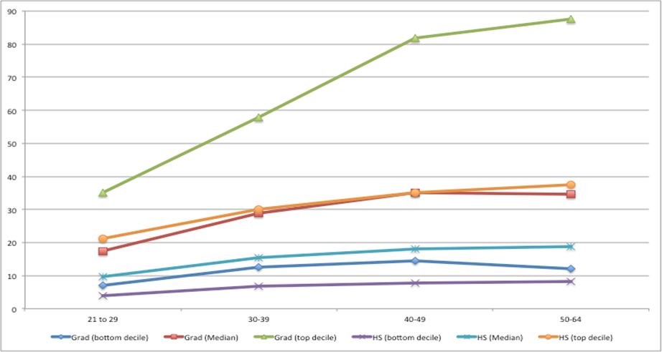
US Male hourly earnings by age-groups: Graduates and HS graduates (source: American Community Survey 2010)

Slide 12
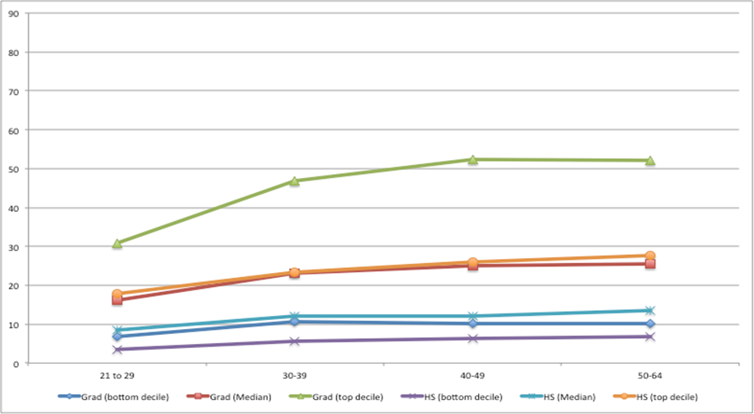
US Female hourly earnings by age-groups: Graduates and HS graduates (source: American Community Survey 2010)

Slide 13
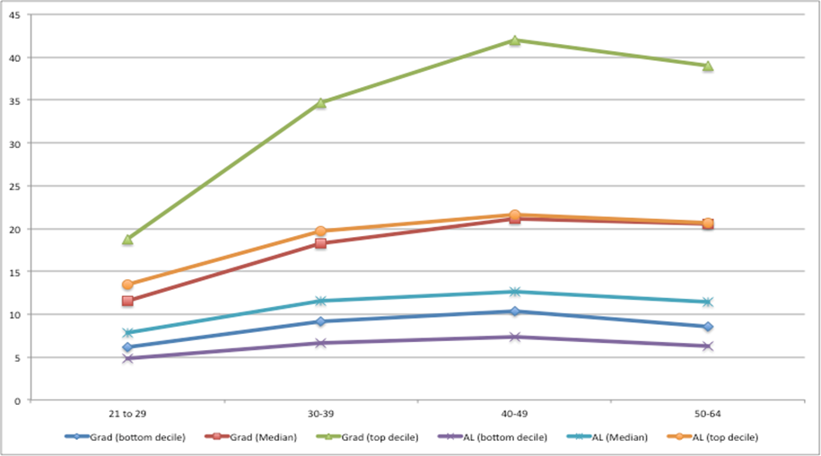
UK Male hourly earnings by age groups (LFS 2010) – graduate and those with A-Level qualification

Slide 14
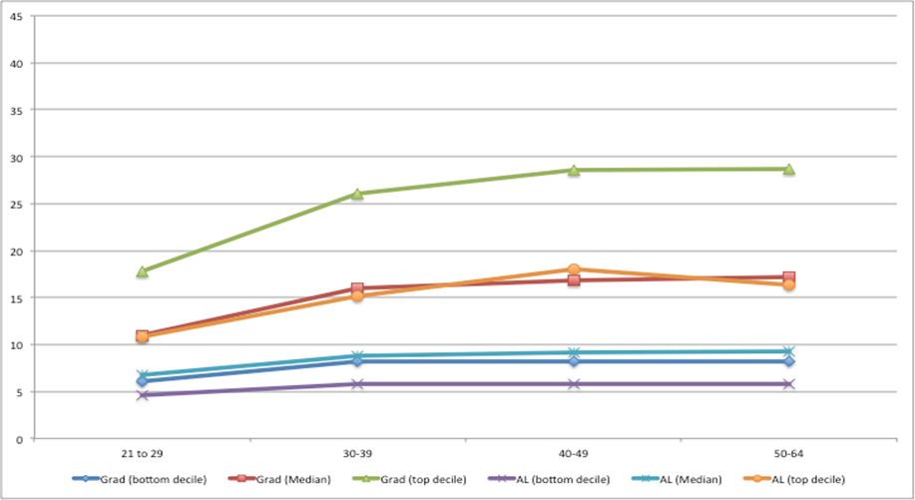
UK Female hourly earnings by age groups (LFS 2010) – graduate and those with A-Level qualification

Slide 15
Crisis Indicators
Under Employment
In the United States it is clear that many graduates are doing sub-graduate work. While the figures vary depending on how underemployment is measured, the best estimates suggest that between 40-50 per cent of young graduates are underemployed. Richard Vedder and his associates reckon that about 52 per cent of four year college graduates are in jobs that match their skills while 48 per cent are overqualified. They also report that over 5 million college graduates are in jobs that require less than high school education. In Britain, the figures are remarkably similar. The Office for National Statistics reports that underemployment amongst graduates has risen from 37 per cent in 2001 to 47 per cent in June 2013.

Slide 17
Institutional Change
When we look at education institutions we see that there is an intimate relationship between wealth and student participation. Due to:
The emergence of international schools which cater for national and global to global elites.
The creation of a global market for higher education. In which the most prestigious universities are also those that attract the children of elites.
But! As we have seen a segmentation of the higher education market, so we have seen a change in the ideology that links education to the labour market. At a time when there are more educated workers on the planet than ever, a new ideology of talent arrives.

Slide 18
The Talented
The idea of the war for ‘talent’ was popularized by McKinsey’s. Some knowledge workers are more productive in the global economy than others, as it is these ‘talented’ workers who would have the knowledge and skills to drive forward complex Transnational Corporations.
So MNCs fish in a small pool of potentially talented workers. The crucial point about these ‘talented’ is not just the qualification or credential they have but the character and ‘performability’ to match. The days when credentials could be linked to access in a bureaucratic hierarchy are over.
There is a beauty contest between the global elite universities and leading MNCs leading to an intensification of positional competition on a global scale.

Slide 19
Skill, ‘Technicians’ and the ‘Talented’
It was considered in the 20th Century that credentials mapped directly onto jobs: that a university degree qualified graduates for the first step in the corporate ladder. No more!
In order for students to gain well paying jobs, they not only need credentials but demonstrate performance through internships, demonstrate general as well
as specific skills linked to their field of study and they ideally need to be multi cultural and multi lingual. The ‘talented’ have these qualities.
This has a significant impact on recruitment. The clearest example of a high performing country on PISA tests is Singapore but may have a problem when
it comes to ‘talent’ understood from a Western perspective:

Slide 20
An MNC Executive in Singapore
‘
Actually, quite frankly to a large extent, we will be very much guided by the Ivy League schools. So when we go out, if we pick somebody from a Brown University, from Georgetown and duh duh duh, we just assume that they are like higher grade. Quite frankly within this room and that’s how we actually make the distinction of global graduate versus somebody from
a local university’.

Slide 21
An Irony!
But MNCs have huge problems when seeking to identify ‘talent’.
When we asked an Executive for Talent Acquisition, the following question:
If you think about the term talent – does it mean something different in China to what it does in Germany or France – or is talent now a kind of globally well-understood concept when you apply it to people?
Her response was clear:
That’s an interesting question. We have discussed that question quite a bit in the last few weeks. Very short, precise answer, no, there is no common understanding that is talent, no.’
And then she commented:
So definition of talent, talent management, what is talent management, you see like – I think that’s a hype word now – everybody is doing talent management not really kind of knowing what to do.

Slide 22
Analytics: How TNCs are Solving the ‘Problem’
We are now moving into an era of surveillance where CVs can no longer be tailored to tell a story. Corporations like Burning Glass are developing extended education profiles for TNCs so that they can make better judgements about those they recruit.
In looking for A* graduates from A* universities they will now have access to student records that means that second chance students, who have failed courses will simply be weeded out.

Slide 23
Global Capitalism and Varieties of Capitalism
Not all forms of capitalism will be equally vulnerable to the global forces.
Anglo-Saxon capitalism is clearly the most vulnerable. Why?
There are 4 possibilities:
1. There is insufficient supply of highly skilled workers.
2. There is insufficient supply of appropriately skilled workers.
3. Linking supply and demand in institutionally problematic in some
economies: e.g ., UK,USA but not Germany or in the Nordic countries?
4. There is insufficient demand for high skilled work.
In the Anglo-Saxon countries there are clearly problems with 3 & 4, although the OECD and policy makers insist it is 2 that is the problem because it is what Human Capital Theory tells them and it is convenient.

Slide 24
What Can be Done About it?
Look outside educational institutions.
Antonia Kupfer in her critique of Human Capital and Reproduction theory has drawn attention to the different patriarchal and capitalist logics at work within educational institutions and those in the labour market. This is clear when she considers the success of women in education and their lower levels of income and occupation relative to men. See Graph 2 in this presentation.
Raise the level of demand and income for women.
One way in which we can reduce the positional competition for credentials
is to introduce a citizen’s or basic wage. It would mean there was a degree
of security irrespective of the educational decisions made by students.
Industrial policy to raise the demand for ‘graduate’ work.

Slide 25
Conclusion
Educational and economic globalization has caused a fundamental rupture in the prospects for upward social mobility. We can no longer view the competition for elite work within the confines of national boundaries.
We cannot see the availability of jobs, just within national boundaries.
Yet policy makers and the OECD continue to do so. Why?
We have a democratic deficit, we cannot control the major global institutions that determine jobs and social mobility.

