Slide 1
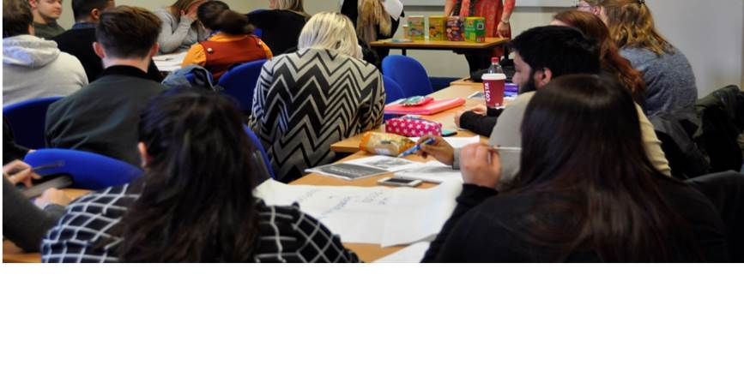


Technology and the Ability
to Learn through Failure;
A Virtual Business Enterprise Team
Angela Richardson
Paul Bocij

Slide 2
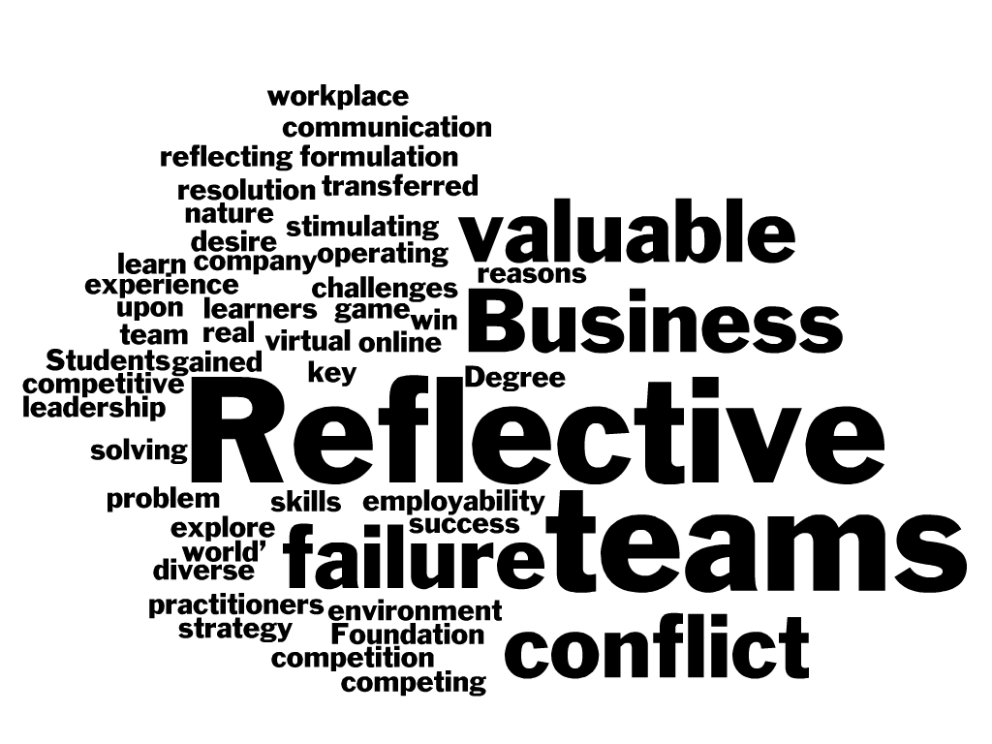
Abstract

Slide 3
Presentation Outline
Foundation Degrees – Research Purpose
Learning Journals – Research Method
Findings
  The Game
  Blended Learning
  Group selections - Skill Developments
Reflection Following Failure Model
Conclusions

Slide 4
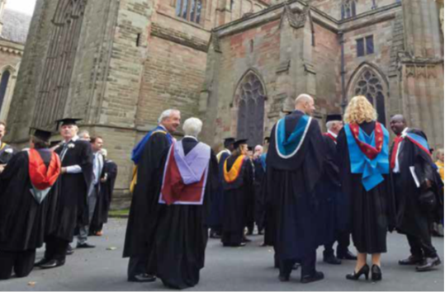
The Research Purpose
Foundation Degrees
Teaching, Learning and Assessment
Reflection
Blended Learning – Employer Engagement, Community of Practice
Reflection
Teamwork and Leadership - Group Selections
Reflection
The Game – Decision Making Skills, Enterprise Activities, Employability Skills

Slide 5
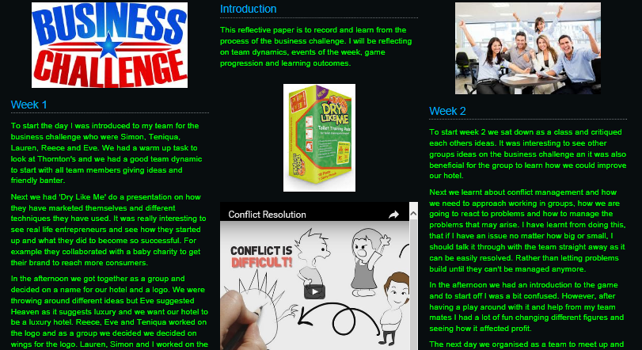
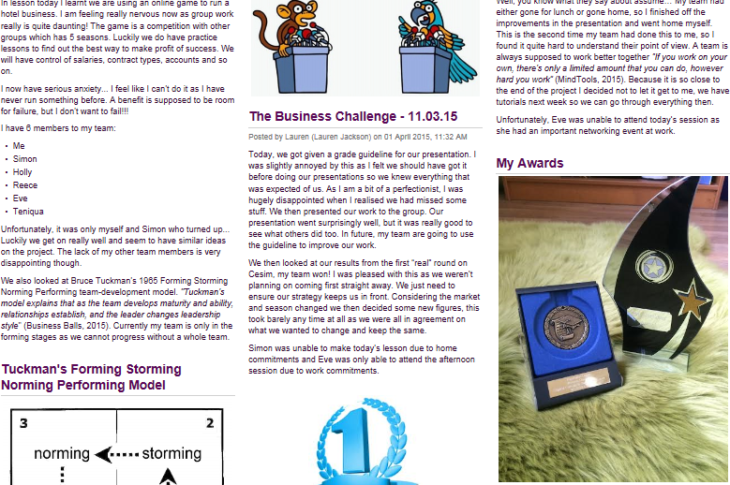
The Research Methods
Individual Learning Journals, Student Interviews and Observations

Slide 6

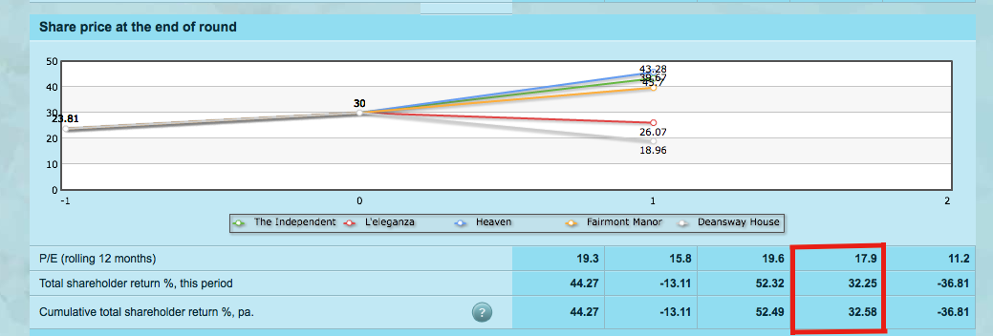
    Strategy Formulation
    Problem Solving
    Working in Diverse Teams
    Conflict Resolution

Slide 7
Blended Learning
‘It was felt that learners who worked in groups to cultivate knowledge and understanding would establish strong norms that were based on trust.’

Slide 8
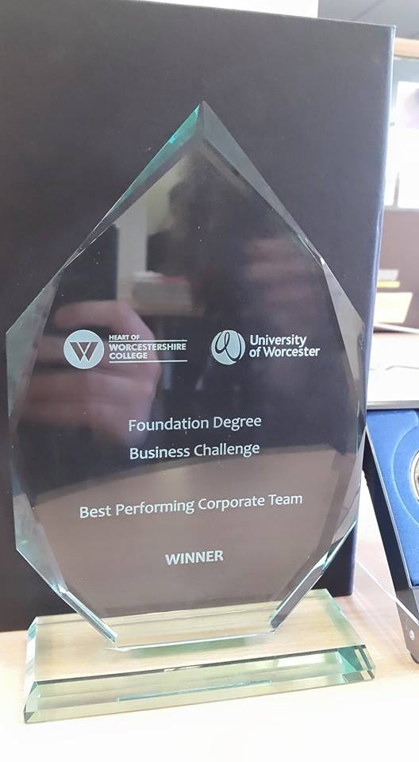
Group Selections
“…by combining all our knowledge makes us better as a team than one individual tackling this challenge on their own…”

Slide 9
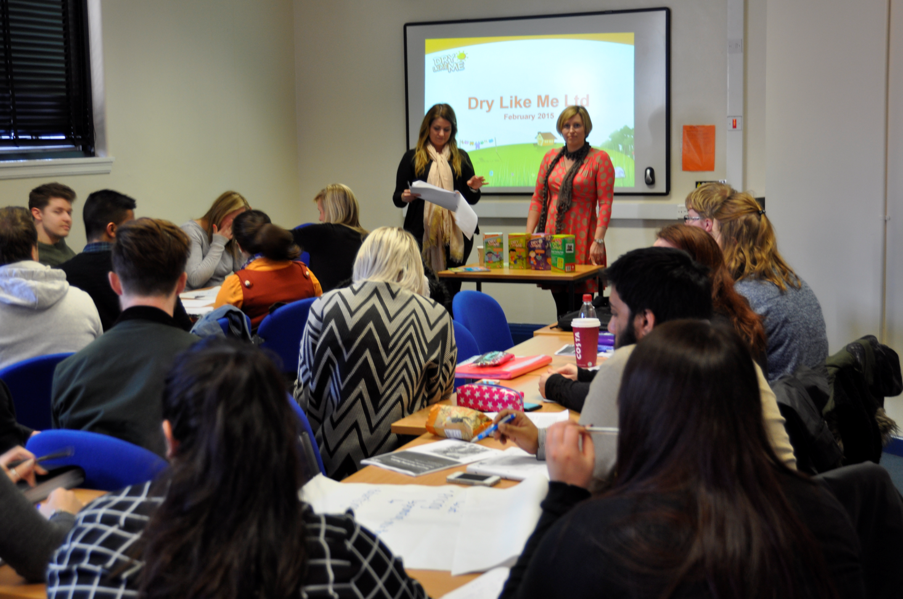
Developing Key Employability Skills

Slide 10
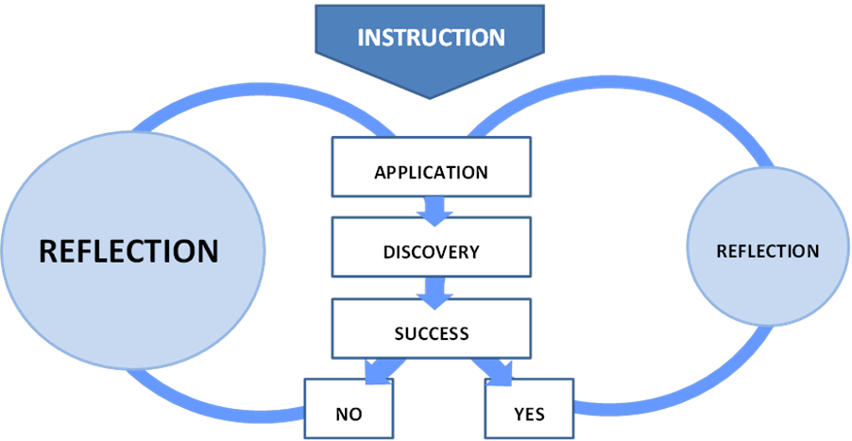
Reflection Following Failure Model

Slide 11
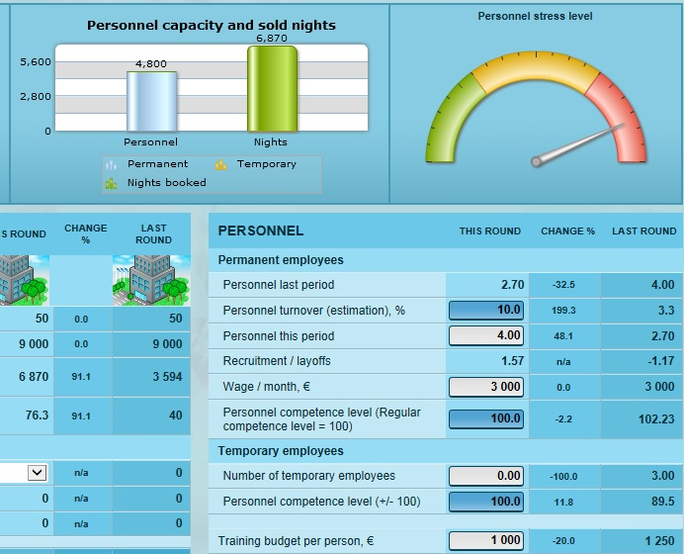
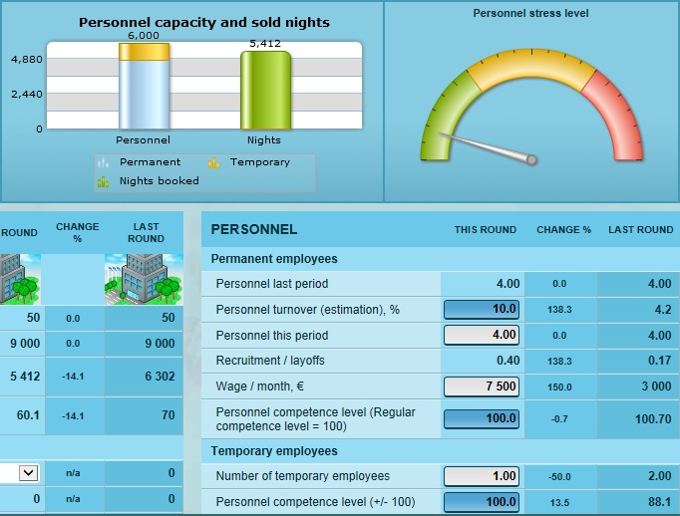
Conclusions

Slide 12

Technology and the Ability
to Learn through Failure;
A Virtual Business Enterprise Team
QUESTION AND ANSWER
Angela Richardson
arichardson@howcollege.ac.uk
Paul Bocij
Bocijp@aston.ac.uk

