Slide 1
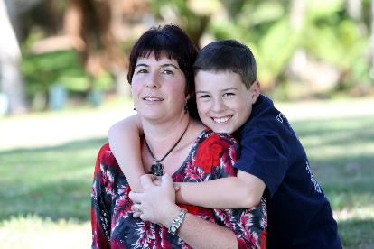
improving the education and EMPLOYMENT outcomes of HIGHLY disadvantaged young Australians
Employer Engagement in Education and Training Conference
London, July 2016
Anne Hampshire
Head of Research and Advocacy
Anne.Hampshire@thesmithfamily.com.au

Slide 2
The Smith Family
VISION
A better future for young Australians in need.
MISSION
To create opportunities for young Australians in need by providing long-term support for their participation in education.
BELIEF
Every child deserves a chance.
STRUCTURE
National, non-government charity, voluntary Board, 600+ staff
HISTORY Established in 1922 by group of businessmen
SCALE Support 125,000 children, young people, parents/carers pa in 94 communities
FINANCES $86.8 million in 2014-15
- $52.5 m from donations, corporate support and bequests
$22.6 m from government
$2.4 m from recycling commercial operation
2

Slide 3
Australia’s educational challenge: Young people are behind at each stage
Early years
Primary years
Secondary years
Post-school years
Developmentally vulnerable
Numeracy
Year 12 completion
Post-school engagement
94% of Year 5 students with a parent who has a uni qualification are above the national minimum standard, compared to 61% of children whose parents did not complete Yr 12.
One in three children in most disadvantaged communities is developmentally vulnerable in one or more key areas when they start school.
Around 30% difference based on socioeconomic status of students.
41% of 24 year olds from most disadvantaged backgrounds were not fully engaged in work or study, compared to 17% among most advantaged.

Slide 4
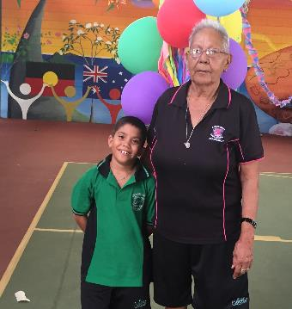
LEARNING FOR LIFE program

Slide 5
Learning for Life scholarship
Financial support
Relationship with a Learning for Life program coordinator
Access to educational programs from early years to tertiary level
+
+
Parent and community engagement

Slide 6
Key programs at different life stages
Early years
Primary years
Secondary years
Post-school years
Parents and carers
Let’s Count
Let’s Read
Student2student reading program
Learning Clubs
iTrack career mentoring
Creative enrichment
Career and post-school pathways
Work Inspiration
Aboriginal girls’ programs
Tertiary mentoring
Financial Literacy
Tech Packs
Financial Literacy
Balanced intervention across young person’s life
Learning for Life scholarship – students can begin in the 1st year of school and continue through to the end of tertiary

Slide 7
Learning for Life – key underpinnings
Began almost 30 years ago
Early intervention and long-term approach (Heckman)
Parental engagement
High expectations
Reciprocity and accountability
‘Beyond school’ – complements but in addition to school
Partnerships
Outcomes focus

Slide 8
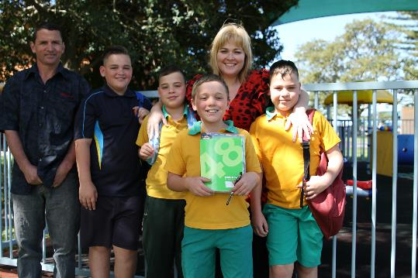
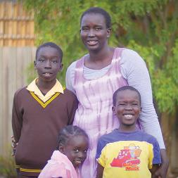
families supported
By learning for life

Slide 9
Learning for Life families
34,000 students nationally; 18,000 families; 94 communities
All low income families – Health Care Card or pension
18% of Indigenous background
Over half are single parent, 6% grandparent/kinship/foster
40% of students and 50% of parents have a health or disability issue
71% of parents not in the labour force or unemployed; 60% haven’t completed high school
20% of students have been at 4 or more schools and 1 in 20 have been at 6 or more schools
More disadvantaged than their peers in disadvantaged schools
50%+ of secondary and tertiary students on program for 6+ years

Slide 10
Learning for Life Through HIGH SCHOOL

Slide 11
Learning for Life through high school
Increased focus on helping LfL students (and families) to understand and plan for study, career and post-school options
Short term programs include: - Learning Clubs - I-track career mentoring - Work Inspiration - Experiential career and uni visit days - Creative enrichment
Networks, mentoring, new knowledge and skills, possibilities, goal setting, self-confidence and self-efficacy, work exposure and experience

Slide 12
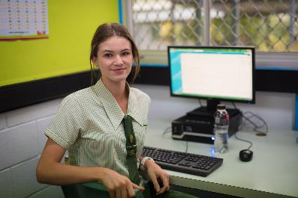
I-track
On-line mentoring program for students in Years 9 to 11
Students matched with supportive adult (half from our corporate partners), who provides advice and guidance about workplace, study and career opportunities and planning for them
Weekly chat sessions for an hour over 18 weeks with trained mentors
Aims to increase confidence, aspirations and knowledge re post- school transition

Slide 13
i-track outcomes, 2015 (pre and post)
Significant increase in % more motivated re school, going to study post-school, knew what school subjects they needed, career they wanted, where to get information re careers, steps to take
Significant reduction in % who were ‘not sure’ what they would do when they left school
More than 3 in 4 students increased their confidence to ask for advice/help from adults
She would always encourage me to do well. She would motivate me on never giving up even at the hardest of times because ‘every no leads me closer to a yes’…she was really inspirational.
He helped me with my career options and what I might be interested in. He told me about his career and what he did to reach where he is. He motivated me to do well in my education and we have many things in common. My mentor is the best.

Slide 14
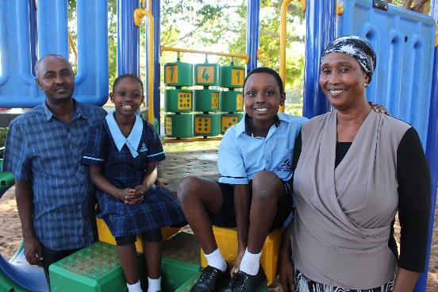
OUTCOMES of LfL students

Slide 15
Measures of effectiveness
Young people are in education, training, and/or work
Young people complete Yr 12 or equivalent
Young people stay engaged with learning
ENGAGEMENT
ADVANCEMENT
ATTENDANCE
LONGER-TERM OUTCOMES
Improved literacy and numeracy
Improved confidence (self-efficacy)
Improved motivation and aspiration
Enhanced networks and relationships
Improved knowledge/understanding
Improved or sustained school attendance
SHORT-TERM OUTCOMES
PROGRAMS Build skills & knowledge & influence attitudes & behaviours
Let’s Count, Let’s Read, Learning for Life, Student2Student, iTrack mentoring, Learning Clubs, Creative enrichment, careers/post-school options workshops, Work Inspiration, Tertiary Mentoring, Tech Packs, Financial literacy
Longitudinal dataset, unique student ID, admin, demographic and outcomes

Slide 16
Improved school completion
The Smith Family’s advancement rate
68.2%
Learning for Life students who were in Year 10 in 2013 and advanced to Year 12 or its equivalent by 2015. Up from 60% for the period 2010–12.
6,500 students across Australia have been supported on Learning for Life to complete Year 12 between 2012 and 2015.
National comparison
The national Year 12 completion rate for 19 year olds from Australia’s lowest socioeconomic decile is 60.6% and for the second lowest decile is 61.4%. This is well below The Smith Family’s Advancement Rate of 68.2%.

Slide 17
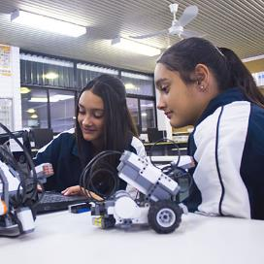
Successful post school transitions
84.2% of former Learning for Life students are in work or study 12 months after leaving the program
Fully engaged
Partly engaged
65.8%
18.4%
For Indigenous young people, 74.2% were engaged – 54.6% were fully engaged and 19.6% were partially engaged. For both Indigenous and non-Indigenous former students who were not engaged, 80% were actively seeking employment and one in six was volunteering.
These rates are significantly above national outcomes for similar young people.

Slide 18
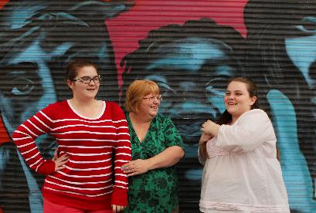
Some of WHAT WE’RE LEARNING

Slide 19
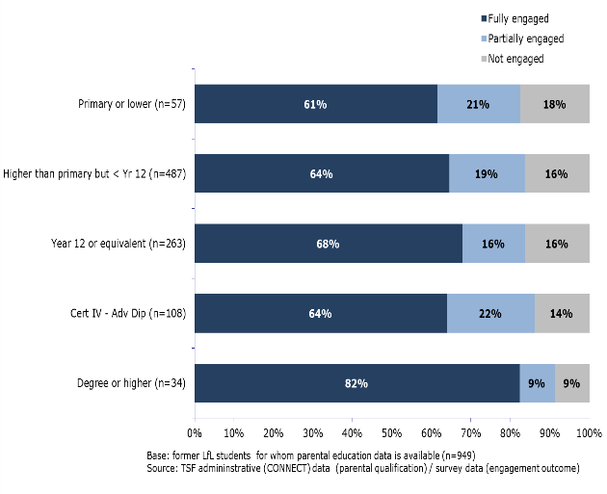
Engagement rate – Parental education
Parental education has little influence on post-school engagement rate of LfL students except if parent has a degree.

Slide 20
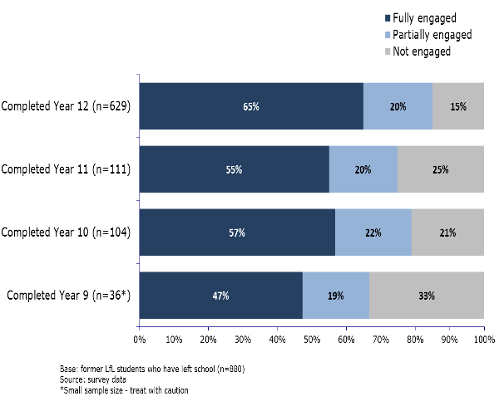
Engagement rate – by highest level of school completed
Stronger engagement if completed Yr 12.
Seemingly little difference between Yr 10 and Yr 11 leavers, however…

Slide 21
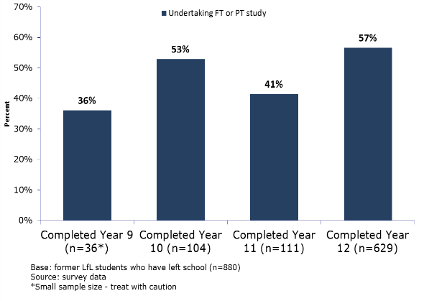
Continuing study by highest level of school completed
Stronger likelihood of continuing study if completed Yr 12.
Young people completing Yr 10 much more likely to continue studying than those completing Yr 11 likely better longer-term outcomes
Policy & program gap in Yr 11 – opportunity to improve our program suite and influence public policy

Slide 22
Early school leavers
Reasons for leaving early – multiple and complex
Years 9-11
Many related directly to ongoing challenging financial circumstances
Desire or need for financial independence
Earn own money
Get a job, apprenticeship or traineeship
Years 9 and 10
Range of school related factors also strongly linked to leaving school early
Problems with students and/or teachers
Missed a lot of school
Dislike school
Not doing well at school
Opportunities for early intervention by The Smith Family

Slide 23
Other findings
Significant proportions (20%+) of those who’d left school early were sorry they’d made that decision
Strong high school attendance rates in Year 8 positively associated with completing school
Stronger achievement rates in English in Year 10 positively associated with completing school

Slide 24
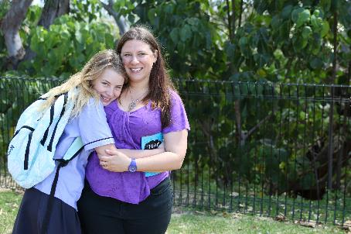
How are we using what we’re learning?

Slide 25
Using data to improve outcomes
Data, evaluation and research are driving program refinements and continuous improvement, for eg:
More tailored support for particular groups of students and at particular times (eg those struggling with school attendance, transitioning to high school, Aboriginal and Torres Strait Islander background students)
Changes to frequency and nature of engagement with families
Re-defining roles of staff, role specialisation
Greater focus on supporting students to complete Year 12
Training for LfL staff on working with highly disadvantaged families
Refined induction program for new staff

Slide 26
Learning for Life: Good progress…journey continues
Evidenced-informed program which has evolved over 30 years
Early intervention, long-term approach, responsive to changing needs
Highly targeted
Reciprocity, parental engagement, high expectations
Improving educational and employment outcomes of highly disadvantaged young Australians, with further improvements possible – not all young people on the program are achieving
Cost effective, involving multiple partnerships and volunteers
Ongoing analysis of longitudinal data will further enhance evidence base

Slide 27
QUESTIONS
Further information is available at www.thesmithfamily.com.au, including a research report on the LfL program
Anne.Hampshire@thesmithfamily.com.au

