Slide 1
Being Smart About Employer Engagement
Chris Gledhill – Managing Director, PDMS

Slide 2
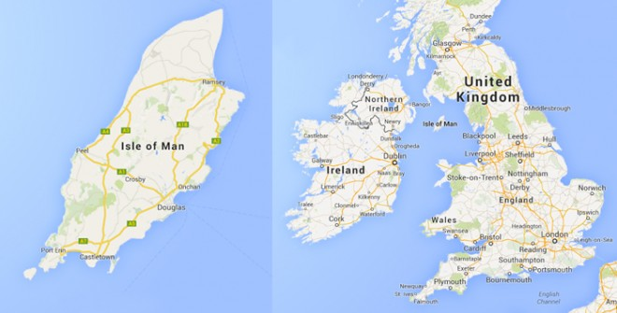
Background – Isle of Man
The Isle of Man is a Crown Dependency with its own parliament, fiscal and legislative autonomy and a diversified economy but limited tertiary education.
A population of 85,000 is served by 5 state secondary schools 1 private secondary school and a college of further and higher education.

Slide 3
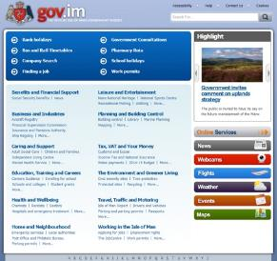
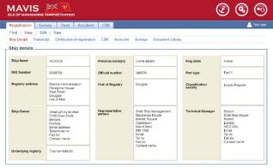
Background - PDMS
Secure Scaleable Online

Slide 4
The story so far…
2007 Widespread skills shortages in engineering, ICT, healthcare, e-business etc…
Collaboration between DTI , Education and Business organisations to address ‘brain drain’ due to lack of HE locally.
PDMS propose a ‘social on line’ approach to strengthen ties back to local labour market for the Manx diaspora…

Slide 5
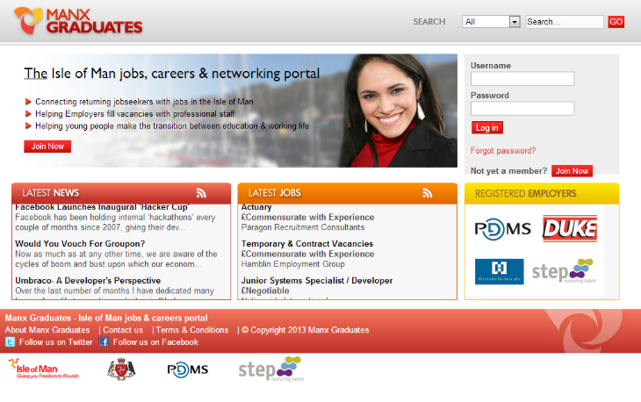
The Story So Far
September 2008 - Manx Graduates launched, backed by DTI

Slide 6
Initial Age Distribution - ManxGraduates

Slide 7
The story so far…
September 2008 - Manx Graduates launched, backed by DTI
Strong initial uptake across all age groups
Financial crisis changes government priorities – focus on NEET
2010 – DTI funding ceased but service maintained by PDMS
November 2013 - Rebranded employed.im, by PDMS, backed by reformed Employability Group – Employers, Education Economic Development

Slide 8
November 2013 – Rebranded as Employed.im to reflect a holistic view of the Labour Market

Slide 9
Our Goal
To create the most effective environment for employment and skills development in the world. Benefitting employers, individuals and the economy

Slide 10
The Context
Young people can access vast amounts of opinion and information online, but the need to match aspirations to the realities of work, to local learning options, and to each individual’s circumstances should be the focus for public support. There are already 10 times more people aiming to work in culture, media and sports than there will be jobs in 2020.
Youth Transition – Helping every young person reach their full potential – LGA – Oct 2014
Matching skills and training to local economies – Young people not pursuing the university route need a clearer track from education into the world of work. The post 16 learning landscape is increasingly fragmented and centralised, with little scope for institutions to collectively engage and meet the needs of local employers, and patchy advice for young people to navigate it. As a result, the skills gap is widening and teenage apprenticeships are falling.
Youth Transition – Helping every young person reach their full potential – LGA – Oct 2014
Notes:
Why we’ve done it

Slide 11
The Context
Employers do not have much spare time to understand and get involved in services to help young people. Public services must establish single and simple two-way conversations based on how services will benefit organisations, as well as young people. Multiple contacts from multiple agencies using public service language is confusing for those employers that want to engage, and is a deterrent for those that do not. Building relationships and trust with employers takes time and relies on a simple coherent offer remaining in place over time.
Hidden Talents – Empowering Employers to help young people towards work and learning – Dec 2013

Slide 12
The Context
A good understanding of the world of work and employment opportunities available is fundamentally important to all young people, irrespective of the educational and career pathways they choose. This needs to start earlier and be delivered in a way which inspires and excites young people. It must also be sustained and focused throughout young people’s education, helping them to manage their careers, develop skills to secure employment and succeed in the workplace.
Education Working for All – Commission for Developing Scotland’s Young Workforce Final Report – Sir Ian Woods, June 2014

Slide 13
The story so far…
November 2014 Implement Get a Job program with Junior Achievement
Undertake review of potential applications for a single labour market platform supporting different government departments, employers the third sector and… Individuals.
It’s a no brainer!
It’s complicated!
It’s a threat!

Slide 14
Corporate Complexity v Individual Focus
How hard can it be?
OMG!!!

Slide 15
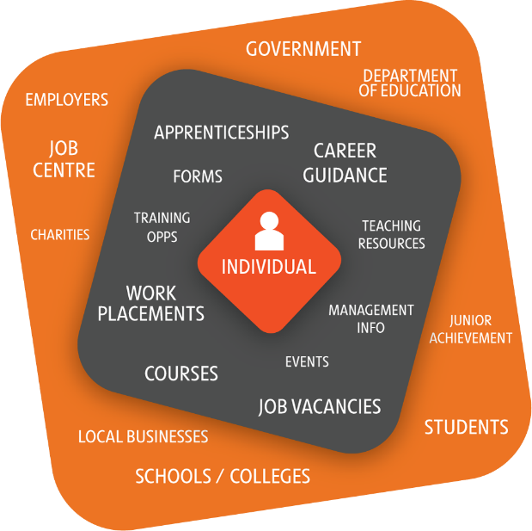

Slide 16
Notes:
What we’ve built to reach our goal

Slide 17
Meanwhile…
We implemented a Textile Skills portal for New Economy Manchester.
Researched best practice and policy on employer engagement employability and Skills
Worked with DfE (UK) on prototype portal for post 16 education using open data from SFA
Worked with Fife Council on an employer engagement pilot project

Slide 18
Textile Skills
Notes:
Promoting a specialised skills sector – explores funding options for employers & individuals based on Manchester’s grant system
Other development options locally:
Nursing
Teaching
E-gaming
Law
Third sector

Slide 19
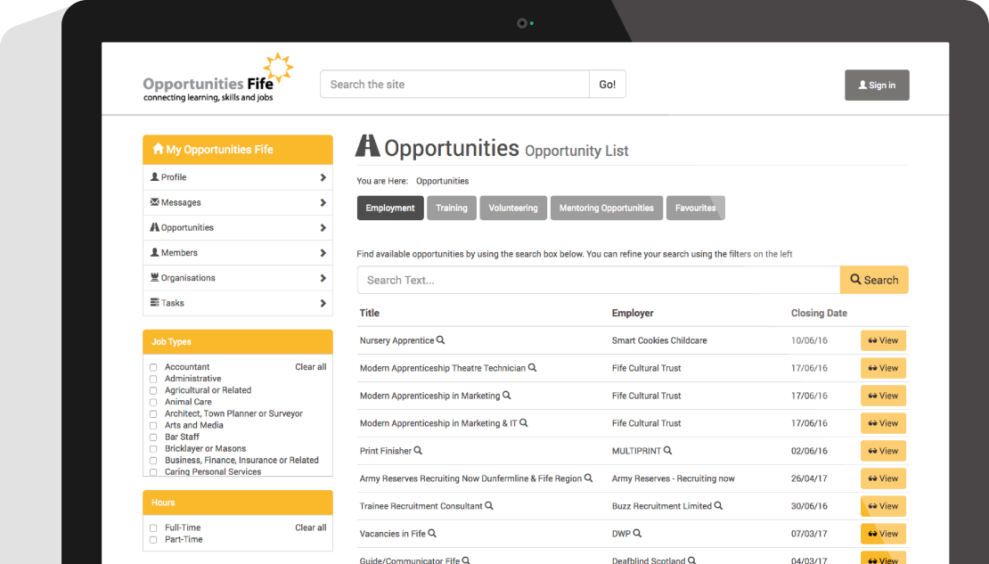

Slide 20
Next…
September 2015 – took over the administration of work experience for all of the Islands 5 secondary schools
Move to single sign-on role based architecture
Provided API for commercial web portals to take Jobs feed
Automated communication of vacancies to the Job Center
Implemented Membership management and accreditation for trade associations

Slide 21
Now
Single point of entry for multiple job listings
Isle of Man working population circa 30,000
6,000 Members (circa 20% of workforce)
2,500 Organisations (circa 80% of active employers)
1,500 weeks of work experience per annum for 5 secondary schools
14,537 vacancies listed in the last 12 months
1 Master site, 3 Industry sites, 2 Commercial sites and 1 Government feed.

Slide 23
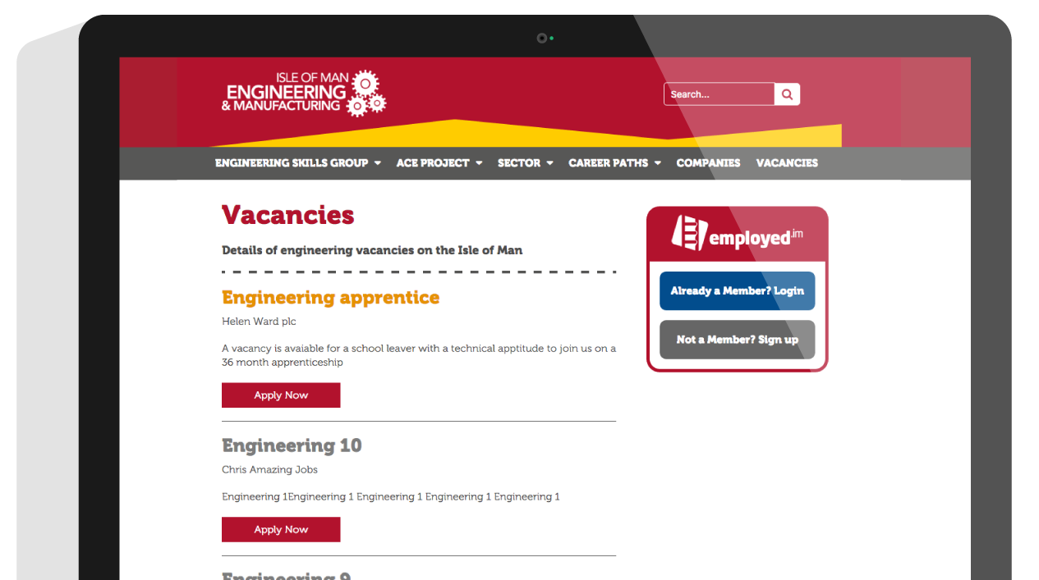
Notes:
“who else is using the Employed platform?”
ACE – jobs feed fed through to their own site – relevant to sector

Slide 24
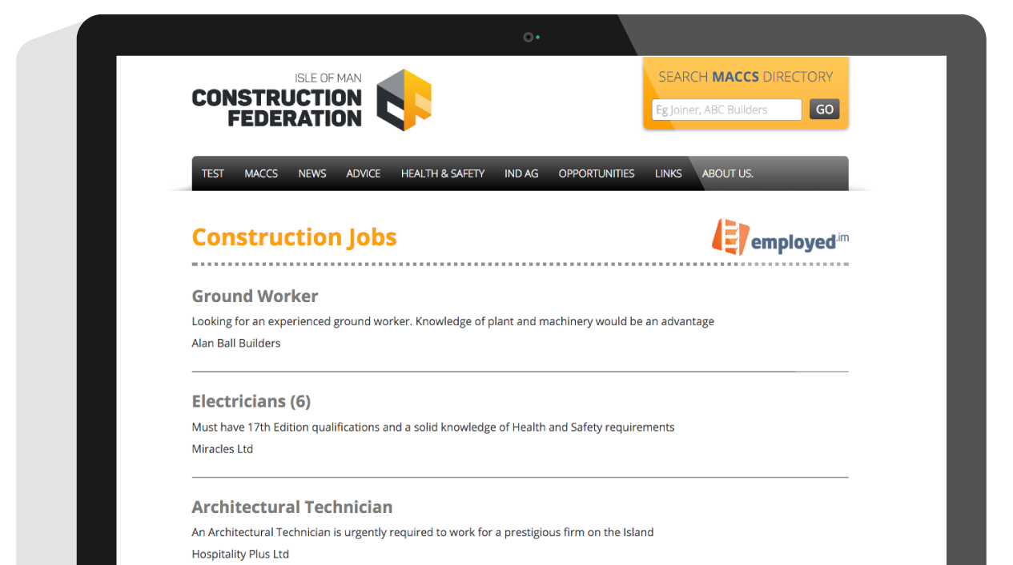
Notes:
Construction Federation – membership management & relevant jobs feed
Other development options:
Nursing
Teaching
E-gaming
Law
Third sector

Slide 25
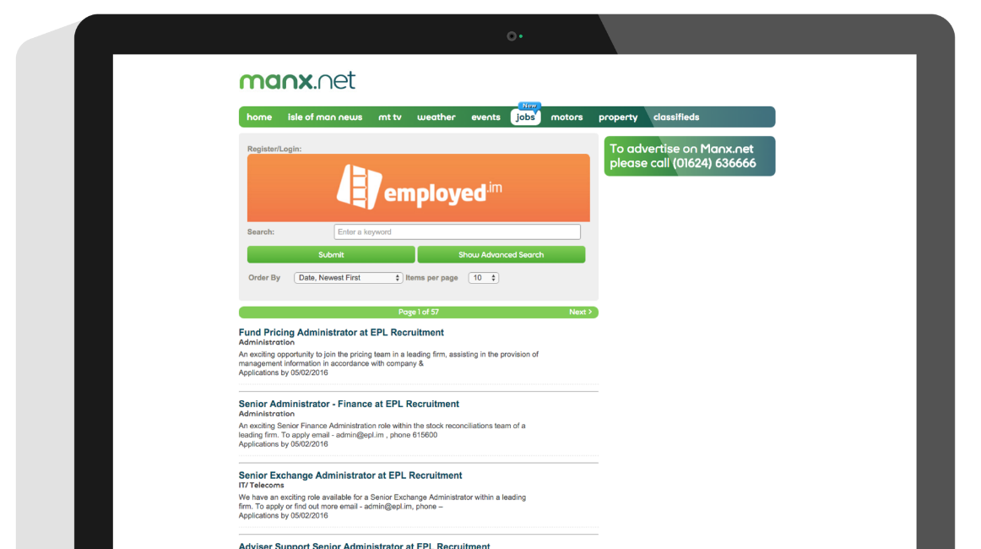
Notes:
Manx.net Jobs Feed – fed from employed.im
Jobs can now be entered on employed.im, sent to Job Centre and fed through to Manx.net (exposure from just one point of entry)

Slide 26
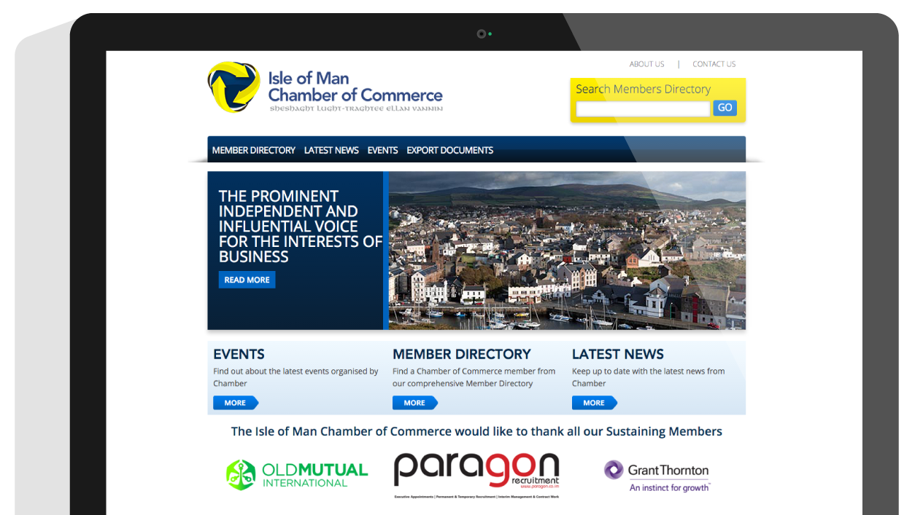

Slide 27
The Issues
Bridging the gap between education and employment
Ensuring people, at any stage in their career, are able to access information and the skills needed to return to or remain in employment
Allowing different agencies and private organisations to operate independently on a common platform.

Slide 28
Lessons learned (so far)
Separating systems from services can work and can be simple and sustainable across multiple participating organisations
Technology on its own is not enough – people make it come to life
Better to work with a coalition of the willing now than wait for total consensus.

Slide 30
Thank you

