Slide 1
Technical, practical and vocational learning: a review of Edge research since 2004
David Harbourne
Edge Foundation

Slide 2
We will:
gather the evidence
grow the movement
provoke debate and galvanise action
invest in inspiring high impact projects
Edge Foundation board paper, June 2005

Slide 3
The words we use

Slide 4
… the distinction, which permeates policy and practice, between the 'academic' and the 'vocational', though taken as self-evident, provides a limited view of both …
'Academic' is never defined, but it is strongly associated in practice with a certain content and mode of learning. The content is largely determined by the subject matter, the theoretical knowledge, which is organised in subjects, can be transmitted as such to the learner, and can be written down …
'Vocational', on the other hand, requires the acquisition of practical skills - the ability to do and to make certain things. Such capacities relate eventually to doing a particular job …
However, it is difficult, upon reflection, to maintain this clear distinction, and with it the differentiated status that it implies.
Richard Pring

Slide 5
Practical (and much vocational) learning is not 'simple' at all; it involves a delicate synthesis of watching and noticing, tinkering and practising, imagining and rehearsing, reasoning and appraising.
Guy Claxton and Bill Lucas

Slide 6
Habits of mind involve investigating, experimenting, reasoning and imagining, while frames of mind include curiosity, determination, resourcefulness, sociability, reflection and wisdom.
The kinds of investigating, experimenting, imagining and reasoning that go on in a repair shop or a retail outlet are as rich, interesting and appropriate as those that go on in a university seminar.
Guy Claxton, Bill Lucas and Rob Webster

Slide 7
The academic/vocational divide debunked – and reinforced

Slide 8
Richardson and Sing, 2011
Schools were asked to identify “academically able” students in Key Stages 3 and 4, based on prior and predicted attainment.
Almost half of the sample at Key Stage 4 opted for at least some learning meriting the description “vocational”.

Slide 9
High-attaining students valued physical, expressive and experiment-based learning in Key Stages 3 & 4.
In fact, they preferred them to more analytical forms of learning – especially writing.
However, almost all of them opted for traditional academic A Levels as a route to high-status universities.
William Richardson and Sue Sing, The impact of practical and vocational education on academically able young people aged 11-16

Slide 10
Mind the Gap, 2010
Currently, central policy-making is largely uninformed either by scientific evidence or by systematic gathering of learner's experience.
The major influence on outcomes and satisfaction is not the superstructure of policies, programmes and methods of assessment … it is what teachers are doing, day by day, in classrooms, work-rooms and labs, with their students.
Bill Lucas, Guy Claxton and Rob Webster

Slide 11
Graduate employability
Kevin Lowden, Stuart Hall, Dely Elliot and Jon Lewin found –
  inconsistencies of approach across faculties and subject areas: in particular, technical disciplines were more likely than arts faculties to have good links with the world of work.
Employers' perceptions of the employability skills of new graduates, 2011

Slide 12
What are “graduate jobs”?
The Higher Education Statistics Agency uses a definition which includes “associate professional and technical occupations” such as laboratory technicians, dispensing opticians, fitness instructors and estate agents.
[Alternative] routes are not well known or understood by teachers, parents or young people. Nor is it widely appreciated that people can go on to study for a degree after completing an apprenticeship - or in some cases, as part of an apprenticeship.
The graduate labour market: an uncomfortable truth, 2015

Slide 13
Employer engagement

Slide 14
Mann and Virk, 2014
In UTCs – and to some extent, Studio Schools – employers are engaged in organisational operation and teaching and learning to a greater extent than anywhere else in the school sector.
Engagement in UTCs is –
Broad: stretching across a wide range of activities and involving both staff and pupils
Deep: engaging individual employers in multiple activities relevant to young people through their school careers
Embedded: an accepted part of the UTC culture, regularly encountered by students and staff alike.
Profound Employer Engagement in Education: What it is and Options for Scaling it Up

Slide 15
Factors for success
It needs to be easy and free (or cheap) to establish links between schools and employers
Business cases (on both sides) need to be clear, to support wider organisational objectives and be widely understood
Schools need to ask for help, rather than waiting for employers to volunteer.
Anthony Mann and Baljinder Virk

Slide 16
Opinions

Slide 17
People tend to agree that …
Our education places too much emphasis on academic achievement
There aren’t enough opportunities for “learning by doing”
All students should study at least one vocational subject at school
But vocational education might just be “a great idea for other people's children” (Alison Wolf)

Slide 18
In 2012, 13% of secondary school teachers described their knowledge of Advanced Apprenticeships as good or very good
YouGov poll

Slide 19
Did school support your choice of path?
Employed adults aged 18-35 who followed - | Yes | No | Didn’t mind either way
An academic path | 65% | 10% | 25%
A vocational path | 36.5% | 31.5% | 32%
OnePoll, 2014

Slide 20
Members of Parliament
Good or excellent knowledge of –
Academic qualifications such as GCSEs and A levels: 76%
Apprenticeships: 57%
Other vocational qualifications: 36%
ComRes, 2015

Slide 21
Edge around the world
(Or: “educational tourism”)

Slide 22
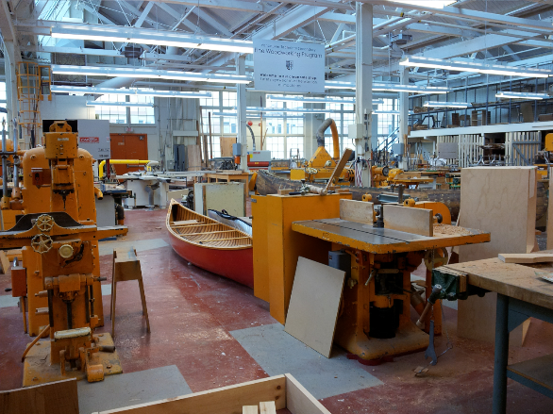
British Columbia

Slide 23
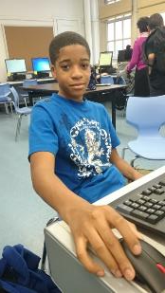
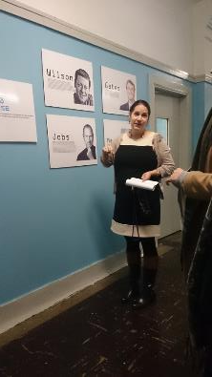

New York

Slide 24
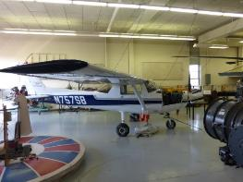
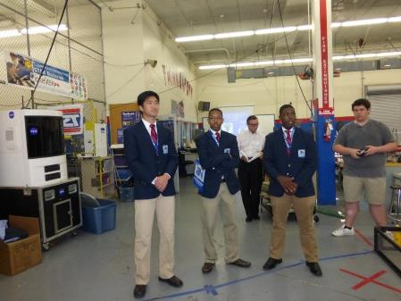
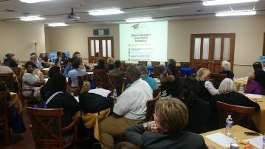
Nashville

Slide 25
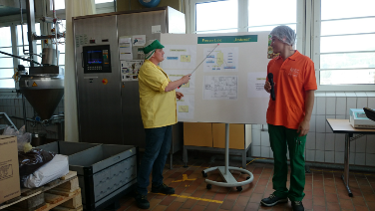
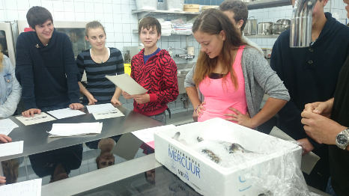
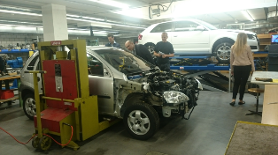
Switzerland

Slide 26
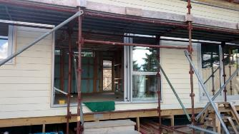
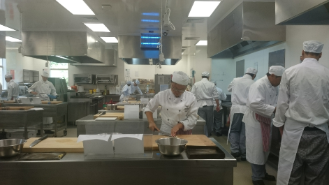
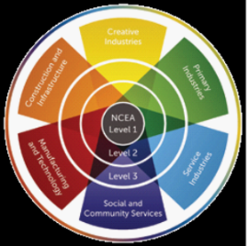
New Zealand

Slide 27
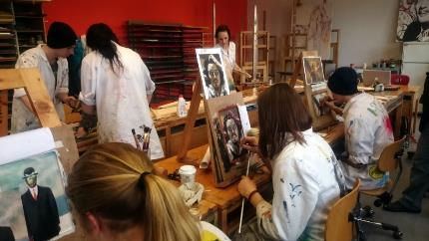
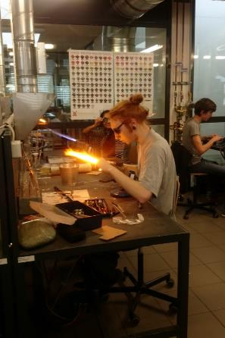
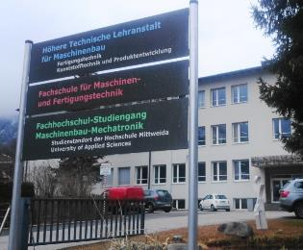
Austria

Slide 28
Conclusion: we still don’t know the half of it.

