Slide 1
VET Schools as Entrepreneurial Hubs
Iván Diego (Valnalon) - London, 21/07/2016

Slide 2
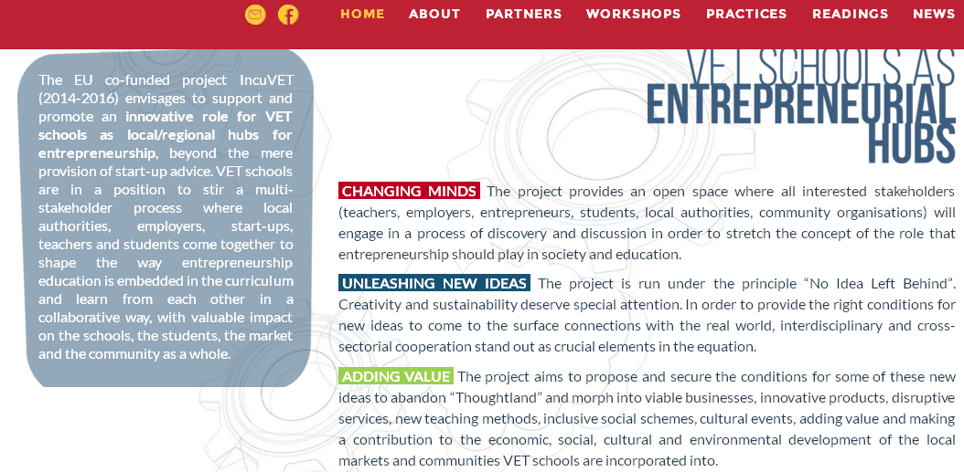
www.incuvet.eu

Slide 3
partners

Slide 4
vision
The overall vision underpinning this strategic partnership contemplates,
“an improved understanding and support of Entrepreneurial Education and Start-up Support in VET Schools”

Slide 5
2009…a gap to be filled
“Some major reasons for the gap identified are the following:
entrepreneurship is not included in all parts of the VET system;
student participation is limited;
teaching methods are ineffective;
the practical element of entrepreneurship is missing;
teachers are not fully competent;
entrepreneurship is not linked to specific training subjects or professions;
business people are not sufficiently involved.”

Slide 6
2016…still filling the gap?
“The evidence thus suggests that the majority of countries/regions have not yet embedded entrepreneurship education in a truly systematic and comprehensive way. It appears that countries currently differ in the emphasis given to its provision: the focus can be on some levels of education only, especially in terms of the subjects integrating entrepreneurship education. There seems to be more provision in lower and general upper secondary education, while transversal/cross-curricular skills are emphasised in primary school. Entrepreneurship as a separate subject, on the other hand, is most common in school-based IVET. “(p.114)

Slide 7
roadmap
Sequence of peer learning activities (workshops) that will enable participating organizations to gain experience and to strengthen their capacities.
At institutional level INCUVET is expected to impact in:
Improved knowledge and acquisition of innovative methods and tools
Development of networks working on the idea of VET schools as regional/local hubs for entrepreneurship.

Slide 8
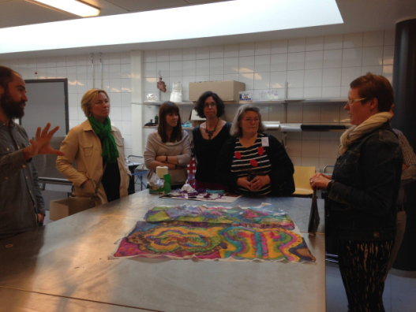
1. Espoo (Finland)

Slide 9
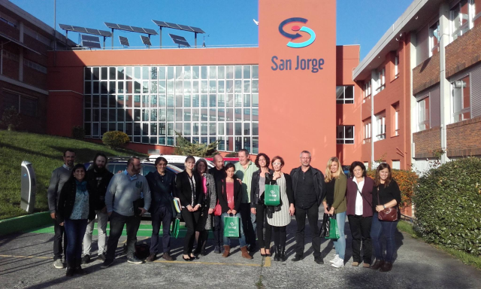
2. Bilbao (Spain)

Slide 10
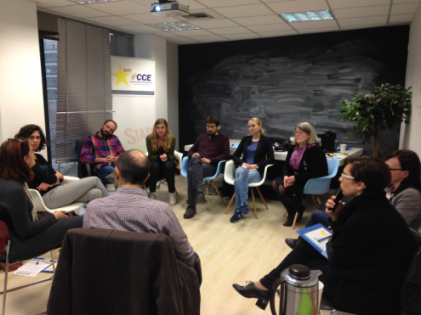
3. Athens (Greece)

Slide 11
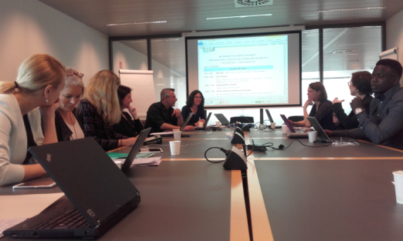
4. Ghent (Belgium)

Slide 12
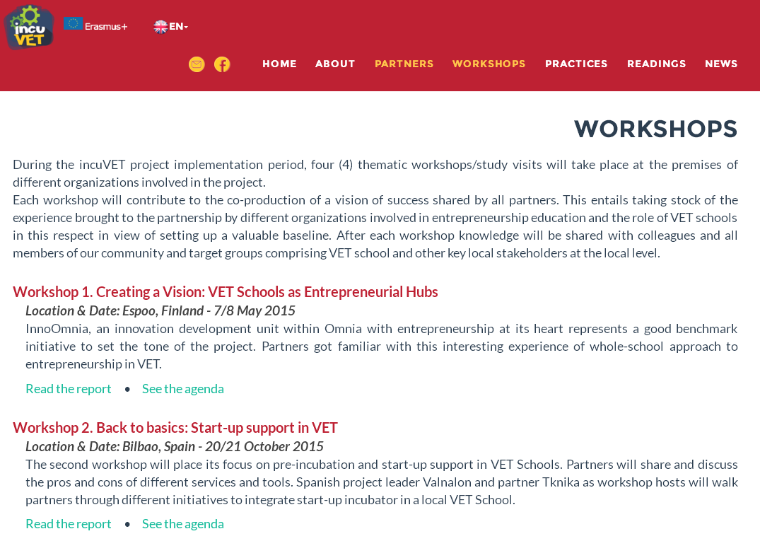
Workshop reports

Slide 13
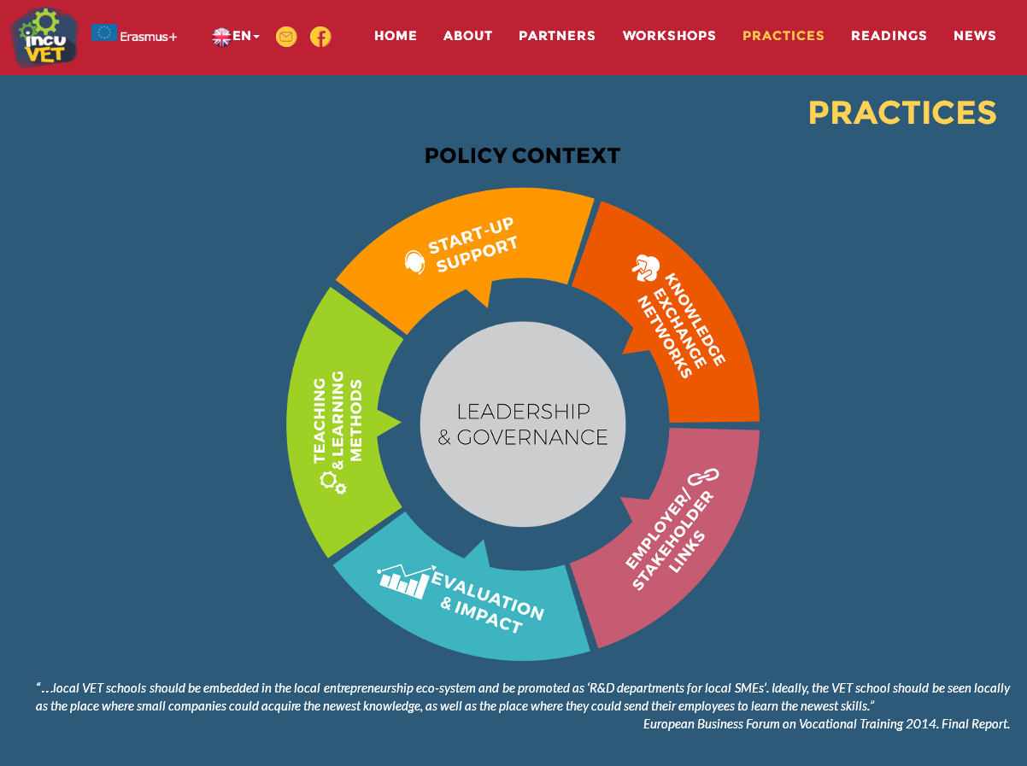

Slide 14
start-up support
“Most apprenticeship frameworks and standards have a business element so enterprise and entrepreneurship are obvious areas within which to locate these activities, framed as ‘real-world’ tasks.“
Related INCUVET Practices
Urratsbat. In-school business incubation (Spain)
Walking the talk at InnoOmnia (Finland) p. 7
Internships for VET Entrepreneurship teachers at a regional business incubator in Asturias (Spain)
Online Business Management Course (Aaja Debrandere, SYNTRA Flanders)

Slide 15
teaching & learning methods
“…and equipping tutors and teachers with a better range of vocational pedagogies. “
Related INCUVET Practices
LOL Empowering entrepreneurship through gamification (Finland)
Ethazi...the end of VET world as we know it (Spain)
IREKIN Initiative: Teachers go ahead! (Spain)

Slide 16
links with employers
“…an approach to providing skills which is increasingly focused on greater engagement with employers.”
Related INCUVET Practices
Employer engagement in VET through challenge-based learning: a teacher’s perspective from Asturias (Spain)
InnoEspoo, a joint project between 3 educational institutions and a local authority (Finland)
Estafette Mentor Training Programme (Belgium)
KMObiel - Evaluation as key in mobile learning pathways (Belgium)

Slide 17
evaluation & impact
“ A set of unambiguously aspirational outcomes for vocational education should be agreed, and included in school and college curricula from primary level upwards.”
Related INCUVET Practices
Skills Evolution Tool (SET), a versatile internet-based platform for classroom-based assessment of transversal skills in VET (Spain)
EntreMirror 2.0. Self-assessment entrepreneurial profiling tool (Belgium)
The educational researcher perspective: An interview with Danielle Morselli (Italy)

Slide 18
knowledge exchange networks
“The next stage of development, happening now, is the creation of regionally (and sub-regionally) collaborating networks of teaching schools.”
Related INCUVET Practices
Ikasenpresa: A motivated teachers’ network spreading entrepreneurial culture among basque students (Spain)
Profesores emprendedores: A grassroots group of entrepreneurship educators - Interview with Pablo Peñalver (Spain)

Slide 19
leadership & governance
“ a positive attitude to change in college leadership can have a transformative effect on FE’s position in local education ecologies.”
Related INCUVET Practices
InnoOmnia, a whole-school approach to entrepreneurship (Finland)
Entrepreneurship Coordinators at Specialist VET Schools in Galicia (Spain)
A government-level initiative to support whole-school approaches to entrepreneurship in VET Schools in Catalonia(Spain)

Slide 20
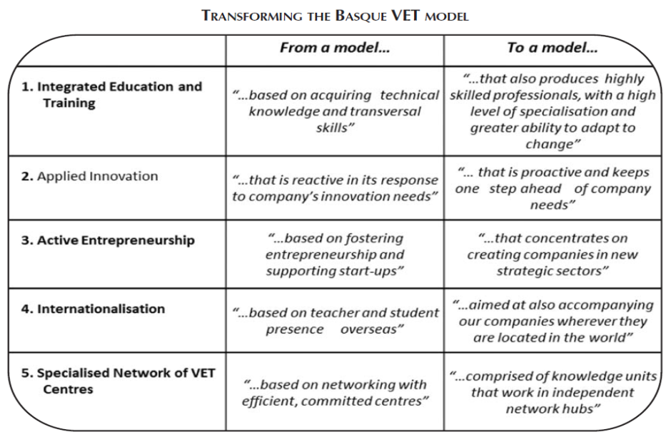
policy context
“… colleges to seize the opportunity of devolution and regionalisation to become agitators for change and enhanced cross-sectoral collaboration in their localities.”

Slide 21
final remarks
“…there is a chance to redefine the sector as a dynamic, entrepreneurial, innovative force for city/regional development, learner engagement and civic pride.”
It’s already underway!!

Slide 22
www.incuvet.eu
ivan@valnalon.com

