Slide 1
Analysis of employees learning competences for further education success
Prof. Dr. Nele Graf
Dipl.-pSych. Denise Gramß
Prof. Dr. Michael Heister

Slide 2
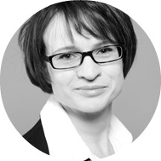
About
Prof. Dr. Nele Graf
Head of Competence Centre of quality of leadership and learning
learning competences of employees
Future of HR: paradigms and measurement of the future in HR
Leadership of teams (System theory)
Dipl.-Psych. Denise Gramß
human factors in learning in different fields of application
Learning and interaction in human machine interaction,
Usability
Prof. Dr. Michael Heister
Head of Department „Vocational teaching and learning, programs and development programs“ in the Federal Institute for Vocational Education and Training (BIBB)

Slide 3
Content
Motivation
Theoretical background
Model of learning competence
Study: Employee learning competence
First results
Conclusions & Outlook

Slide 4
Motivation
digital
Lifelong learning of employees
employability
complex
individual professional success
global
technological
company competiveness
innovative

Slide 5
Lifelong learning is changing
general
Traditional learning processes at school, university etc. do not prepare
organised
timed
given
Learning competences become an important prerequisite for cooperate learning
Learning
is
changing
Learning and working are increasingly intermeshed – learning is much more self-directed
at the workplace
prompt
individual
self-paced
specific

Slide 6
The research project
Which are the relevant competences employees need for successful cooperate learning?
LEKAF – Analysing and encouraging learning competences of employees
conducted by
supported by
Prof. Dr. Michael Heister
Federal Institute for vocational education and training

Slide 7
Theoretical background - 2 approaches
Individual learner characteristics
Learning management
process
Psychology
Work science
Adult education
Competence research
Need for cognition
HR management
Learning needs
Need for closure
Learning goals
Achievement motivation
Learning design
Self-efficacy
Help seeking
Learning style
Expert experiences
Persistence
Media competence
Evaluation
Learning motivation
Goal orientation
Cooperation competence
Resilience
Transfer

Slide 8
Theoretical background – self-reflection
Social cognitive theory (Bandura, 1986)
Achievement motivation (Atkinson, 1953)
Need for cognition (Cacioppo & Petty, 1982)
Need for closure
(Kruglanski, Webster & Klem, 1993)
Learning style (Honey & Mumford, 1986)
Media competence (Mandl & Krause, 2001)
Cooperation competence
(Mandl & Krause, 2001)

Slide 9
Theoretical background – learning management
Learning transfer and evaluation (Wirth & Leutner, 2008)
Help seeking (Holmann, Epitropaki & Fernie, 2001)
Persistence (Ponton, Derrick, Carr, 2005)
Learning management (Garrison, 1989)

Slide 10
Prior studies – employees and experts
Quantitative work
Qualitative work
survey of employees
survey of employees
survey of experts
Learning competences, esp. learning style
(N=88)
Factors of individual learning process and framework conditions
(N=142)
Delphi-Study with experts (executives, HR manager)
(N=50)
I like to understand how things work.
✓
strongly agree
agree
slightly agree
slightly disagree
disagree
strongly disagree

Slide 11
Model of learning competences
Self-reflection
Learning management
Learning avoidance
Recognise learning needs
Readiness to learn
Achievement motivation
Setting learning goals
External motivation
Learning management
Determine learning design
Activist
Realising learning
Learning style
Reflector
Transfer
Theorist
Evaluation
Pragmatist
Learning access
Media competence
Persistence
Cooperation competence
Learning motivation
Level of learning
Learning ability
Self-efficacy
Cognitive need
Learning culture
Learning support by executive
Learning conditions
Support

Slide 12
Method – online questionnaire
March 2016
91 items about 4 parts of the model
Demographic data
10.000 employers
How?
Self-reflection, learning management, learning conditions, support
Employees learning competences
What?
age, gender, education, branches, department
Who?
across Germany, from different industries, branches, company sizes and departments
June 2016

Slide 13
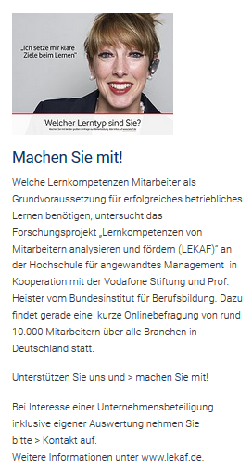
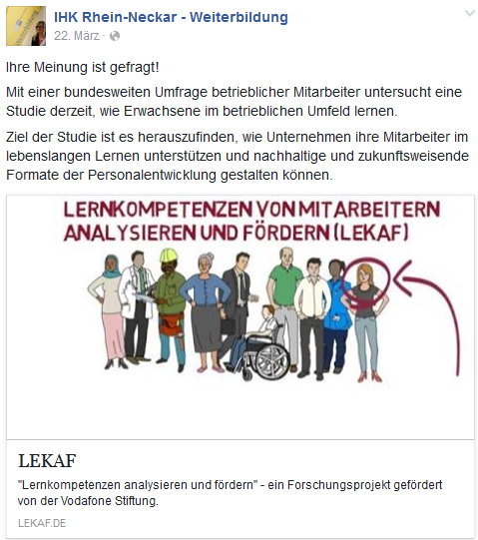
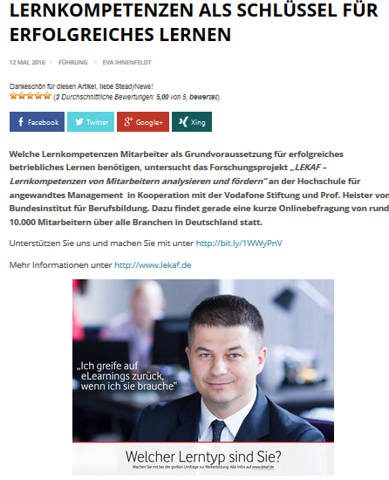
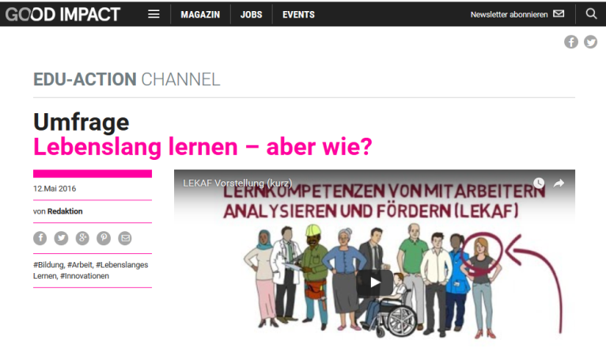
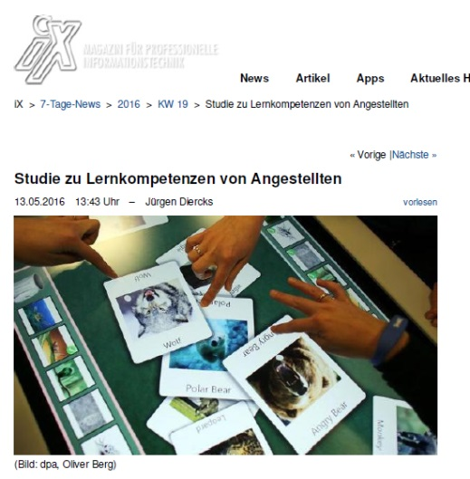
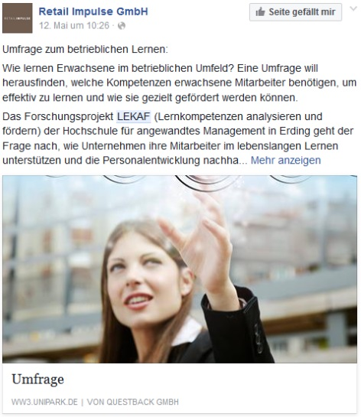
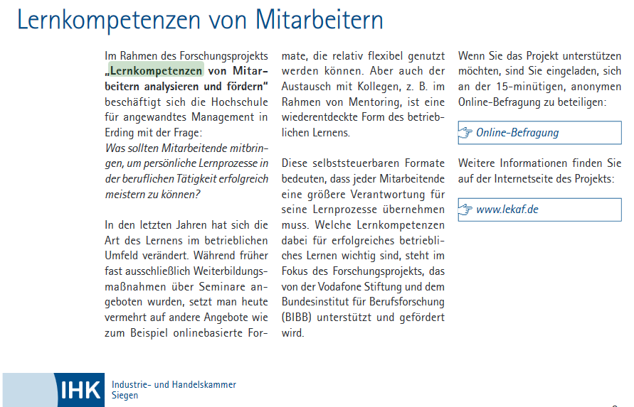
Research marketing

Slide 14
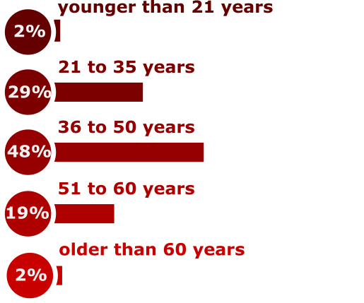
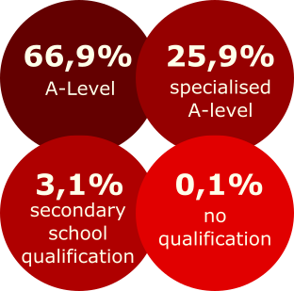
Demographic data (N=10.162)
Gender
Age
School education
50%
50%
Current occupation
other 3,7%
apprentices
executives
3,8%
Higher education
19,5%
employee
74,6%
others 4 %

Slide 15
Branches
Automotive industry and supplier
3,5%
Construction, handcraft, manufacturing
0,9%
Electronics, electrical engineering, technology
0,9%
Financial services, insurance, real estate
42,3%
Health and social services, Pharmaceuticals
6,1%
Commerce, sales and distribution
5,5%
Gastronomy, hotels and tourism
0,1%
IT, internet and telecommunications
31,6%
Consumer products, foodstuffs and luxury food
1,3%
Public services and non-profit organizations
1,3%
Personnel recruitment services
1,1%
Transportation, logistics and traffic
0,5%
Consulting, auditing, advertising
0,5 %
Science, research, training, education
4,7%

Slide 16
First results – model of learning competences
Factor analysis, description of factors
Reliability analysis and item selection
Sum scores for each factor for further analyses
Self-reflection
Motivation
Readiness to learn
Achievement motivation
openness
External motivation
Activist
Learning style
Reflector
Theorist
Learning access
Media competence
Cooperation competence

Slide 17
Learning competences in vocational education and work
Results include participants up to 35 years in vocational education (N=451) and professional employees (N=2124)
Learning style
Observer learning style is more preferred in vocational training
Both groups are high in activist learning style
In vocational training learning should be a combination of observing and trying out
Mann-Whitney-Test

Slide 18
Learning competences in vocational education and work
Readiness to learn & external motivation
In vocational education readiness to learn (openness, achievement motivation/avoidance, motivation) is significantly lower compared to employees
p<.001
But external motivation is comparable (p=.574)
Strengthen the personal benefit of learning and the openess to new and difficult tasks in vocational training
provide incentives
Mann-Whitney-Test

Slide 19
Learning competences in vocational education and work
Learning access
Media competence in learning is lower for people in vocational education
p<.001
p<.001
also cooperation competence in learning is lower in vocational education than for professional employees
In vocational training critical and goal-oriented use of media needs to be supported
Mann-Whitney-Test

Slide 20
Conclusion & Outlook
Recommendations for education and training
provide support for self-directed learning by the analysis and training of learning competences
knowledge about learning preferences is important
Vocational education should consider the preferred learning styles of active learning by trying out and observational learning
Strengthening the motivation, openness and reduce the learning avoidance in vocational education
Encourage media competence for vocational education

Slide 21
Thank you
for your attention

Slide 22
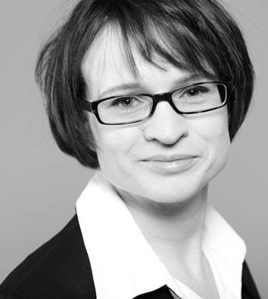
Contact - for questions and further information
Prof. Dr. Nele Graf
nele.graf@fham.de
Denise Gramß
denise.gramss@fham.de
Website: https://lekaf.de/
Twitter: @projekt_lekaf
University of Applied Management, Vulkanstr. 1, 10367 Berlin, Germany

