Slide 1
Tell it like it is: education and employer engagement; freelance and self- employment
Professor Prue Huddleston, University of Warwick
Dr Heidi Ashton, University of Leicester

Slide 2
Key Facts
Creative Industries worth £84.1 billion
£10 million per hour
Creative industries have grown by 25% since 2011 against the 12.1% growth rate for the UK overall.
The GVA for creative industries was £84.1 billion and £133.3 billion for the creative economy as a whole.
More than 15% of the total UK workforce is self employed (www.parliament.uk)
Cultural sector accounts for 8.8% of total UK labour market (DCMS, 2015)
2.6-2.8 million jobs – 1 in 12 (DCMS 2016)
Since 2008 the GVA of the creative industries has increased by 15.6% compared with 5.4% for the UK economy as a whole.
Notes:
Freelancers are a growing group of workers largely invisible (Banks + Hesmondhalgh)
Cultural industries are important for our economy
One of the few growth sectors during the last recession as we head towards another.
17.9 billion in exports in 2013. Hailed as a driver of growth.

Slide 3
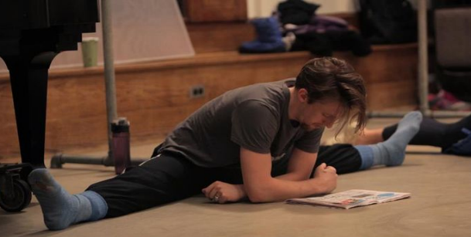
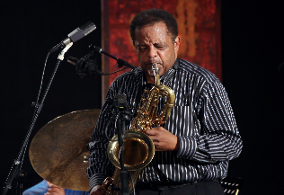
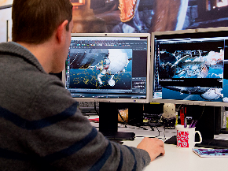
WHAT THE RESEARCH TELLS US
Notes:
Case study is about dancers but this is applicable, relevant and found in research across the sector.

Slide 4
QUALIFICATIONS – A DIFFERENT VALUE SYSTEM
“I found out that I had got a scholarship into Laines; I knew I was going to college before I started my GCSEs. So…I didn’t really try.”
“Often I found they [teachers] kind of didn’t like get it. Because it’s such a completely different type of thing, it’s a different kind of world almost. I remember.... you know, I suppose I was sixth form age, to do with whether I would need like UCAS points or things to be able to go on and I had to explain... it’s not quite like that, you know, you have an audition, it’s completely different.”
“I got quite good grades in my GCSEs they assumed I would be pushing more because all my family are pharmacists they thought I would push more for that side of things if I didn’t go into dancing, which they all thought I wouldn’t because they kept saying it’s a hard world, you won’t be good enough. Its like how do you know you have never seen me dance! They had never seen me dance. They were just thinking little girl from Hull, she is nowhere near London; it’s never going to work out for her. They just didn’t understand.”
Notes:
Lack of understanding in mainstream education.
Exams largely irrelevant
Problems with careers advisors not understanding the potential within the industry. No Need for formal qualifications.
Different skills required, auditions, portfolios etc. Link to other research
Employer engagement limited to experiences outside of school environment

Slide 5
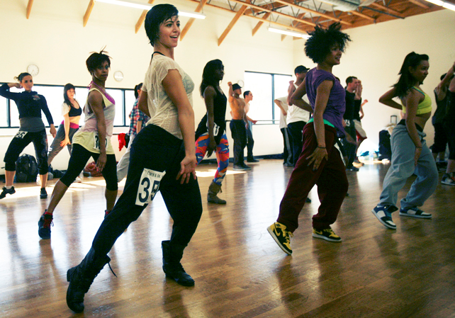
FREELANCING – WORKING TO GET WORK
Those working in the sector require a range of skill sets including:
Ability to present oneself and ones work in different ways (portfolios, auditions, showreels)
Commercial and sector awareness
Confidence and Networking
Team work
Creativity
Adaptability and versatility
“We adapt very, very quickly because we have to.”
Notes:
This is backed up through a range of studies in the sector more generally.
Examples from the case study.
Range of work engaged within and outside the sector, teaching, styling, working for agents, box office etc, promotional work, fitness and massage, photography, shop work etc.
Skills are both transferable and desirable

Slide 6
Importance of social networks and subcultures.
“I was always shocked at people’s lack lustre attitude to their future because I was so driven. And I think I almost felt alienated in that way because I couldn’t talk about my passions, not just because of what it was, but about anything that made your heart alive, you know. People didn’t seem to have that.”
“With dancers it’s like your own people, you have this underlying bond that’s unconditional because of what you are, what you know and what you do”.
“Oh I am definitely not a dancer because of the money; it doesn’t really give you much money at all! [Laughter] But there is so much more enjoyment out of…your career than the money. There is so much more to it than that. I am really proud, I am very proud to be a dancer.”
It always used to be the same circle of people getting work, and the people that are not getting work kind of just get left to the side or don’t really get noticed in any way. So I kind of just wanted to push myself as well, instead of getting disheartened and not carrying on (…) and I have gotten quite a lot of work.”
Notes:
Link to engagement being outside of school environment – for dancers subculture begins at school.
Use of social media to get work and engage with the industry (link to research in TV also)
Need for resilience

Slide 7
Different worlds?
Mismatch between requirements of the ‘prescribed’ curriculum and the requirements of this sector (Williams, Hillage et al, 2012, UKCES, 2014, Creative and Cultural Skills, 2015, Warwick Commission, 2016)
School assessment inimical to types of assessment required in the sector
Unwillingness to consider creative arts as ‘serious’ subjects – lack of ebacc recognition; teacher shortages;
‘Between 2003-2013 there has been a 50% drop in the GCSE numbers for Design and Technology and 23% for Drama. Between 2007-2013 there has been a 25% drop in other craft related GCSE’s’ (Warwick Commission)
Failure to recognise creative and cultural activities provide opportunities unavailable elsewhere in the curriculum and, for some, unavailable outside school (RSA, 2016)

Slide 8
Different worlds?
Lack of understanding of what is required within the sector and more widely: ‘There is no such thing as a career for life, particularly in this game, there is no straight path, life’s just not like that.’ ‘You need confidence to put yourself forward no matter what technical skills you may have.’ (Employers)
Outreach activities by creative and cultural enterprises make a significant contribution in helping young people develop creativity: ‘each year the Dance Track team goes into schools across Birmingham and delivers workshops to thousands of Year 1 children.....for those who show an enjoyment and aptitude for dance.’

Slide 9
Stepping out
Education should provide young people with a more realistic view of employment (15% self-employment)
Creative and cultural sector is a rich source of evidence and expertise, providing role models to which young people can relate
Education policy makers and professionals should recognise influences beyond school that shape young people’s identities and interests

Slide 10
Thank you
p.j.huddleston@warwick.ac.uk
hsa8@leicester.ac.uk

