Slide 1
‘Different pathways, diverse destinations’
Finding from three evaluations of careers provision for schools, colleges and universities.
Dr. Sean Richards
UCL IOE Post-14 Centre for Education and Work. June 2016.

Slide 2
Background & Context
In recent years serious concerns have been expressed by researchers and policy makers and employers over the quantity and quality of impartial and effective Careers Education Information Advice and Guidance (CEIAG) provided to young people in Schools Colleges and Universities.
This has led to new policy drivers from HM Government and Ofsted to improve CEIAG provision. Careers advisors organisations have also expressed concerns regarding the effects of funding cuts, rationalisation of local services and a lack of support for careers practitioners.
Dr. Sean Richards. UCL IOE Post-14 Centre for Education and Work

Slide 3
Careers Policy Reports & Responses
DBIS (2012) New Careers Service. Right Advice, Right Time.
Tooley et al (2014) Advancing Ambitions.
Gatsby Benchmarks, Matrix Foundation.
Ofsted (2014) Careers Guidance for Schools and Careers Guidance for Colleges.
Louise Archer. (2015) Aspires 2 Project. Kings College .
Education Sub-committee on Education, Skills and the Economy (2016)
The Sainsbury Report (2016) Programmes of Study

Slide 4
Research suggests young people need both broad generic and some specialist knowledge and skills to make successful transitions into work.
Young people need better understandings of the world of work through narrowing the distance between the world of work and education.
CEIAG needs to start early (primary school) and be a regular and integrated feature of young people’s programmes of study in schools and colleges.
A bewildering range of organisations have emerged to broker school - employer partnerships, providing work experience placements, employer talks, external workplace visits, employer-led workshops and a presence at traditional careers events and skills fairs.
Dr. Sean Richards. UCL IOE Post-14 Centre for Education and Work

Slide 5
The Careers Education Information Advice and Guidance Marketplace
Dr. Sean Richards. UCL IOE Post-14 Centre for Education and Work

Slide 6
Believe in Young people. Registered Charity.
2. National Careers Service Prospects Inspiration Agenda.
3. Access to HE. Prepare to Succeed. UCL IOE BAME Focus Groups.
Dr. Sean Richards. UCL IOE Post-14 Centre for Education and Work

Slide 7
Dr. Sean Richards. UCL IOE Post-14 Centre for Education and Work

Slide 8
Believe in Young people.
Developed a web-based portal for young people, teachers and employers.
Provide an end-to-end managed service .
Employer engagement via work experience placements.
Provision of CEIAG resources for teachers, including lesson plans.
Self-assessment of young people’s employability skills.
Collection of longitudinal data for measuring outcomes.
Dr. Sean Richards. UCL IOE Post-14 Centre for Education and Work

Slide 9
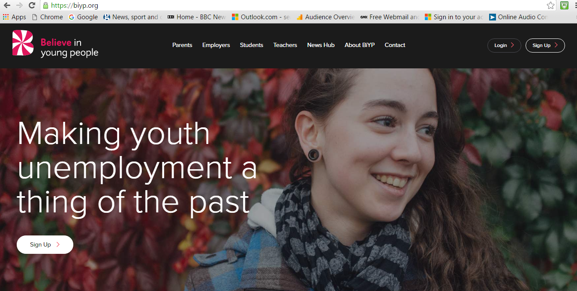
Dr. Sean Richards. UCL IOE Post-14 Centre for Education and Work

Slide 10
BIYB : Headline Achievements 2012 to 2015.
Improve skills and behaviours of young people by 32%
Delivered over 3,000 work experience placements .
Engaged = 513 schools and colleges
8 Major National Employers signed up in partnership
2,096 Local employer sites engaged in the first six months
Initial successes were in the Catering and Hospitality Sector, Costa, Hilton.
Employers assessed 63% of BiYP students as employable and work-ready
Supported the transition of over 1,700 young people into apprenticeships/jobs
Over 69,000 students work ready across all employer sectors
Dr. Sean Richards. UCL IOE Post-14 Centre for Education and Work

Slide 11
Believe in Young People Survey to establish how learners make careers decisions.
600 learners from Key Stage 3 and 4.
The survey was repeated with 1000 non-Believe in Young People students managed by Whitbread’s PR agency Lexis and the CBIA survey conducted with CBI, Whitbread and BiYP in 2015.
Key Findings;
The BiYP solution develops a higher quality talent pipeline.
36% of BiYP students considered management responsibilities as important – 19% higher than Non BiYP students.
29% were confident about making an informed careers decision – 9% higher than Non BiYP students.
Dr. Sean Richards. UCL IOE Post-14 Centre for Education and Work

Slide 12
54.62% responded that they are very likely to do a degree versus only 10.47% expressing a desire to progress onto apprenticeships or vocational learning.
30% of learners had not had careers advice from a careers professional.
60.25% preferred online advice compared to paper careers campaigns 14.96%,
BiYP students valued the guidance and advice given and their work experience by 5 to 10% higher than non-BiYP students. BiYP students valued the skills development gained on the programme 10% higher than non-BiYP students
BiYP students research their future career options much more frequently – weekly rather than monthly than non-BiYP students surveyed and show a keener interest in and make better preparations for their future careers.
Future Developments: extending reach. New Website due October. House of Lords soiree. UCL IOE research into programmes of study.
Dr. Sean Richards. UCL IOE Post-14 Centre for Education and Work

Slide 13
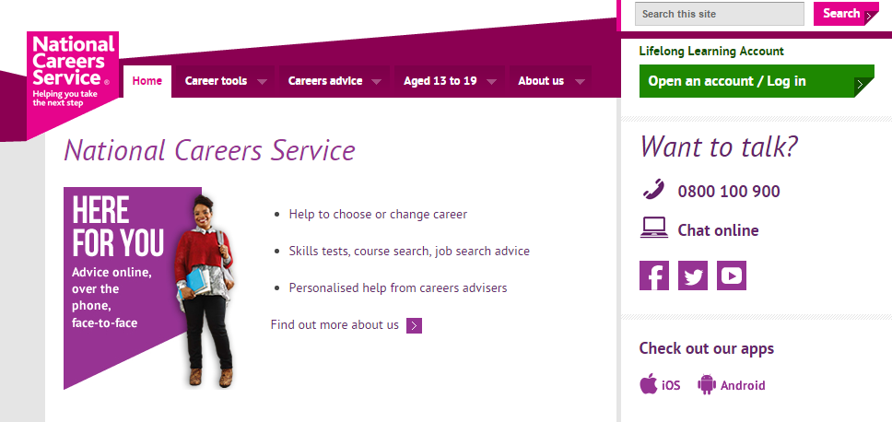
Dr. Sean Richards. UCL IOE Post-14 Centre for Education and Work

Slide 14
2. National Careers Service - Prospects Inspiration Agenda in London.
Employer engagement by brokering inspiring employer talks and activities with schools and colleges .
Provision of impartial CEIAG at Inspiration events and at major national and regional careers events and skills fairs.
Working in partnership with the London LEP, London Ambitions and the Careers and Enterprise Company’s Enterprise advisors.
Dr. Sean Richards. UCL IOE Post-14 Centre for Education and Work

Slide 18
Key Achievements : National Careers Service/Prospects Inspiration Agenda.
Engagement : Totals to March 31 2016
(National Careers Service Inspiration Agenda figures)
Total Number of young people engaged = 11,609
Total number of School / College Activities = 96 activities
School Activity targets exceeded with 200 schools and colleges engaged overall.
Employer Engagement target exceeded with 342 employers engaged overall.
Particular success with the Business and Finance and Construction sectors.
Dr. Sean Richards. UCL IOE Post-14 Centre for Education and Work

Slide 19
According to Archer et al (2015) ‘Aspires 2 Project’. ‘Less than two thirds of Year 11 students have received careers education. Less than half of all students have had work experience. And only 57 per cent of students are satisfied with the careers education that they have received’. (p.3.)
However if we look at an example of feedback collected from Yr. 12 students at one typical Inspiration Activity with a construction company, 92% of students reported gaining a better understanding of the world of work, 86% said they had gained a better understanding of job roles, 84% reported understanding more about the qualifications and skills needed by employers.
Feedback from Inspiration Agenda activities show that they do help young people to understanding modern recruitment practices through mock interviews and with activities and examples of work-based learning.
Dr. Sean Richards. UCL IOE Post-14 Centre for Education and Work

Slide 20
National Careers Service - Prospects Inspirations
The value of large careers fairs and skills events
Small targeted and more specialised events.
Link to STEM Event.
Work going forward. Videos on You Tube. Impacts. NEETS.
https://www.youtube.com/watch?v=NIrCc2D6TTQ&list=PLHDu0rwz9X6yGDh9wuGHwDcHKAvO8qTZ2
Dr. Sean Richards. UCL IOE Post-14 Centre for Education and Work

Slide 22
3. Access to HE (London Higher) Prepare to Succeed Project.
24 Focus Groups were conducted at 8 London universities with 200 1st and 2nd year undergraduate students from Black and Minority Ethic (BAME) backgrounds.
LSB. LSE. UCL. Greenwich. Kingston. GSM. RVC. St Mary’s.
Respondents were undergraduate 1st and 2nd years from a large sample of courses We discussed their experiences at university so far and the influences on their career choices and outcomes since leaving secondary school.
Dr. Sean Richards. UCL IOE Post-14 Centre for Education and Work

Slide 23
The topics discussed in the focus groups were:
•The extent of CEIAG received pre - HE and by whom
•The influences of formal and informal sources for CEIAG
•How subjects were chosen and when
•Expectations of HE study and the realities
•Level of preparation for HE study
•Key features of HE study
•What would it have been important to know pre HE, that could help make options and pathways clearer and career decisions easier to manage?
Dr. Sean Richards. UCL IOE Post-14 Centre for Education and Work

Slide 24
Key Findings : Prepare to Succeed (BAME) Focus Groups.
There are widely different pathways into and through HE. The experiences and the routes to HE are very different for Home versus International Students and between young university leavers and older students.
individual stories provide a richer set of contextual relevance in terms of perceived options and other influences upon career decisions.
All learners reported undertaking their own careers research - mostly online.
Many learners reported benefiting from flexible WP schemes, including pre-HE Access and Foundation courses.
Careers advisors don't feature as highly as peers, and family and friends (some of whom are employers) and course tutors for signposting learners into careers.
Dr. Sean Richards. UCL IOE Post-14 Centre for Education and Work

Slide 25
Student progression choices into HE after A levels are highly constrained by their grades, so resits and gap years form part of the picture of the sometimes messy progression - post A levels.
Pragmatic choices are made when choosing a university based on the availability of the course at certain institutions, some students travelled up to four hours a day to university because it was the only institution that provided the course that met their employment needs and which they were eligible to join.
Flexibility of attendance and modes of study and access to on-line support and resources offered a variety of ways to study working around other commitments.
Dr. Sean Richards. UCL IOE Post-14 Centre for Education and Work

Slide 26
For students with family and support sources locally, there were benefits of short journey times, going to university locally saved money, in some cases, but accommodation costs were a burden, and were often funded by significant part-time work hours alongside their studies.
Some of the students reported that there was no or not enough work experience included on their courses.
In relation to employer engagement. At course level some very close links with employers, vetinary sciences, medicine, engineering and STEM and with the creative and cultural industries, arts & textiles, and interior design.
https://www.youtube.com/watch?v=pJs5vrpfce0
Dr. Sean Richards. UCL IOE Post-14 Centre for Education and Work

Slide 27
WORKING LEARNERS and Learning Workers
FE and HE learners are on the whole learning whilst earning.
For many learners, learning is both practical and aspirational, it is part of an effort towards and an investment in their futures towards a better life.
For some learners their part-time learning and earning are closely related, but for many, particularly younger and less qualified learners, part time jobs do not always align with their aspirations, but the work-based skills and experience they gain places them well ahead of the competition.
The need for Double - Loop CEIAG.
Learners therefore need good CEIAG to develop in employment and good CEIAG guiding their aspirations for future learning and professional work.
Dr. Sean Richards. UCL IOE Post-14 Centre for Education and Work

Slide 28
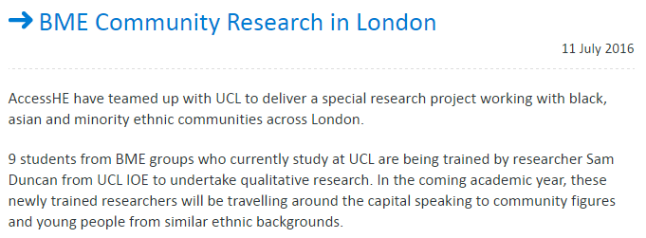
Dr. Sean Richards. UCL IOE Post-14 Centre for Education and Work

Slide 29
Challenges for improving CEIAG 14 – 19 Provision.
Promoting Apprentiships and vocational routes in schools at a time when many schools (and parents) prioritise academic ambitions
Extending and strengthening College-Employer Partnerships in the light of local area reviews and mergers
Preparation of learners before and debriefings and evaluation of impacts after, CEIAG and employer events are as important as the quality and quantity of provision.
Dr. Sean Richards. UCL IOE. Post-14 Centre for Education and Work

Slide 30
Challenges for improving CEIAG 14 – 19 Provision
Policy stability and responding to learner- worker voices
Consideration of alignment between employment and learning
Integration of work experience placements within learners’ Study Programmes.
Overcoming low or unrealistic aspirations
More robust longitudinal data to measure the longer term impacts of Careers and Employer Engagement initiatives and innovations.
Dr. Sean Richards. UCL IOE. Post-14 Centre for Education and Work

