Slide 1

A systematic review of current understandings of employability
Stella Williams

Slide 2
Overview of talk
What led to this research
Aims of the research
Methodological approach
Results
Concluding points

Slide 3




Knowing who is in the room
Your paper is part of the systematic review.
Employability is not a new area for you, but you haven’t seen this research yet.
You have read the paper.
Left standing – Employability is a new area of interest to you.

Slide 4
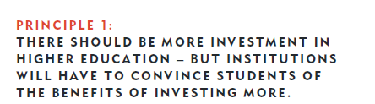
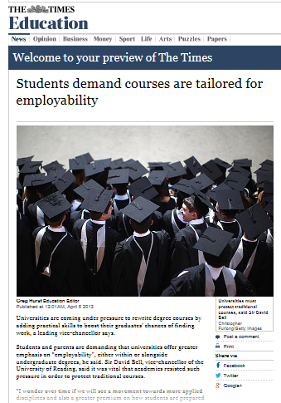
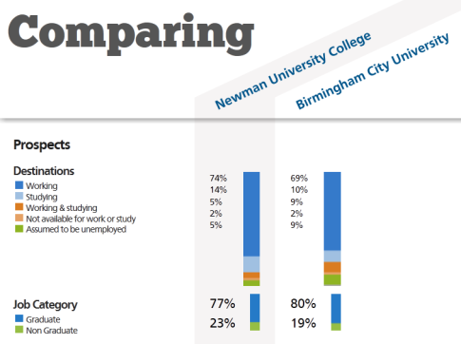
Background
My context:
Evaluating employability award
Discussions of employability enhancement linked to my modules
Wider context:
Terms meaning has evolved
Destinations of Leavers from Higher Education (DLHE) survey, inadequate
Assessment requires theoretical basis
Without assessment how do we know interventions work?

Slide 5

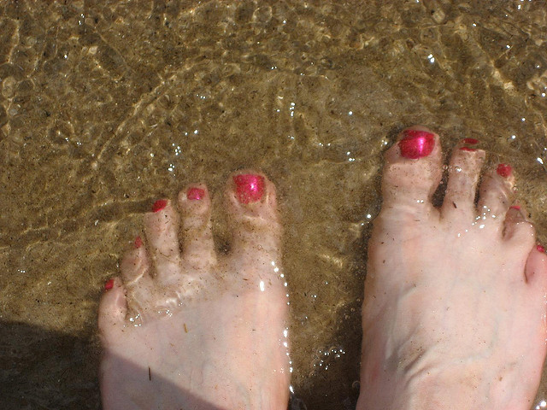
The aim of this research
Part of a bigger project
Identifying existing conceptualisations
Identifying consistencies and inconsistencies
Identifying what is missing from this work

Slide 6
Methodology
Carving out a manageable task
Avoiding personal assumptions or bias
Varying empirical and theoretical quality
Papers published between 1960-2014
Inclusion criteria:
(1) produced in the English language
(2) aimed to provide a holistic conceptualisation of employability
(3) concerned the development of an individual’s employability
Combined via a content analytical approach, into an interpretive synthesis to inform future developments.

Slide 7
Interpretative synthesis
Thijssen Van der Heijden & Rocco (2008) The Three Conceptual Components
Three categories:
Capital
Contextual conditions
Employability Radius
Employability competencies
Career management
Contextual components

Slide 8
Capital
‘’Anything an individual possesses that can be seen as leading to an increased probability of positive economic outcomes, or other personal outcomes relating to the area of work.’’ (Williams et al. 2015, p.11)
Elicit demand OR functionality
Human, Social, Cultural, and Psychological

Slide 9

Human Capital
Arthur, Claman, and DeFillippi (1995)
Knowing how
Hillage and Pollard (1998)
Baseline – basic and essential
Intermediate – occupationally specific
High skills- organisational performance
Knight and Yorke (2003)
Skills and understanding
Role of expertise, transition, tactic or practical intelligence
Areas of gain
Harvey, Locke, and Morey (2002) degree, extra curricular experience
Dacre Pool and Sewell (2007) work and life experience

Slide 10

Social capital
Bourdieu (2008) ‘’social obligations or connections seen as convertible to economic gain.’’ (p.12)
Arthur et al. (1995) Knowing whom
Fugate, Kinicki, and Ashforth (2004) Social capital

Slide 11

Cultural capital
‘Fit between the employers ideas, customs and social behaviours and those of the potential employees.’ (Williams et al. 2015, p.13)
Explain some of the value of a degree?
Impact of labour market position?
Van Der Heijde and Van Der Heijden (2006)- balance
Hogan, Chamorro-Premuzic, and Kaise (2013) – socially desirable behaviour

Slide 12


Psychological capital
Luthans (2002) ‘positively oriented human resource strengths and psychological capabilities that can be measured, developed, and effectively managed for performance improvement in today’s workplace.’ (Luthan, 2002, p. 59)
Optimal performance
developed

Slide 13
More than capital
Can do the job
Social fit
Know the right people
Can do it well
Selection and recruitment gateway

Slide 14
Career Management
‘‘An individual’s competence in navigating the labour market in order to achieve their personal career goals through access to relevant training and employment opportunities.’’ (Williams et al. 2015, p.16)
Signal management
Self management

Slide 15


Career management
Signal management
Self-management
Spence (1973) Signalling theory
Having the correct signals
Knowing the correct signals
Communicating the correct signals
Bridgstock (2009) ‘individuals perception and appraisal of themselves in terms of values, abilities, interests and goals.’ (p.37)
Hillage and Pollard (1998) – deployment – awareness of their capital
Harvey et al. (2002) - self reflection
Knight and Yorke (2004)– metacognition
Dacre Pool and Sewell (2007) – reflection and evaluation
Fugate et al. (2004) –Career identity ‘goals, hopes, fears, personality, values, beliefs, norms etc.
About an accurate assessment of what have, can get, and what want.

Slide 16
More than capital and career management
Can do the job
Awareness of what done, who are, and what want
Social fit
Possess the right signals
Know the right people
Can do it well
Are asked for the right signals
Context in which this occurs
Appropriately present the right signals

Slide 17
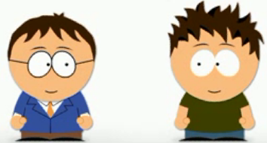
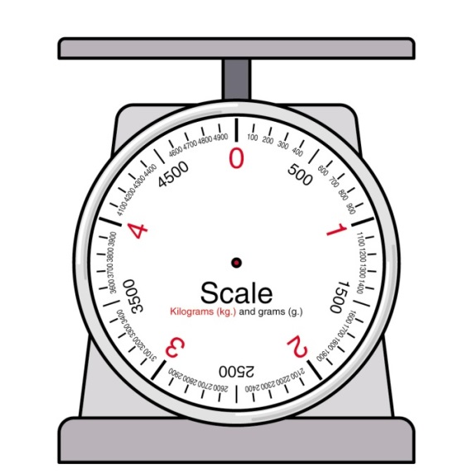
Contextual Components
Brown, Hesketh, & Wiliams (2003) Positional conflict theory
de Grip, van Loo, & Sanders, (2004) Taxonomy of developments leading to changing demands
Other contributors
Hillage and Pollard (1998) personal circumstances
McQuaid and Lindsay (2005) access to opportunities
Thijssen et al. (2008) broadening and transition conditions

Slide 18
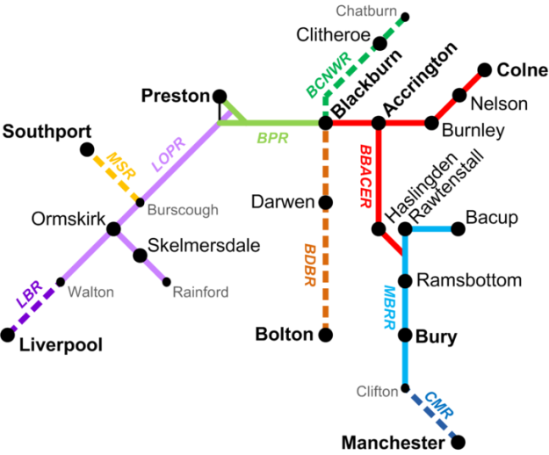
Concluding points
This research offers:
A road map
Justification for widening the field of investigation
…selection and recruitment practices: context, career management models
… self-theories, self efficacy theory
… boundariless career and protean career/personality
… demographic component (in and out groups), social identity perspective
… identity and orientation models
… transitional learning, expertise, practical intelligence
Explanation for differences in employability outcomes?
Identification of intervention directions within and outside of HE

Slide 19
Thank you for Listening

Slide 20
References
Arthur, M. B., Claman, P. H., & DeFillippi, R. J. (1995). Intelligent enterprise, intelligent careers. Academy of Management Executive, 9(4), 13.
Bourdieu, P. (2008). 15 The Forms of Capital. Readings in economic sociology, 4, 280.
Bridgstock, R. (2009). The graduate attributes we’ve overlooked: Enhancing graduate employability through career management skills. Higher Education Research & Development, 28(1), 31-44.
Brown, P., Hesketh, A., & Wiliams, S. (2003). Employability in a knowledge-driven economy. Journal of education and work, 16(2), 107-126.
Dacre Pool, L. D., & Sewell, P. (2007). The key to employability: developing a practical model of graduate employability. Education+ Training, 49(4), 277-289.
de Grip, A. J., van Loo, J., & Sanders, J. (2004). The Industry Employability Index: Taking account of supply and demand characteristics. International Labour Review, 143(3), 211 -233.
Forrier, A., & Sels, L. (2003). The concept employability: A complex mosaic. International journal of human resources development and management, 3(2), 102-124.
Fugate, M., Kinicki, A. J., & Ashforth, B. E. (2004). Employability: A psycho-social construct, its dimensions, and applications. Journal of Vocational behavior, 65(1), 14-38.
Harvey, L., Locke, W., & Morey, A. (2002). Enhancing employability, recognising diversity: making links between higher education and the world of work.
Hillage, J., & Pollard, E. (1998). Employability: developing a framework for policy analysis. Labour Market Trends, 107, 83-84.
Hogan, R., Chamorro‐Premuzic, T., & Kaiser, R. B. (2013). Employability and career success: Bridging the gap between theory and reality. Industrial and Organizational Psychology, 6(1), 3-16.
Luthans, F. (2002). Positive organizational behavior. Developing and managing psychological strengths. Academy of Management Executive, 16(1), 57-72.
Kluytmans, F., & Ott, M. (1999). Management of employability in the Netherlands. European Journal of Work and Organizational Psychology, 8(2), 261-272.
Knight, P. T., & Yorke, M. (2003). Employability and good learning in higher education. Teaching in Higher Education, 8(1), 3-16.
McQuaid, R. W., & Lindsay, C. (2005). The concept of employability. Urban studies, 42(2), 197-219.
Spence, M. (1973). Job market signaling. The quarterly journal of Economics, 87(3), 355-374.
Thijssen, J. G., Van der Heijden, B. I., & Rocco, T. S. (2008). Toward the employability—link model: current employment transition to future employment perspectives. Human Resource Development Review, 7(2), 165-183.
Van Der Heijde, C. M., & Van Der Heijden, B. I. (2006). A competence‐based and multidimensional operationalization and measurement of employability. Human resource management, 45(3), 449-476.
Williams, S., Dodd, L., Steele, C, Randall, R. (2015). A systematic review of current understandings of employability, Journal of Education and Work, Published electronically, DOI: 10.1080/13639080.2015.1102210

