Slide 1
Overview
Inspiring the Future since its launch in 2012
Successes and lessons learnt over the last 4 years
Questions

Slide 2
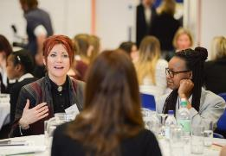
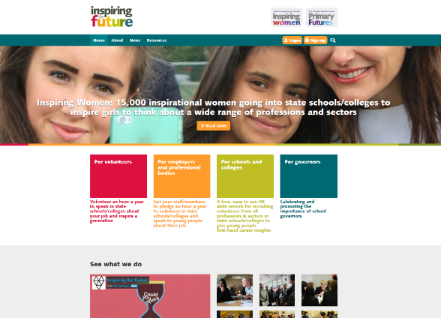
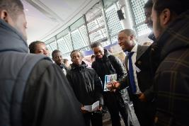
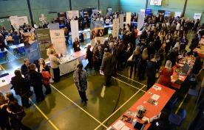
What is Inspiring the Future?

Slide 3
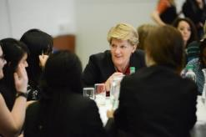
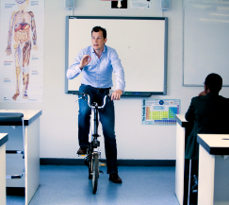
Specialisms | Activities
Apprenticeships | Career Insights
Design and Manufacturing | Help with CVs
Enterprise/Entrepreneurs | Mock Interviews
Financial Literacy | Numeracy relating to careers (Primary)
Maths – Using it at work | Reading relating to careers (Primary)
Science and Technology | Being contacted about becoming a school governor
Languages – French, German, Italian, Spanish, Russian, Mandarin, Japanese, Urdu, Arabic

Slide 4
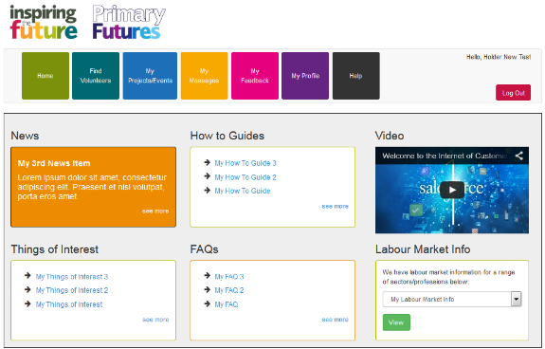
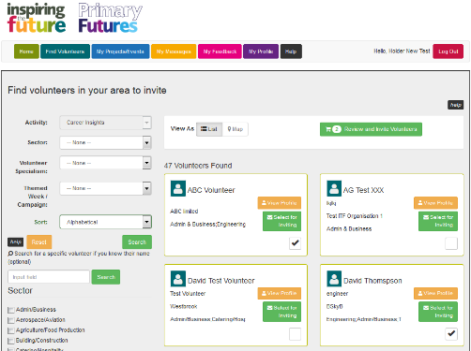
Inspiring the Future

Slide 5
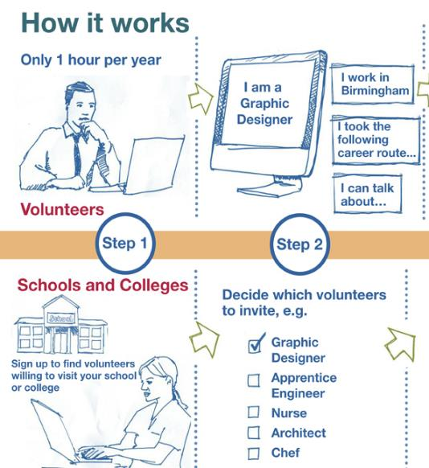
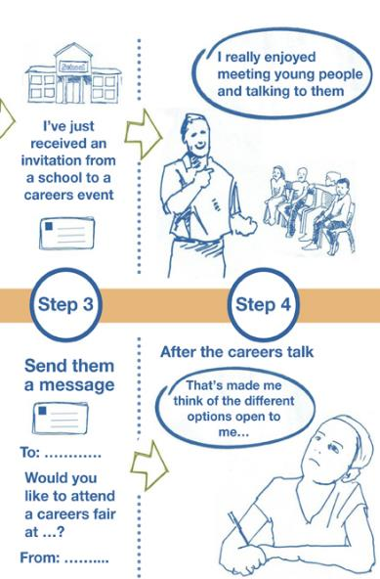

Slide 6
Growth over the 4 years of Inspiring the Future
 | Year 1 (Aug 12 – July 13) | Year 2 (Aug 13 – July 14) | Year 3 (Aug 14 – July 15) | Year 4 (Aug 15 – July 16)
Volunteers | 5,521 | 14,977 | 23,297 | 30,046
Teachers | 2,930 | 5,888 | 8,496 | 10,176
Invites Sent | 5,599 | 36,141 | 93,115 | 134,379
Primary - 2,314
Middle Schools - 2,569
Secondary - 397
Colleges - 75

Slide 7
Inspiring the Future
Technology
Schools
Volunteers
Campaigns

Slide 8
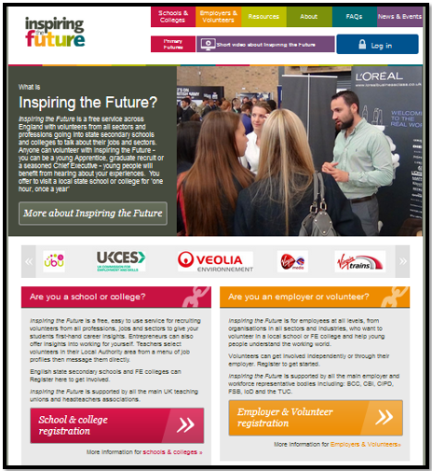
Year 1 – July 2012 – July 2013
Original Website
 | Year 1 - (Aug 12 – July 13)
Volunteers | 5,521
Teachers | 2,930
Invites Sent | 5,599
Very basic pilot website
Limited functionality
Limited reporting
Relatively low numbers – supply was not meeting demand. Not yet critical mass
Lack of funding, small staff base
Latent enthusiasm

Slide 9
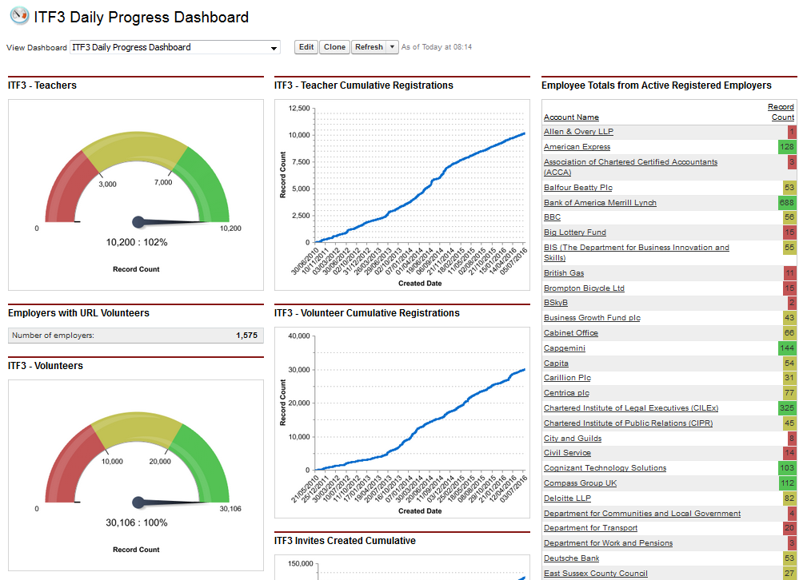

Slide 10
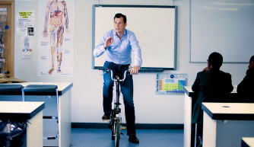
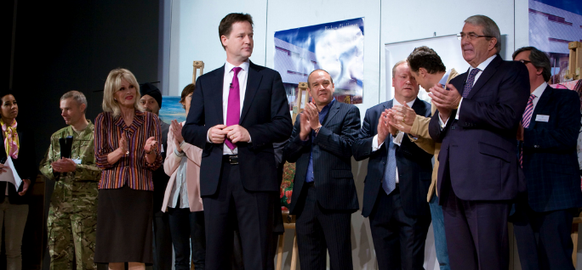
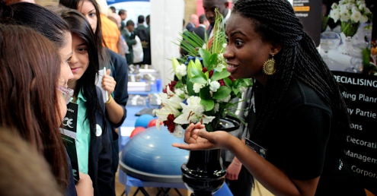
Year 1 – July 2012 – July 2013

Slide 11
Technology
Year 1
Basic Website Launch – Salesforce/Visualforce
Proof of Concept
Year 2
Funding Identified for Improvements
Year 3
Year 4
Lessons Learnt for Improvement
Feedback from Stakeholders – limitations of current system
More robust system needed to sustain traffic and growth
New website launched in January 2015
Different stakeholders with different requirements
New website designed and scoped
Feedback received July 15.
Further improvements identified:
Employer pages, Mapping and governor recruitment
Further improvements funded
Employer pages scoped and launched
Mapping project with partnership with Ordnance Survey
Governor recruitment sign up and search pages researched, scoped, tested and launched for 15/16 school year

Slide 12
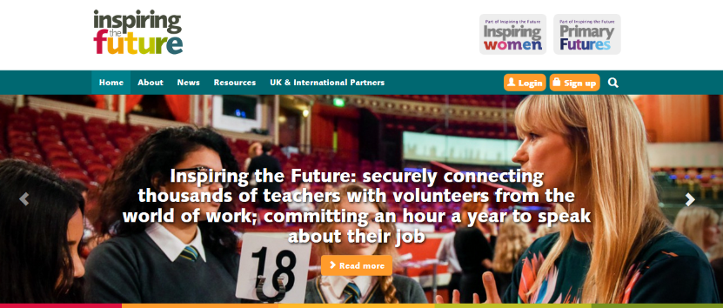
Inspiring the Future

Slide 13
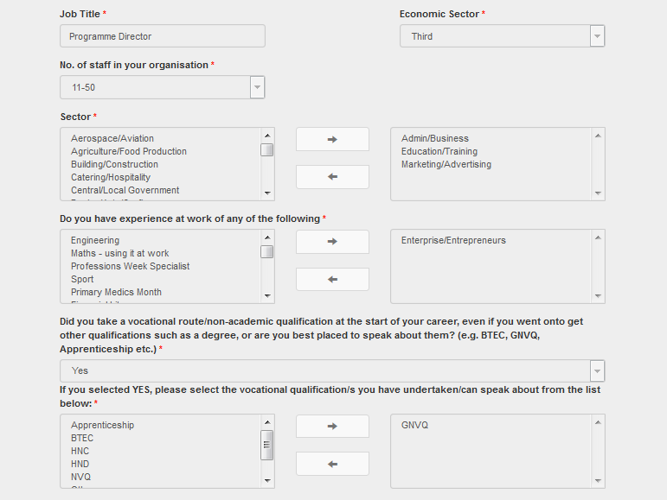
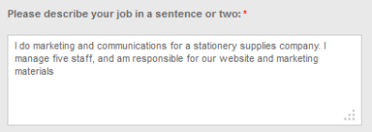
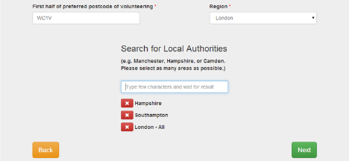
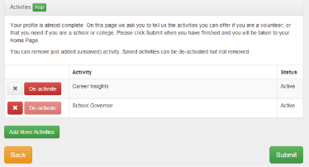
Signing up is quick and easy
Add different specialisms
Tell schools a little bit about your job and qualifications
Add different locations where you can volunteer in
Select different activities you could help with

Slide 14
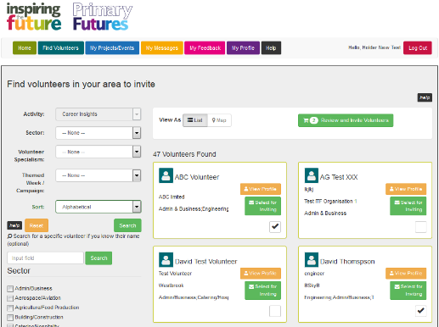
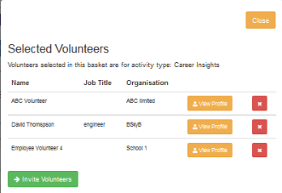
Inspiring the Future

Slide 15
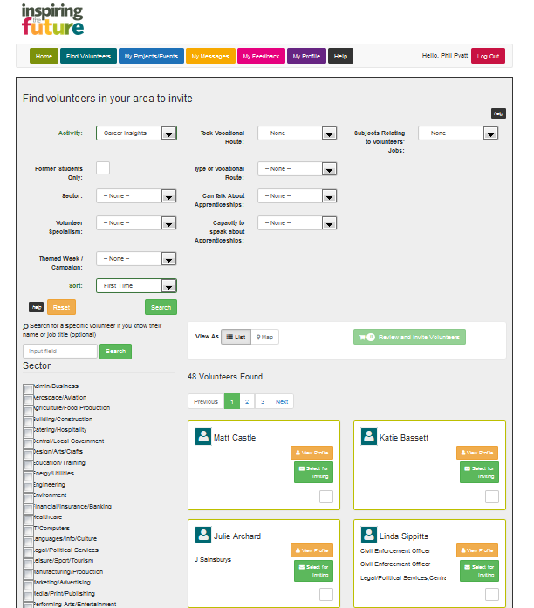
Viewing potential matches

Slide 16
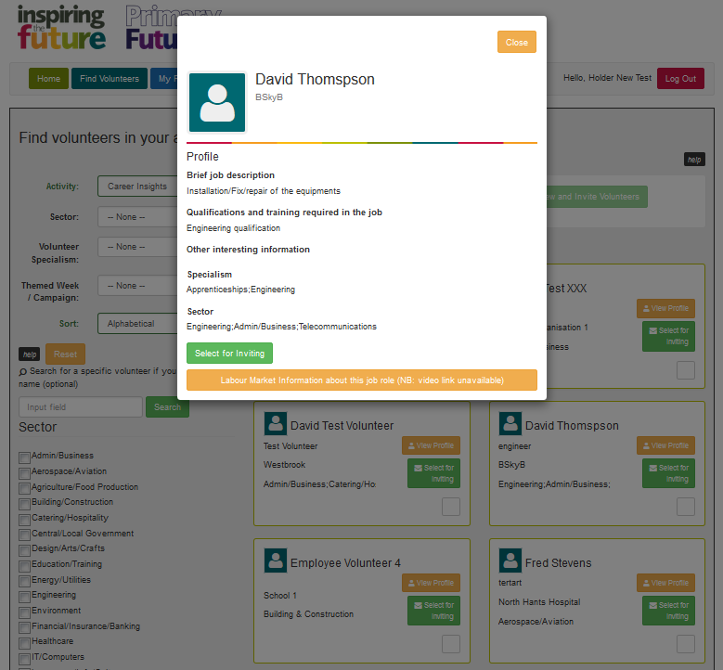
Viewing a Volunteers Full Profile
‘Volunteer Profiles’ – by clicking
you can view a more detailed profile of the selected volunteer. If you would like to add them to the invite list simply click and they will be added to your volunteer bucket. If you do not want to add them simply click
and continue your search.
Notes:
There is now compelling evidence that where young people gain insights into the world of work whilst at school, they can expect to do better in their later working lives
Analysis published in 2013, ‘Wage Premia, NEET outcomes and career confidence’ by Percy & Mann shows that the greater number of times young people come into contact with employers, the less likely they are to be NEET and the more they are likely to earn than comparable peers. And the effects are striking: wage premiums of up to 18% are found
It is becoming clear that a great many young people have a very limited understanding of the range of jobs that might suit their interests. In the UK, we have a number of longitudinal studies which follow young people from birth into adulthood and we now know from these studies that teenagers who were confused or unrealistic about their career aspirations at 16 are significantly less likely to do as well as peers after they leave education
A recent study of occupational preferences of 11,000+ young people by age group, Nothing in Common: The career aspirations of young Britons mapped against labour market demand (2010-2020) by EET/UKCES illustrated the low levels of teenage interest in building disciplines:

Slide 17
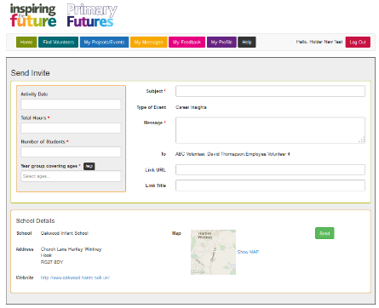
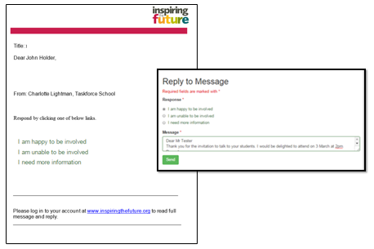
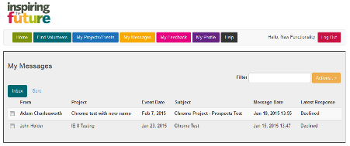
Inspiring the Future
Volunteers rely through the email

Slide 18
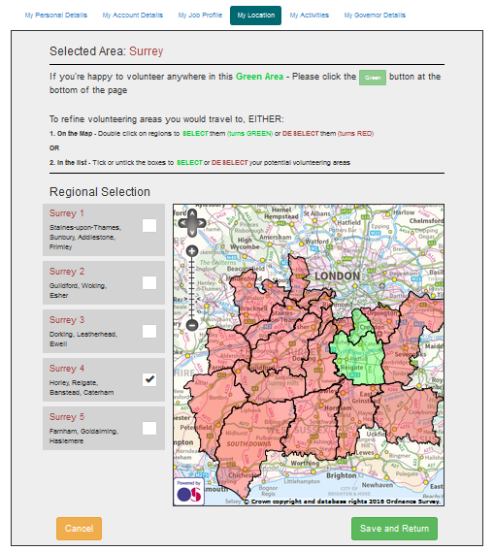
Year 4 – August 2015 – July 2016
Launch of Mapping

Slide 19
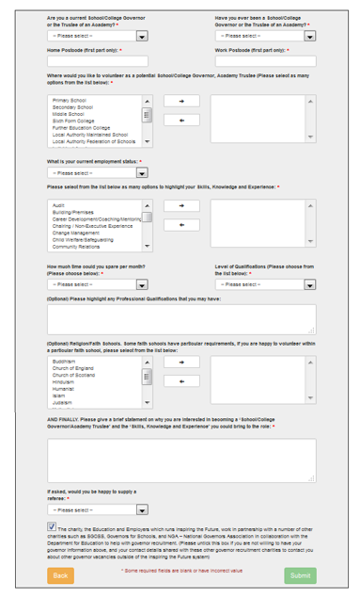
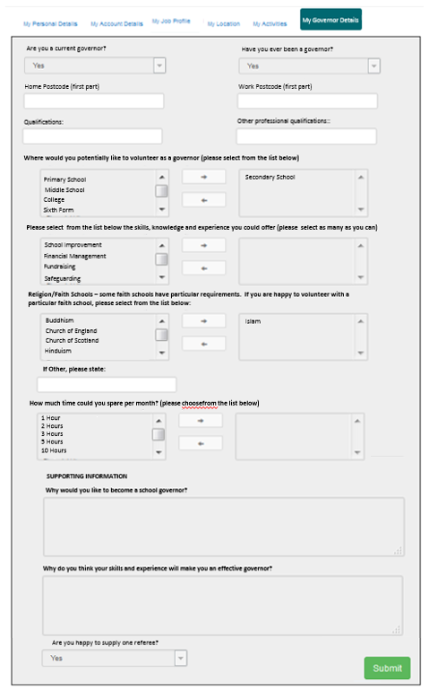
Governor Form - Volunteer Profile

Slide 20
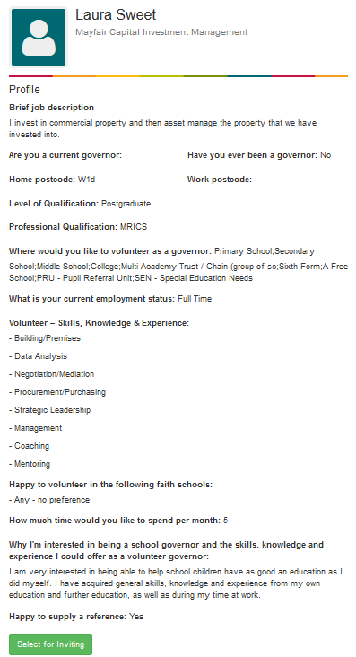
New Governor Volunteer Profiles
Volunteer Profile is slightly different when ‘Governor’ is selected as the search criteria
Will show more information from the new governor profile information

Slide 21
Employers
Year 1
Basic Website
Year 2
Year 3
Year 4
Additional functionality of new website, better reporting
Employer pages launched
Proof of Concept
Lessons Learnt for Improvement
Trying to reach ‘critical mass’
High profile support
Reaching out to new organisations!
Strategic use of resources, targeting the right people
Project delivery, eg NHS, Apprenticeships
Ability to focus on organisations
Relationship building. Sometimes it takes 2 years.
Intensive- no ‘silver bullet’
Events, eg Your Life
Corporate relationships, Bank of America Merrill Lynch, Sainsbury’s

Slide 22
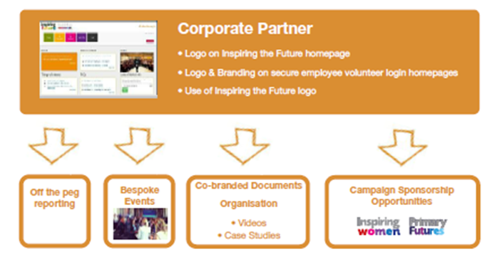
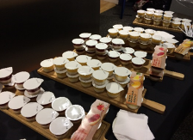
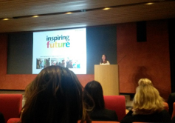
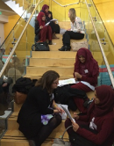

Slide 23
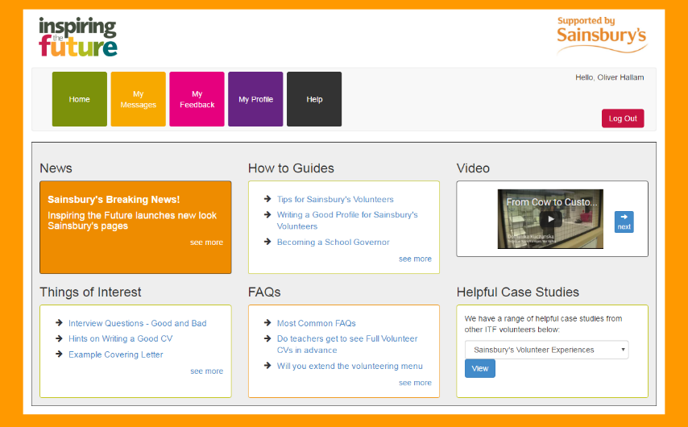

Slide 24
Benefits for Employers/Professional Bodies
Free secure service that makes it easy to engage with state schools and colleges by matching employee volunteers
Communicating with young people offers excellent personal development opportunities for employees
An effective means of supporting corporate social responsibility and long-term recruitment objectives
A gateway to working with schools and colleges, across a wide range of activities that support learning and progression
Free reports for employers through dedicated registration links, and professional bodies through membership indicators
Opportunity for a bespoke platform, supporting volunteers and maintaining brand integrity in schools
"I just thought I would drop you a note about the careers fair today. It was a great event where
young people were given the opportunity to explore ALL the different options open to them
when they leave school. The young people I met were really engaged and I really enjoyed
assisting them on widening their horizons". Volunteer PwC

Slide 25
Schools
Year 1
ITF launched in secondary schools and colleges in England.
Year 2
Partnership established with the NAHT and ASCL
Year 3
Year 4
PF launches – reading/numbers added as an activity
Inspiring Governors pilot launched – governors activity added
Promoted out widely using different networks
Staff recruited within those organisations to promote ITF
IW launched, schools encouraged to undertake specific events
CV/Interview practice added as an activity
Design and Build week (themed weeks established)
Volunteers able to select their old school for volunteering
Reach out to more partners – work with teach first on guidance
More guidance needed for schools
More targeted campaigns
Start work on targeted projects on apprenticeships, NHS and various corporate partners
Expansion to Scotland, Wales, Northern Ireland and Isle of Man

Slide 26
OUR CAMPAIGNS
Inspiring Women launched in 2013
Primary Futures launched in 2014
Additional campaigns and themed weeks launched on a rolling basis

Slide 27
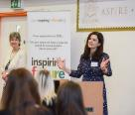
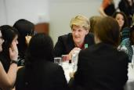
Inspiring the Future: Inspiring Women Campaign
Launched October 2013
Follow the Inspiring Women blog: www.itfinspiringwomen.wordpress.com

Slide 28
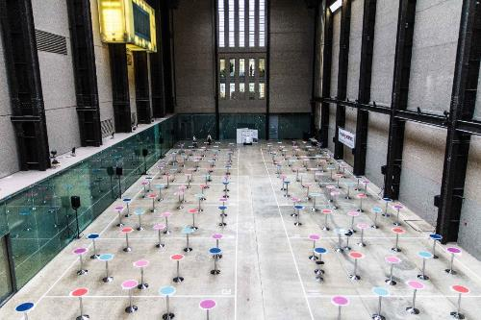
Recruited 20,000 volunteers
Useful for employers’
gender diversity strategies
High-profile events showing
women working across different
sectors, including arts, defence,
fashion, sport, engineering, design, coding, business and enterprise
Support schools to run events challenging gender stereotypes

Slide 29
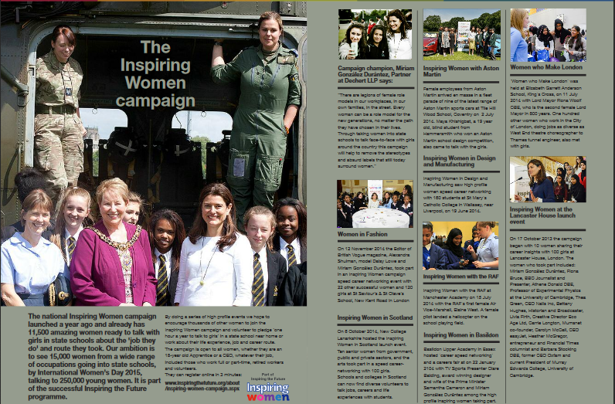
Year 2 – August 2013 – July 2014

Slide 30
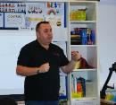
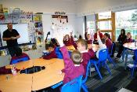
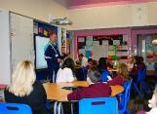
Inspiring the Future: Primary Futures
Primary school project working under the banner of 'Inspiring the Future'
Innovative approaches which allows primary schools to easily engage volunteers to work with primary aged children, run in partnership with the NAHT
Volunteers can talk about their current job and why reading and numeracy in their primary school days were so important in achieving their current status
"We need to give our children and young people a vision of the opportunities available to them, so that they understand the value of learning and in doing so raise aspirations. It is never too soon to start this. We also need better connections between schools and the communities and businesses they work with. “
Russell Hobby, NAHT General Secretary

Slide 31
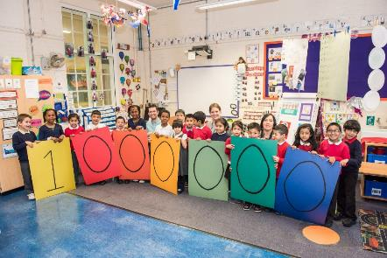
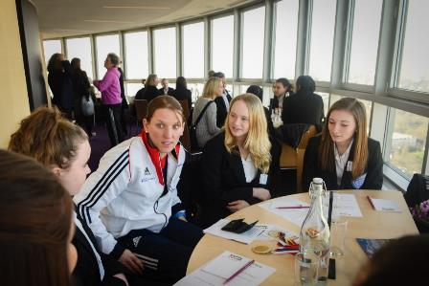
Additional campaigns and themed weeks
Coastal Towns
Inspiring Languages
Inspiring Women in Sport
Apprenticeships
Designed and Made

Slide 32
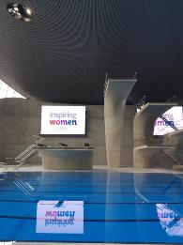
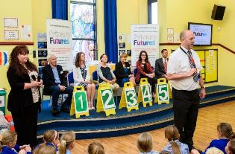
Things to consider
Balance of supply and demand from schools and volunteers
Ensuring spread of activity by geographical region and by sector
New ways to present the events and activities, to ensure maximum media and communications potential

Slide 33
Survey Results

Slide 34
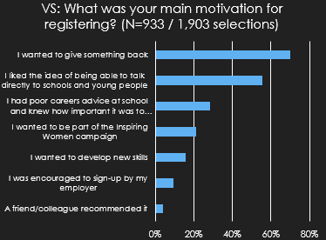
Volunteer Responses

Slide 35
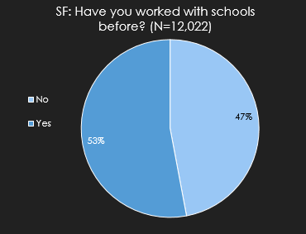
Volunteer Responses

Slide 36
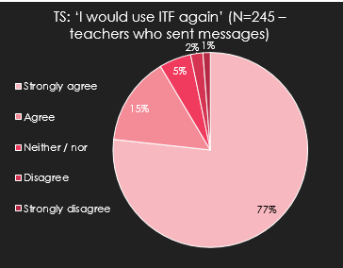
Impact on teachers & volunteers

Slide 37
ITF – Rating by teachers & volunteers

Slide 38
Example of some of the Employers and Professional bodies signed up

Slide 39
Key Contacts
For any queries please contact:
Department | Name | Job Title | Email Address | Telephone Number
Inspiring the Future Director | Phil Pyatt | Director – Inspiring the Future | phil.pyatt@educationandemployers.org | 0207 566 4880
Employer Engagement | Oliver Hallam | Business Development Manager | oliver.hallam@educationandemployers.org | 0207 566 4881
Inspiring Women Campaign | Gabriella Oakley | Inspiring Women Engagement Manager | gabriella.oakley@educationandemployers.org | 07703 734840
Schools Team | Charlotte Lightman | Schools Liaison Manager | charlotte.lightman@educationandemployers.org | 0207 566 4880
General Enquiries |  |  | enquiries@inspiringthefuture.org | 0207 566 4880

