Slide 1
Chris Percy, Independent Researcher Elnaz T. Kashefpakdel, Education and Employers Research
What makes a career talk sing:
Under what school delivery circumstances or student attitudinal contexts are career talks associated with optimal, long-term wage outcomes?

Slide 2
The 1970 British Cohort Study provides a large, robust longitudinal dataset to explore pathways to labour market
Survey background
Survey attrition rate
Follows ~17,000 born in England, Scotland and Wales in a single week of 1970
Data is available at Birth, age 5, 10, 16, 26, 30, 34, 38 and 42
Data for background variables from birth 16
Labour market outcome data at age 26

Slide 3
Outcome variable: Wage for full-time employed at age 26
Full-time weekly income in 1996 (age 26) [nominal £]

Slide 4
Distribution of selected careers activity during 1986

Slide 5
Each career talk with external speakers linked to +0.8% wage
Year 10 Career Talks with External Speakers
Control variables (Bold = In regression)
Regression Results
Academic ability
Teacher assessment of academic ability at 16
Maths - CSE/O-level results
Highest level of qualification at 26
Cognitive assessment age 5 (hum. fig. drawing)
Number of talks at year 10 vs. Ln Wage at age 26
Co-eff: 0.008 [0.001 p-value]
R² 24%
N 784 (outliers excluded)
Socio-economic status
Father socio-economic status
Mother socio-economic status
In receipt of council housing (or benefits)
Benefits received from government
Early home learning environment
Frequency of parents reading to child age 5
Mother’s interest in child’s education age 5
Amount of TV watched age 10
Demo-graphics
Gender
Whether has a UK parent
Local labour market
LEA economic activity rate

Slide 6
Individuals who found career talks very helpful display a stronger wage premium
Perceived usefulness of career talks
Did you find the careers talks useful?
Regression, Career talks coefficient
Model | Did not find helpful | Found very helpful
Yr 10 – With Controls | 0.9% N = 90 | 1.6%** N = 130
Yr 11 – With Controls | 0.2% N = 266 | 0.9%** N=274
* Sig at 10%; ** Sig. at 5%

Slide 7
Conclusions: What can we learn by applying the same analysis to different in-school careers activities?
Is it information content in the speech that matters or the person delivering it?
# Timetabled internal career classes
✗
# Careers chats with school staff
✗
# Other school times careers discussed
≈
# Careers talks with external speakers
✓
EVIDENCE-INFORMED HYPOTHESIS

Slide 8
But are activities really separable? Career talks with internal or external speakers reflect staff efforts within same school culture
Intensity index: Internal school careers culture
Affects how useful external speakers are felt to be
For careers classes or other times careers were discussed, in either year 10 or 11:
> 30 → + 5
> 20 → + 4
> 10 → + 3
> 3 → + 2
> 0 → + 1
+1 for each of careers teacher, form tutor, year head or other teacher whom you saw to discuss your future
+1 if you had a careers officer interview
= Max of 25 possible points
 | Intensity Index*
 | 0-5 | 6+
Very Helpful | 42% | 58%
Quite Helpful | 45% | 55%
Not Very Helpful | 54% | 46%
Not at all Helpful | 63% | 37%
* Approx. split top/bottom half of n=4,834 respondents
Ordinal regression, control number of external speaker careers talks → remains stat. sig.

Slide 9
Conclusions: Why does it matter that these are not separate activities?
Is it information content in the speech that matters or the person delivering it?
# Timetabled internal career classes
✗
# Careers chats with school staff
✗
# Other school times careers discussed
≈
# Careers talks with external speakers
✓
Do external speakers add more value in a school environment that is rich in internal careers activity?
Student perspective on utility
✓
EVIDENCE-INFORMED HYPOTHESIS
Yr 10 wage premium if also had careers adviser interview / Yr 10 internal activity?
≈
0.1%pt increase but also more consistent

Slide 10
Conclusions: What about student attitude?
Is it information content in the speech that matters or the person delivering it?
# Timetabled internal career classes
✗
# Careers chats with school staff
✗
# Other school times careers discussed
≈
# Careers talks with external speakers
✓
Do external speakers add more value in a school environment that is rich in internal careers activity?
Student perspective on utility
✓
EVIDENCE-INFORMED HYPOTHESIS
Yr 10 wage premium if also had careers adviser interview / Yr 10 internal activity?
≈
0.1%pt increase but also more consistent
“Jobs are hard to get” (4-point scale)
✓
Itself has 6% on wage;
CTs ≈ link to confidence
How do student attitudes inter-relate with the wage premium of careers talks with yr 10 external speakers?
(we can’t explore before / after talk effect)
“Possible to get job if really determined”
✓
CTs → agree (≈) ; Don‘t fully agree → No premia
“There is an actual job I want to do”
✗
Cross-tab only
≈
CTs → No diff.
Agree → 1% vs 0.7%
“All school subjects are useful”
≈
CTs → No diff.; More imp. → ≈ more premia
“Jobs are important” (3x variants)
Notes:
3x variants
b960122 Having almost any job is better than being unemployed - 1 strongly agree --> 5 strongly disagree
b960127 If I didn't like a job I'd pack it in even if there was no other job to go to - as above
c5e2 Adult life: Having a full-time job
The slightly higher premia one is: b960122 (others had too small variations for the 5+ level to be tested_

Slide 11
Thank you – Any questions

Slide 12
Policy intervention at scale requires a perspective on two possible confounding effects: individual agency and signalling effect
Possible confounding effects
Individual agency?
Signalling or positioning effect?
Concern over self-selection bias for proactive, go-getting students.
“…fairly limited choice for students…” - Faith Muir, now Senior Lecturer at Canterbury Christ Church, was TVEI co-ordinator in a Hackney school
“…little discretion for young people… LA opt in…” - Prue Huddleston, Professor Emeritus at the University of Warwick
→ Little agency concern for students (schools are harder to control for)
However: Is this the right question? “Attitudes are not fixed and motivation without the means to act has little value”
e.g. students do better in job market just because they look better, not because they are better (“if everyone is special, then no-one is special”)
Risk for all education policy
Career talks with external speakers are unlikely to have CV value, but may signal via talking points
190 student comments to 2011 YouGov survey on employer engagement suggest little concern

Slide 13
Example quotes from students and teachers
Social capital
Cultural capital
“Told us from experience. Told us straight.”
“You got advice that seemed more genuine.”
“I trusted the word of someone in the working world as opposed to a careers advisor or teacher ‘telling’ you what to do.”
“My work experience placement made me determined to work hard in education and aim for a worthwhile job I will enjoy.” (young adult)
“You see the change in attendance, behaviour. They realise how important it is to get English and Maths. Impact on motivation is huge” (teacher)
“I did work experience at a hairdressers. It made me realise that I wanted to go to university so that I got a good job and didn’t have to fall back on boring jobs like hairdressing.”

Slide 14
Appendix (pending Q&A)

Slide 15
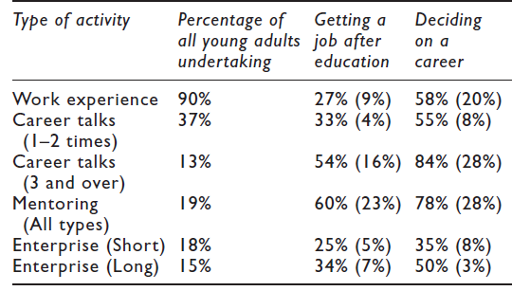
Two surveys suggest that more diverse and more personal employer interactions are more often perceived as helpful
Perceptions of utility (YouGov, 2011)
Deciding on a career (b-live)
Had Useful V Useful
Source: b-Live foundation fieldwork, 469 respondents
xx% = Found helpful; (xx%) = Found very helpful

Slide 16
YouGov survey - 1,002 UK adults aged 19-24
Question: Some schools and colleges arrange for their students (aged between 14 and 19) to take part in activities which involve employers of local business people providing things like work experience, mentoring, enterprise competitions, careers advice, CV or interview workshops, workplace visits, taking part in classroom discussions.
Did you take part in such activities between those ages?
If so, on how many different occasions (more or less) did it happen?”
Never
Once
Twice
Three times
Four times or more
Don’t know

Slide 17
Interval regression: Average correlation of £500 - £1,300 between wage and each extra employer contact (N=169, FT only)
Control variables
Variable
P-Value
Value
Age
Highest qualification (L1-L5)
Ethnicity (white vs non-white)
Region of UK
School type 14-16
School type 16-19
Gender
Age
0.02
£900
Employer contacts
0.03
£900
Independent school (16-19)
0.04
£4,000
Highest qual level
0.01 - 0.08
£5,000-£8,000

Slide 18
Conclusion of this study
Each school-mediated activity with employers relates to average earnings premium of £900 (4.5%). Individuals who attended 4 or more engagement activities will earn on average £3600 more than their peers who did zero activities.
Across range of models, higher level (2+) employer contacts relates to lower likelihood of NEET outcomes (at 5-20 percentage points) than comparable peers with 0 contacts.
Statistically significant positive relationships between volume of engagement and career confidence

Slide 19
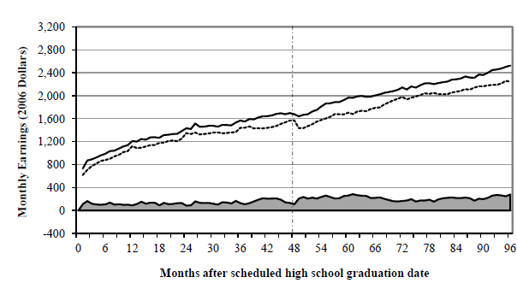
US: Careers Academies show an average 11% wage premium
Engineering, IT, Healthcare etc combining academic and technical education with employer support
e.g. typically 1.5x-3x more people participating in employer talks, school-based enterprise, job shadowing, mock interviews etc. (over half had such support)
1,764 participants randomly assigned to intervention or control group, tracked for 8 years
Controls: Family characteristics, educational attainment, including gender, ethnicity, socio-economic status, attendance rates, location of academy, cohort, duration of employment, hours worked per week, …
Kemple, J. J. with Willner, C. J. (2008), Career Academies Long-Term Impacts on Labor Market Outcomes, Educational Attainment, and Transitions to Adulthood. New York: MDRC. Orr et al (2007) “National Academies Foundation Career Academies” in Neumark D. Ed. Improving School-to-work transitions, 190-191

Slide 20
From a global policy imperative…
… employer engagement in education has become widely promoted as a means to:
1. Improve pupils’ general preparation for the world of work (within vocational education and across schooling)
2. Enhance social mobility
3. Address strategic skills shortages
4. Increase pupil engagement and attainment
OECD, Learning for Jobs (2010), Off to a Good Start? (2010), Skills Strategy (2012)
Harvard Graduate School for Education, Pathways to Prosperity (2010- )
European Union, Ingenious project (STEM), CEDEFOP (vocational education)

