Slide 1
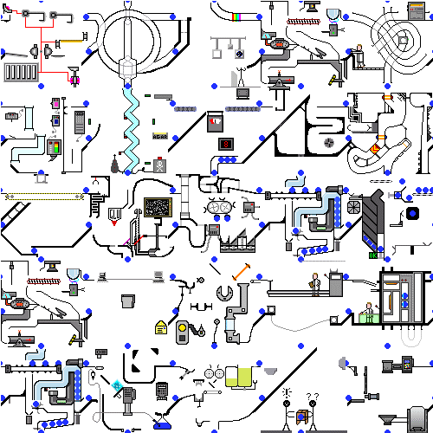
LMI: Myths and Realities
Dr Deirdre Hughes, Former Commissioner, UKCES & Principal Research Fellow, Warwick Institute for Employment Research (IER)

Slide 2
Overview
Career matters
Policy drivers in the UK
‘LMI for All’ and #EmployID
  Enablers and barriers
  Macro challenges and opportunities
  Levers for change
Where next?

Slide 3



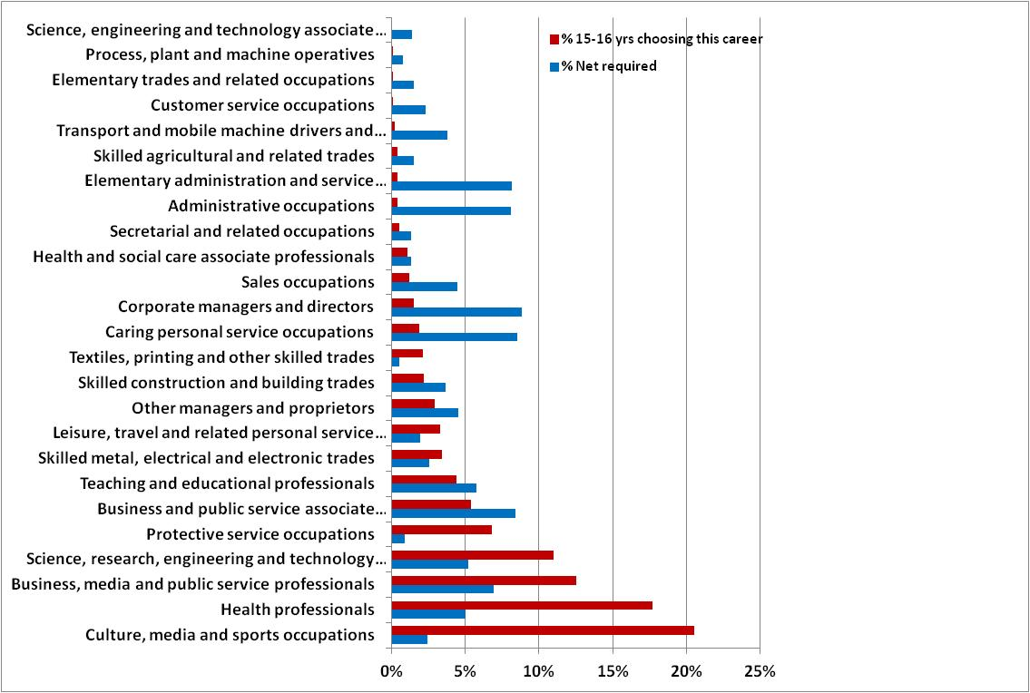
...against teenage aspirations
Notes:
UKCES report ‘Nothing in Common’ (2013) The report maps the career aspirations of 10,729 British teenagers against the projected demand for UK employment over the period 2010-2020 as established by UKCES analysts. A statistical measure shows that the aspirations to have nothing in common with projected employment demand. The report includes full details of teenage occupational aspirations segmented by age and by the type of school attended.
City & Guilds recent findings – show similar trends

Slide 4
Learn/Earn
Typical English student faces debts of over £44,000 at graduation
English students now face some of the highest tuition fees in the world, and the highest average debts at graduation
Ministerial Taskforce: “Help businesses to create two million new jobs to achieve full employment; support three million new apprenticeships; make sure that all young people are either earning or learning”
Notes:
Even compared with graduates of US private for-profit universities (who graduate with about £29,000 of debt), estimates suggest that English students fare worst. The vast majority of English students’ study-related debt is held by the state, which has relatively clear repayment conditions compared to other Anglophone countries. In the US, only a minority of students are repaying under income contingent arrangements.
should be cause for concern, not least because the number of part-time and mature students enrolling at UK institutions across recent years has dropped precipitously.
Highest tuition fees in the world should be cause for concern, not least because the number of part-time and mature students enrolling at UK institutions across recent years has dropped precipitously. (Sutton Trust, April 2016)
Alongside Cabinet Committees, a number of Implementation Taskforces have been established to monitor and drive delivery on the Government’s most important crosscutting priorities. These taskforces will bring together the key Ministers and officials on a regular basis to track progress; spot potential problems and blockages and agree plans for resolving them; maintain momentum and ensure accountability; and make sure that actions are followed through. Each taskforce will report to the Prime Minister and Cabinet on a regular basis.
Taskforce Membership reporting to the PM
Minister for the Cabinet Office, Paymaster General (Chair) (The Rt Hon Matt Hancock MP)
Chancellor of the Duchy of Lancaster (The Rt Hon Oliver Letwin MP)
Secretary of State for Work and Pensions (The Rt Hon Stephen Crabb MP)
Secretary of State for Communities and Local Government (The Rt Hon Greg Clark MP)
Secretary of State for Education, Minister for Women and Equalities (The Rt Hon Nicky Morgan MP) Chief Secretary to the Treasury (The Rt Hon Greg Hands MP)
Minister of State for Employment (The Rt Hon. Pirti Patel MP)
Minister of State for Skills (The Rt Hon Nick Boles MP)
Parliamentary Secretary for the Cabinet Office (Lord Bridges of Headley)

Slide 5

Major Policy Drivers
Devolution
Open Data Policy (The Cabinet Office)
Universal Credit System (DWP)
Increasing job insecurity (DBIS/DWP)
Skills gaps and skills mismatch (6 Government Departments)
Ageing society

Slide 6

Preparing … for a future we cannot clearly describe…..

Slide 7






Notes:
Digital architect Designs a selection of virtual buildings for advertisers and retailers to market their products
• Home carer Helps care for elderly people in their own homes
• Elderly well-being consultant Specialises in holistic and personalised care for the elderly
• Body part maker Creates living body parts for athletes and soldiers
• Nano-medic Creates very small implants for health monitoring and self-medication
• Vertical farmer Farms crops upwards rather than across flat fields to save space
• Waste data handler Disposes of your data waste in a responsible way
• Climate controller Manages and modifies weather patterns
• Avatar manager Designs and manages holograms of virtual people
• Memory augmentation surgeon Helps preserve and improve memory in an ageing population
• Time broker Handles time banked by customers in lieu of money for goods or services
• Personal branding manager Develops and manages your personal brand
• Child designer Designs offspring that fit parental requirements
• Omnipotence delimiter Reins in our belief that anything is possible and we are all-powerful
• Personal medical apothecary Provides a bespoke range alternative therapies.
• Haptic programmer Develops technology around the science of touch, such as gloves that make your hand feel warm, or wrapped in velvet.

Slide 8
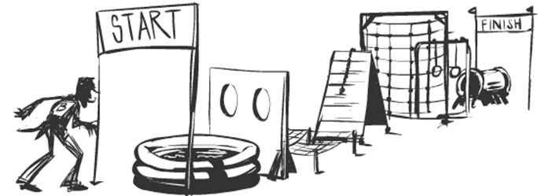
Career learning

Slide 9

Task ahead
Keep people switched on to learning
Encourage them not to close down opportunities too early
Broaden horizons and challenge inaccurate assumptions
Create relevant experiences and exposure to the world of work, career adaptability and resilience

Slide 10
Different datasets
Learning in further education - Individualised Learner Record (ILR)
Receipt of state benefits – National Benefits Database (NBD)
Employment & Earnings - HMRC P45 & P14 record
School Destination Data & HESA Data
Mandated or signposted referrals by Job Centre Plus staff to interventions for the unemployed – DWP Labour Market System (LMS) and New Deal (ND) evaluation databases

Slide 11

LMI for All (UK)
Provide free access
UK LMI through an open API
Data includes
Present employment by occupation
Future employment by occupation
Pay by gender, hours and decile
Job vacancies
Skills - rated in terms of levels and importance – through the O*Net survey data
Hard to fill vacancies
University course destinations
Apprenticeships
Notes:
Office for National Statistics – ASHE, LFS, Census of Population, BRES
LFS Labour Force Survey
ASHE Annual Survey of Hours and Earnings
BRES Business Register and Employment Survey
ESS Employer Skills Survey
………………
UKCES – Working Futures and ESS data
BIS, DfE, & other bodies – access to data on education and training courses
DWP - vacancies (Universal Job Match)
HESA – data on higher education
Burning Glass – vacancy data
Apprenticeship Service

Slide 12


Funded by:
Developed by consortia:
Notes:
Four sequential, but distinct, research and development phases have ensured a successful outcome. A prototype stage (Phase 1, November 2012 to May 2013) tested the feasibility and viability of the foundation concepts and ideas. Phase 2A followed almost immediately and was completed satisfactorily in 2013 (see Bimrose et al., 2013, for a detailed account). The third stage, Phase 2B, which was largely based on recommendations from Phase 2A, detailed progress on implementing these recommendations and was published in 2015. Phase 4 now reporting.

Slide 13

To increase and widen use of high quality labour market information to support decisions about careers and learning
www.lmiforall.org.uk/
Notes:
LMI for All data has achieved Pilot level certification from the Open Data Institute which means extra effort went in to support and encourage feedback from people who use this open data.
Rather than design an app or website ourselves, we want to ensure that creative developers could openly access LMI for All in order to play with the data and create innovative new ways to present LMI for All data.

Slide 14
Purpose of LMI for All
To develop a comprehensive, high quality data offering that can inform career choices
To promote third-party websites and applications as a means of opening-up the data to individual decision-makers
To offer an engaging, accessible and reliable platform for developers
To build wider awareness and support for LMI for All among key stakeholder groups
Notes:
The development of LMI for All service has extended over a four year period (2012 – 2016). During this time, the feasibility of developing a comprehensive career LMI data tool that exploits open data sources that can be mainstreamed into service provision has been demonstrated.

Slide 15
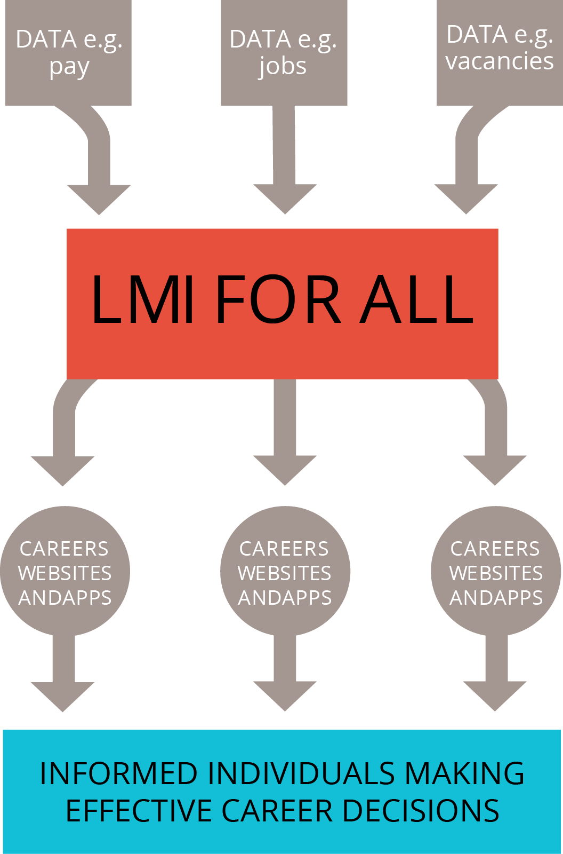
An online data portal which brings together existing national sources of high quality, reliable labour market information (LMI)
An open data project, which supports the wider government agenda to encourage use and re-use of government data sets
After successfully completing its pilot stage, LMI for All was given full project status.
Notes:
There are four key objectives to providing and developing the technical infrastructure:
The maintenance of a secure and robust infrastructure for the data, including test and production servers and provision for back up services. The hardware and software environment should be capable of being extended in relation to increased data provision and added numbers of users.
To implement processes to ensure that the data made available to developers and end-users meets required quality standards and avoid disclosure. This involves programming at the API level to suppress data which are unreliable due to sample sizes and to provide warnings with data which although non-disclosive is based on small samples. It also requires processes for checking data against expected returns and providing guidance to developers in the use of the API.
To provide modern and flexible software tools to allow the querying of the database by external users. This entails the extension of the previous data tools to facilitate querying through data cubes.
To provide software tools and spaces for documenting the process and allowing public access to the LMI for All database. In particular, this involves supporting developers in producing applications which utilise the API through resources made available on the LMI for All website.

Slide 16
Objectives
IDENTIFY: robust sources of LMI to inform decisions about learning and work
COLLATE: sources in an automated, single, accessible location for careers
FACILITATE: easy use of LMI data in conjunction with other data sources
EVALUATE: relevance of the data tool with key stakeholders
Notes:
The LMI for All database and API has been designed for use in careers guidance, either directly by end users, mediated through applications, or by careers organisations and agencies working with clients. However, feedback from conversations at various events has suggested further potential uses. These include for economic and social planning, for planning courses and education and training provision and for use in labour market and social research. Of course, there is nothing to stop organisations developing applications now for these purposes and indeed the Department of Works and Pensions is collaborating with the European EmployID project in developing and implementing a Dashboard for use by Work Coaches in Job Centres as well as by Employment Advisers working with companies. However, in order to promote such uses, then this has implications for dissemination and promotion and for the further development of the LMI for All website and support materials. It might also have implications for future data provision, for instance through including travel-to-work data and other economic and social data sets.

Slide 17
Development process: Dynamic and Iterative
Data
Accessibility & Open Data
Stakeholders & Communication
Notes:
There are four key objectives to providing and developing the technical infrastructure:
The maintenance of a secure and robust infrastructure for the data, including test and production servers and provision for back up services. The hardware and software environment should be capable of being extended in relation to increased data provision and added numbers of users.
To implement processes to ensure that the data made available to developers and end-users meets required quality standards and avoid disclosure. This involves programming at the API level to suppress data which are unreliable due to sample sizes and to provide warnings with data which although non-disclosive is based on small samples. It also requires processes for checking data against expected returns and providing guidance to developers in the use of the API.
To provide modern and flexible software tools to allow the querying of the database by external users. This entails the extension of the previous data tools to facilitate querying through data cubes.
To provide software tools and spaces for documenting the process and allowing public access to the LMI for All database. In particular, this involves supporting developers in producing applications which utilise the API through resources made available on the LMI for All website.

Slide 18
Big questions…
Employment levels by occupation | How many jobs are there? How many in my area? What are the past trends? What are likely future trends? | Labour Force Survey, Working Futures
Average earnings by occupation | How much do people get paid for this job? How much at the start of their career? How much in my area? | Annual Survey of Hours and Earnings
Unemployment by occupation | What proportion of people in this occupation are currently out of work? | Annual Population Survey
Profile of qualification level by occupation | What level of qualification do people have in this job and what am I likely to need? | Labour Force Survey, Working Futures
Vacancies by occupation | How many vacancies are there for this job? What proportion are hard to fill? | Employer Skills Survey
Notes:
Enablers and barriers
Changing and evolving context – Potential users of the service noted organisational changes and the evolving context of careers in terms of funding challenges to overcome so that they could engage with the LMI for All resource. The operational environments impacted in different ways. These ranged from whether developing an interface or application was viable in the current context at all, to determining whether applications could be used by clients/customers on their own, or within a careers guidance support session. Linking the development of an interface to organisational strategic objectives emerged as helpful in initiating the process of implentation.
Generating buy-in and the need for a lead/steering group – The majority of potential users recognised the value and potential of LMI for All for providing high quality LMI and enhance their service provision, so gaining ‘buy-in’ from management was not problematic. Some suggested that LMI for All would add credibility to their current LMI provision. It was clear that organisations needed an individual, or a steering group, to lead on the development. Examples of existing interfaces were valued for demonstrating the potential of LMI for All.
Resourcing an interface – Resourcing, both in terms of understanding how much an interface would cost and how to fund it were consistently identified as issues. The costs of developing an interface were found to vary by organisation. It was very much dependent on the availability of in-house technical skills, requirements and complexity of the interface and whether external support was needed both in terms of technical skills and a platform to locate the interface.
Understanding the development process and requirements – For many, a significant challenge was achieving an understanding of the design and development process. Whilst recognising the need for a plan, budget and lead, many were unsure where to start – finding and defining a budget, the type of interface to be developed, target audience(s), etc. Guiding questions were found to be helpful, such as: what questions do your advisers and/or clients/customers ask most frequently? Who would your target audience be?; how do clients/customers access your service (face-to-face, on the web, or through a mobile device)?
Technical knowledge and skills – For careers organisations, sourcing the required technical skills and know-how was identified as an issue. For some, this related to developing new skills. Others used existing tools and platforms to develop an interface (such as Appy Pie and a jQuery plugin called Chartinator) and yet others outsourced the development.
Identifying a target audience and needs – The majority of potential users had a number of ideas about target audiences and how LMI needs could be met by the development of an LMI for All interface. Refining these ideas into a practicable product was sometimes a challenge. Some organisations refined their ideas by working with a steering group or surveying staff to identify the greatest LMI need, whilst others made decisions based on funding streams and organisational strategic objectives.
Data queries and concerns – Potential users of the service had a number of questions regarding the data. Whilst all recognised that LMI for All contained high quality data, some concerns were also raised about how to fill missing data gaps, such as course and vacancy data, and how to combine (or ‘mash’) with other data sources. Some questions were about the currency of the data and how often it would be updated. The long-term sustainability and availability of the resource was a recurrent concern.
Dissemination and marketing – This was considered to be a key phase of the development process, but was mainly recognised by those who had experience of developing a product in the past. Some identified future events in which a product could be launched to ensure the most impact. Buy-in from staff to both use and promote the product was considered to be vital.
Time – For many, the length of time anticipated for the development process has been underestimated. Early estimations of the time required for a development were optimistic and then quickly revised, as different stages of the process took longer than expected. For example, identifying a developer and getting a costing can take several weeks as the developer briefing is refined.

Slide 19

In 2030 the UK workforce in 2030 will be multi-generational, older, more international and female. Technology will be pervasive, jobs more fluid and the global labour market highly competitive

Slide 20

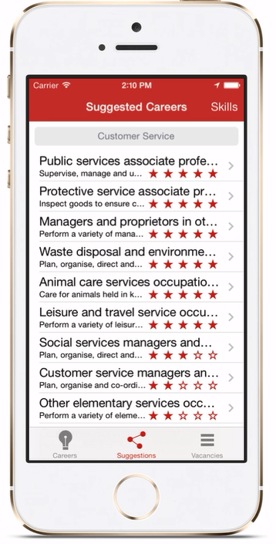
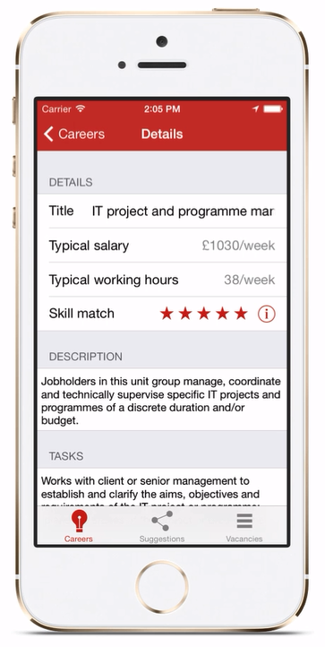
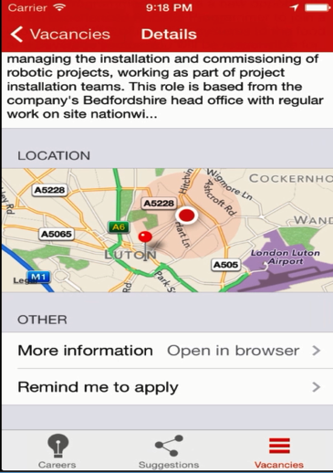
JobHappy, by Harry Jones
https://www.youtube.com/watch?v=7imKYpvKZjk&index=3&list=PLuvzHvGAOplyzJgBX2IHLUAecElK3lzOi
Notes:
The JobHappy App won runner up in the UKCES CareerHack competition (2014).
This app was designed to support people with their career choices by presenting a range of information (such as job description and tasks, qualification requirements, salary data, employment forecasts, regional data and a selection of courses). For users unsure of their career, they can input their skill levels, which enables JobHappy to generate and recommend matching careers using the skills data for each occupation, unemployment rates and how difficult it is to fill vacancies. Once a user has chosen a career they can use the app to find vacancies in their local area or more widely.
https://www.youtube.com/watch?v=7imKYpvKZjk&index=3&list=PLuvzHvGAOplyzJgBX2IHLUAecElK3lzOi
http://www.lmiforall.org.uk/career-hack/competition-winners

Slide 21
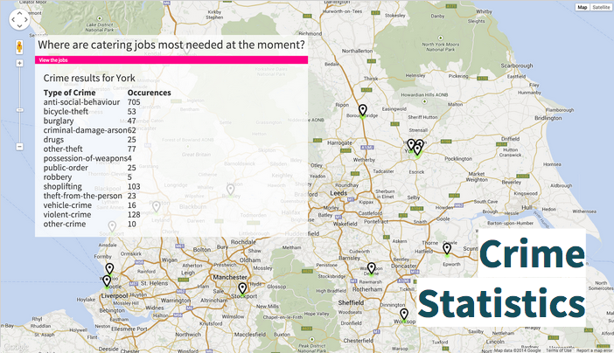
Hot Jobs: mobile app

Slide 22
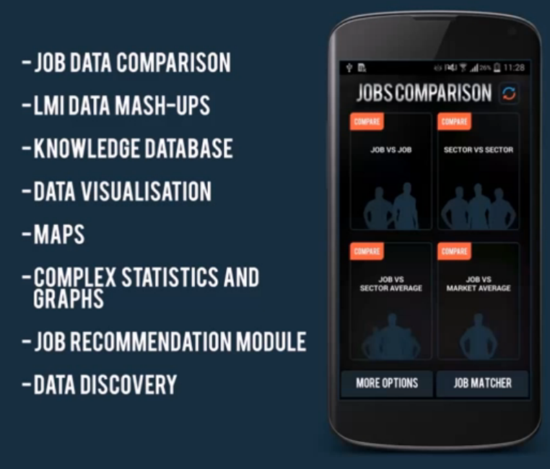
Careers Advisor by LogToMobile
Notes:
Developed by LogToMobile
This was the winner of the UKCES CareerHack competition (2014).
The Career Advisor App is a mobile app allowing users to select two jobs from the standard occupational classification lists. Users are then presented with a range of labour markets indicators for each job, such as employment rates, estimated pay, regional salary, and skill level requirements. Indicators are represented in different formats to enable users to easily understand the data. Occupational information is also included from the ONS and presented alongside information from other sources. Users can also explore sector data through a range of visual representations, which are linked to other regional sources of data. Some career tools are available through the app, such as skills assessments and personality tests
Available to download

Slide 23
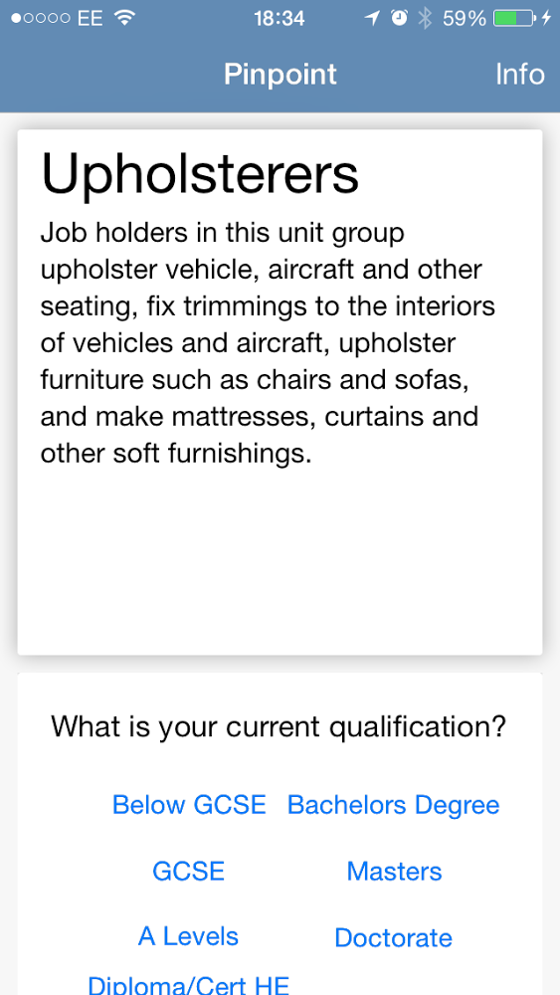
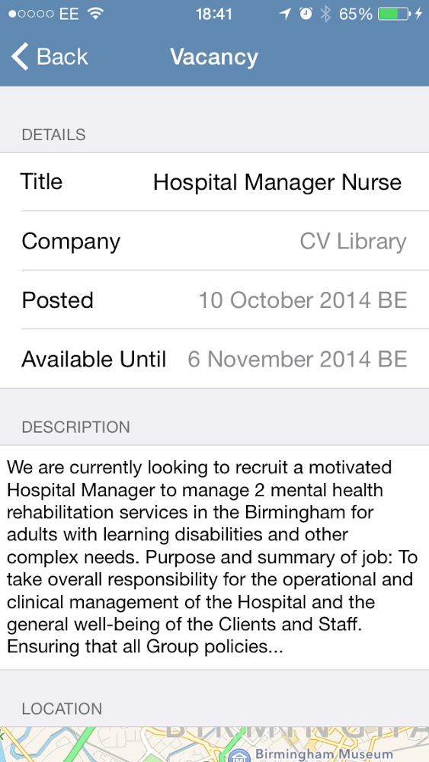
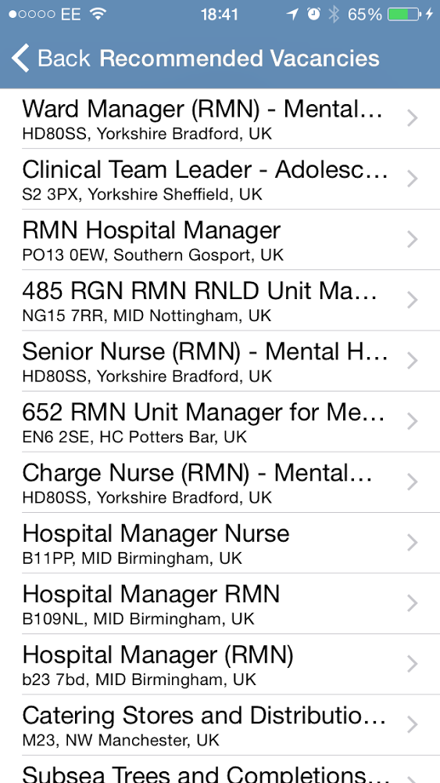
Pinpoint, by Harry Jones and Phil Hardwick
Notes:
Tinder, swiping
Pinpoint
By Phil Hardwick and Harry Jones
Pinpoint is Tinder for jobs. Version 1 was developed for the June 2014 LMI for All mod day by Harry Jones and Phil Hardwick. Version 2 is a refactored and improved version started by Phil Hardwick and worked on at the September 2014 LMI for All mod day by Phil and Harry.
Pinpoint is a mobile app which is intended for use prior to meeting with a careers advisor.
Developers identified that most people going to see a careers advisor don’t know what they want to
do. By swiping on small snippets of information (left for no and right for yes), users automatically
build up a profile which suggests jobs to them. They can then either apply for jobs in their area, or
take that information back to an advisor.
https://github.com/datagovuk-hackcode/lmi-mod-pinpoint

Slide 24
Careerometer: widget development
Web application: widget that can be easily deployed on websites
Access: provided to data at headline level
Core elements: earnings and employment prospects
Comparisons: between occupations facilitated
Target users: Years 7-13 learners; 19+ learners; parents and carers; undergraduates; career development professionals
Timeline: Available now
Notes:
LMI For All provides an easily customisable widget for websites. The Careerometer widget provides access to a selection of headline data relating to pay, weekly hours of work and future employment prospects. The data are organised by occupation: the user simply types in the title of the job you are interested in and the widget provides a series of options from which you can select the most relevant to you.
The data relating to hours and pay are estimates based on the Annual Survey of Hours and Earnings (Office for National Statistics). The estimates of future employment prospects are projections taken from the Working Futures study and are based on past employment trends.
Datasets:
Occupation Title
Pay
Description
Prospects
Estimated weekly hrs

Slide 25
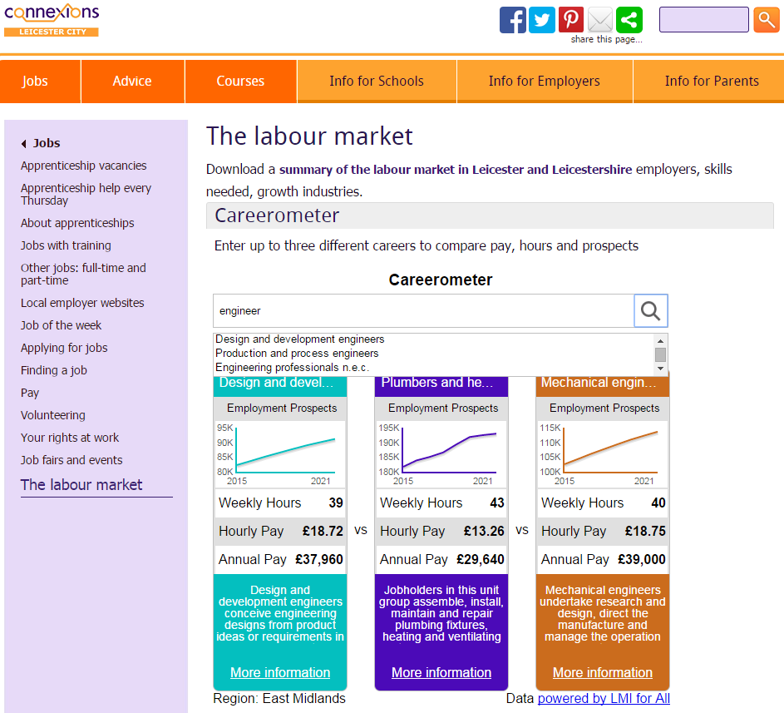
Careerometer widget – freely available
LMI for All widget
Notes:
Customisable widget that can be embedded into any website
Provides headline information on pay, average hours and employment prospects
Allows users to compare up to four occupations at once
In the last couple of months we have made available a customisable widget that allows third parties to provide a level of access to LMI for All via their website.
It’s a simple tool that provides basic access to the data and allows comparison of occupations with regard to headline indicators including average pay and projected employment.

Slide 26
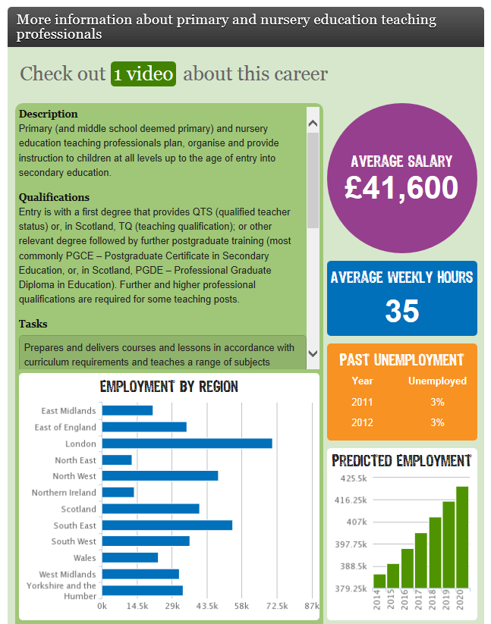
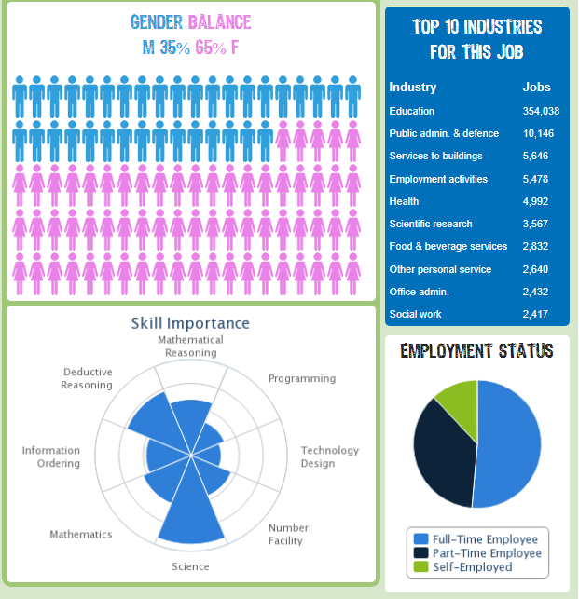
icould
http://icould.com/
Notes:
Data alongside career videos to encourage and inspire young people to think broadly about their careers.
icould is an interactive careers website
offers free access to over 1000 personal video stories, plus practical tips, insight and advice
selected LMI data, such as job description, qualifications and tasks, average salary and past and predicted employment is shown beneath each video
free to use
Over 100,000 unique users a month
Used by individuals and classroom settings
Around 85% users are first-time visitors

Slide 27
http://skillsmatch.intelligentlondon.org.uk
BA 10685947
BA 10685947
Notes:
Skills gaps
Projected vacancies
London provision
Skills supply and employer demand map

Slide 28

EmployID
Aim: To support PES practitioners and their organisations across Europe in engaging actively in professional identity transformation
Developing a set of services: eCoaching, reflection, MOOCs, online networking, analytical & learning support tools, leading to improved individual and organisational performance in the delivery of employment services
Join as an Associate Partner (free) – https://employid.eu/associate-partner-members

Slide 29
Where next?
DWP/ EmployID developing & implementing a Dashboard for Work Coaches in Job Centres as well as Employment Advisers working with companies
Redesigned widget
Careers Chatbot
National Career Development Strategies – four nations
Notes:
LI requires practitioner skills and competences in interpreting and sense making – this cannot be left simply to chance!
If you move to more advance modular widget then

Slide 30
For more information…
  Website:
  http://www.lmiforall.org.uk/
  https://employid.eu/
  #employID
@deirdretalks
http://www2.warwick.ac.uk/fac/soc/ier/
Email:
deirdre.hughes@warwick.ac.uk

