Slide 1
All partnerships aren’t equal. Investigating the benefits of industry-school collaborations, from a business perspective.
-Kerry Lee
-Fatima Abdulghani
-John Hope

Slide 2
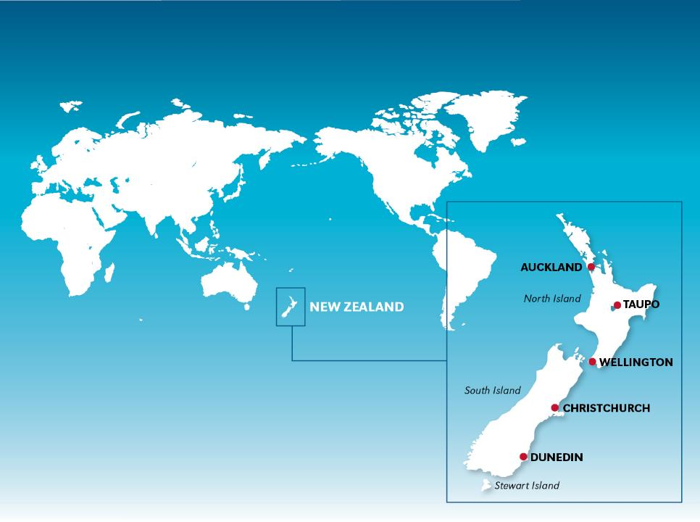
PLACE HOLDER SLIDE – NZ MAP
Notes:
as you will be well aware NZ is the centre of the universe
Situated in the southern waters of the Pacific Ocean
Lies approximately 2,000 km (1200 miles) east of our closest neighbour Australia
Made up of two principal islands (North and South Islands) and many other smaller islands

Slide 3
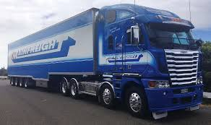
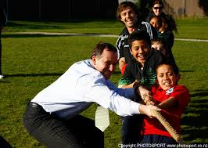
Successful school-business partnerships
Bruce Plested
Notes:
Bruce – has a logistics company and given millions to schools but he doesn’t like giving a hand out.
He will be very generous if a school approaches his company with a business plan. A plan stating what was needed and why and how his money would make a difference.
This research designed to find out what businesses and schools wanted.
Mainfreight – over 6000 employees and $2billion revenue this year
1993 Company had softball uniforms 1997 school changed its name
Many of the organisation's ways of working - such as open-plan offices and having student greeters

Slide 4
http://www.open.ac.uk/researchprojects/enduringlove/methods
Notes:
Explain methods
Met with companies brokering with schools
Invitation sent to all business in these organisations newsletters
40 businesses responded

Slide 5
Notes:
Participants were evenly spread across small, medium and large businesses

Slide 6
Notes:
63% were national businesses
With a large proportion of participants from the business and trade sector (40%)
This data is reflective of the general mix of the NZ industry sectors

Slide 7
Type of schools linking with each business sector
Industry sectors |  | Which school/s did your organisation link with?
 |  | Primary (% of group) | Secondary (% of group) | Both primary & secondary (% of group)
 | Manufacturing/construction | 2 (22%) | 7 (78%) | 0 (0%)
 | Computer/IT/telecommunications | 0 (0%) | 3 (38%) | 5 (62%)
 | Business/banking/finance | 0 (0%) | 11 (69%) | 5 (31%)
 | Education/government | 2 (29%) | 2 (29%) | 3 (43%)
 | Total (% of total) | 4 (10%) | 23 (58%) | 13 (32%)
Notes:
In general a large proportion of the respondents linked only with secondary schools (58%)
Very few only linked with primary schools (10%)
Manufacturing and construction – a few (22%) were happy to work with younger students and if so that is all they did but the majority (almost 80%) preferred older secondary students – they were the only sector where it was one or the other not both.
When looking at who was linking with secondary –manufacturing/construction and business/banking/finance

Slide 8
Frequency of school links undertaken by
business sectors each year
Industry sectors |  | Approximately, how often did your organisation link with schools?
 |  | Daily (% of group) | Weekly (% of group) | Monthly (% of group) | Annually (% of group)
 | Manufacturing/construction | 0 (0%) | 3(33%) | 2 (22%) | 4 (44%)
 | Computer/IT/telecommunications | 2 (25%) | 2 (25%) | 2 (25%) | 2 (25%)
 | Business/banking/finance | 1 (6%) | 1 (6%) | 12 (75%) | 2 (13%)
 | Education/government | 0 (0%) | 2 (29%) | 4 (57%) | 1 (14%)
 | Total (% of total) | 3 (8%) | 8 (20%) | 20 (50%) | 9 (23%)
Notes:
Manufacturing/construction – sees them weekly or annually -generally links with few schools Computer/IT/telecommunications – very even spread
Business/banking/finance- generally schools every month
Education/government links monthly
Total – almost half businesses link with a few schools (less than 10)

Slide 9
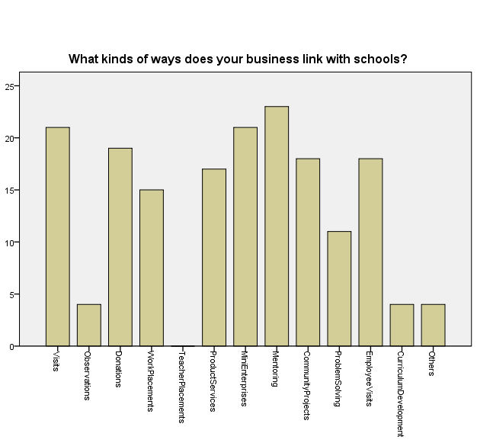
Frequency of interactions in industry-school partnerships
Notes:
Least commonly occurring interactions-observations, teacher placements, curriculum development
Most common – no surprises – mentoring, visits, mini-enterprises, donations, employee visits

Slide 10
Percentage of business sectors
providing each interaction
Industry sectors |  | Mentoring | Mini-Enterprises | Visits | Donations | Community Projects | Employee Visits | Products and Services | Work placements | Problem Solving
 | Manufact/construction | 11% | 22% | 67% | 89% | 44% | 44% | 11% | 44% | 22%
 | Computer/IT/telecom’s | 75% | 63% | 50% | 63% | 50% | 25% | 63% | 38% | 50%
 | Business/bank/finance | 63% | 56% | 63% | 38% | 31% | 44% | 44% | 50% | 6%
 | Education/government | 86% | 72% | 14% | 0% | 71% | 72% | 57% | 0% | 57%
 | Percentage of ‘yes’ responses per interaction | 58% | 53% | 53% | 48% | 45% | 45% | 43% | 38% | 28%
Notes:
Give a couple of minutes to look at

Slide 11
If you were a school
wanting assistance with community projects which sector would you approach?
Percentage of business sectors
providing each interaction
Industry sectors |  | Mentoring | Mini-Enterprises | Visits | Donations | Community Projects | Employee Visits | Products and Services | Work placements | Problem Solving
 | Manufact/construction | 11% | 22% | 67% | 89% | 44% | 44% | 11% | 44% | 22%
 | Computer/IT/telecom’s | 75% | 63% | 50% | 63% | 50% | 25% | 63% | 38% | 50%
 | Business/bank/finance | 63% | 56% | 63% | 38% | 31% | 44% | 44% | 50% | 6%
 | Education/government | 86% | 72% | 14% | 0% | 71% | 72% | 57% | 0% | 57%
 | Percentage of ‘yes’ responses per interaction | 58% | 53% | 53% | 48% | 45% | 45% | 43% | 38% | 28%
Notes:
Similarly if you needed donations you would be best to avoid those in the education of governmental sectors

Slide 12
If you were a school and a parent (in the construction industry) said “sing out if my company can help in any way”.
-What might you suggest?
Percentage of business sectors
providing each interaction
Industry sectors |  | Mentoring | Mini-Enterprises | Visits | Donations | Community Projects | Employee Visits | Products and Services | Work placements | Problem Solving
 | Manufact/construction | 11% | 22% | 67% | 89% | 44% | 44% | 11% | 44% | 22%
 | Computer/IT/telecom’s | 75% | 63% | 50% | 63% | 50% | 25% | 63% | 38% | 50%
 | Business/bank/finance | 63% | 56% | 63% | 38% | 31% | 44% | 44% | 50% | 6%
 | Education/government | 86% | 72% | 14% | 0% | 71% | 72% | 57% | 0% | 57%
 | Percentage of ‘yes’ responses per interaction | 58% | 53% | 53% | 48% | 45% | 45% | 43% | 38% | 28%
Notes:
Most frequently used interactions
However if you wanted mentoring they would be the last ones to go to

Slide 13
Business’ view of whether they would recommend school-business partnerships
Business Sector |  | Would you encourage others to link with schools?
 |  | Yes | No
Manufact/construction |  | 100%
Computer/IT/telecom’s |  | 100%
Business/bank/finance |  | 88% | 12%
Education/government |  | 100%
Notes:
All generally positive

Slide 14
Perceived benefits to business’ image/reputation across different industry sectors as a result of
school-business partnerships
How beneficial is it for your organisation's reputation/image to link with schools?
Industry sector |  | Not beneficial | Limited benefits | Some benefits | Beneficial | Very Beneficial
 | Manufacturing/Construction |  | 11% | 22% | 44% | 22%
 | Computing/ IT / Telecommunications |  |  |  | 12% | 88%
 | Business / Banking/ Financial |  | 6% | 6% | 63% | 25%
 | Education/ Government |  |  | 14% | 29% | 57%
Total |  |  | 5% | 10% | 42% | 43%
Notes:
Significant difference between Computing/IT and manufacturing/construction and business/banking

Slide 15
Perceived benefits to business from forming networks in the community across different industry sectors as a result of school-business partnerships
How beneficial is it for your organisation in terms of forming networks within the community to link with schools?
Industry sector |  | Not beneficial | Limited benefits | Some benefits | Beneficial | Very Beneficial
 | Manufacturing/Construction | 11% |  | 11% | 67% | 11%
 | Computing/ IT / Telecommunications |  |  |  | 12% | 88%
 | Business / Banking/ Financial | 12% | 6% | 19% | 38% | 25%
 | Education/ Government |  |  | 14% | 14% | 72%
Total |  | 7% | 3% | 13% | 35% | 42%
Notes:
Significant difference between Computing/IT and manufacturing/construction and business/banking

Slide 16
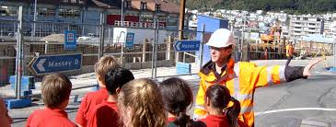
Manufacturing/Construction
Most common type of links:
Donations & Visits
-also support observations
Tend NOT to support
Mentoring, mini-enterprises, problem solving, providing products and services
Notes:
Not giving away stuff but rather providing time

Slide 17
Manufacturing/Construction
- strong emphasis on supporting secondary schools
- Minimal advertising benefits. Need to ensure & highlight benefits of forming networks with the community and any promotional activities undertaken. Remind of employee benefits
Notes:
This sector felt they gained less than other industry sectors (in terms of image and reputation, forming networks, and advertising). In order to sustain partnerships with industries from this sector schools would need to be aware of these views and either ensure the industry is aware of all promotion undertaken by the school or else identify other ways to ensure benefits are received by the industry. Schools would also need to identify the amount of contact and interaction which was possible and desired by the industry as many in this sector had minimal (annual) contact with schools. Whether this was because of an existing partnership arrangement or the preference of the school or industry is unclear
Benefits to employees noted

Slide 18
Computer/IT/Telecommunication
Most links supported
especially mentoring
Tend NOT to support…
Work placements and employee visits
https://www.googleclass.jpg&imgrefurl=https%3A%2F%2Fmrwachs.wordpress.com%2F2015%2F09%2F04%2Fif-i-want-to-work-in-the-compter-industry-should-i-go-to-university-this-university-of-manitoba-article-might-present-some-insight%2F&docid=ohGMYEv9eY4dAM&tbnid=Jo7MRkWqA-athM%3A&w=1000&h=288&hl=en&bih=935&biw=1350&ved=0ahUKEwjZy4WT0ujNAhWLK8AKHW-6BrAQMwhoKEQwRA&iact=mrc&uact=8

Slide 19
Computer/IT/Telecommunication
supports both primary and secondary schools
links with many schools
Very beneficial to their image reputation forming networks with the community (significant)
https://www.googleclass.jpg&imgrefurl=https%3A%2F%2Fmrwachs.wordpress.com%2F2015%2F09%2F04%2Fif-i-want-to-work-in-the-compter-industry-should-i-go-to-university-this-university-of-manitoba-article-might-present-some-insight%2F&docid=ohGMYEv9eY4dAM&tbnid=Jo7MRkWqA-athM%3A&w=1000&h=288&hl=en&bih=935&biw=1350&ved=0ahUKEwjZy4WT0ujNAhWLK8AKHW-6BrAQMwhoKEQwRA&iact=mrc&uact=8
Notes:
Industries that belonged to the computing/IT/telecommunications sector perceived significantly greater benefits to business image and reputation and to forming networks within the community compared to industries in other sectors. This may be partially attributed to recent changes in computing in New Zealand high schools, in order to clarify the notion of computer science. A New Zealand study suggested that these perceptions could have changed as a result of high levels of support from industry organisations (Bell, Andreae, & Robins, 2012). This active engagement could explain why this sector perceived greater benefits to their image and to forming networks with the community than industries in other sectors.

Slide 20
Business/Bank/Finance
Most links are strongly supported
Less support for..
Donations, community projects & problem solving
irefund.com.au/business-finance

Slide 21
Business/Bank/Finance
supports secondary schools, or both secondary and primary
Fewer links and contact often monthly
Least positive about partnerships
- Emphasise benefits
irefund.com.au/business-finance

Slide 22
Education/Government
Most links supported especially
mentoring, mini-enterprise, community projects, employee visits, problem solving and curriculum development
Do not support…
Donations, work placements and visits are rare
http://www.telestream.net/telestream-solutions/education-government.htm

Slide 23
Education/Government
supports primary & secondary schools, (weekly or monthly)
- Emphasise community networks
http://www.telestream.net/telestream-solutions/education-government.htm
Notes:
Approaching this sector could be the cheapest and quickest way to ensure mutual benefits are obtained

Slide 24
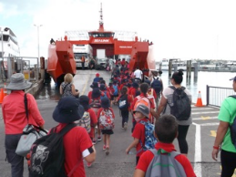
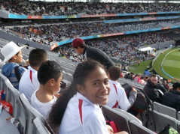
Children benefit
Uniforms
IT
Books
Trips
Soap box derby racer
Scholarships
Staff and school
IT support and guidance
Staff training
Corporate events
Notes:
The relationship between Bairds school and Mainfreight typify what can be achieved with a successful school-business partnership.
The school has learnt and copied many of the organisation's ways of working - such as open-plan offices and having student greeters
The business has provided funding for information technology, uniforms, sports equipment, books through the Duffy Books in Homes programme and even a fleet of soapbox derby racers.
They have provided a pool of up to $27,000 in tertiary scholarships and $12,500 for high school fees, uniforms and trips will be available to past Bairds Mainfreight students.

Slide 25
“The whole is greater than the sum of its parts” (Aristotle)
“Kahore taku toa I te toa takitahi,
he toa takitini”
(We cannot succeed without
the support of those around us)
Kia ora

Slide 26
Auckland
New Zealand’s largest city
Notes:
Auckland is New Zealand’s largest city.
It is a cosmopolitan harbour city with a population 1.8 million
Point out where the University is located in relation to the city, harbour, suburbs etc

Slide 27
The University of Auckland
Leading research institution
Ranked 82nd among the world’s top universities*
Outstanding research-led learning
*QS World University Rankings 2015
Notes:
We are ranked 82nd among the world’s top universities.
Our mission is to be an internationally recognised, research–led University, known for the excellence of its teaching, research, and service to its local, national and international communities (from an old presentation)
We pride ourselves on our outstanding research-led learning. What does this mean for you? Throughout your studies at Auckland, you will be taught by academics who are major contributors in their fields. They incorporate the latest research into your classes, you will be exposed to new research as it’s happening.
The 2015 rankings of the other New Zealand universities (with 2014 rankings in brackets) are:
Otago, 173 (159)
Canterbury, 211 (242)
Victoria, 229 (275)
Massey, 337 (346)
Waikato, 338 (401-410)
Lincoln, 373 (411-420)
AUT, 481-490 (501-550)

Slide 28
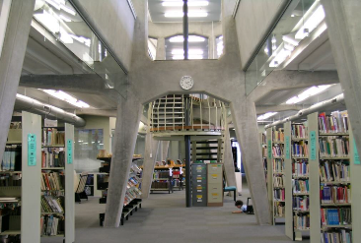
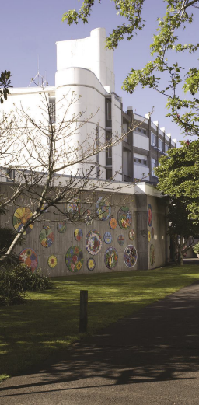
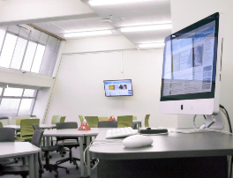
Faculty of Education
Ranked 23rd in the world!

Slide 29
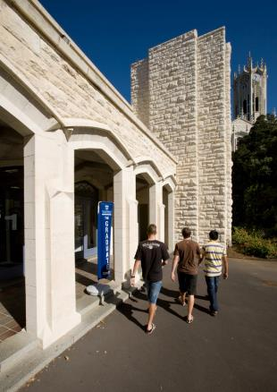
PhD studies at Auckland
Affordable fees
– NZ$6,699 per year (£3,799)* (2017)
3-4 years by thesis
Close working relationship with supervisor
PReSS Fund – up to NZ$2,900/year
for conferences
research-related travel and accommodation
laboratory consumables
* Exchange rate at 2016
Notes:
University provides $26million worth of PG scholarships and awards
PhDs at Auckland are 3-4 years and by research thesis only. You will have a supervisor with whom you’ll have a close working relationship.
A NZ government scheme for international PhD students means that these students pay the same tuition fees as New Zealand PhD students. This results in a very affordable price for our international PhD students of only 6,699 New Zealand dollars per year. This is the price for 2013. In UK pounds this is approximately £3,122.
ALL doctoral students have access to a Postgraduate Research Student Support Fund (or Press Fund). The Press Fund means you can receive up to $2,900 per year ($1200 for education students) to go towards your expenses such as:
Conferences
Travel and accommodation related to your research
Editing and printing your thesis
Laboratory consumables etc.
https://www.auckland.ac.nz/en/for/international-students/is-tuition-fees-and-costs/phd-fees.html
29

Slide 30
PhD studies at Auckland
Your dependent children will receive the same schooling benefits as NZ children
Your spouse/partner is eligible to work
Upon graduation, apply for a one-year work permit.
Notes:
In addition to very low tuition fees, there are a range of other benefits for PhD students:
Dependent children receive the same schooling benefits as New Zealand children until their final year of high school. This means they pay no school tuition fees except for a small yearly donation
Your spouse or partner is eligible for an work visa
Upon graduation, international students are eligible for a twelve-month open work permit

Slide 31
Haere mai!

