Slide 2
Mick Blaylock – Head of Core Maths Support Programme mblaylock@cfbt.com
Overview
Core Maths Support Programme
Uptake
Priorities
Challenges
Impact

Slide 3
Core Maths
Aspiration: ‘The vast majority of students continue with their maths education post-16.’
“Core Maths is the single most important initiative in post-16 mathematics in a generation.”
Professor Paul Glaister, Reading University
.. for work, study and life …
Notes:
Culture change required
Benefits for increasing post-16 Level 3 participation.

Slide 4
Distinctive characteristics of Core Maths
Problem solving – mathematics in a meaningful context
Mathematical modelling
Embracing Technology
Professional development – lesson study + Core Maths Masters
Notes:
Culture change required
Benefits for increasing post-16 Level 3 participation.

Slide 5
Reporting to
Department for Education
CfBT Education Trust
Lesley Traves
Partner Schools and Colleges with Core Maths Lead Teachers and Tutors
CMSP
Head of Programme
Mick Blaylock
Managing Core Maths
Chair – Bob Sawyer
Teaching Core Maths
Chair – Sue Pope
Promoting Core Maths Senior Advisory Board
Chair – Dr Deirdre Hughes
Editorial Board (Resources)
Chair – David Burghes
Assessment for Core Maths
Chair – Tom Rainbow
Technology for Core Maths
Chair –Nicola Letts
Higher Education
Task Group
Chair – Anthony Tomei
Internal Advisory Board Working /Task group

Slide 6
Core Maths Support Programme:
A sector led expanding programme
September 2014
Sector led initiative: 26 Partner Schools & Colleges
30 Core Maths Lead Teachers and Tutors
153 Early Adopter Teaching Projects
3500 students
October 2015
Sector led initiative: 30 Partner Schools & Colleges
34 Core Maths Lead Teachers and Tutors
over 350 centres teaching Core Maths
Potentially 10,000 students with 3,000 sitting the first examinations in 2016
Five additional partners: Cambridge Regional College, Harris Federation; Trinity Academy, Halifax; Malmesbury School; and West Lancs College.

Slide 7
Centres offering Core Maths in 2014/15 and 2015/16
Type of institution | Number teaching Core Maths |  | Total number of institutions | Percentage coverage
 | 2014-15 | 2015-16 |  | 2014-15 | 2015-16
Schools with sixth forms | 77 | 245 | 2104 | 4% | 12%
Sixth Form Colleges | 14 | 33 | 95 | 15% | 35%
FE Colleges | 54 | 68 | 225 | 24% | 30%
Studio schools | 3 | 15 | 52 | 6% | 29%
Total | 148 | 361 | 2476 | 6% | 15%

Slide 8
Core Maths Key Priorities
Aspiration: ‘The vast majority of students continue with their maths education post-16.’
Key Priorities:
More centres offering Core Maths
Centres offering Core Maths ‘at scale’
Support for Early Adopters preparing students for 2016 Core Maths examinations
Raising the profile of Core Maths
While retaining distinctive characteristics of Core Maths

Slide 9
Key Priority 4: Raising the profile of Core Maths
Audiences
Students
Parents
Teachers
Senior Leaders
Higher Education
Employers
Careers Advisers

Slide 10
Impact: The Leigh UTC- Making Maths Count
the staff that are delivering Core maths are rejuvenated by the fresh approach to mathematics, which has impacted on their teaching on other courses.
The course has given confidence to students and allows them to be empowered with mathematical reasoning to put forward a strong argument within topics that students feel passionate about.

Slide 11
Website support www.core-maths.org/
Endorsements
Case Studies
Awarding Organisations
Resources
Regional Support
Top tips for teachers

Slide 12
New Website

Slide 14
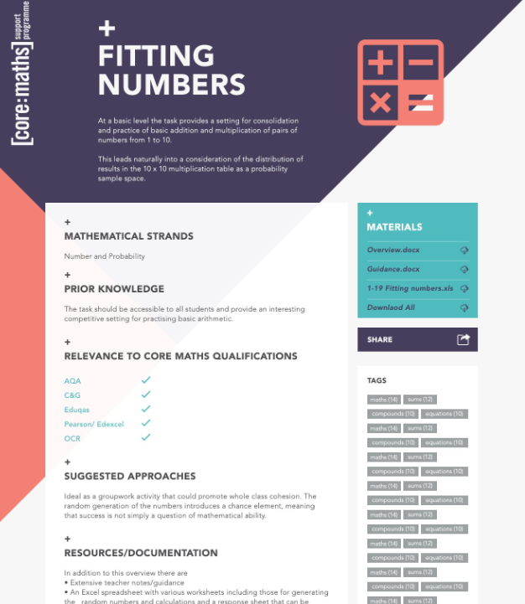
Support for introducing Core Maths
Website developments

