Slide 1


Investigating the Impact Quality of a New Apprenticeship Approach (NDTS) in Malaysia at
London Conference On Employer Engagement in Education and Training 2016 Programme
Ramli Rashidi
University College of Technology Sarawak (UCTS), Malaysia
&
Ludger Deitmer
Insitute Technology and Education, ITB, University of Bremen, Germany

Slide 2

`
1. Background
The introduction of National Dual
Training System (NDTS) in the
Malaysia in 2005.
The Malaysian government wants to
ensure that industry
(employers) and training
institutions (PUTRI) collaborate more actively.
The dual dimension of the German VET
system injected into the country’s
reform of the national VET system.

Slide 3


Problem statement in many dual related systems: Connection between work and learning too weak!
VET School learning is not related to real company work task
School learning is not focusing on vocational theory of the practical dimension
Learning dimension at work underdeveloped
Schools lacking professional resources
Teaching Styles behind in terms of action orientation
Company
school/Insitute

Slide 4
The ultimate goal of the collaboration is to produce a highly competent, skilled and well educated workforce
the notion that such an apprentice system would produce graduates that are skilled and knowledgeable of industrial standards.
More and intense collaboration under vocational institutions (VET School) and the workplace (employers)
Developing rich occupational competencies in practical and theoretical terms (Learning based on a series of work process task).

Slide 5
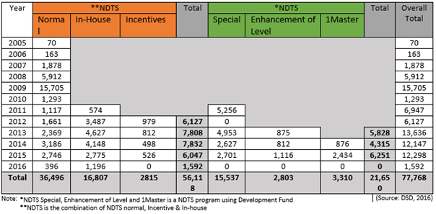
Participation of Apprentices from 2005 till 31st March 2016

Slide 6
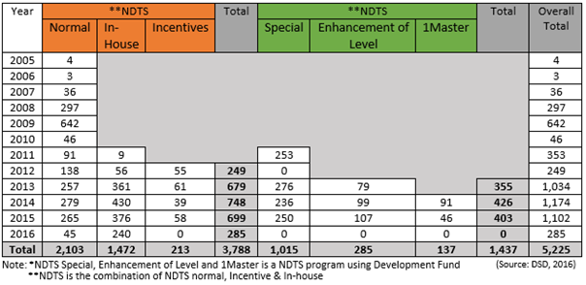
Employer Engagement in Apprenticeship Training from 2005 till 31st March 2016

Slide 7
Reform of the VET system
On May 19, 2004, the Malaysian House of Parliament approved the National Dual Training System (NDTS)
Private sector collaborate with the public sector by sharing resources.
Better coordination between state education institutions and private industry
The government’s delivers tax incentives and payments for training places.
Quality of cooperation must be monitored and evaluated

Slide 8
Process oriented vocational learning
order
planning
…
Technical
realisation
Technical
approval
by customer
Order flow of the industrial work process
Content of the vocational learning is derived from the work and business process
Target: action orientation for training and professional education and training
Notes:
Prozessorientierte Ausbildung
Die Neuordnung der Metall- und Elektroberufe 2003/2004 berücksichtigt die Qualifikationsanforderungen wie sie arbeitsorganisatorisch in den Betrieben nach Vorgabe der Geschäftsprozesse längst Realität wurden.
Die Rahmenlehrpläne und Ausbildungsordnungen sind deshalb nicht mehr wie 1987 nach fachsystematischen Lehrgängen aufgebaut, sondern darauf ausgerichtet, dass die Auszubildenden einen Überblick über den gesamten Arbeits- und Geschäftsprozess erhalten und lernen, wie man einen kompletten Kundenauftrag von A bis Z bearbeitet.

Slide 9



Our research questions:
Issues:
i. How does one evaluate the collaborative performance of the public training institutes and private industry in the implementation of the Malaysian National Dual Training System?
ii. Can such an evaluation lead to an improvement of the dual cooperation element in the system: here employers and here training institutes?
iii. What is the appropriate framework to be used to infuse an active collaboration?

Slide 10

Two Implications:
First implication
Feedback from the industrial and TVET players
Focus group workshops - convergence and divergent opinions and experiences with the Learning cooperation
Actual performance of the Learning cooperation
Results of the working group to use for improvement
Second Implication
To look at the best working collaboration frameworks
Identify the key components/elements, process factors influencting a good outcome for apprentices, companies and VET institutes

Slide 11

Key components/elements: Criteria
i. Goals of cooperation are clear, well defined and achievable.
ii. Partnership development addresses communication, collaboration
and trust.
iii. Management of partnership addresses rules and procedures, clear
allocation of responsibility and fair distribution of modules to be
implemented according to agreements.
iv. The Impact of learning competencies responds to the needs of
students, instructors and coaches as well as organizational learning.
v. Evaluation of the collaborative performance in the dual system are
clearly defined. collaboration between Institute and company is
working well, growing apparent interest for the dual system and
whether the dual system has improved

Slide 12
4 Findings and their significance

Slide 13
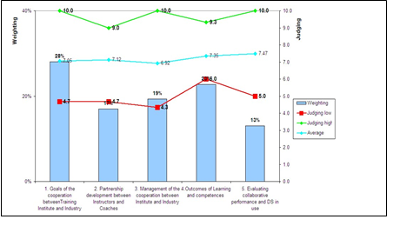
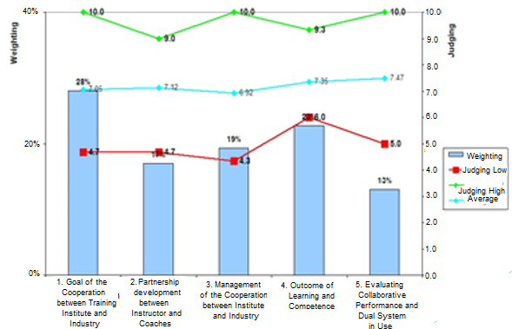

4 Findings and their significance

Slide 15
EXAMPLE: Interim Results of stakeholder interviews, one evaluation workshop: company perception on NDTS
Industrial partners, especially the small ones, feel that they benefit too little from NDTS;
Lack of good information for all companies in Malaysia.
Lacking skill on training in SMEs; missing skilled trainers
companies fear misconception („bad swing“) between what is learned in the college and what can be learned in the enterprise
participation of bigger companies in NDTS has a lead function for SMEs
Local work and learning partnerships require a set of different tools for planning, experience and evaluate cooperation
Industrial and school participants of the evaluation tool workshop gave full support and recommendation for the ERC Tool: Monitoring or formative self evalaution
They regard as most important criteria:
(first): development of trust under industrial and school partners,
(second): Monitoring of apprentice competence achievement
(third ): achievement of defined cooperation goal
(fourth) Continous evaluation of the cooperation.

Slide 16
Learning effects of the Focus Group through the participative evaluation of collaborative performance and the dual system in use

Slide 17
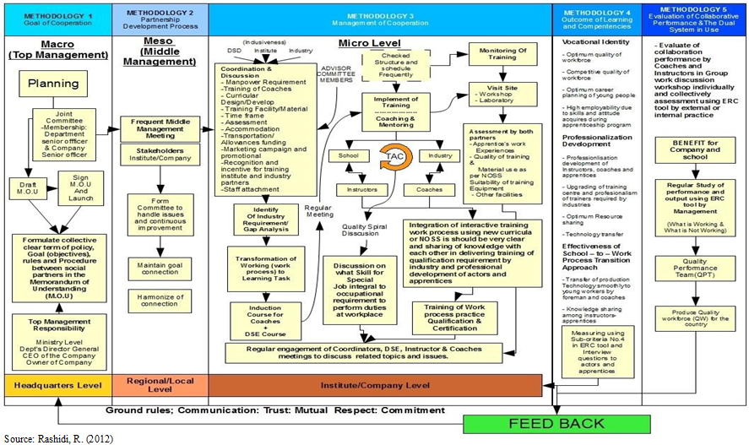
The holistic view of the Framework for Effective Collaboration in NDTS

Slide 18
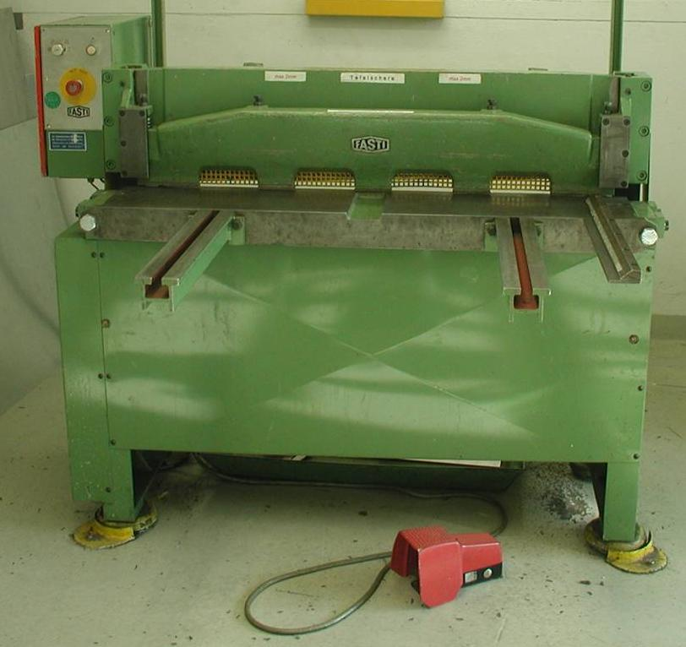
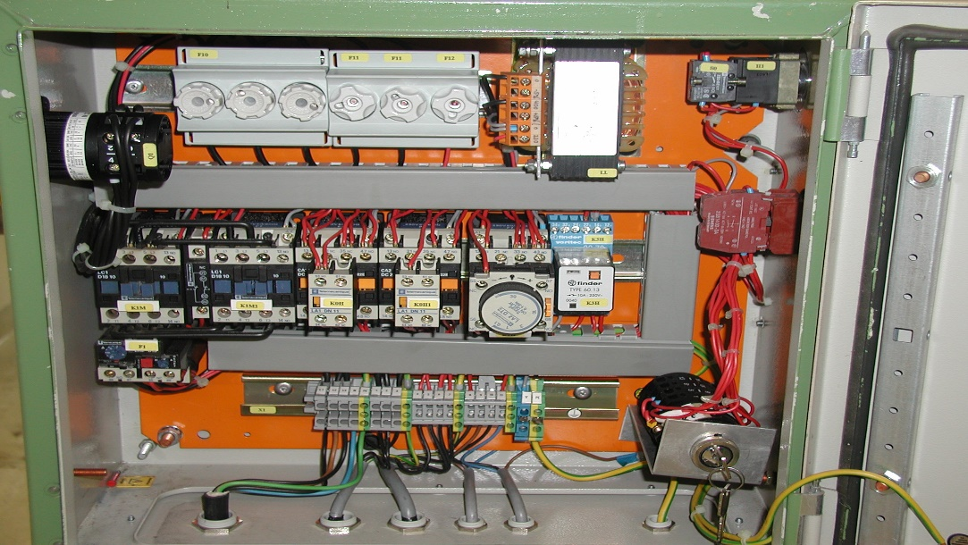
Example of a Work and learning task (wlt)
Ensuring and Enhancing safety on a metal cutter

Slide 19
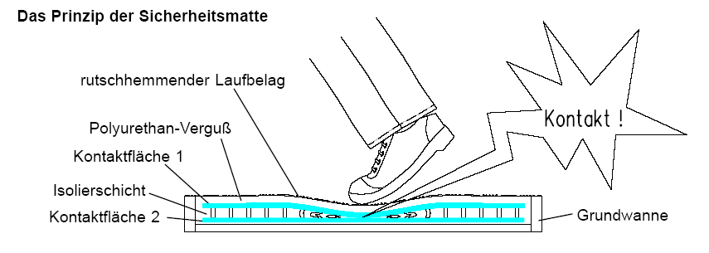

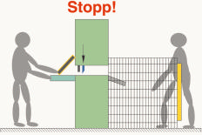
Variants on problem solving to ensure safety while working with the machine
Notes:
Schichten werden abgebaut, welche Arbeiten werden noch selbst gemacht?
Welchen Zugang braucht ein MA zu der neuen Technik:
Was muß er darüber wissen
Welche Aufgaben sind damit zu lösen
Es ist nicht damit getan neue Technik im Labor zum laufen zu kriegen

Slide 20
Learning Task Evaluation: SEVALAG

Slide 21
The studies found that:
The goal needs to be explained and discussed and be transparent to all individual partners.
Trust and communication between partners is extremely crucial in maintaining the current close relationship and understanding of each other’s roles.
Explicit allocation of tasks and work distributions satisfies partners.
Sharing roles in increasing the learning organisation through a dual system with minimum expenditure has motivated the partners.
The dual system still has a deficiency to a certain extend (module argument) but more time is needed to see improvements.

Slide 22
Use of self evaluation instruments in cooperation terms:
Instrument for improving learning partnerships
Supports reflecive re-orientation on own task and responsibilties
High identification of actors with the evaluation results
Quality of different work and learning task to be improved
Rather quick visualisation of strenght and weaknesses
Develops insights for improvements

Slide 23
Follow up discussion points:
Brought NDTS an image increase for VET?
Do the students/parents decide for a professional VET track instead of academic education track?
Do research outcomes influence the developments in these countries and help to formulate policy better?
What can other Countries learn from the developments?

