Slide 1
Building bridges between schools and industry:
The Mauritian Experience
London Conference on Employer Engagement in Education and Training 2016
Dr Shalena Fokeera-Wahedally
21 July 2016

Slide 2
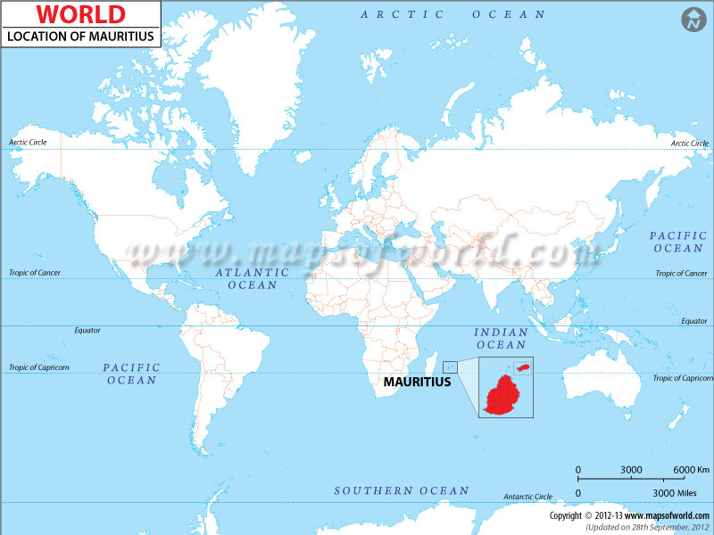

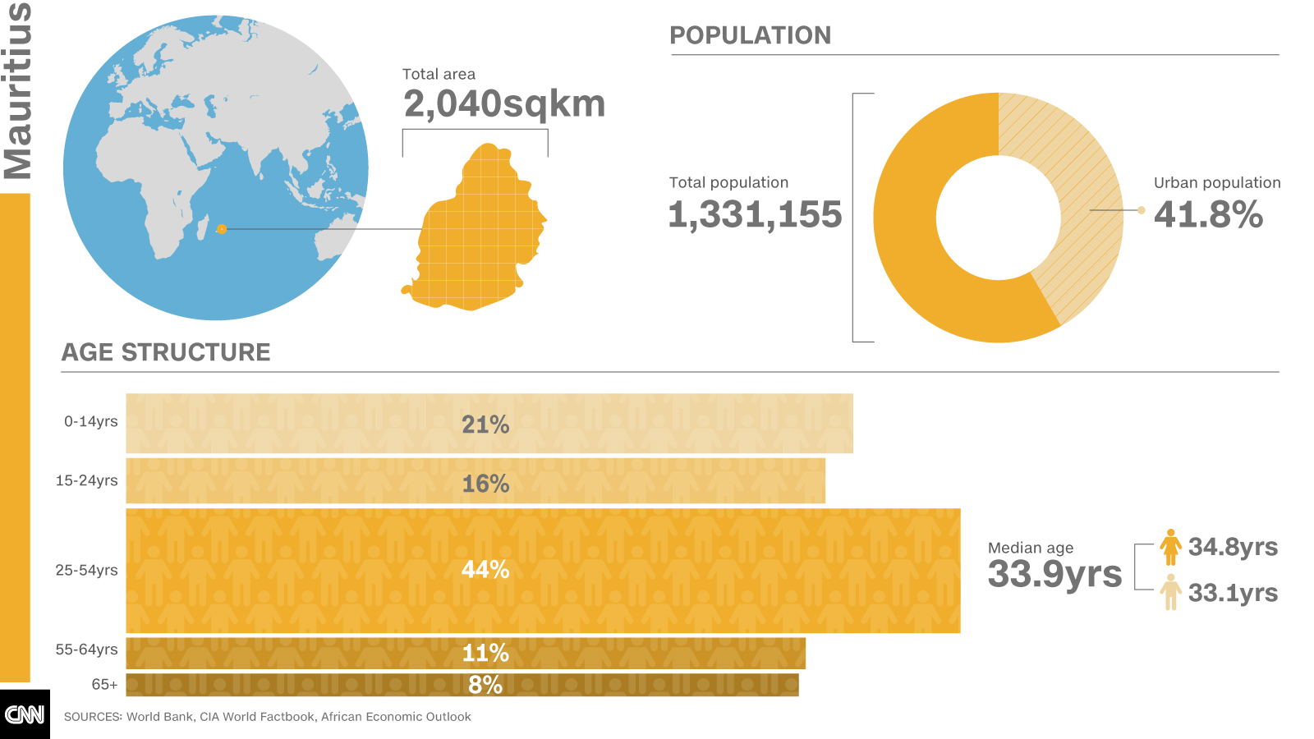
Population – ~ 1, 332 000
Students’ population at secondary level – 115 000
Students’ population at 16+ level - ~ 22500
The labour force for year 2015 was estimated at 584,600 and employment at 538,300
The estimated number of unemployed for 2015 was 46,300. The unemployment rate worked out to 7.9%.
Former French and British Colony
Independent since 1968
Republic since 1992
Member of the Commonwealth

Slide 3
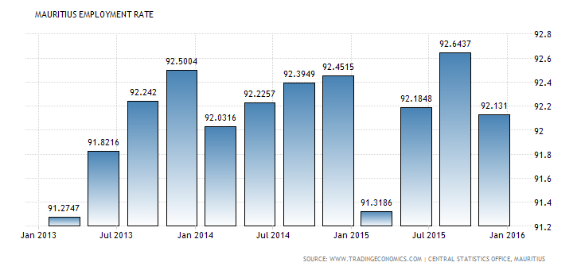
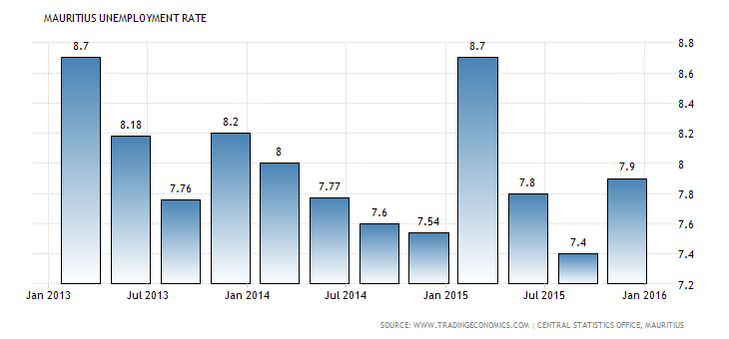
Most of the workers (79%) were employees.
Among the unemployed, women outnumbered men (26,800 compared to 19,500) though they were generally more qualified.
Unemployment rate was highest at the lowest age groups and decreased progressively with increasing age.
Youth (aged 16 to 24 years) unemployment rate stood at 26.3% (21.6% for male and 32.7% for female).

Slide 4
Mauritian Education System
Primary exams- CPE
Pass = secondary Failure = vocational
Modelled after the British education system
  2 years preprimary
  6 years primary
  7 years secondary
  Post secondary
  education
Free schooling
Free transport
Free textbooks at primary
3 years lower secondary
2 years leading to the School Certificate- O level - University of Cambridge
2 years leading to HSC
A levels - Cambridge

Slide 5
Higher School Certificate - HSC
Exists for more than 50 years
Highly competitive
National laureate/ scholarship scheme
Highly academic
Recognised worldwide
Prepares students for the University

Slide 6



End of Secondary Cycle Education
11 000
16 000
Higher School
Certificate (HSC)
SC
2 500 compete
Out of 8500 + (1500)
HSC Professional
(HSC Pro)
1500 successful
candidates drop out
School-based
component
Workplace-based
component

Slide 7
What do our students do after their HSC?
After HSC (an initial population of 11000)
8 800 students are successful
2200 unsuccessful students might go for employment
4000 students go for higher studies
4800 students go for employment

Slide 8


Employers Students

Slide 9
Mahmood Cheeroo, former secretary of the Chamber of Commerce and Industry:
“We need young people who can adapt to the system. There must be a wider choice of subjects and more 'soft skills'. We need to review our entire educational system.”

Slide 10
Roland Dubois, ex-president of YEP
“…Another issue is the problem of mismatch of qualifications……”.
“The other problem that we have is not just a qualification mismatch but also lack of skills. …..Also, companies look for people who have experience and a youth who has just graduated from university does not have the necessary working experience. Another issue is lack of employability skills. Youth have just been taught to concentrate on their field of studies, however they are not aware of the labour market, they lack communication and CV writing skills, and they do not even know how to convince and negotiate with people. …”

Slide 11
HSC Pro - Development
Introduced in 2007
Consultations with Université Laval & Sherbrooke University in Quebec & with Cambridge in the UK
Focus group with stakeholders:
    Employers
    Educators
    Policy makers
    Students
Cambridge involved in developing the curriculum content of the HSC Pro
Acceptance of HSC Pro as an suitable model by the Mauritian Education System
Introduced on a pilot basis in 2015

Slide 12
ICT Sector in Mauritius
ICT sector - Mauritius’ GDP at 6.8%, 3rd economic pillar of the island.
Value added – Rs bn 19.4 in 2012 (compared to Rs bn 6 in 2002)
Growth Rate– 9.5 per cent in 2012

Slide 13






Aims & Objectives of the HSC Pro
Aims:
Objectives:
Completion
& Pass rates
Alternative Pathway
1
1
Lifelong learning & Employability skills
Mismatch bet. Academic &
Work skills
2
2
Fit for purpose
3
3
Economy

Slide 14
Guiding Principles
HSC Pro at par with the traditional HSC
Recognition of the qualification by universities and employers
Provide the opportunity for Higher Studies
Provide opportunities to experience relevant work placement
Be directly employable
Develop critical and analytical skills through the syllabuses offered

Slide 15
Structure of the HSC Pro
The HSC Pro Curriculum comprises
three main components
Main Subjects
Work Placement
Subsidiary Subjects
2 or 3
A-level courses
including
Mandatory
&
1 or 2
AS-Level subjects
Global Perspectives
(mandatory)
Cambridge Technical IT

Slide 16

Benefits to the student
Acquisition of employability skills
Chance of immediate employment
Flexibility in assessment
Potential for upgrading qualification
Possibility for sponsorship for HE

Slide 17
Benefits to employers
Provide opportunities for involvement in the education and development of their future workforce
Enable potential recruitment of new employers who can be immediately productive

Slide 18
Benefits to schools
Catering for a diverse range of learning needs;
Providing a relevant curriculum which develops skills appropriate for lifelong learning;
Provide opportunity for ongoing professional development of teachers who have a direct link with the reality of the industry

Slide 19



HSC Pro Pilot Schools
Boys – 2
Girls – 3
Mixed - 6
SSS – 3
National - 1
BEC - 2
MGI - 2
Private - 3
Le Chou College
Goodlands SSS (B)
Universal College (B&G)
Rabindranath Tagore SS (B & G)
Manilall Doctor SSS (G)
St Mary’s West College (B &G)
Belle Rose SSS (G)
New Educational
College (B&G)
MGSS Solferino (B & G)
S Bissoondoyal SS (B)
Loreto College Mahebourg (G)
KeatsCollege (B&G)

Slide 20
What has been done for the piloting?
Expression of interest from schools, educators and students
Consultation with employers in:
  The development of the syllabuses
  The work placement component
12 pilot schools

Slide 21
What has been done for the piloting?
Training of educators
Briefing of Heads of schools
Recruitment of companies
Training of workplace supervisors
MoU with employers
Insurance cover to students
Transport cover
Upgrade of schools’ infrastructure

Slide 22
Period for the Work Placement
PERIOD |  | DURATION OF PLACEMENT
YEAR 1 | April Holidays | 1-2 weeks
 | August Holidays | 2-3 weeks
 | Oct- Dec Holidays | 5 weeks Last week of October to first week of December
YEAR 2 | April Holidays | 2 weeks
 | August Holidays | 2-3 weeks
 | Oct- Dec Holidays | No Placement

Slide 23
Work placement component
During school holidays
Meeting and link established between the educators and the workplace supervisors
Link to their syllabuses

Slide 24
What we have observed?
Students have opted for the HSC:
  Potential to get real work experience
  Greater possibility to secure a job
  Less final exam pressure
  No other option – otherwise would drop out from school or repeat the class

Slide 25
Why do students opt for the HSC Pro?

Slide 26
What we have observed?
Students who have opted for the HSC Pro:
  Come from economically deprived households:
    Manual worker
    Skilled worker
    Semi – professional
    Professional

Slide 27
What we have observed?
Schools with a ‘5 star’ reputation have been less diligent and committed
Schools with strong leadership and management and committed and dedicated educators are coming out of the lot

Slide 28
Students’ feedback on the course
Students are acquiring important skills such as:
  Self- learning
  Responsibility
  Employability skills
Committed teachers learning a whole new approach to teaching and assessment

Slide 29
Linkbynet
“Joe a été pendant toute la durée de son stage, un collaborateur très sérieux et appliqué avec un comportement exemplaire. Il a su accomplir toutes les missions qu’on lui a attribuées avec brio et ce stage, j’éspère que ca va l’aider et le motiver a avancer dans ses études et sa carrière professionelle. Il a beaucoup de potentiel pour y arriver.”

Slide 30
Mauritius Telecom
“Has been very participative in discussion with staff and shown good enthusiasm to learn more. Was very proactive on customer interaction.”

Slide 31
Nesco Ltd
“She is a very attentive girl, obedient, shows interest in learning new skills., well groomed, good team player, improving her adaptability to work under pressure.”

Slide 32
Data Communications Ltd
“ Good team player with lots of potential;
Could gain from being a bit more strict with himself;
Did his best but stops were he could do more;
Very good at handling tasks given with no effort.”

Slide 33
BPML
“Lakshana has been clever and confident during the placement. She has good analytical skills and was persistent in completing her tasks. She also raised several points that can add value to the information systems at BPML. Lakshana is well mannered and has been appreciated by the staff.”

Slide 34
Main challenges
Not respecting deadlines for the submission of work
Lack of commitment and support from certain heads of schools and teachers
Qualification perceived as being for less academically able students
Absenteeism
Lack of commitment of certain employers
Maintaining link between schools and employers

Slide 35
Way forward
Review of pilot schools
Bringing in a scholarship scheme
Review of the work placement periods
Consolidating the team at the MES
Introduction of new strand in the HSC Pro
More training and support

Slide 36
Thank you

