Slide 1
Engaging Employers Sustainably Through One-Hour ‘Career WorkOut’
Tom Bulman
Notes:
Worktree
MK-based, a company since 1992, charity since 2001,
Now focused on scaling up ‘Career WorkOut’

Slide 2
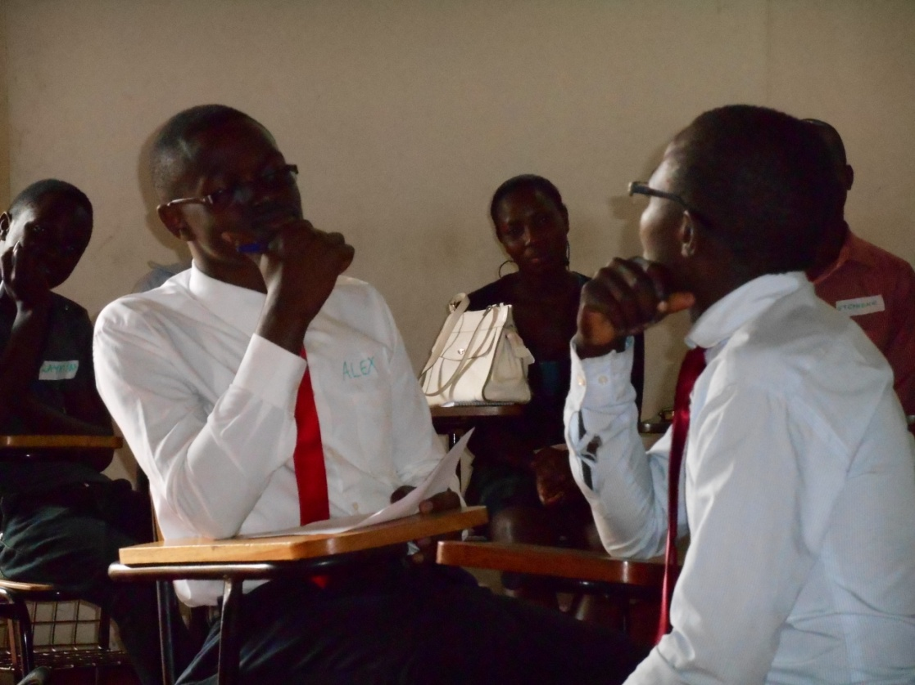
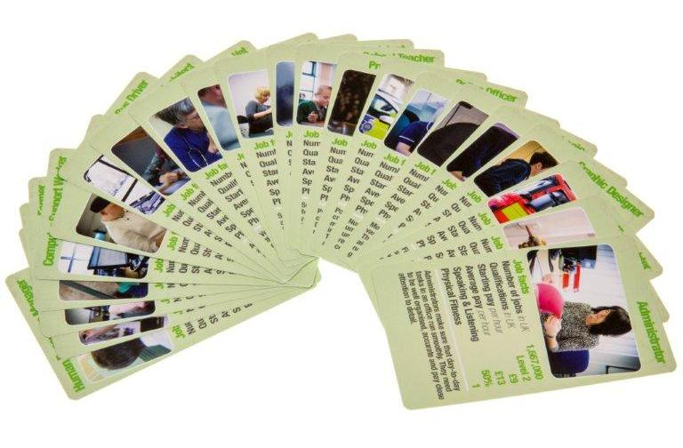
Notes:
arranged 50,000 work placements; ran a full-time Citischool ‘school without walls’, later became iPEC with annual roll of 50 excluded teenagers; in 2012, produced ‘World of Work’ career trump card, now used in 500+ UK schools; in 2013-15, visited Uganda, China and India to train teachers and trainers to deliver employability training.

Slide 4
Research evidence
Pupils achieve more in school if they have work aspirations (IoE, 2012)
Young people prefer careers information directly from employees (City & Guilds, 2012)
The more employee contacts they have, the more they learn about work (E & E Taskforce, 2011)

Slide 5
E ≈ (Q + S + WE) x C

Slide 8
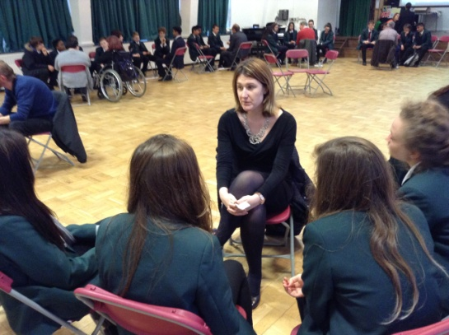
Notes:
Kate Webster, Hewitsons

Slide 9
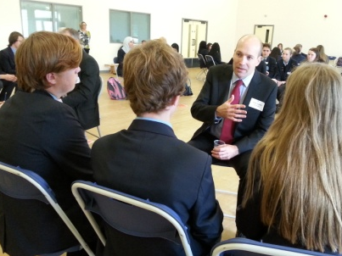
Notes:
Alan Cusdin, Santander

Slide 10
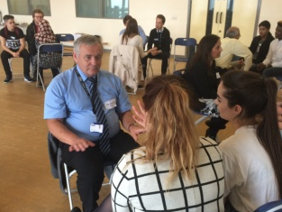
Notes:
Alan Almond, NHBC

Slide 11
Typical Questions
What’s your job?
How did you get it?
Why do you do it?
What would you change about it?
What advice would you give...?

Slide 12
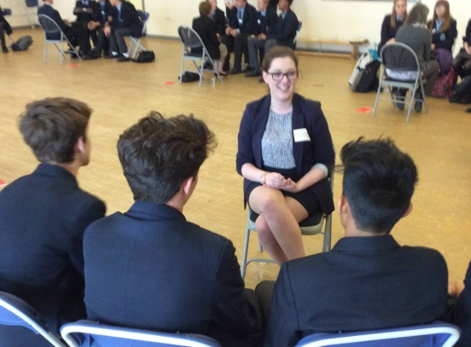
Notes:
Becky Taylor Willis, Keen Shay Keens

Slide 13
Notes:
Andrew Hall, Haywood Mann

Slide 14
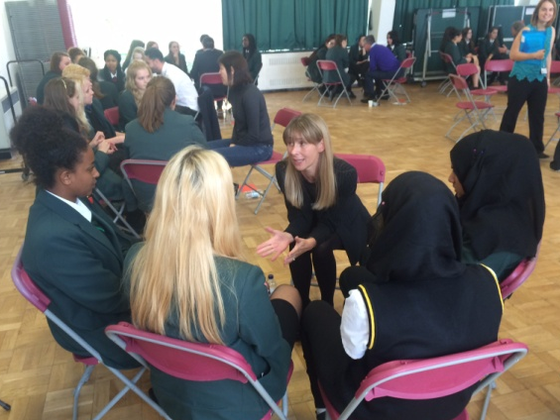
Notes:
Trisha Merry, Barclays

Slide 15
C E I A G

Slide 17
Tony Nelson, Headteacher of The Hazeley School:
“Feedback from our students and staff strongly suggest that Work tree’s Career WorkOut has had a dramatic positive impact on student aspirations, personal vision and drive. In over two decades in education I have not come across a more effective programme for achieving these goals across such a wide range of students for so minimal investment in terms of time and money.”
Robyn Green, Deputy Headteacher of Oakgrove School:
“Parents have picked up on the value of the Career WorkOut sessions we’ve run for all students this year. Our recent parental survey results have just come in and there has been a significant increase in parents’ rating of careers advice – up 7% on last year’s survey.”

Slide 19
Ofsted
‘Personal Development’ (Ofsted):
a lively and cost effective way of raising career awareness and aspirations
develops employability skills, especially Speaking & Listening to unfamiliar adults
develops students’ respect for others and for life and work in modern Britain.

Slide 20
Employer Benefits
Social responsibility
MK’s future prosperity depends on young workers having good awareness of different career opportunities and strong employability skills.
Staff recruitment
By asking questions about your work, students are introduced to your company and the benefits of working there.
Staff productivity
After participating in a session, 98% work guests agree and 41% strongly agree “I now feel more positive about my work”.
Networking
Chance to meet fellow professionals who share your business ethos.
Notes:
Evidence from first term of operation, Sep-Dec 2015:
At February 2016, 2000 students and 400 work guests participated in 60 sessions. Students experienced
20% increase in 'confidence making choices about my future work options’
20% increase in 'confidence talking to adults I don't know‘
8% increase in 'commitment to learning and achieving'. 99% of guests 'enjoyed the session’ and 98% ‘felt valued’ 100% teachers agreed 'the session helped students develop their employability skills'.

Slide 23
MK 50 Vision
Every young person in MK meets and interviews 50 guest workers before leaving school...
...one in 30 MK workers
volunteers one hour each year

Slide 26
Sponsors 2015-16
Notes:
Career WorkOut 2015-16 is sponsored by MK employers and funded by grants from Natwest and MK Community Foundation.

Slide 27
www.worktree.org/events

