Slide 1
Effective employer mentoring: Lessons from the evidence
Tristram Hooley

Slide 2
About this presentation
This is my personal perspective on how to make school-employer engagement work.
It is not the views of the Company.
References are given at the end.

Slide 3
About the company

Slide 4
Mentoring campaign
“Many people can look back at their younger selves and point to someone, perhaps a parent or teacher, a sports coach, or their first boss, and say ‘that’s the person who found my passion. They’re the ones who made the difference.
But if you haven’t ever had someone in your life who really believes in you, who sees your potential and helps bring it to the fore, the sands of time can drain away, and your talents can remain hidden.”

Slide 6
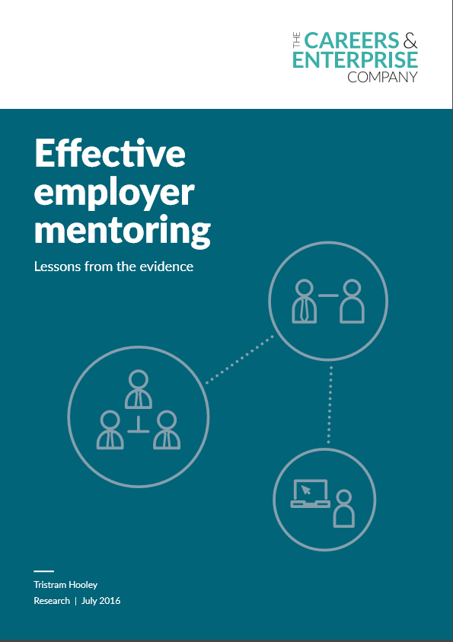

Slide 7
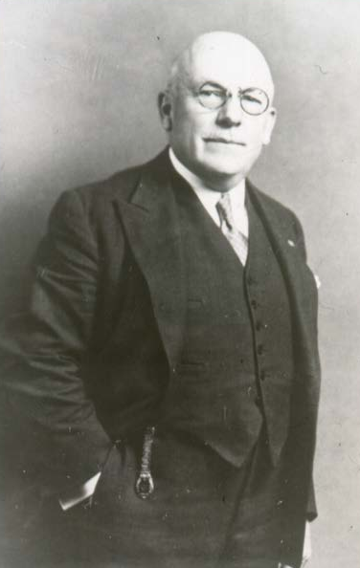
A rationale for mentoring
There is only one possible way to save that youngster, and that is to have some earnest, true man volunteer to be his big brother, to look after him, help him do right, make the little chap feel that there is at least one human being in this great city who takes a personal interest in him; who cares whether he lives or dies.
Earnest K Coulter

Slide 8
A definition of employer mentoring
Employer mentoring is a sustained relationship between an employer, an employee or a self-employed person and a young person, focusing on personal or career development. Employer mentors can help to engage young people in the school, inspire and motivate them, and provide them with meaningful encounters with the world of work.

Slide 9
What impact does employer mentoring have?
There is a substantial evidence base supporting the role of employer mentoring in schools.
We can describe the strength of this evidence as moderate to good as it includes high-quality studies and a number of statistical meta-analyses.
The evidence suggests that mentoring can have a significant and observable impact on behaviour, attainment and progression. However, the effect sizes are typically small.
Mentoring is a moderate-to-low cost intervention.

Slide 10
Challenges
Employer challenges. Mentoring is demanding. It can be difficult to recruit and retain mentors. This is particularly the case if you are looking for mentors with particular demographic features.
Schools challenges. The school year is typically very disrupted leading to shorter mentoring relationships.
Relationship challenges. Mentoring is ultimately about relationships between individuals. These don’t always work out.

Slide 11
What makes mentoring work?
The evidence suggests that mentoring needs to be high quality in order to deliver any impacts and that badly organised mentoring can do more harm than good.

Slide 12
Features of quality mentoring
Programme design
Recruitment and screening
Matching
Orientation, guidance and training
Support and supervision
Closure

Slide 13
References
Hooley, T. (2016). Effective Employer Mentoring: Lessons from the Evidence. London: Careers & Enterprise Company.
Prime Minister’s Office, Cameron, D. and the Department for Education. (2016). Prime minister to announce new generation of mentors to help struggling teens. Available from https://www.gov.uk/government/news/prime-minister-to-announce-new-generation-of-mentors-to-help-struggling-teens [Accessed 7th March 2016].

Slide 14
Conclusions
There is a strong evidence base which supports the use of employer mentoring.
Employer mentoring can have a significant and observable impact on behaviour, attainment and progression. However, the effect sizes are typically small.
Mentoring is a moderate-to-low cost intervention.
Mentoring programmes need to deal with employer challenges, schools challenges and challenges in the mentoring relationship.
It is important that mentoring is high quality.
The evidence provides useful insights as to how best to organise employer mentoring.

Slide 15
Contact details
Tristram Hooley
Professor of Career Education
Senior Research Adviser to the Careers & Enterprise Company
thooley@careersandenterprise.co.uk
Also at
http://adventuresincareerdevelopment.wordpress.com
@pigironjoe

