Slide 1
Who is getting advice? Year 11 students’ views on careers education and work experience in English secondary schools
Employer Engagement in Education and Training
July 21st, 2016

Slide 2
Project Team
Dr Julie Moote (Research Associate)
Prof Louise Archer (Principle Investigator)
Prof Becky Francis (Co-Investigator)
Dr Jennifer DeWitt (Co-Investigator)
Emily MacLeod (Administrator)
Lucy Yeomans (Research Student)
Context
Methods
Results
Implications

Slide 3
Project Aims
To understand the changing influences of family, peers, school, careers education and social identities and inequalities on students’ science and career aspirations
To relate these to their actual subject choices and attainment on national GCSE examinations and their post-16 choices
Context
Methods
Results
Implications

Slide 4
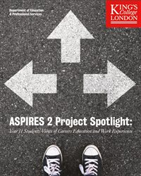
Context
Methods
Results
Implications

Slide 5
Rationale
Support for the impact and importance of careers education
(Harkins, 2001; Hooley et al., 2015; OECD, 2004)
Evidence from career professionals and school leaders, but student perspective also needed
(CDI, 2015; Gatsby, 2014)
Decline in quantity and quality of provision
(Achquah et al., 2016; Beck et al., 2006; National Careers Council, 2013)
Context
Methods
Results
Implications

Slide 6
Research Questions
What sorts/types of careers information, advice, guidance do students report?
Which groups of students are reporting receipt?
Are students satisfied with current provision?
Context
Methods
Results
Implications

Slide 7
The ASPIRES Project
Phase 1 (age 10/11)
Survey of 9,319 Y6 students, 279 primary schools
Interviews with 92 children and 78 parents
Phase 2 (age 12/13)
Survey of 5,634 Y8 students (69 secondary schools)
Interviews with 85 children
Phase 3 (age 13/14)
Survey of 4,600 Y9 students
Interviews with 83 students and 65 parents
Phase 4 (age 15/16)
Survey of 13,421 Y11 students
Interviews with 70 students and 62 parents
Phase 5 (age 17/19)
Survey of Y13 students
Interviews with students and parents
Context
METHODS
Results
Implications

Slide 8
Overview of Online Student Survey
Background information
Aspirations
Attitudes toward school science
Images of scientists
Self-concept in science
Participation in science-related activities
Parental attitudes to science
Peer attitudes
Subject preferences
Careers education and work experience
Context
METHODS
Results
Implications

Slide 9
Overview of Survey Data
Have you been provided with any information from school or career services relating to the jobs you are interested in?
(yes, no, don’t know)
The careers information I have received at school has been helpful.
(strongly agree-strongly disagree)
Context
METHODS
Results
Implications

Slide 10
Overview of Interview Data
Have you met with a careers advisor yet or had any careers talks/meetings? If so, was it useful? (Why/why not?)
(If haven’t met with an advisor yet) Do you know when that happens?
How could this experience have been improved?
Context
METHODS
Results
Implications

Slide 11
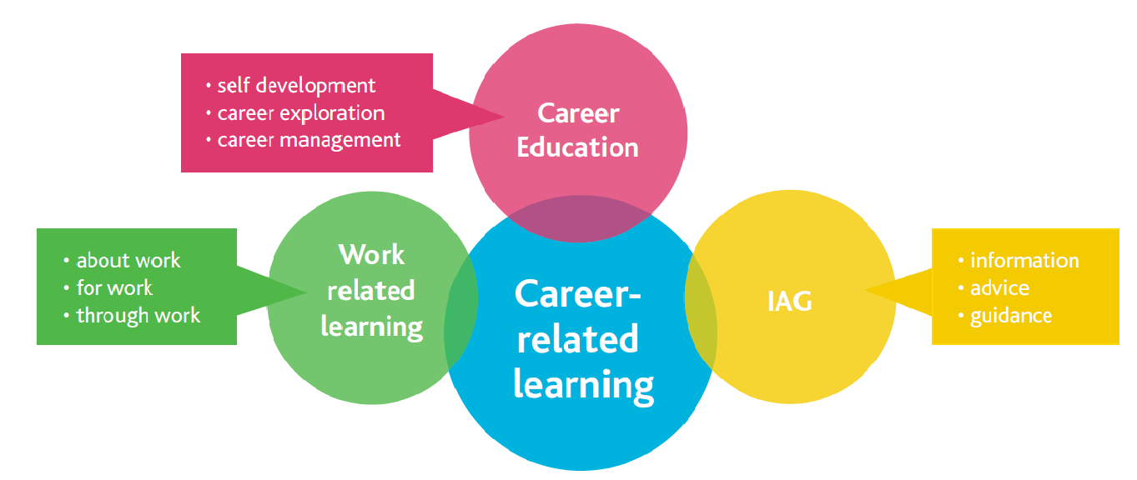
Terminology
Hutchinson (2013)
Context
METHODS
Results
Implications

Slide 12
What types/sorts of CIAG do students report?
Range of experiences (from interviews)
Mostly one-to-one sessions and career talks
Internal and external members of staff
Completed online careers questionnaires
60% of interview subjects had one-to-one session
42% mentioned having career talks at school
11% reported timetabled careers lessons
‘Well we have PSHE which is like, they help us about our careers, our future and stuff like that... But it’s citizenship and basically stuff like that…’
(Kaka, British Asian boy)
Context
Methods
RESULTS
Implications

Slide 13
Who received careers information?
Less than two thirds of survey sample reported careers advice
Clear demand for ‘more and better’ careers education
Less than half of all students reported work experience
Patterned in ways that may be working to promote inequalities relating to gender, ethnicity and social class
Context
Methods
RESULTS
Implications

Slide 14
Male Students
Context
Methods
RESULTS
Implications

Slide 15
White Students
Context
Methods
RESULTS
Implications

Slide 16
Socially Advantaged Students
Context
Methods
RESULTS
Implications

Slide 17
Triple Science Students
Context
Methods
RESULTS
Implications

Slide 18
Top Set or Non Set Students
Context
Methods
RESULTS
Implications

Slide 19
Students planning A-Levels and Apprenticeships
Context
Methods
RESULTS
Implications

Slide 20
Overview of Data
Have you participated in any work experience relating to the jobs you are interested in?
(yes, no, don’t know)
Have you had any workplace experience? If so, who organised it (school, parents, family friends)? Was it useful? (Why or why not?)
Context
METHODS
Results
Implications

Slide 21
Male Students
Context
Methods
RESULTS
Implications

Slide 22
White Students
Context
Methods
RESULTS
Implications

Slide 23
Double Science/Applied Students
Context
Methods
RESULTS
Implications

Slide 24
Apprenticeships and Part-time work
Context
Methods
RESULTS
Implications

Slide 25
Regional Differences
Context
Methods
RESULTS
Implications

Slide 26
Differences by Aspiration
Context
Methods
RESULTS
Implications

Slide 27
Differences by Aspiration
Context
Methods
RESULTS
Implications

Slide 28
Factors contributing to producing these patterns
Too little, too late
Lack of personalisation/ relevance
The self-referral nature of provision
Too biased/ partisan
Prefer to use other sources of information
Context
Methods
RESULTS
Implications

Slide 29
‘Too Little, Too Late’
20% reported support was obligatory
Most reported only offered in Year 11
‘mainly literally just been pushed on us this year.’ (Louise, White British girl )
Only 4 mentioned they had met with an advisor more than once
More than half felt advice was too late
Subject choices already made and issues relating to exam pressure and university applications
Context
Methods
RESULTS
Implications

Slide 30
The Self-Referral Nature of Provision
‘Um, we have a careers advisor, but like to try and find her during break times is so difficult because she’s either in that room over there or she’s in the [other wing] and then it’s like really difficult because they shut. Then you’re not allowed anywhere in school apart from the hub during break time or lunchtime, so trying to get through one set of doors to go find her and then finally you’re in through, not having her there and having to go back to go a different way and then break time’s over and you’re just like well that was … So I kind of gave up on that one.’
(Charlie, White British girl)
Context
Methods
RESULTS
Implications

Slide 31
The Self-Referral Nature of Provision
May contribute particularly to gender trends
proportionately more girls reported that the provision was optional and boys were more likely to report having met with an external careers advisor
May also help to explain the lower levels of access to careers provision reported among Black students
‘…Yeah, or sometimes you just get given it if you don’t feel confident with what you’re doing in the future. You just tell the teacher and then they’ll just book you an appointment.’ (Gemma, Seychelloise girl)
Context
Methods
RESULTS
Implications

Slide 32
Too Biased/Partisan
Over half of the students who reported having met with a careers advisor, felt that the support was overly focused on A level choices
‘She could have like talked about what I wanted to be I guess. I mean she just talked about what A Levels I want to do. And then that was it, she just updated my details and that was it. So I think there’s going to be like a second part of it hopefully.’ (Celina, White British girl)
Desire for impartial advice and guidance
Context
Methods
RESULTS
Implications

Slide 33
Lack of Personalisation/Relevance
‘We’ve had a lot of careers talks. People come out of lessons and they have these talks, but I don’t think they’ve actually helped me at all. I wouldn’t expect them to I don’t think, because it is quite a specialist thing, so I wouldn’t expect them to get someone in just for that, but yeah they are quite concerned about everyone getting careers talks.’
(Finch, White British boy with Indian/Italian heritage)
Context
Methods
RESULTS
Implications

Slide 34
Lack of Personalisation/Relevance
‘If it was like kind of a smaller group, like kind of a one on one meeting. Cos the way we did it was like everyone in the hall, and sat on tables and stuff, and it was just noisy, you couldn’t really hear anything.’ (Gemma, Seychelloise girl)
‘…they’ve been very vague and not very helpful…They just gave us a website and you had to just Google like what job you want to do…It’s not like oh sit down one to one. Like what do you think you’ll do in the future?’
(Carol, White European girl)
Context
Methods
RESULTS
Implications

Slide 35
Lack of Personalisation/Relevance
May contribute to gendered patterns
proportionately more female students reported that they found meetings with careers advisors and career talks unhelpful
In contrast, 81% of boys who reported having met with a careers advisor expressed that they felt the meeting was useful
Context
Methods
RESULTS
Implications

Slide 36
Preference For Other Resources
Girls and students from South Asian communities more likely to discuss career aspirations and plans with family
‘Um, well in my school we have a careers advisor, so I could go to her. Um, but I could just go to my dad and if he doesn’t know he can just ask around. Um, if not I can look on the internet, so the other day I actually looked to see what kind of jobs there are in paediatrics and surgery and what you can specialise in, so …’
(Isabel, Sri Lankan girl)
Context
Methods
RESULTS
Implications

Slide 37
Key Messages
Careers education is failing to reach those most in need; girls, minority ethnic, working-class, low-attaining students, who plan to leave full-time education or are unsure of their post-16 plans
Urgent attention needs to be given to acknowledging and redressing inequalities in terms of who is, and who is not, participating in careers education and work experience
Context
Methods
Results
IMPLICATIONS

Slide 38
What might be done?
Policy needs to focus on ‘participation’, not just ‘provision’
Dedicated resourcing to target, engage and support disadvantaged groups
Address regional differences in work experience and explore ways of providing more work experience in fields such as science and law
Take particular care with respect to schemes and opportunities that are offered on an ‘opt in’ and/or ‘selective’ basis
Context
Methods
Results
IMPLICATIONS

Slide 39
Keeping in touch/ further Info
www.kcl.ac.uk/aspires
www.kcl.ac.uk/enterprisingscience
Follow our research on Twitter:
@ASPIRES2science
@enterprisingsci
Enterprising Science: science capital seminar videos: https://www.youtube.com/playlist?list=PLun2jODy9M2cvE3bgJ-UCc0dotvrSfRVG
** NEW** ES project Science capital 2 min animation: buff.ly/1KLEbN7

