Slide 1

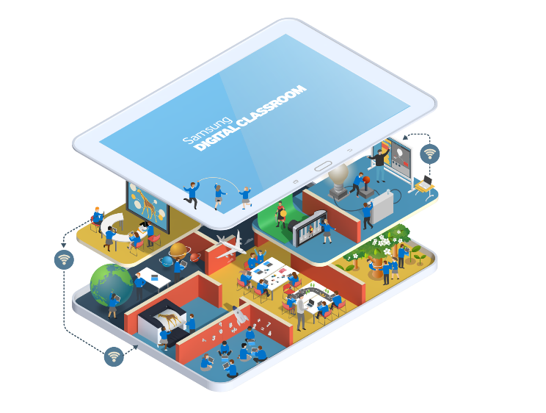
21st century thinking:
How we can use technology to inspire a generation of creative and collaborative thinkers

Slide 2




Where it started
Skills
gap
5m young people in Europe (22% of total)
Over 750,000 in UK are unemployed
900,000 ICT jobs unfilled in Europe by 2020
750,000 UK digitally skilled employees needed by 2017
“The evidence is clear...only urgent action...can prevent this skills crisis from damaging our productivity and economic competitiveness.” Science & Technology Committee (June 2016)
Samsung’s Citizenship Commitment in Europe (since 2013)
Digital Classroom
Digital
Academy
400,000 young people directly benefited by end 2019
Access to technology
Youth employment
Digital Skills
Notes:
This project started when we began to consider the skills gap and how we might help.
We realised that its not just about techy jobs of the future, although there is a shortage of tech skills
This is about the wider issues of the digital literacy that we all need
95% of all jobs require basic digital skills
We need to prepare young people in the UK for this future, for their benefit and for our overall economic success.

Slide 3

It’s not…
if you know how to use a tablet, or
if you know how to code but….
it’s about future-proofing
our children with skills for the future
“In the end, technology can amplify great teaching, but great technology cannot replace poor teaching” Andreas Schleicher, OECD, 2015
creativity
creating
experimenting
Problem-solving
Self-learning
Life-long learning
INCLUSION
ASPIRATION
INNOVATION
sharing
communicating
Notes:
It’s about more than knowing how to use a tablet or code.
It’s about making sure our children can use technology to innovate
While we recognise that the delivery of STEM subjects is hugely important for the UK’s future, we want to encourage young people to combine technical knowledge and skills with the creativity and confidence that leads to the most innovative and successful ideas.
At Samsung, we want to inspire learning and innovation.

Slide 4
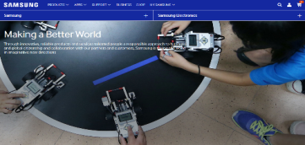
Creativity and collaboration is key
Creative thinking and collaborative problem-solving allows us to achieve breakthrough innovations.
Technology has advanced this way, but can help accelerate this process for the next generation. Crucially though, there needs to be a desire – a life-long passion for discovery.
Notes:
At the heart of what we are trying to achieve is creativity
We want to inspire the next generation to use technology to imagine, work together and create

Slide 5

Our Digital Classroom programme
We are working with partners to explore how we can think about the role of technology in education in new ways.
Notes:
We have been working with teachers in schools across the UK to explore how technology can help education and young people
How it can inspire them
Help them work together
And ensure that no one gets left behind
The role of the teacher is crucial in ensuring that we deliver practical solutions for the classroom

Slide 6



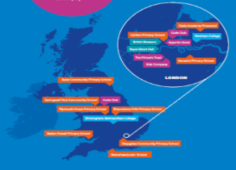
2013-2016, 3 years of Digital Classrooms
13 schools across the UK, part of global network
of over 2,400 Samsung partner schools
In areas facing economic and social challenge
- High % Free School Meal/Pupil Premium,
- Special Educational Needs
- English as an Additional Language
Visionary head teacher and passionate champion teachers! Reaching 20,000+ children and young people every year
Notes:
The schools and partners we have chosen to work with are all facing challenges
We want to explore how technology can help overcome these challenges
We’ve supported with kit, with technical support and training.
We’ve encouraged our teachers to share.
And with our partner, EdComs, we’ve sought to measure the impact of our work

Slide 7


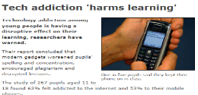

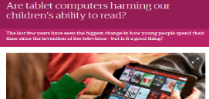


At a time when ….
Notes:
We have been working with teachers in schools across the UK to explore how technology can help education and young people
How it can inspire them
Help them work together
And ensure that no one gets left behind
The role of the teacher is crucial in ensuring that we deliver practical solutions for the classroom

Slide 8






We’ve taken the learnings and…
Informing other Samsung initiatives
- Samsung Digital Academy for Teachers at Harborne Academy
- British Museum Samsung Digital Discovery Centre
- Samsung Digital Classrooms at the Royal Albert Hall, V&A
- Samsung Digital Classrooms at The Prince’s Trust centres
Sharing our experience with others
- Conferences, education events
- TechUK’s white paper on Digital Skills for government
- ‘Technology in education a system view’ research report with Education Technology Action Group
- ‘Digital Families’ research report with Bournemouth University
Notes:
The schools and partners we have chosen to work with are all facing challenges
We want to explore how technology can help overcome these challenges
We’ve supported with kit, with technical support and training.
We’ve encouraged our teachers to share.
And with our partner, EdComs, we’ve sought to measure the impact of our work

Slide 9
Supporting schools
  Technical support
  Regular phone calls
  Equipment
  Online community
  Teacher events
  Independently evaluated
Notes:
The approach has been multifaceted
Schools received equipment: Galaxy Tablets, 75”Interactive Whiteboard, Wireless Printer, Wifi-enabled Galaxy Cameras)
And Tech support – installation training, midyear training days.
Catch-up status phone calls – to ensure issues are resolved
Online community – with teachers, Samsung, EdComs, and tech support – to encourage sharing of ideas
Events for teachers to meet other teachers
Evaluation research – to measure the impact of the programme
Since the start of the pilot there has been frequent dialogue with teachers to support them in teaching. We were keen to not be prescriptive, but give teachers the flexibility to utilise the tech in any way that they choose. The community has facilitated the sharing of ideas, lessons learned and best practice. It’s been an iterative process and interesting to see the schools respond differently.

Slide 10
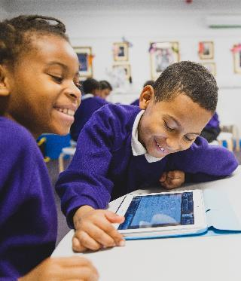
The evaluation
Objectives
Measure the impact of SDC on performance and attainment
Capture changes to teaching and learning practice
Promote and share learning across the participant community and beyond
Our approach
Genuine action research
Grounded in pedagogy, practice and the everyday teaching context
Formative and longitudinal
Qualitative and quantitative
  Equipment
  Online community

Slide 11
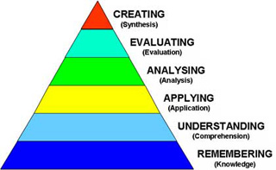
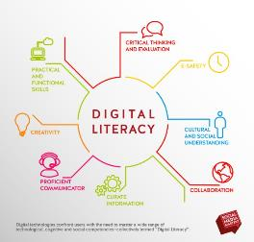

The evaluation Framework
  Equipment
Bloom’s Taxonomy
  Online community
spiritual, moral, social & cultural development
achievement
quality of teaching
behaviour & safety
needs of pupils at all levels, inc SEN

Slide 12
KPIs
KPI | Measurement | Activity
Impact on pupils’ higher order thinking skills | % of pupils indicating improvement on skills such as creating, analysing, evaluating, applying e.g. work creatively, work in team, share knowledge, use information learnt to make decisions | Pupil surveys Teacher surveys Teacher interviews
Impact on pupils engagement / enjoyment | % of pupils who enjoyed lessons using SDC Reported pupil behaviour in lesson | Pupil surveys Lesson observation
Impact on pupils’ digital literacy skills | Change in % of pupils able to perform ICT related tasks Reported pupil behaviour in lesson | Teacher surveys Pupil surveys Lesson observation
Impact on Ofsted criteria | % of pupils who learnt about E-Safety | Teacher surveys
Impact on teaching style | No. of teachers who have increased confidence No. of teachers changed their teaching style | Teacher surveys Teacher interviews Head teacher interviews
Impact on whole school / community | No. of head teachers reporting a change to teacher and pupil attitudes across the school No. of head teachers who have changed their ICT strategy No. of schools conducting community based activities | Head teacher interviews Teacher interviews

Slide 13
Digital classroom mixed method research
Sept
July
Benchmark head teacher / teacher telephone interviews
Teacher
start of year surveys
Teacher
end of year surveys
Samsung Digital Classroom installation
Pupil / teacher
start of year surveys
Pupil / teacher
end of year surveys
Three year engagement:
Sept 2013 – 5 schools
Sept 2014 – 10 schools
Sept 2015 – 13 schools
School case study visits: 360 feedback

Slide 14
Pupils’ technology access at home increased
Access to internet at home
Use a digital device for schoolwork at home
*
Q. 8 Do you have access to the internet at home?
Q. 10 do you use a computer, laptop or tablet for doing school work at home?
Base (Total Sample): Pupils (379 start of year) (248 end of year)

Slide 15
Pupils’ access to devices at home increased
Pupils’ access to devices at home
*
*
*
*
*
*
*
*
Q. 9 Which of these devices are available for you to use easily at home?
Base (Total Sample): Pupils (379 start of year) (248 end of year)

Slide 16
Increase in lesson activities
Frequency of computer or tablet usage at school
Searching the internet
*
*
*
Playing educational games
*
Writing
*
*
Working on a project with other children
*
*
*
*
Q. 11 How often do you use a computer or tablet for each of these activities at school?
Base (Total Sample): Pupils (379 start of year) (248 end of year)

Slide 17
Increase in lesson activities, including higher order thinking skills
Frequency of computer or tablet usage at school
Presenting and explaining ideas
*
*
Reading stories
*
Drawing pictures
*
*
Writing code
*
Q. 11 How often do you use a computer or tablet for each of these activities at school?
Base (Total Sample): Pupils (379 start of year) (248 end of year)

Slide 18
Digital literacy improved
Ease of doing tasks on a computer
*
*
*
*
*
Q. 12 Do you find it easy or difficult to do the following tasks on a computer?
Base (Total Sample): Pupils (379 start of year) (248 end of year)

Slide 19
Samsung Digital Classroom supported pupils’ learning
Helpfulness of equipment in doing tasks*
*
*
*
*
*
*
*
*Note: This question used the term ‘computer’ at start of year survey and ‘Samsung equipment’ was used for the end of year survey
Q. 21 How helpful do you find the Samsung equipment when doing the following activities?
Base (Total Sample): Pupils (379 start of year) (248 end of year)

Slide 20
Pupils were positive about the Digital Classroom
Views on the Digital Classroom
Q. 15 Do you agree or disagree with the following statements?
Base (Total Sample): Pupils (248)

Slide 21
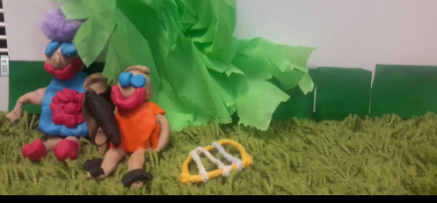
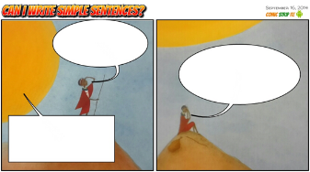
Our research identified increased creativity in the classroom
“The children enjoy blogging and have become critical app reviewers receiving feedback on their writing.” Teacher
Teachers felt the Digital Classroom experience had changed the way they manage their students’ learning in and out of the classroom
Greater creativity and collaborative learning have been at the heart of the change
  85% of pupils reported it is easy to work creatively
  83% of pupils reported it is easy to present and explain ideas
Teachers are learning with their pupils
  Empowering pupils and increasing their confidence
“I have found myself being more creative as a practitioner and trying new ways of teaching more readily through the use of the equipment.” Teacher

Slide 22
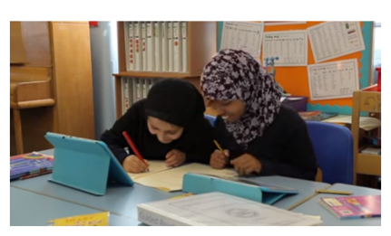
And increased collaboration
Teachers believe pupils have improved their ability to work collaboratively and share work
  Removing the fear of failure
  Developing better relationships with their teachers
85% of pupils say the equipment has helped them to work with other pupils in a team
Pupils are experiencing a different way of learning
Teachers and pupils are working together
  Teachers using technology to give instant individual feedback
“Sometimes the best moments are when you accidentally discover a new way of working together.” Teacher

Slide 23
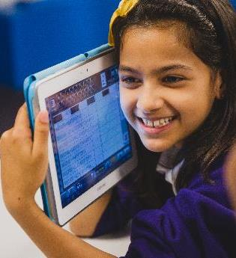
For everyone
Teachers felt it gave flexibility and the capacity to differentiate learning and make lessons far more inclusive
  Improving the quality of work
Pupils welcomed access to a more engaging learning environment and lessons adapted to meet their individual needs
  Pupils who struggled were able to make work more attractive, gaining independence, confidence & pride
  High achievers were able to extend their learning
Disproportionately positive effect of the technology on children who need extra support and motivation
  Specialist apps for SEN pupils

Slide 24
For everyone
“It’s changed my life…it’s helped me learn. I don’t have to sit there with a big massive dictionary now. You can just type in the word and see the meaning.” Pupil
“You can see the skills of the pupils have improved. I have the low ability boys – there is one child who struggles to put a sentence together in class but he’s just a whiz on the tablet.”
Teacher
“They’ve taken charge of their learning and are pushing themselves – that’s what they’ll need in secondary school.”
Head Teacher

Slide 25
Skills and attainment
Teachers felt the Digital Classroom had a positive impact on pupils’ skills
  Including ICT performance and wider learning
Teachers also saw an impact on attendance, with pupils more motivated to come to school
86% of pupils felt they had learned new skills because of the Samsung Digital Classroom
Academic results have improved
  One school had highest ever results for that year group
  A class with access to the Digital Classroom outperformed their peers in both numeracy and literacy
“The children have thoroughly enjoyed being part of a Samsung classroom, they are more confident in using ICT and have shown an increase in motivation when doing homework, in addition to classroom lessons.” Teacher
“So far this year, attendance monitoring suggests the Digital Classroom improved attendance. It’s going to be one of the big impacts which is great.” Head Teacher

Slide 26
Conclusions
Over the course of our programme, we have seen dramatic changes in the way teachers
are using the technology
As a result of this, we have seen real improvements in the skills of pupils, particularly
around creativity and collaboration
  These skills of creativity and collaboration are key to the success of the next generation
We have seen pupils’ attitudes to learning changing
  Resulting in increased engagement, inclusivity and attainment
And the novelty doesn’t wear off, teachers and pupils continue to find new ways to use technology to learn and share
We have seen teachers sharing their learning and best practice within their school and further afield
  Increasing teacher confidence across whole schools
We are keen to share what we have learnt and see others build on it

Slide 27
Questions?
Jessie Park, Samsung UK
Liz Watts, EdComs

