Slide 1




How access to the medical profession is conceptualised by key stakeholders Evidence from a case study of NHS ‘work tasters’ Dr Steven Jones, University of Manchester Dr Anthony Mann, Education and Employment Dr Elnaz Kashef, Education and Employment Ms Rachael McKeown, Education and Employment

Slide 2

Evidence…
Towards optimising policy in practice:
Systems and structures that work for all stakeholders;
Clarity of information and guidance;
More equitable distribution of opportunity among young people;
Towards a theory of work experience:
Human Capital (employability skills)
Social Capital (contacts & networks; connections to people ‘in the know’)
Cultural Capital (self-belief; understanding of ‘the game’)

Slide 3
Research Context
Young people struggle to access to the kind of employer engagement activities needed to enter leading universities and professions
(Huddleston and Stanley 2011; Stanley et al, 2014; Mann and Kashefpakdel 2014; Jones et al, 2015; Social Mobility and Child Poverty Commission, 2012, 2013)
Access varies according to school type and socio-economic background
(Hatcher and Le Gallais, 2008; Jones, 2014; Southgate et al, 2015; Sutton Trust, 2014, 2016)

Slide 4

Case study: the NHS
Largest healthcare system in the world - employer of around 1.6 million people;
Medical Schools students disproportionately drawn from wealthier backgrounds;
(HEFCE 2014; Ferguson et al 2012)
80% of medical school applicants come from 20% of the country’s secondary schools and colleges; half do not provide a single applicant;
(Medical School Council, 2014)
Stereotypical views of the medical profession.
(Greenhalgh et al., 2004)

Slide 5
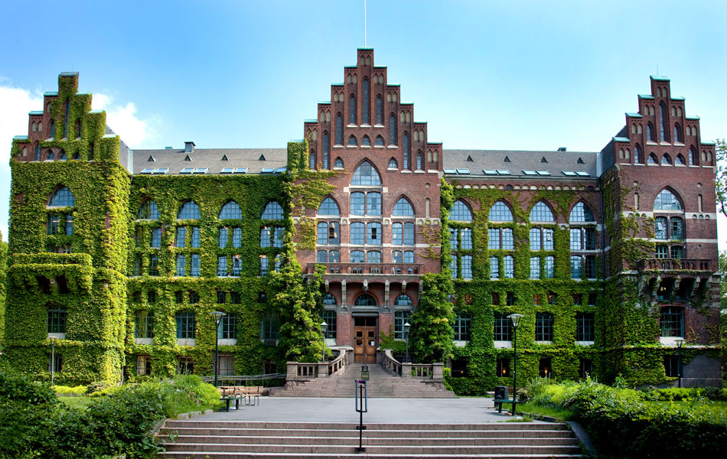
The NHS and access to Medical School
“We expect applicants to have a range of work experience. It is important that you have an understanding of the complex nature of a doctor's role, as well as being aware of the highs and lows of the profession. Work experience is also important in enabling you to develop (and to demonstrate that you have) the relevant skills and qualities that are essential to becoming a good doctor.”
(requirements for entry to Medical school at Russell Group university, cited in Mann et al. 2011, 5)
Russell Group universities overwhelmingly want medical students to have relevant work-based experiences: 88% ‘desirable’ or ‘essential’.
(Mann et al., 2011)

Slide 6
The pilot study and stakeholder surveys
The pilot study:
18 “Work Tasters”: episodes of job shadowing lasting between one and three days.
The stakeholders survey:
707 members of state schools staff, representing approximately one-fifth of all English secondary schools and colleges;
1,074 Medical Students, of whom 964 were under 30 years of age;
317 NHS staff members, evenly split between clinical and non-clinical professionals.

Slide 7



Triangulation of Methods
school staff
NHS staff
medical students

Slide 8
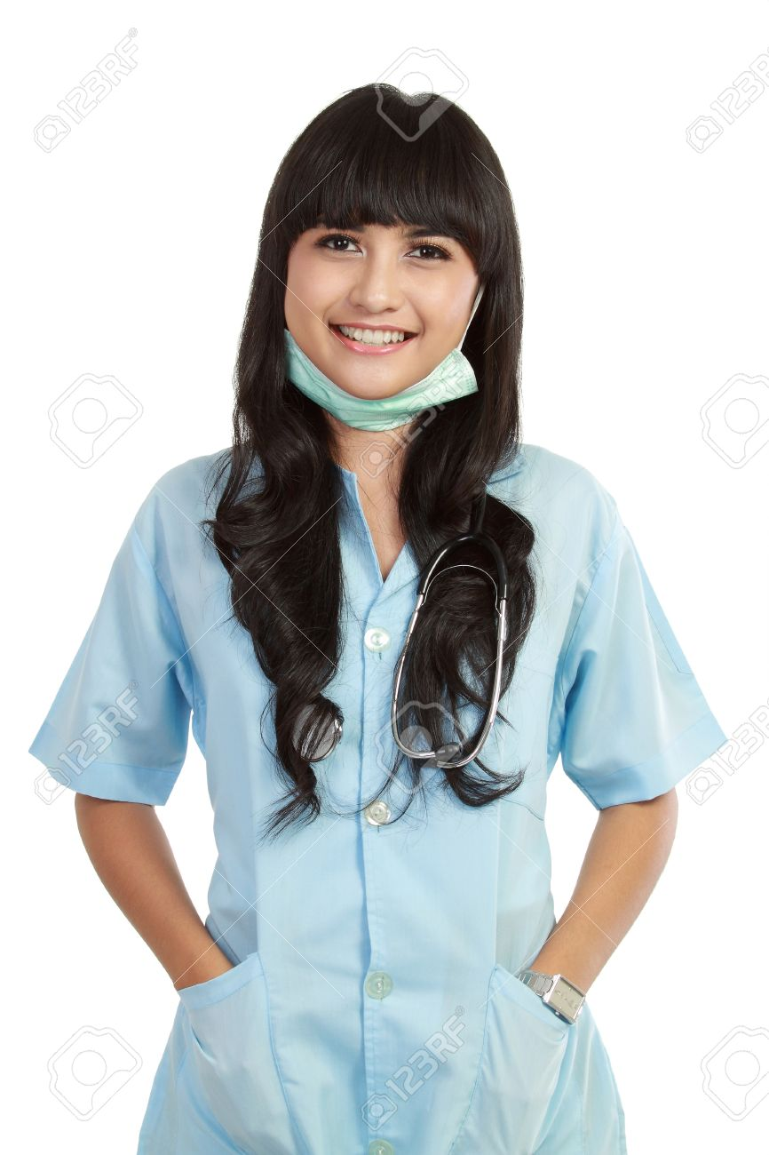
Triangulation of Methods
school staff
NHS staff
medical students
Evaluation
by young people doing Work Tasters

Slide 9
School Staff: How easy or difficult is it for your students to find work-based experience that allowed them to gain insights into what working the NHS is like? (N = 669)

Slide 10
Social Capital for some … but serendipity for others
“The children who manage to get work experience with doctors seem to be 95% from private schools with a parent or parent’s friend who is a doctor”
(NHS staff member)
“It's more that I found it easier I think to apply to medical school because my dad is a doctor so I know what kind of things I need to say on my personal statement because he read through it several times.”
(Medical Student)

Slide 11
Social Capital for some … but serendipity for others
“I was lucky that my aunt was a radiographer who arranged for me to spend time with other radiographers, a physiotherapist and an occupational therapist so that I could show some experience of the NHS. I’m embarrassed to say that my expectations came from episodes of Casualty.”
(NHS staff member)
“Probably the most helpful was job shadowing in radiography, which I found quite fun. [It was] arranged through my Grandma's friend's daughter.”
(Medical Student)
“My brother’s football team mate's dad was a pathologist at the local hospital. He let me shadow him for the morning and took me round all the labs, the mortuary and talked to me about the career path.”
(Medical Student)

Slide 12
Role of schools
“I’d say my secondary school was probably my biggest burden. They had a lack of insight and resources to provide support that more privileged schools have.”
(Medical Student)
“Work placements in any medical/health related field is almost impossible to get. Students are up against hundreds of other students and often what happens is students with parents who are in that field or know people get the placements. Our children's parents don't know anyone. So, huge barriers.”
(School Staff)

Slide 13
Medical Students: “When considering your own career aspirations, did you know anyone (friend or family) who worked in the NHS and was able to offer you trusted and useful advice?” (N= 835)
 | Non-Selective State Schools | Selective State Schools | Independent Schools
Yes (one person) | 25.0% | 24.3% | 22.2%
Yes (more than one person) | 25.8% | 30.9% | 43.3%
No | 49.2% | 44.9% | 34.5%
Total | 496 | 136 | 203

Slide 14
Teacher perceptions of pupil access to sources of trusted and useful advice
% of school’s pupils claiming free school meals

Slide 15
Work Tasters pilot: 1-3 days, 1-3 pupils aged 16+ shadowing 2+ NHS professionals
18 pupils from disadvantaged schools take part in 11 pilot Work Tasters (2015):
Demand: considerable demand for new and better access to NHS workplace experiences from schools and Medical Students;
Value: overwhelmingly felt to be useful in HE applications and career decision-making; more helpful on average than traditional work experience;
Delivery: strongly valued as an alternative to reliance on family networks; broad support for online self-matching between schools and NHS professionals.

Slide 16

What young people valued most about their NHS work experience
1 | Authentic insight into the reality of working in the NHS | 37%
2 | Saw a variety of NHS roles | 16%
3 | Opportunity to meet people / talk to people and get advice | 14%
4 | Confirmed career aspirations | 13%
5 | University application process | 12%
“I gained an understanding of what doctors actually did and how the NHS functioned. I felt before I did this it was a big black box.”
“It gave me a genuine insight into the realities of working within the NHS, particularly in a struggling hospital. It allowed me to enter medical school with my eyes very much open, under no illusions that what I was about to into was easy or glamorous.”
“It was quite upsetting and shocking at times but also supremely rewarding. This made me think very seriously about pursuing a career within medicine and whether I was cut out for it emotionally/mentally.”
“Wide variety of experiences, which were 'the real thing', not a 'diluted' experience for teenagers.”
“Medicine no longer felt like a distant aspiration that I had no chance of getting into.”

Slide 17
What school staff regard as most valuable about NHS experiences
1 | Job shadowing | 33%
2 | Work experience | 23%
3 | Volunteering | 17%
4 | Employment | 10%
“Students rarely get the opportunity to visualise the reality of the workplace. Even in work experience the tasks can be artificial. Shadowing a professional with the opportunity to ask questions is hugely beneficial in swaying a young mind either way thus ensuring the choices are more valid.”
“The value of implementing a programme of job-shadowing will remove barriers that exist for some children who may find it difficult to secure their own placements due to lack of opportunity or because there are no family or social networks or connections to rely on. Work experience should be available to all not just the ‘gifted’ or highly-academic.”

Slide 18
Conclusions: in practice…
90% of school staff felt that access to work experience in the NHS was currently difficult or very difficult to access;
82% of school staff felt confident a job shadowing programme would be popular among pupils;
75% of Medical Students strongly agreed that job shadowing would be helpful in UCAS applications.

Slide 19
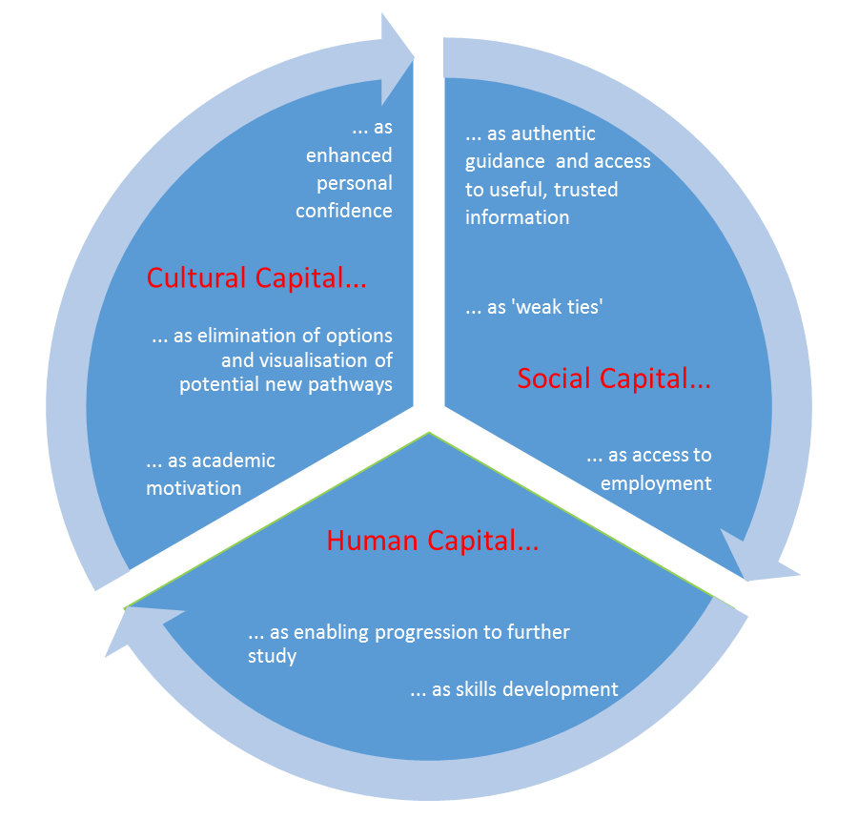
Conclusions: in theory…
“The knowledge of ‘how to play the game’ to get into Medical School was something unbeknown to everyone that I was in contact with at the time. So I had to figure it out for myself, and in this respect I was always a bit behind the curve. Getting work experience was extremely difficult. I wouldn’t have been able to do it if it wasn’t for having a tenuous contact in a hospital.”
(Medical Student)
Jones, Steven, Anthony Mann and Katy Morris. 2016. “The ‘Employer Engagement Cycle’ in Secondary Education: analysing the testimonies of young British adults”. Journal of Education and Work.

