Slide 1


Young Careers
Working together
to shape young futures

Slide 2
Today
About Reed in Partnership
Youth employment research
Importance of engaging employers
Young Careers programme

Slide 3




Reed in Partnership
National provider of public services, drawing on over 50 years of the Reed family of businesses’ recruitment experience.

Slide 4

















Our youth programmes
Young Careers

Slide 5



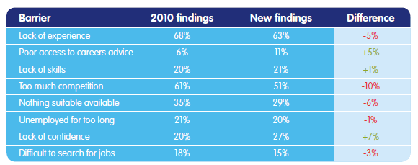
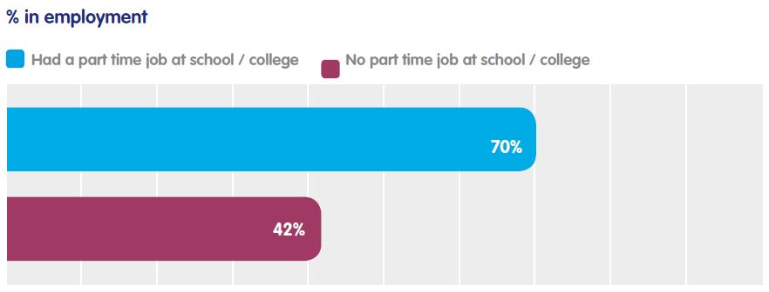

Young People and Employment

Slide 6
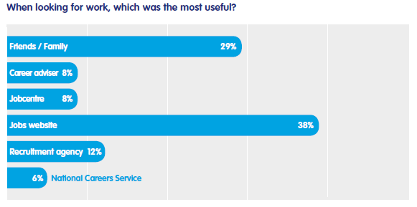
What sources do young people find useful?

Slide 7
Careers advice

Slide 8

Views of young people

Slide 9
Preferred destinations for young people
Source: YouGov

Slide 10
Improving careers advice
Less narrowly focused on university route
Promote ‘high ability’ apprentices
Begin at an earlier age
Prioritise with “whole school approach” rather than isolated sessions
Involve parents in discussions about future careers
Government reshuffle provides opportunity to streamline

Slide 11
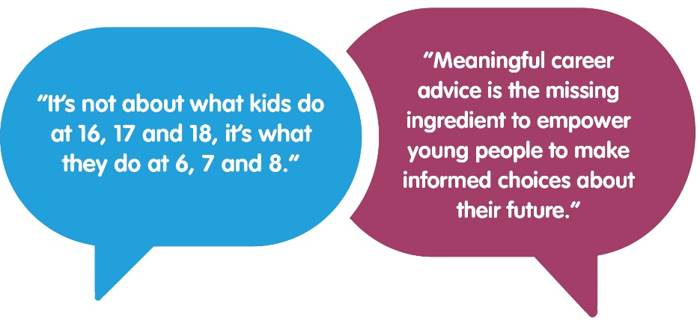

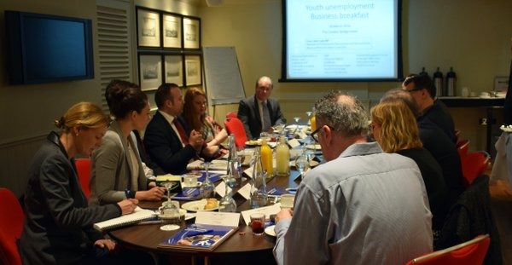

Employer engagement

Slide 12
Young Careers programme
Pilot programme funded by Skills Funding Agency
Geographic cluster (Barnet & Enfield) and an employer sector-based cluster (ICT Excellence) – 6 schools in each
Complement existing support from National Careers Service & Careers and Enterprise Company
Aim to have lasting impact beyond pilot period

Slide 13
What are we trying to achieve?
Research methods to support schools to deliver better careers advice
Increase number of employer/pupil interactions
Inspire young people to consider new careers
Build confidence of engaging with business
Ensure that teachers provide informed guidance
Focus advice on emerging IT sector

Slide 14
Employer ‘Young Career Champions’
Develop a brand employers enthusiastic to engage with
Flexible programme tailored to individual businesses
As little as an hour every few months
Careers Fairs, Employer talks, Employer Workshops, Open Days & Employer visits

Slide 15

A modern careers solution
Supported by Engagement Manager and Careers Officers
Multi-model with online resource accessible 24/7
Pilot includes running research projects to test new methods

Slide 16
Get involved
Join our exciting pilot project and help
shape future careers advice
Andrew Mackenzie
Policy & Research Manager
e: andrew.mackenzie@reed.co.uk
t: 0207 708 6063

