Slide 1


Slide 2
We know that there is a problem
There are 750,000 vacancies, one quarter skill-shortage related
… youth unemployment 3x higher than total unemployment
ONS June 2016

Slide 3


We also now know what works
Encounters with employers, with workplaces, with further and higher education
Information about local jobs, how the curriculum connects to work
A plan tailored to an individual’s needs and supported by guidance
- Sir John Holman
“…young adults surveyed who recalled greater levels of contact with employers whilst at school were significantly less likely to be NEET and earned, on average, 18% more than peers who recalled no such activities.”
- Dr Anthony Mann

Slide 4

But it’s not consistently implemented
    66% businesses believe work experience is critical for recruitment
    yet only 38% offer work experience in England
Only in 40% of schools do young people have one encounter each year

Slide 5
Our diagnostic
1. Inconsistent coverage – especially in areas which are more SME
2. Evidence base not well disseminated – schools and employers do not know where to invest scarce resource
  3. Different ‘conveyor belts’ – schools and employers have different language, timetables and working patterns

Slide 6
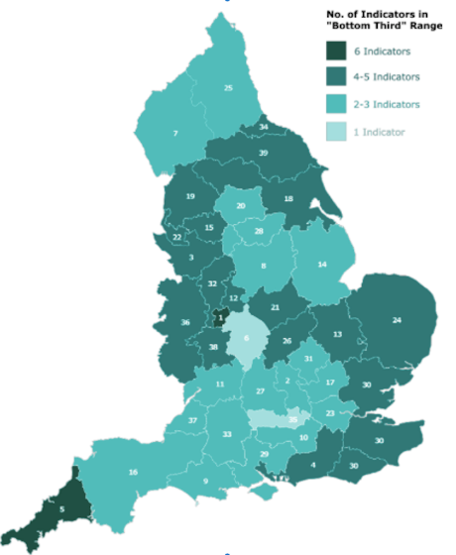
Careers & Enterprise ‘Cold Spot’ Analysis
Outcomes
Employer engagement
Deprivation
Notes:
Cold spots include uptake of apprenticeships post KS4 – directing employer resources to coldspots

Slide 7
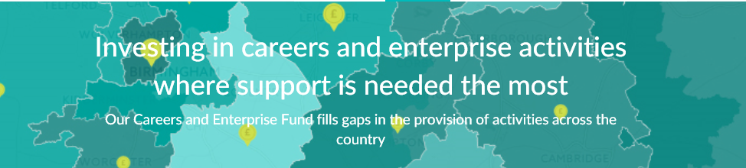

2. The Careers & Enterprise Fund
£10 million deployed including match
75% in ‘Cold Spots’
Just under a quarter of a million young people helped

Slide 8























2. Careers & Enterprise Fund beneficiaries

Slide 9
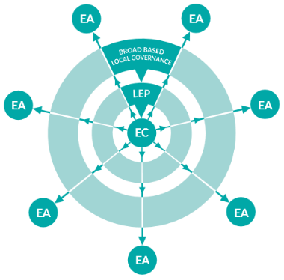
3. Enterprise Adviser network
1 full time, well paid, Enterprise Coordinator per 20 schools to ‘hold the ring’ locally and understand local schools, businesses and careers offers > 200 at run rate
1 Enterprise Adviser per school to provide strategic guidance to Head Teacher and bring school as close as possible to changing world of work > 4,000 at run rate

Slide 10
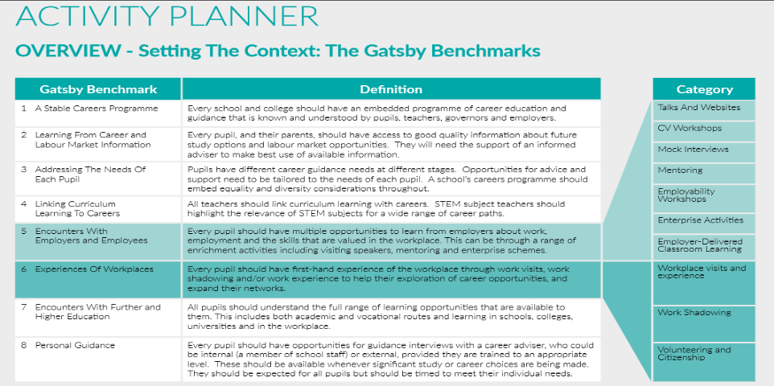
3. Enterprise Adviser network toolkit

Slide 11
Live in 36 out of 39 LEP areas
73 Enterprise Coordinators
800+ schools and colleges signed up
1,000 Enterprise Advisers
Notes:
Give some example names of EA’s: Deloitte, Rolls Royce, UKCES, Balfour Beatty, Eversheds, British Gas, Crisis, many more SMEs / entrepreneurs in Food & farming (Blacker Hall Farm), gaming, IT and marketing consultancy
EAs to date represent a wide range of industry sectors. The highest proportion (16%) work in professional services, business, legal, scientific and technical activities (Figure 11). Of the EAs working in “other” sectors, these industries span:
energy;
research;
horticulture; and
marketing.

Slide 12
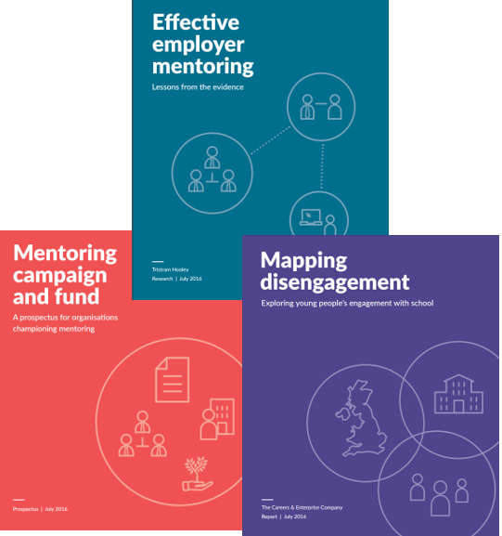
4. Mentoring Community & Fund
Employer-led mentoring
25,000 students pre GCSE

Slide 13
Joining the dots
1. Join the Enterprise Adviser Network
- Employers: Become an Enterprise Adviser
- Schools: Connect to your local Enterprise Coordinator
2. Scale up your school engagement activity
- 33 inspiring careers & enterprise programmes
- Share your own programme
3. Collaborate on research
- An evidence-led approach to ‘what works’

Slide 14
Our principles
Test, learn and adapt
Build on what works
Work nationally, tailor locally
Enable and convene the best programmes
Notes:
You can meet some of the EAN team during the TMP worldwide & CEC workshop session at 11:00-12:00 in exchange room 9

Slide 15
Join the fast-growing Enterprise Adviser Network
To inspire and prepare the future generation
www.careersandenterprise.co.uk
info@careersandenterprise.co.uk

