Slide 1
The importance of a simple system
David Harbourne
Edge Foundation

Slide 2
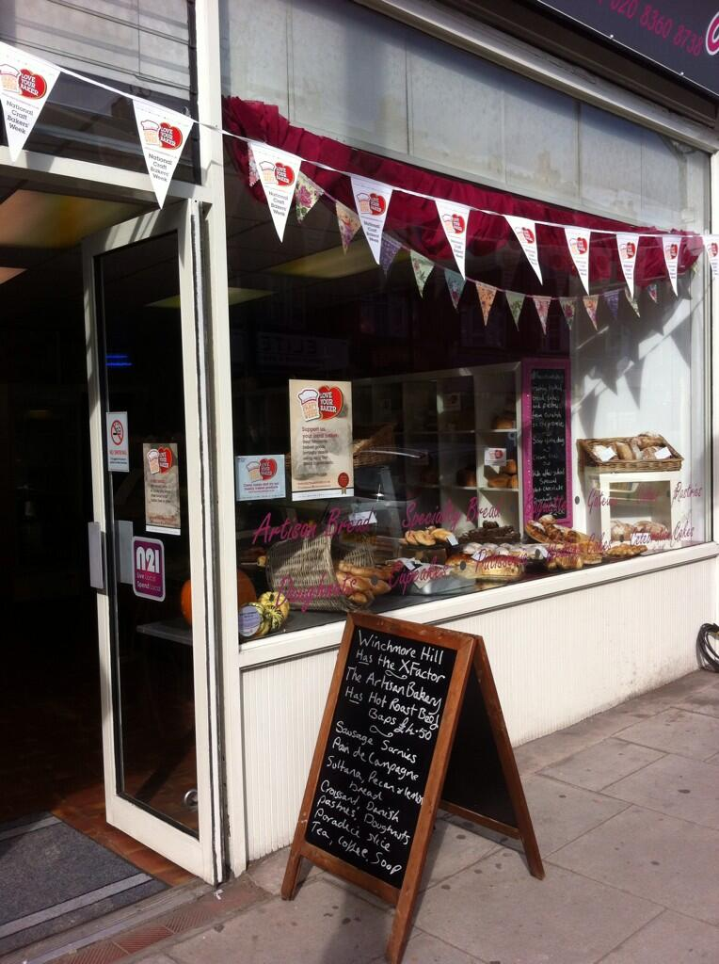
Where I came in:
“College lecturers haven’t worked in a real bakehouse for years. Everything they teach is old-fashioned. Who leaves dough to prove overnight in a wooden trough these days? Yet they still teach it in college!”

Slide 3
What bakers do
Check deliveries of raw ingredients
Work safely and hygienically, alone and with other team members
Weigh and mix ingredients
Divide, mould, prove, bake and finish a wide variety of products

Slide 4
Which became:
National Occupational Standards
National Vocational Qualifications
Performance criteria
Range statements
Units and elements
Underpinning knowledge
Assessor
Verifier
Modern Apprenticeships and National Traineeships

Slide 5
Modern Apprenticeships
National Traineeships
Level 3
Originally conceived as an alternative to A levels
Skilled craft worker
Able to work with minimal supervision
Might supervise others
Level 2
Replacement for Youth Training
Semi-skilled worker
Usually working under supervision
Key skills –
communication
application of number
information technology

Slide 6
Which became:
Advanced Level Apprenticeships
Intermediate Level Apprenticeships
Plus:
Entry to Employment (for a while)
Train to Gain (for a while)
Adult Apprenticeships
Higher and Degree Apprenticeships
Traineeships

Slide 7
Too complicated?
Hundreds of pathways
Multiple levels
Thousands of qualifications
Complex frameworks
Complex funding regime
Competition among providers

Slide 8
Every university degree consists of a set of courses and modules which vary by subject and institution …
… but hardly anyone asks about them!

Slide 9
“What are you studying at university?”
“Mechanical engineering.”
“What will you be when you finish?”
“A mechanical engineer.”

Slide 10
What matters is not the qualification you get, but the person you become
Baker, hairdresser, electrician, farrier, tailor, accounts technician, car mechanic, glazier, dental technician, greenkeeper, engraver, veterinary nurse, boat builder, driver, laboratory technician, data analyst

Slide 11
So: hide the wiring!

Slide 12
Richard Review
Getting a group of employers to write a short standard is easy.
Getting other employers to support it is hard.
And a standard that fits two sides of A4 is only the start …

Slide 13
Characteristics of a simple system
A finite number of (broad) standards
Social partnership, supported by core funding
Stability
Consistent branding and marketing
Clear career routes (+ careers information, advice and guidance)
Advice and brokerage for employers
Targeted subsidies

Slide 14
Switzerland
Apprenticeships do not train people for a narrowly-defined job in a specific factory; they lay the foundations for a career and progression to higher level qualifications.

Slide 15
New Zealand
A handful of Industry Training Organisations set standards, provide advice and broker support.

Slide 16
Scotland
Slow, steady development of Apprenticeships builds confidence and trust, supported by a seven-year Youth Employment Strategy and clear pathways:
school → apprenticeships → jobs → further learning → careers → HE → career development

Slide 17
England
Standards?
Institute for Apprenticeships?
Sainsbury?
Funding?

Slide 18
“What are you doing these days?”
“I’m an apprentice aircraft fitter.”
“What will you be when you’ve finished?”
“An aircraft fitter, obviously!”
“And after that?”
“I’ll probably take a degree. I want to be head of aircraft maintenance for a major airline.”

