Slide 2
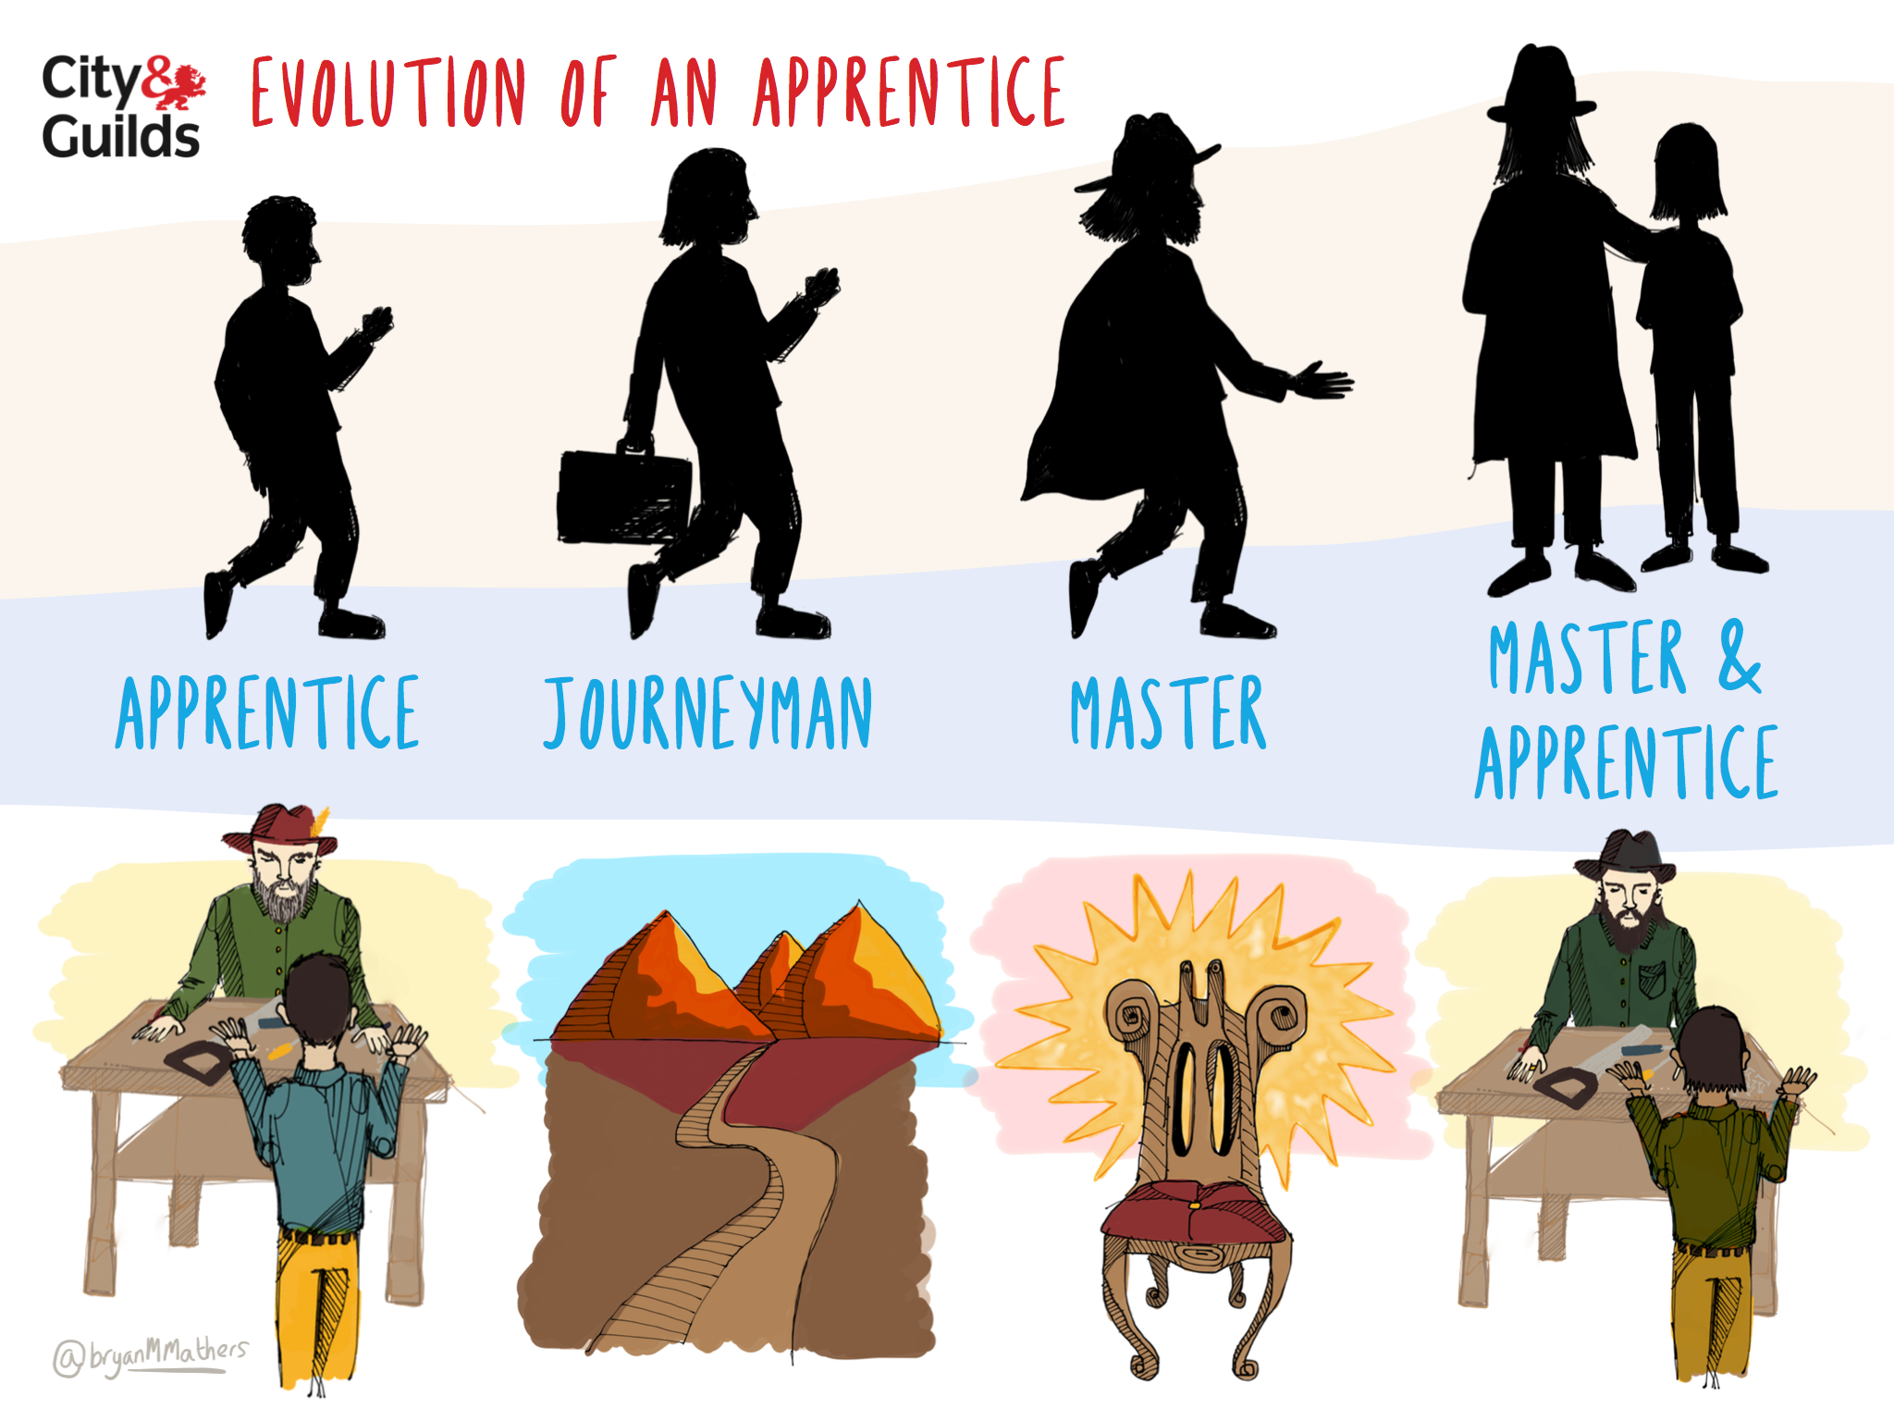

Slide 4
13
Notes:
Slide 7
Secondly, I want to talk about apprenticeships. Back when we and indeed Harland and Wolff were formed, apprenticeships were serious and long-term routes to mastery of a particular skill or craft. Novices were taken on by a master and began a journey of up to seven years learning and perfecting their craft. Today, certainly in the UK, an apprenticeship has taken on a loose, all encompassing meaning and can sometimes be completed in a matter of months.
The value of apprenticeships in contributing towards individual, organisational and societal productivity has been demonstrated again and again. In 2012, we commissioned a piece of research from the economic research agency SQW on the economic impact of apprenticeships which found that government’s investment to provide a million extra apprenticeship places by 2013 would drive wide-ranging economic benefits – lower benefits payments, more cash flow for government from taxes and overall increased competitiveness for the UK.
SQW projected the business and tax benefits of investing in apprenticeships combined to a total of £5.57 billion added to our economy – higher than predicted returns from the 2012 Olympic Games.
Looking abroad we can also see a clear benefit to a thriving apprenticeship system. The latest Global Competitiveness Report from the World Economic Forum ranked Switzerland first with one of the reasons for this being its dual vocational and education system, which heavily promotes apprenticeships. The benefits of this system are clear when only 8% of Swiss youth are unemployed, compared with 16.9% in the UK.
Looking back to our own apprenticeship system – I believe it has the ability to contribute meaningfully to our economic growth and prosperity, but first there needs to be a reappraisal of an apprenticeship and what the programme delivers the individual and organisation. The UK Government is certainly shining a spotlight on apprenticeships – there have been wide ranging reforms to apprenticeships which seek to put more power in the hands of employers and there is a clear commitment from Government to keep increasing apprenticeship places. We heard George Osborne pledge at the Conservative party conference last week that he would be making three million additional apprenticeship places available through cutting benefits elsewhere.
Potential additional slide here to visualise the six principles
However, what is not being addressed, and surely needs to be if we are to help apprenticeships achieve their full potential, is a focus on the fundamental make up of an apprenticeship and the types of learning that are delivered within it. At City & Guilds we are working with the trailblazer groups of employers to support them as they respond to the reforms. We are also in the process of creating our own definition of what an apprenticeship should be, driven by 6 core principles that set out the qualities of a good apprenticeship.
Principle 1: Put learning at the heart of apprenticeships
There have been very few policy initiatives related to learning and assessment over a number of years and almost none related to the core learning in the workplace. We have commissioned research to assess the effects of this gap and to help us develop an action plan that focuses on the method and quality of learning an apprentice receives.
Principle 2: Apprenticeships should be a route to ‘mastery’ of an occupation.
This is about the ability to work independently, without close supervision, and to a standard that is based on the best achievable not the minimum acceptable. The sort of skill levels we are aiming at here would inevitably mean some work roles now included in apprenticeships at Level 2 would no longer be applicable. But this does not necessarily mean that whole occupations should be removed. Traineeships, or similar alternative programmes should be used for these work roles and a ladder into Apprenticeships.
Principle 3: Apprenticeship programmes should reflect the development of knowledge, skills and experience.
Knowledge includes the body of knowledge and principles for the occupation but also the know-how. Experience is nurtured with mentors to gain the confidence and capability necessary for high productivity and problem solving. An apprentice should be prepared for the future as much as for the present demands of the occupation.
Principle 4: Apprentices must satisfy independent third parties of their mastery on completion of their training.
This is an opportunity for apprentices to demonstrate to existing ‘Masters’* of their occupation that they are ready to join their ranks. Independent end assessment has been adopted as a policy in the current reform process and City & Guilds is carrying out development work to implement this for a number of Trailblazer groups. This is not seen as a replacement for more traditional formative assessment used to guide development of vocational skills, but rather an alternative feature to augment the ongoing judgements and provide enhanced rigour and independence to the process. Strategies adopted for this ‘completion’ assessment should be sensitive to the way that people learn and demonstrate their competence across different sectors.
Principle 5: Full time vocational education for 16 to 18 year olds and apprenticeships should be systematically integrated.
Completion of a full-time vocational course (at the appropriate level) should provide exemption from part of the apprenticeship requirements. Providers of vocational education should be required to manage the transition from full-time education into apprenticeship effectively so that students complete their training and progress into relevant employment.
Principle 6: Governance of apprenticeships should be independent of Government.
Employer-led groups (including representation for individuals), should control the content and development of apprenticeships within a simple framework. This governance should be independent of Government. Government should continue to control funding.
In the rush to create ever more apprenticeship places, let’s not lose sight of the importance of developing high-quality apprenticeships capable of contributing to a city’s economic success.
*Traditionally a master would have risen up through the ranks from novice to journeyman to master. They would have produced a masterpiece before being accepted into their relevant guild. The masterpiece, along with a sum of money, needed to be accepted by the masters in the guild before the individual could join the guild. Now the master was ready to take on his/her own novice, or apprentice at the start of their journey.

