Slide 1
Apprenticeships in Switzerland: simplicity and quality
London, 22. July 2016
Lutz-Peter Berg, Swiss Embassy London

Slide 2
Swiss Education System: Simplicity
Tertiary vocational qualifications
Univ
Appl. Science
Work
University
choose sector
no job link
employability??
no pay
Apprenticeship
64%
A Levels
26%
«GCSE» equivalent (age 15/16)

Slide 3
A simple choice – though not an easy choice
Work, university
Apprenticeship:
Gold Standard
A Levels:
Gold Standard
«GCSE» equivalent (age 15/16)

Slide 4
Who defines «Gold Standard» apprenticeships ?
Sector associations
Training content
Companies
Apprenticeships
Sector organisations:
Umbrella organisations for companies
Define learning content
Updating frameworks / new frameworks
Notes:
-The VET/PET sector is funded by the three partners just mentioned before.
-Most of PET programmes are borne by companies and private individuals.
-In 2010, the public funding for the VET/PET system amounted to around CHF 3.4 billion.
-Approximately one fourth of these total cost is assumed by the confederation and the other three fourths are provided by the cantons.
-Professional organisations provide both services and funding for the Swiss VET/PET system: they do the groundwork, run their own training centres and promote specific occupations (VET sector) and professions (PET sector).
-Around 30% to 40% of the companies in Switzerland having the possibilities to form apprentices take part in VET programmes and this generates costs of course.

Slide 5
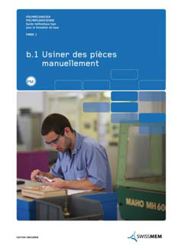
Example of Sector Associations: Engineering Umbrella organisation (with Education Commission)
1000 member companies
17 full-time employees for vocational training
developing frameworks, teaching materials, running training centres
Swissmem companies train approximately 8.200 apprentices

Slide 6
Example of Sector Associations: ICT Switzerland
22 Associations, e.g.:
Swiss Telecommunications Association
Swiss Open Systems User Group
Fibreoptic Network Switzerland
EuroCloud Swiss
Swiss Society for Medical Informatics
Swiss Internet Industry Association
Business Informatics Association
Western Switzerland Informatics
.
.
25 Big Companies, e.g:
Accenture AG
Cisco Systems
Credit Suisse AG
Google Switzerland
Hewlett-Packard
Huawei Technologies
IBM Schweiz AG
Microsoft Schweiz
SAP (Schweiz) AG
Swisscom AG
UBS AG

Slide 7
Gold Standard apprenticeships: Employer-driven
Regional Government
(implementation , supervision)
Vocational Colleges
(State schools)
Government
(National standards)
Companies
Apprenticeships
Learners
Sector associations
Notes:
-It is one of the fundamental principle of the Swiss VET/PET system that it is based on a cooperation between the Confederation, the Cantons and trade associations or professional organisations that include trade associations and other social partners.
(-This is actually set forth in Art. 1 of the Vocational and Professional Education and Training Act (VPETA).)
Professional organisations →Annimation
-Professional organisations (which include trade associations and social partners) are mainly responsible for curricula.
-They sit in the driver seat and define and update the content of vocational and professional education programs.
-In addition they hold responsibility for PET qualification procedures.
-This ensures that VET as well as PET respond to the economic needs, match the qualifications needed and take into account the actual number of jobs available. → Annimation
-The members of the trade associations, the companies provide VET apprenticeships and also offer some PET traineeships.
Cantons
-The 26 cantons are responsible for implementing and supervising the VET/PET system.
-Supervisory activities cover counseling and support to the parties of apprenticeship contracts (VET students and host companies).
-Concerning implementation, the cantons are responsible for implementing VET programs in vocational schools and running occupational, educational and career guidance counseling offices.
-Apprenticeship marketing also belongs to the tasks of the cantons.
Confederation
-Last but not least on the level of the confederation there is on the one hand the State Secretariat for Education, Research and Innovation, that is responsible for VET and PET sector at the federal level.
-Basically the SERI is responsible for strategic management and development.
-This includes for example: quality assurance as well as ensuring comparability and transparency of courses throughout Switzerland.
-On the other hand there is the Swiss Federal Institute for Vocational Education and Training (SFIVET). SFIVET belongs to the same department as the SERI and provides tertiary-level basic and continuing training to VET/PET professionals. SFIVET also conducts research and development in the VET/PET field. There are locations in all three language regions: in Zollikofen, Lausanne and Lugano.

Slide 8
Gold Standard works for business Cost/benefit Swiss companies with apprenticeships (million Swiss Francs, 2009)
Notes:
-However this figure shows, that host companies usually benefit from offering VET apprenticeships.
-According to a cost/benefit study conducted in 2009, the gross costs of companies offering VET apprenticeships amounted to CHF 5350 million (5.4 billion).
-This figure was outweighed by the productive output generated by learners, which amounted to CHF 5824 million (5.8 billion).
-Therefore the net benefit amounts to 474 million Swiss francs.
-In other words host companies return on investment in VET programmes is positive.
Zusatzinformation:
Quelle der neuen Daten: Stefan C. Wolter und Mirjam Strupler, “Die duale Lehre: eine Erfolgsgeschichte – auch für die Betriebe. Ergebnisse der dritten Kosten-Nutzen-Erhebung der Lehrlingsausbildung aus der Sicht der Betriebe”, 2012.

Slide 9
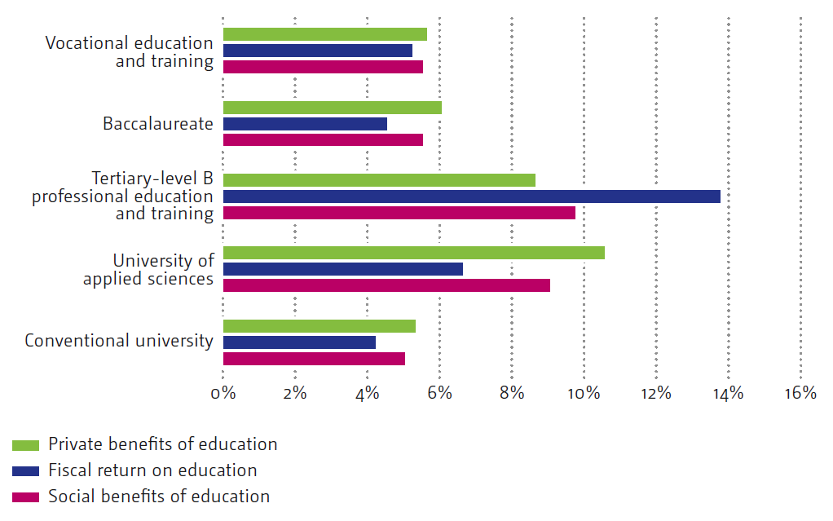
Apprenticeships work for learners Private, fiscal and social returns on education (men)
Benefits from a higher level of education compared to the next-lowest level
Source: Education Report Switzerland 2010: 284
Quelle: Bildungsbericht Schweiz I 2010, S. 286
Notes:
-This figure might be of special interest with regard to PET. It shows the benefits derived from a higher level of education compared to the next-lowest level of education.
-You can see that tertiary-level professional education and training generates very good private, fiscal and social returns.
Private benefit implies that only the person receiving the education derives any benefit from that education. In contrast social benefit implies that also other people (who are not necessarily required to obtain an education themselves) will benefit from the endeavours of that one individual.
Finally there is a fiscal benefit, which is one aspect of social benefit.
-The most obvious benefit to society are greater tax revenues that individuals pay from the higher income gained from their education.
-In its simple form, the return on investment is obtained by offsetting the State’s expenditure against the tax income that investment in education has generated through the higher salaries enjoyed by those who received the education.

Slide 10
Quality apprenticeships as «Gold Standard»
Employer-driven
content: set by industry associations (i.e. employer)
Companies recruit apprentices: demand-driven (employer)
Skills supply matches labour market
not education provider market
not government skills forecast
Good personal returns & economic returns
Universal buy-in
Standard entry route to work: difficult to be NEET
Labour mobility is easy
Notes:
Let me briefly summarize before we have some minutes for questions and answers:
Key # 1 is the full integration of VET/PET in the Swiss education system
-VET provides two-thirds of young people in Switzerland with a solid foundation in a given occupation.
-and due to the permeability of the Swiss education system, VET forms the basis for lifelong learning and opens up good career prospects.
Key # 2 is the labour-market orientation of VET/PET, since
-The dual VET programmes combine practice and theory.
-and the professional organisations play a decisive role in the definition of the contents of the VET/PET programmes.
Key # 3 is the shared responsibility for the Swiss VET/PET system,
-that it is based on a cooperation between the Confederation, the Cantons and professional organisations that include trade associations and other social partners.
These strengths of the Swiss VET/PET sector contribute to:
-in international comparison low general and youth unemployment rates; → next slide

Slide 11
Simplicity through employer-driven quality
Work, university
A Levels:
Gold Standard
Apprenticeship:
Gold Standard
«GCSE» equivalent (age 15/16)

