Slide 1


The Challenge of Engaging Employers:
A Report from the Field
Bob Schwartz, HGSE
Education and Employers Conference
July 22, 2016

Slide 2

THE PATHWAYS TO PROSPERITY REPORT
“The American system for preparing young people to lead productive and prosperous lives as adults is clearly badly broken. Failure to aggressively overcome this challenge will surely erode the fabric of our society.”

Slide 3
Education Level of U.S. Labor Force
Source: Georgetown Center on Education and the Workforce, 2012

Slide 4
2020 EMPLOYMENT PROJECTIONS
Sources: Recovery 2020, Georgetown Center on Education and the Workforce, 2013; and Complete College America

Slide 5
EXAMPLES OF JOBS THAT REQUIRE MIDDLE SKILLS
Sector | Type of Job | Number of Openings | Median Annual Pay
Computers & IT | Computer Support Specialists | 607,100 | $46,260
Engineering | Electrical Technicians | 151,000 | $56,040
Health Care | Respiratory Therapists | 112,700 | $54,280
Life, Physical & Social Sciences | Environmental Science Technicians | 29,000 | $41,380
Production | Semiconductor Processors | 21,100 | $33,130
Source: “Who Can Fix the Middle Skills Gap?” Harvard Business Review, 2012, T Kochan, D Finegold, P Osterman
Data from Occupational Outlook Handbook, U.S. BLS, 2010
Notes:
The ladder faculty is assistant, associate, and full professors.
We have a lot of nonladder faculty at HGSE also:
Professors of Practice,
Senior Lecturers,
Lecturers,
adjunct lecturers
visiting faculty
For today, we’re focusing on the ladder ranks as those are the tenured and tenure-track faculty.
Overall, we’ve added 9 ladder faculty in the past 5 years, but most of that growth has been at the junior ranks, not the tenured faculty ranks.
Our plan going forward is to grow the senior faculty somewhat more than the rest of the ladder.

Slide 6
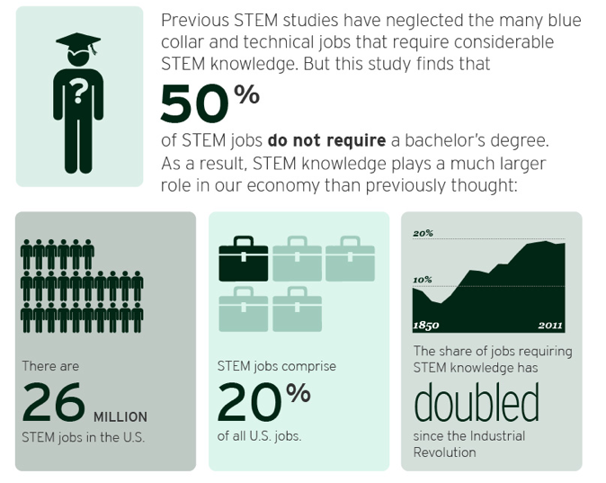
STEM OPPORTUNITIES ABOUND
Source: The Hidden STEM Economy, Brookings, 2013.

Slide 7
STRONG VOCATIONAL SYSTEMS: THE NEW VET
In strong vocational systems, 40% to 75% of upper secondary students choose to participate: VET can be school based or mix of school and work

Slide 8








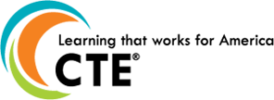






The time is now for pathways

Slide 9
Growing pathways NETWORK
46%
Of our nation’s K12 public school students in 12 states and we’re GROWING

Slide 10
Growing pathways movement
25
Grantees in New Skills for Youth (Including District of Columbia, Hawaii)

Slide 11
Growing pathways movement
6
States in NGA’s Work-Based Learning Policy Academy

Slide 12
You are transforming outcomes
Students
Middle and high school success
Postsecondary success
Career and community success
Employers
Skills gap/talent shortage addressed
Pipeline of young professionals
Increasing number of jobs
Economies
State and regional economies thriving and growing in key STEM industry sectors
Notes:
Every student has clear college and career goals with the supports to achieve them
Every employer has a pipeline of young professionals with the skills needed to contribute to and lead the workforce
Every regional and state economy is thriving and growing, providing opportunities for upward mobility to its citizens

Slide 13
OUR GOAL: SYSTEMS OF 9-14+ PATHWAYS
ALL YOUNG PEOPLE
Complete high school with at least 12 college credits and WBL experience
Attain postsecondary credential with value in regional labor market
Advance in career and pursue further education as interested
Launch a career in a high-demand, high-growth, high-wage occupation

Slide 14
KEY PATHWAYS IMPLEMENTATION LEVERS
Rigorous Academic and Career 9-14 Pathways
Early, sustained career counseling and information
Intermediary links between education and employers
Engaged employers: work-based learning opps. & curricula support
Committed state leaders and favorable policy environment

Slide 15
MOST PREVALENT CAREER AREAS OF FOCUS
BASED ON REAL-TIME LABOR MARKET DATA
Information Technology
Cross-cutting and key to all 21st century careers, not just in IT fields
Health careers
But paths must be carefully chosen to ensure mobility
Advanced Manufacturing
Few know the opportunities and salaries, stigma attached

Slide 16
GRADES 9-14 INTEGRATED PATHWAYS
Rigorous Academics
System Outcomes:
Financially sustainable, aligned and integrated 9-14(+) career pathway systems
Increased number of skilled young professionals with credentials of value to the labor market
State and regional economies develop talent pipelines in key industry sectors
Secondary Pathways
Postsecondary Pathways
Stackable Credentials ➔
AA/AAS ➔
Acceleration & College/Career Readiness through
Dual Enrollment, Integrated Instruction, and WBL
BA/BS ➔
Intern-ships, WBL
Low Skilled Jobs
Semi-Skilled Jobs
Middle Skilled Jobs
Advanced Skilled Jobs
Career and Technical Ed.

Slide 17
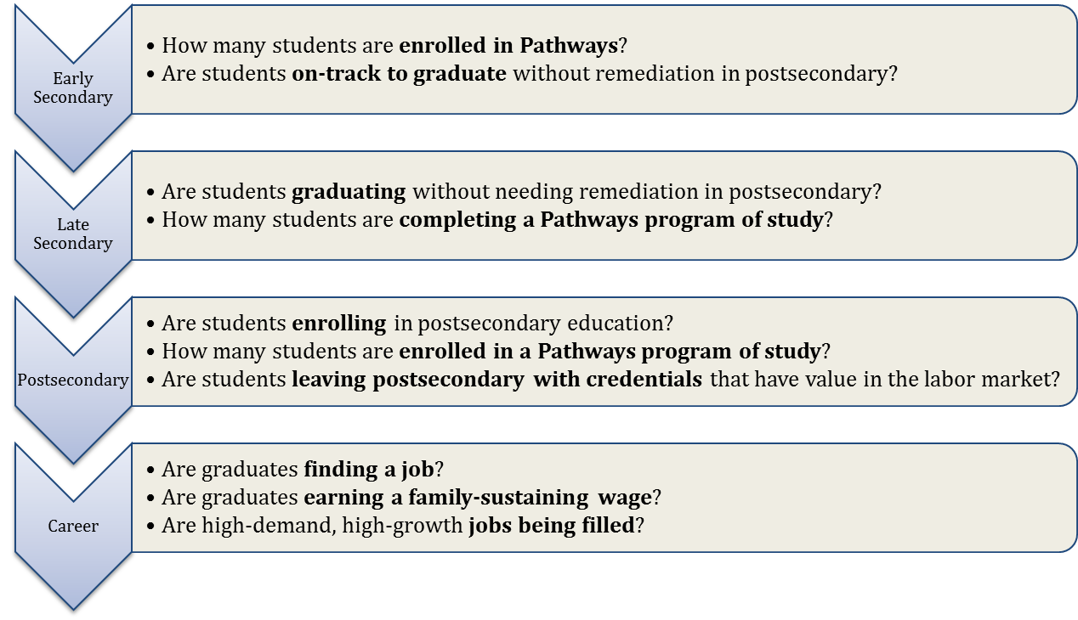
Moving the needle: Milestone METRICS
Notes:
There are the major milestones we’re trying to achieve through the 9-14 integrated pathways work. We have additional leading indicators and “structural” indicators that help monitor progress toward meeting milestones.

Slide 18
california
INVEST
Unprecedented Investments Statewide: California invested over $1.4 billion in the expansion of Career Pathways across the state
POLICY
New Legislation: AB288 allows K-12 and community college districts to create partnerships to expand dual enrollment opportunities
LEAD
Cross Agency Career Pathways Leadership Team: CDE, CCCCO, WDB provide cross-agency state leadership team focused on enhancing and growing career pathways
SUPPORT
Regional Pathways Support: Technical assistance infrastructure to support pathway development, employer engagement, increased articulation and dual enrollment

Slide 19
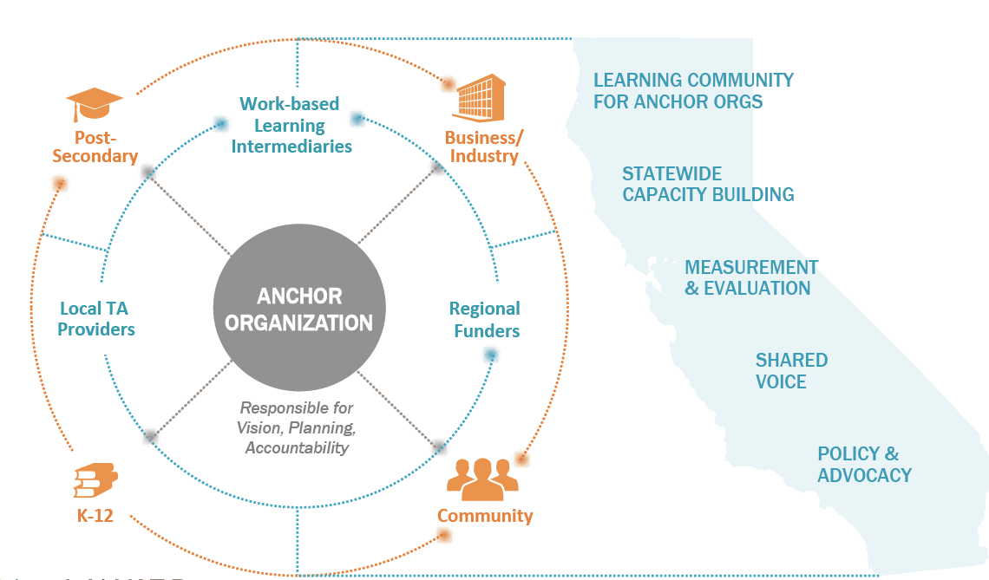
CALIFORNIA CAREER PATHWAYS
Seven Linked Learning Regions
38 California Career Pathways Trust Consortia

Slide 20

stem learning exchanges
Provide Curriculum Resources
Expand Access to Equipment
Support Peer‐to‐Peer Networks
Provide Work‐Based Learning
Sponsor Challenges
Provide Professional Development
Provide Career Development
Review Program of Study Model
Review P‐20 Pipeline Performance

Slide 21










Workforce
Investment Board
Postsecondary Partners
Industry Partners
Pathways Tennessee
Economic Development Groups
K-12 School Systems
State & Local Government
Pathways TN is about changing culture and aligning priorities
Notes:
IT BEGINS WITH PARTNERSHIPS
Change is not going to happen without everyone at the table and sharing a common vision: To provide relevant, seamless, and hands-on education for all citizens to gain the knowledge and skills for employment in a high demand, high skill field.
Discuss the issues
Identify commonalities between stakeholders
Create a unified regional plan
Implement
Review, make changes, repeat

Slide 22




INDUSTRY DRIVEN GRADES 9-14 IT ACADEMY: SAP AND C-TOWN TECH IN BOSTON
Higher Education Partner
K-12 Partner
Workforce Partner
Industry Partner
Mayor’s Office
JFF
Notes:
In 2012, SAP shifted its Corporate Social Responsibility portfolio to focus on targeted investments in high schools that promote long-term sustainability and help prepare the next generation of professional to work in the IT field. SAP launched its first signature education initiative at Business Technology Early College High School in Queens, NY. SAP is currently sponsoring 3 active sites in the US and Canada: Queens, Vancouver, and Boston, and one more is slated to open in Oakland, CA in fall 2016.
In 2014, SAP enlisted the support of JFF to serve as the intermediary organization in the planning and implementation of a SAP education initiative in Boston, MA called C-Town Tech.
C-Town Tech is a 9-14 IT Pathway at Charlestown High School created in partnership between Boston Public Schools, SAP, a global enterprise software company, Bunker Hill Community College, the Boston Private Industry Council, the Boston Mayor’s Office, and Jobs for the Future.
C-Town Tech welcomed its inaugural cohort of 30 students this September who are already enrolled in their first college-level IT course in addition to their required core academic classes. Through participation in the pathway, students will be able to earn up to 30 credits toward an Associate’s degree in IT at Bunker Hill Community College. Students in the program will also have access to mentors at SAP, and work-based learning activities like job shadowing, career academies, career fairs, and short-term and long-term internships at SAP and within its ecosystem. Entry level IT jobs in the Boston area come with competitive salaries; for example, IT help desk salaries start at more than $45,000 a year.
SAP asked JFF to write a “blueprint” of their education initiatives to capture the key elements and principals found across each site, highlight the unique contexts and characteristics where these initiatives have been implemented, and provide helpful resources and guidelines for other companies interested in engaging in long-term school partnerships like these.

Slide 23
SPOTLIGHT: CENTRAL OHIO
$15M Straight A grant to jumpstart regional pathways development, responding to Central Ohio Compact
16 partnering school districts—including the largest urban district in state, large suburban districts, and small rural districts
6 pathways co-created and implemented across districts: business and logistics, advanced manufacturing and robotics, health careers (2), networking and digital technology, health information management technology
Columbus State Community College providing innovative online dual enrollment opportunities and serving as a core lead
Executive Committee and Steering Committee meet regularly to guide the work
Comprehensive communications support for pathways
Intermediary and logistical support from Educational Service Center of Central Ohio

Slide 24




WWW.INNOVATIONGENERATIONOHIO.COM

Slide 25


Slide 26
MAKING CONNECTIONS
The National Network brings together 25 industry associations.
It includes sectors that represent 75 percent of future jobs by 2020 (an estimated 30 million new jobs).
Members are sharing what works for individual industries across multiple sectors.
9

Slide 27
OUR WORK
As the influential voice of business, the National Network develops and promotes the use of tools and resources to help employers:
Identifying competencies and promoting credentials that lead to work
Use competency-based hiring practices to find the right person with the right skills for the right job.
Provide more work-and-learn opportunities across the economy.
11

Slide 28
OUR WORK
The National Network is equipping employers with tools to put our work into practice:
Employers can change HR practices and recruit, screen and hire on competencies.
Employers can adopt the Common Employability Skills, which signal to workers the skills they need to succeed.
Using the Work-and-Learn Guidebook, employers can expand work-and-learn opportunities.
12

Slide 29
OUR WORK
The National Network is connecting with working learners by:
Providing clear information about the knowledge, skills and abilities workers need to succeed in the workplace.
Encouraging business and educators to work together to create pathways that lead to current and future jobs.
Harnessing technology to expand learning options that address realities of working learners while meeting the needs of the modern workplace.
13

Slide 30



PROGRESS TO DATE
The National Network has developed and released tools to begin rebuilding the outdated workforce development infrastructure. Initial tools include:
A framework of common employability skills workers need to succeed, regardless of industry;
A blueprint for industry organizations to create standards-based
credentials; and
A guide that helps employers understand and develop competency-based work-and-learn models (under development).
14

Slide 31

FOR MORE INFORMATION, CONTACT:
Nancy Hoffman
nhoffman@jff.org
617.728.4446, ext. 132
Amy Loyd
aloyd@jff.org
617.728.4446, ext. 282
Bob Schwartz
schwarro@gse.harvard.edu
617.496.6303

