Slide 1
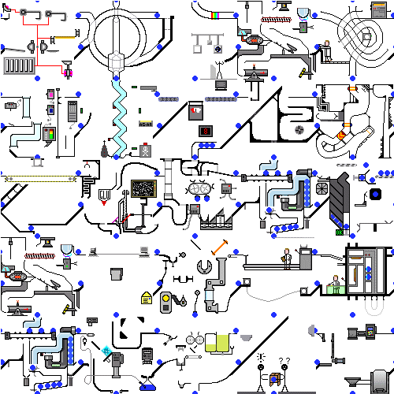
An International Literature Review: Careers Education

Slide 2




Commissioned by
with support from

Slide 3
Research Team
Dr Deirdre Hughes, Research Programme Director, supported by Dr Sally-Anne Barnes and Beate Baldauf, Senior Researchers, University of Warwick, Institute for Employment Research (IER)
Dr Anthony Mann, Director of Policy and Research, supported by Rachael McKeown, Research Assistant, Education and Employers
Notes:
We started the work on 2016 and completed the research report earlier this month
Approximately xx weeks on we’re now in a position to share with you key findings from our joint research

Slide 4

Overview
How the research journey unfolded
  Key stages: remit & methodology
  Findings
  Challenges and opportunities
  Key emergent themes - policy, research and practice Conclusions
  Where next?
Notes:
The structure of the presentation:
focus on the main stages of the research and share key findings;
highlight some key challenges and opportunities emerging from the work
jointly consider with you, as a learned audience, where next?
We have further plans which we’d like to share with you and we’re keen to hear your views and experiences

Slide 5
Remit
To provide an overview of the evidence-base underpinning careers education and its impact on pupils’ skills and outcomes
Definition: Careers education
“Careers-focused school and/or college mediated provision designed to improve students’ education, employment and/or social outcomes”

Slide 6
Aims of the review
To systematically review the evidence-base on how careers education makes a difference to young people’s outcomes from their schooling, drawing on the most up-to-date & reliabel literature findings relavnt to the UK and other OECD countries
To examine robust casual evidence on careers education impact assessment from a wide range of studies using experimental and quai-experimental designs

Slide 7
Research process: dynamic and Iterative
Data
Data Extraction
Key informants
Notes:
A four-level impact assessment model) was used to describe impact studies in terms of the robustness of the research design and the reliability of the causal evidence they provide (Hughes, 2004, see Appendix 4) From this, we agreed with the Education and Endowment Foundation (EEF) to focus, and include in the review, level 3 ‘outcome measurement studies with control by calculation’ (typically longitudinal studies) and level 4 ‘outcome measurement studies with a control group’ (typically randomised control studies).
Some further data were captured on level 1 and level 2 studies, often qualitative pieces providing insights of genuine value to researchers; however, these are not presented in this report.

Slide 8
Key Stages: methodology
Notes:
To optimise chances of identifying relevant reliable research within a literature which is characterised by use of varying terminology and diffused across a very wide range of disciplines and academic and public reports, the research team used wide-ranging evidence databases via the University of Warwick Library (e.g. EBSCO and Scopus which allow sophisticated searching across a wide range of thematic databases) plus rare personal resource libraries.
In addition, key informants were contacted across OECD countries (see Appendix 1) to invite submission of copies of studies considered as robust causal evidence on careers education impact assessment. Finally, the review team considered literature previously identified by the Department for Education and in works commissioned by the Education Endowment Foundation (EEF) as potentially useful.
Appendix 2 identifies which keyword search terms were used as a result of this search strategy. Note that each row represents an ‘OR’ function where, for example, the terms ‘young people’ OR ‘adolescent’ OR ‘pupil’ OR ‘education’ OR ‘school’ were used in conjunction with the other terms. We also used the ‘NOT’ facility in searching databases where we excluded the terms ‘opinion studies’ OR ‘no counterfactuals’ OR ‘weak counterfactuals’.

Slide 9
Inclusion criteria
Research published in the English language since 1996
Only studies from OECD countries
Adheres to an experimental or quasi-experimental design;
Research that examines some aspect(s) of careers education directly linked to school and college provision i.e. all types of schools and colleges ranging from primary education to upper secondary education or equivalent;
Research that focuses on young people i.e. all types and age span from: Key Stage 2 aged 7-11 year olds; Key Stage 3 aged 11-14 year olds; Key Stage 4 aged 14-16 year olds; and Key Stage 5 aged16-19 year olds.
Notes:
Highlight the unique aspect of this international literature review – a specific focus on experimental or quasi-experimental studies related to careers education

Slide 10
Exclusion criteria
Studies were excluded if they:
Focused on higher education, training, apprenticeships, and/or the UK Department for Work and Pensions ‘Work Programme’;
Focused on opinion studies with no (or weak) counterfactuals;
Did not adhere to either an experimental or quasi-experimental design;
Did not include a control or comparison group;
Did not include outcome measures which directly linked to careers education interventions in schools and/or colleges;
Did not focus on children aged 7 years old or above; and
Were doctoral or post-graduate student studies.
Notes:
We only included studies from the year 1996 because it was felt that 20 years’ worth of research would uncover the main themes in terms of which interventions have been developed and implemented in English-speaking countries.

Slide 11

Mindful of…
Operation of the youth labour market and expectations of young people
Technological change and the forces of globalisation (and BREXIT)
Nature of jobs available and skills required by employers
Curriculum reform
Infra-structure change
New statutory requirements
Notes:
We were also mindful of an extensive body of evidence highlighting rapid changes within the operation of the youth labour market and educational expectation of young people. Technological change and the forces of globalisation have changed the nature of jobs available and the skills required by employers. The numbers of people working part-time or for themselves has increased rapidly since the 1980s. The era of the job for life for many people is well and truly gone – the typical twenty-first century Briton can expect to work in a dozen or more different jobs across a number of different career areas. Twelve years ago, Facebook, Twitter and LinkedIn did not exist. Seventeen years before that, we did not have the worldwide-web. Technology, moreover, has irreversibly changed the way that young people are schooled both within and outside of the classroom. The last generation has seen, moreover, a clear shift in expectations that young people will overwhelmingly stay in education after the age of 16 with high proportions going on to higher education.
Mann, A. and Huddleston, P. eds. (2015). How should our schools respond to the demands of the twenty first century labour market. Eight perspectives. London: Education and Employers.
Today, the average person changes jobs ten to fifteen times (with an average of 11 job changes) during his or her career, which means a good amount of time is spent changing employment. Retrieved from: http://jobsearch.about.com/od/employmentinformation/f/change-jobs.htm.

Slide 12
Emerging themes
What young people think about their future careers matters
Career uncertainty
Career misalignment
Experience of the world of work
Independent and impartial career guidance
Terminology
Notes:
In the UK, Schoon and Polk (2011) have used two longitudinal databases – the National Child Development Study 1958 and British Cohort Study (BCS) 1970 – to explore the long-term impacts of teenage career aspirations, finding that the character of teenage aspirations can be directly linked to adult social status (using a variable combining occupational status and net weekly income) at age 33/34. Longitudinal studies following the experiences of young people are rare. One ongoing study which demands close attention is the ESRC Aspires2 project led by Professor Louise Archer at King’s College, London
Staff and colleagues (2010) look, moreover, at the implications of career uncertainty at age 16 finding it related to significantly lower levels of educational attainment than comparable peers with professional aspirations. From a US perspective, using data from the National Educational Longitudinal Study, Staff and colleagues (2010) have found significantly lower earnings accruing to young adults at age 26 linked to teenage uncertainty in career aspirations.
Drawing on the BCS, Sabates and colleagues (2011) have tracked individuals through to the age of 34 and found statically significant higher levels of unemployment experienced and lower levels of earnings (approximately 7% of wage variations identified) linked to teenage misalignment. These insights are especially relevant to the work of the Education Endowment Fund because it disproportionately young people from poorer backgrounds who are significantly more likely to be uncertain and or misaligned (Yates et al., 2010).
The proportion of 16-17 year olds combining full-time education with part-time employment has fallen from 42% in 1997 to 18% in 2014 (UKCES). With such decline, the requirement grows on schools, through the realm of careers education to help young people gain the types of insights, exposure and experiences which they might traditionally have accessed through direct paid experience of the labour market.
Career guidance can play a central role in learning systems by increasing individuals’ engagement with learning, making clear the pathways through learning and work, and supporting the acquisition of career management skills for managing life, learning and work (ELGPN, 2014). This literature review shows a shortage of quasi-experimental and experimental studies in the UK and further afield on the development of career dialogue and career management skills within schools and colleges
TERMINOLOGY - Terms such as careers education, career guidance, career counselling and career development are often used inter-changeably in the literature. Phrases like mentoring and enterprise education are also commonly used to describe some very different educational experiences. Terms such as experience of work and/or work experiences are sometimes used interchangeably. In an effort to standardise the career education language, our focus is primarily on curriculum-based interventions, pastoral interventions and those activities designed to provide direction and support to improve individual outcomes, including episodes of employer engagement.

Slide 13
Findings
International Literature Review: Careers Education
Notes:
There are a wide range of factors which influence individual career choice and decision-making, and/or which can impact on outcomes;
Careers education interventions are sometimes not a discrete input, but instead embedded in other contexts, such as programmes of distinctive learning provision, employer/employee relationships, and or within multi-strand initiatives;
Comparing the evidence available in different studies is problematic when the nature of careers-focused education, the depth of work undertaken and client groups, vary considerably;
There is not an agreed set of outcome measures for career education (and career guidance/career counselling/career development), or common methods of collecting output, or outcome data, except in the case of a limited number of discrete programmes;
Definitional problems also present themselves when addressing this issue. The first of these may be in attempting to define what careers-focused education is, and what it is intended to do. In seeking to identify and measure the outcomes of careers-focused education a clearly delineated type of intervention is desirable, although not always achievable; and
Effective career guidance (career counselling or career development) is a process which, over time, is made up of a number of individual interventions, possibly of different types.

Slide 14
Careers education
Aims to enable students to acquire the knowledge, skills and attitudes that will allow them to understand and succeed within and beyond their schooling
Research literature over the last twenty years on the impact of careers education on student outcomes is often considered weak and fragmented, due mainly to the complexity of differing elements identified and reported in differing ways
Notes:
The 2008 review of the impact of business engagement on pupils commissioned by the (then) Department for Children, Schools and Families stated:
“There is no shortage of literature on employers and/or business involvement in education. Much of this literature, however, was excluded from the scope of this review, mainly because it is largely anecdotal, […] or not evaluated to even modest scientific standards. There is a particular shortage of studies of employers’ links with education that have used robust research designs […] that can provide robust evidence of an impact. Many studies are descriptive and/or are based on single group before and after designs without a true comparator. […] Another weakness of the studies in this area is that they have small sample sizes with low statistical power. This can lead to either inconclusive findings or to erroneous conclusions.”
As will be seen in this review, while significant additions to the literature have been made since 2008, the research remains both relatively diffuse and weak. Literature is found across a wide range of disciplines: career guidance, education policy, sociology, economics, vocational guidance, human resource management and many other academic fields. Studies of merit have also been commissioned, and published, by many government bodies, creating a literature which is unusually fragmented. It is for the determined reader to identify and make sense of the connections across all the areas of study.

Slide 15
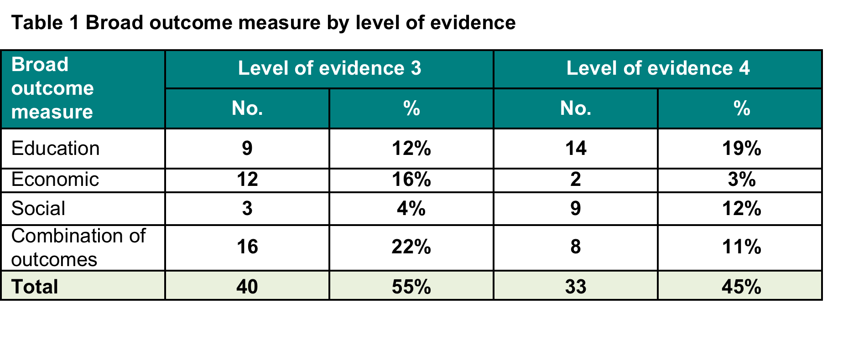

Slide 16
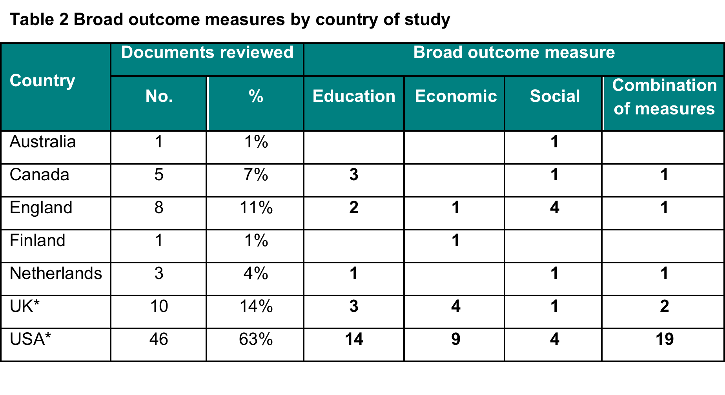
Note: The total number of documents reviewed is 73, but this table totals to 74. This reflects that one study was undertaken in both the UK and USA*.
Notes:
Note: The total number of documents reviewed is 73, but this table totals to 74. This reflects that one study was undertaken in both the UK and USA*.

Slide 17
Figure 2 Representation of broad outcome measures by country of study
Notes:
The studies in the in-depth review reflect research on different age groups (and consequently levels of education). Table 3, below, illustrates that the majority of studies (n=59) were carried out in secondary schools, with only 3 studies specifically related to research into special education needs (SEN) within mainstream schooling. Only 2 studies solely considered primary education. A few studies focused on interventions in primary and secondary school education, typically relating to US Middle School provision (n=9).
Upon completion of the literature review, the researchers identified two additional references highly relevant in this regard. These are not included in the overall analysis but have potential to be included: Phelps. I. A. & Hanley-Maxwell, C. (1997) School-to-work transitions for youth with disabilities: a review of outcomes and practices. Review of Educational Research 67(2), 197-222 and Wagner, M. W. & Blackorby, J. (1996) Transitions from High School to Work or College: How Special Education Students Fare. The Future of Children 6(1), 103-120.

Slide 18
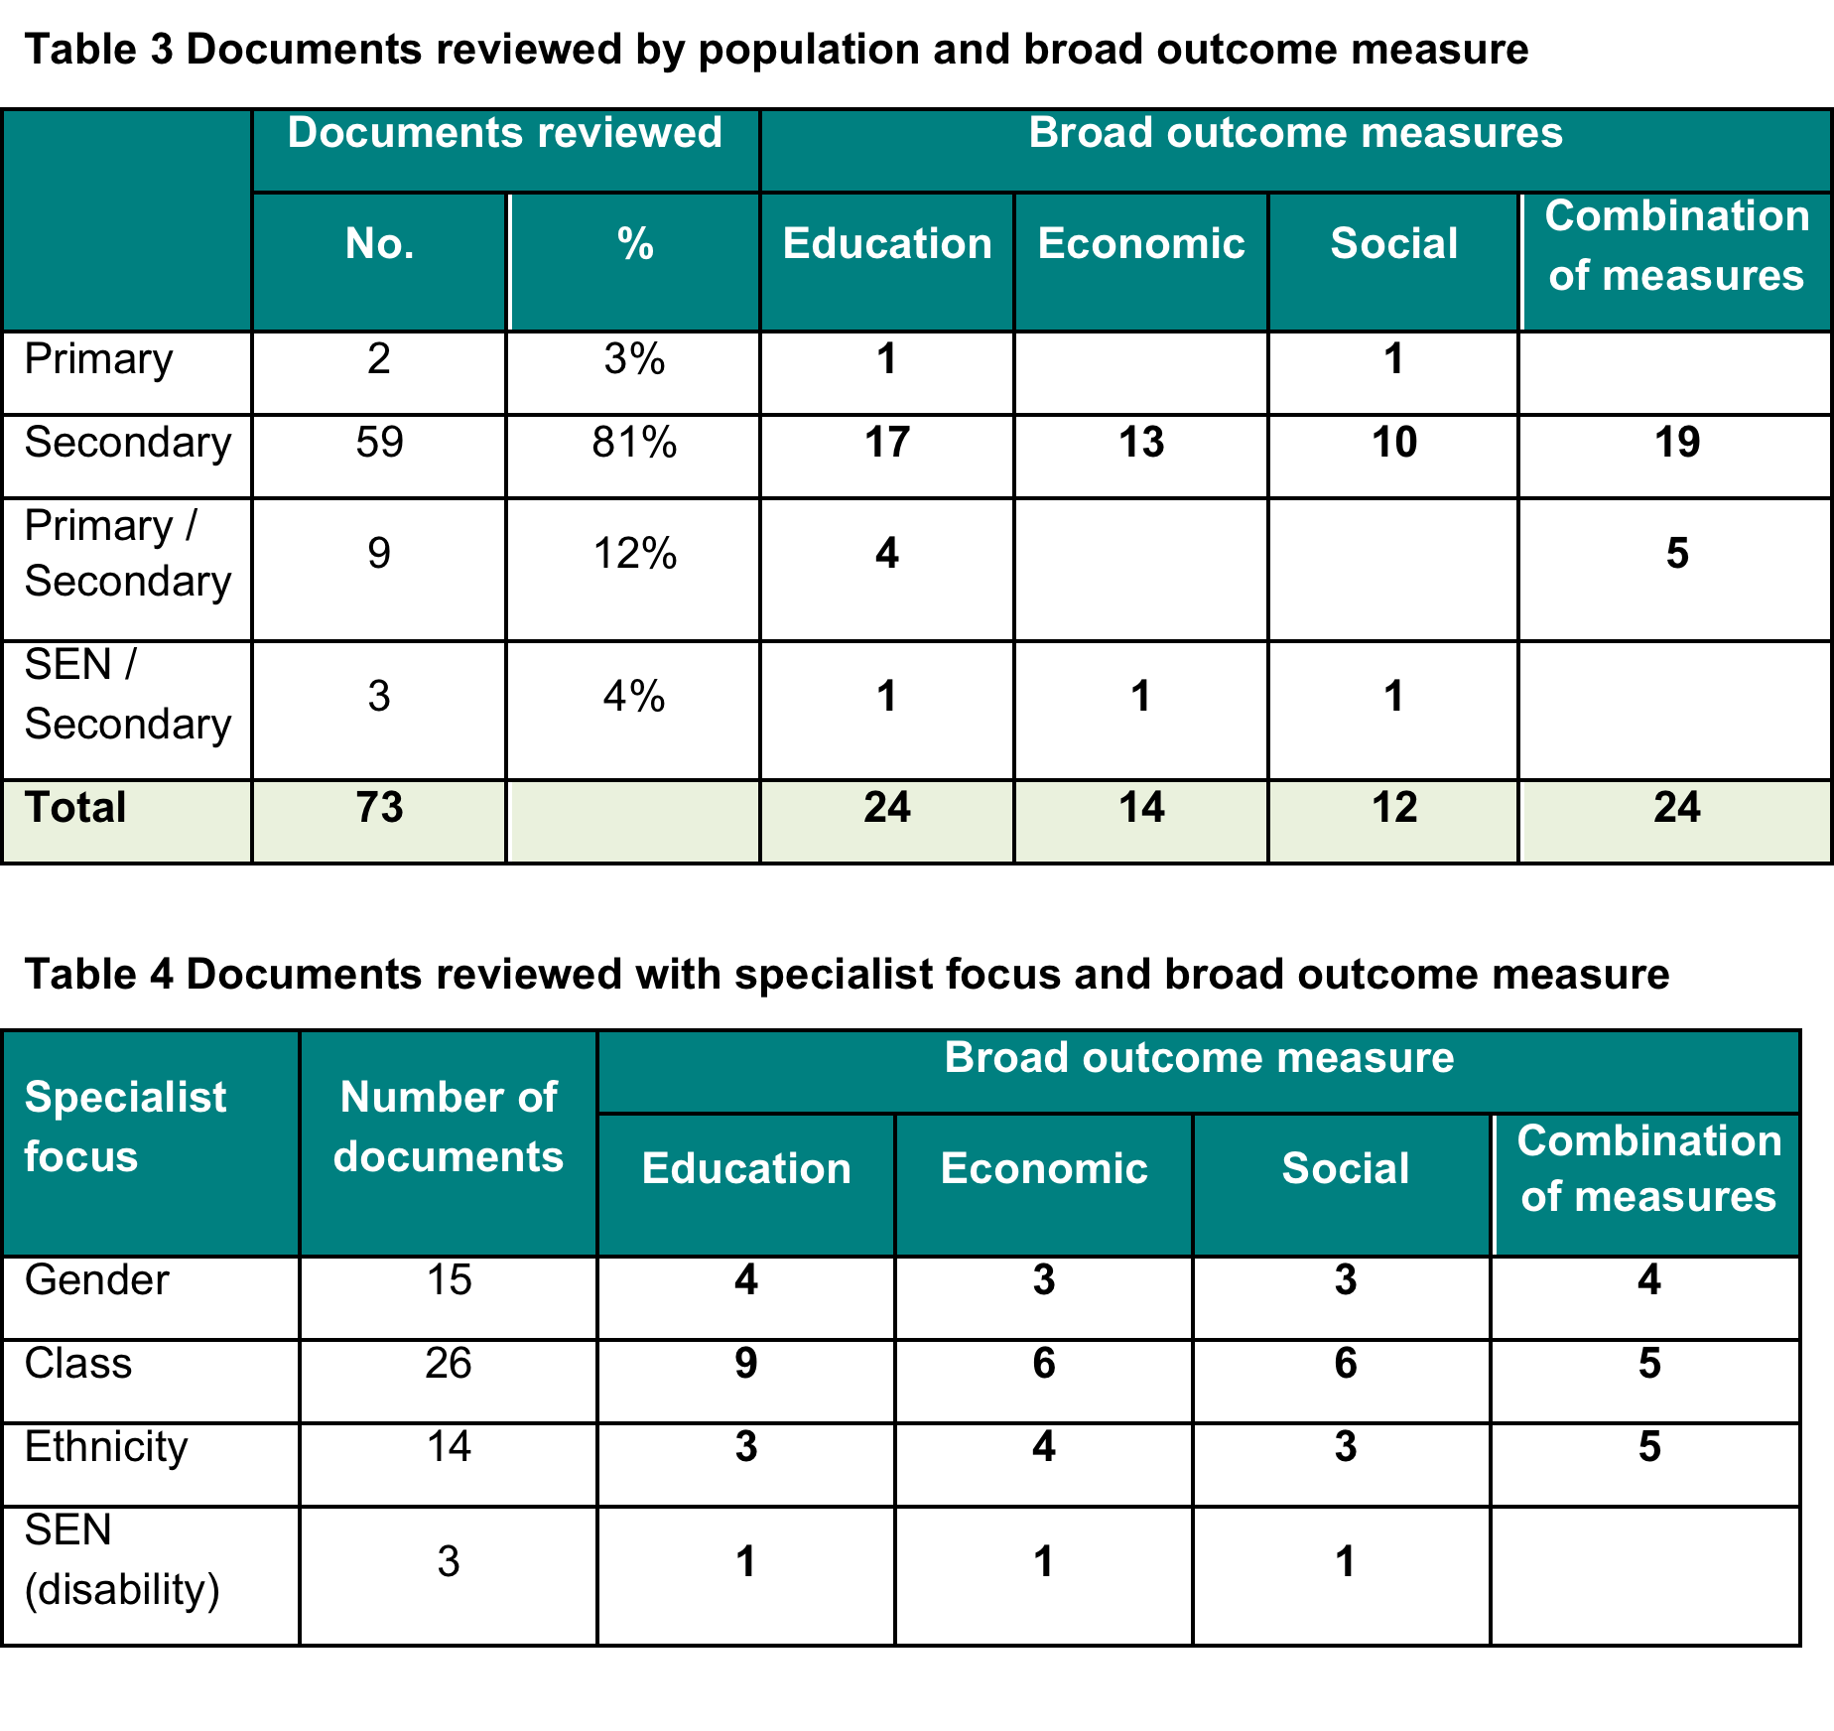
Notes:
The dominant research discourse in this field of careers education study focuses on class/disadvantage/poverty. Studies that focus on gender tend to highlight the disparity between male and female participation in education and, in particular actual and perceived wage earnings and employment opportunities linked to economic outcomes. Much of the literature reflects on ethnicity from a US perspective. In the UK literature, emphasised is placed on enterprise activities for young people from ethnic minority backgrounds. As mentioned above, the literature on careers education for those with disabilities and or special educational needs is underdeveloped in the identified literature. Given the opaque quality of this literature, it is recommended that a further narrowly focused review is undertaken.

Slide 19

Dimensions
Careers provision
Enterprise
ICT and careers education
Job Shadowing
Mentoring
Transformative leadership
Volunteering
Work experience
Work-related learning

Slide 20
Outcomes
Educational outcomes, e.g. attainment level, participation in education and/or training, sustainable progression
Economic and employment outcomes, e.g. earnings, employee retention, likelihood of finding work and/or congruence with the work environment, transition from education to work, social mobility
Social outcomes, e.g. cultural capital, community engagement, confidence, resilience, self-esteem, improved non-cognitive skills and/or mental health well-being, reductions in those not engaged in education, employment or training (NEET), those not engaging in criminal activity.

Slide 21
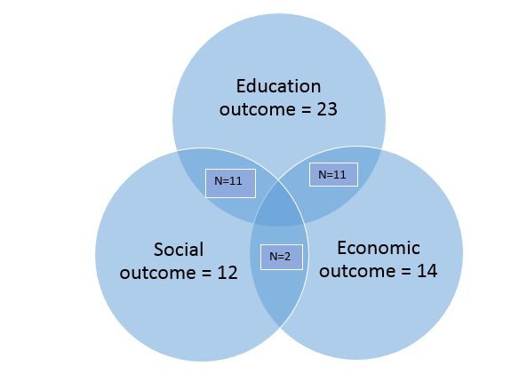
Figure 3 Representation of broad outcome measure and combinations of measures

Slide 22
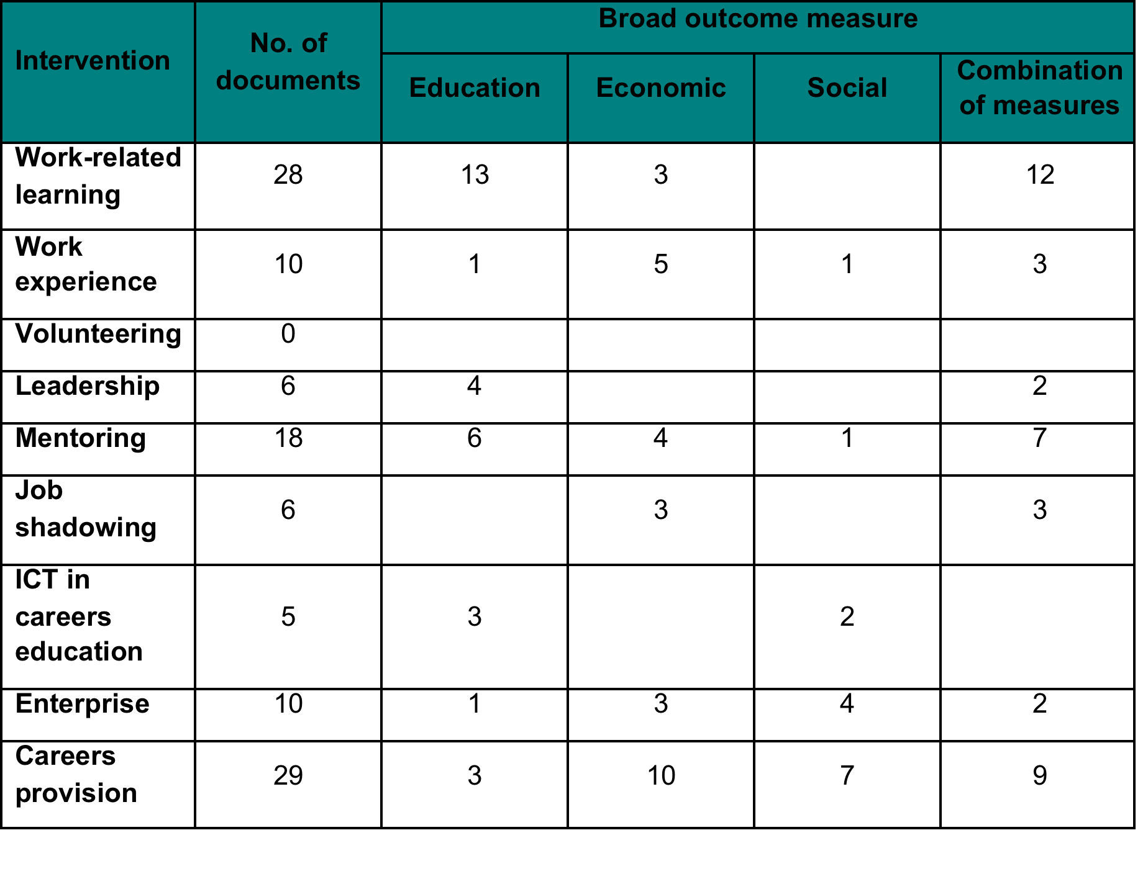
Table 6 Broad outcome measure by intervention
Notes:
Literature relating to part-time teenage employment
Twenty-three studies were identified as relevant to the review.
Literature is predominantly US in origin and split in analyses of outcome areas between educational and economic impacts.
While the literature on careers education can best be described as weak, it stands in contrast to an extensive literature which has used longitudinal databases to make sense of the influence of teenage participation in the labour market through part-time employment, alongside full-time education. In our analysis, we have not classified this as ‘an intervention’ but recognise much of the findings are linked to economic outcomes for young people. The review identified 23 pieces of research literature using level 3 and 4 methodologies, which looked at the impact of school-age part-time working on academic achievement and long-term employment prospects. Twelve studies relate to the US, eight to the UK (including one which looks narrowly at Northern Ireland and three focused on England and five, Australia). The studies present analysis from a range of longitudinal studies, including: National Child Development Study (UK), British Cohort Study, Longitudinal Study of Young People in England, Youth Cohort Study (UK), Longitudinal Study of Australian Youth, National Education Longitudinal Study (US), National Longitudinal Survey 1979 (US), Youth Development Study (US). Collectively, the dataset provides significant insight into the effects of teenage part-time working on young people. This brief review represents the most comprehensive survey of such literature and reveals a great deal of consistency in results.

Slide 23
WHAT WORKS? EDUCATION OUTCOMES
Does careers education improve educational outcomes?
What difference can it make to educational outcomes?
Why does it make a difference?
Which interventions can be expected to be most effective
Notes:
On educational outcomes related to careers education, a literature using Level 3 and 4 methodologies does exist, but it is limited. Our initial review identified, 58 pieces of research literature. Having set aside the literature related to part-time employment, 45 studies on careers-focused education provision meeting the review criteria were identified.
The literature is overwhelmingly American. Of the 45 studies identified, 33 (75%) relate to the United States; seven (16%) relate to the UK, including England; four (9%) to Canada; and one (2%) to the Netherlands.
Of the UK research studies, it is notable that five of the seven studies were the direct result of government-funded activity either by the precursors to the Department for Education or the National Audit Office; and, the remainder represent evaluations of programmes funded by third sector organisations. The reviewers of this study have found no evidence of UK academia engaging in a serious fashion, without such funded encouragement, in the question of whether young people’s educational outcomes can be related to school-mediated careers-focused education.
The literature is strongly focused on secondary education with 44 of the 45 studies providing comment on careers education received by pupils between the ages of 12 and 19. Ten studies (22%) did have something meaningful to say about the impact of provision received by pupils between the ages of 5 and 11. Such studies mainly related to US Middle School provision.
Studies often describe either programmes of activity, which involve more than one intervention or, on occasion, look systematically at the impacts of different interventions in isolation. Within the 45 studies, it is possible to identify 67 discrete de facto studies providing assessments of the impact of different interventions on the educational outcomes of pupils.
Of the research studies, 27 (60%) provided largely positive findings, evidencing improvements in educational outcomes linked to pupil participation in careers education; 17 (38%) presented mixed findings, whereby outcomes were either both positive and negative in broadly even distribution, depending on variables such as pupil demographic, or wherein no meaningful changes in educational outcomes could be detected, whether positive or negative. Just one of the research studies (2%) showed that pupil participation in careers education could be unambiguously linked to negative educational outcomes for pupils.

Slide 24
  What difference can it make to educational outcomes?
Examination results, academic course-taking behaviour i.e., selection of more advanced courses (Dalton et al., 2013)
Progression to, and completion of, higher education and type of institution and courses successfully undertaken (Bragg et al., 2002) (Neild); (Fletcher & Zirkle, 2009; MacAllum et al., 2002, p.9);
GCSE or equivalent qualifications results – eight highest grades achieved;
Staying on rates (UK) at 16 (Golden et al., 2005);
High school graduation rates (US) (Kemple, 2001; Nield et al., 2015; Bishop, 2004)
Grade Point Average (US) (MacAllum et al., 2002);
Credit accumulation (Nield et al., 2015).
Notes:
A majority of studies provided evidence of improvements in academic achievement. However, a review of the studies highlights a very considerable variation in how academic outcomes were measured.

Slide 25
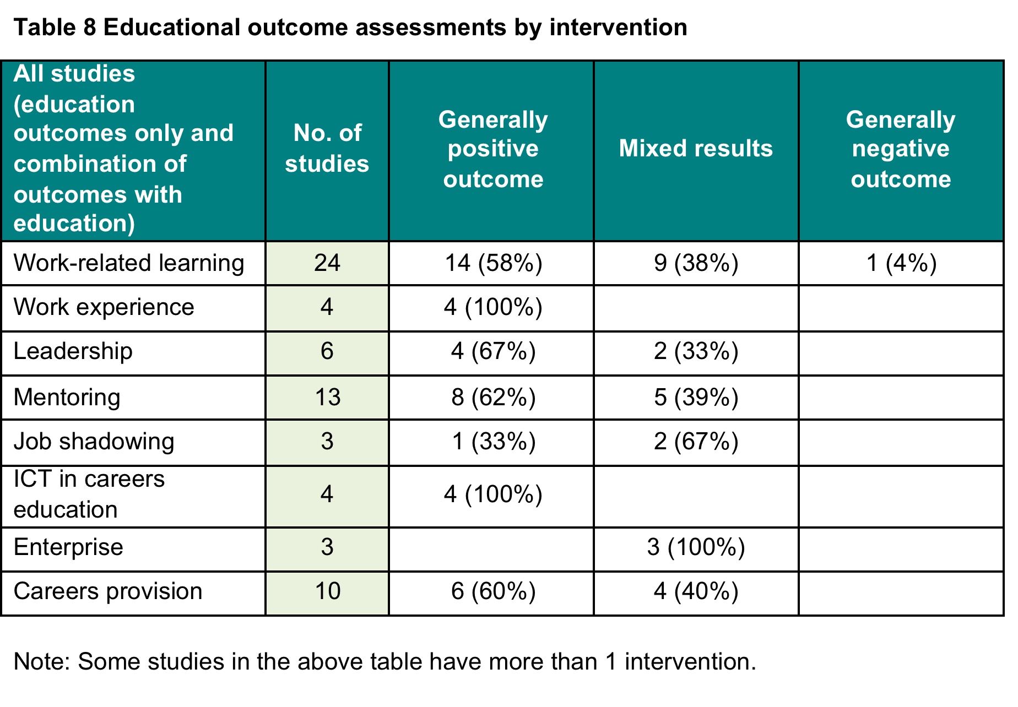
Notes:
This and the following table illustrates the limited character of modern research literature

Slide 26
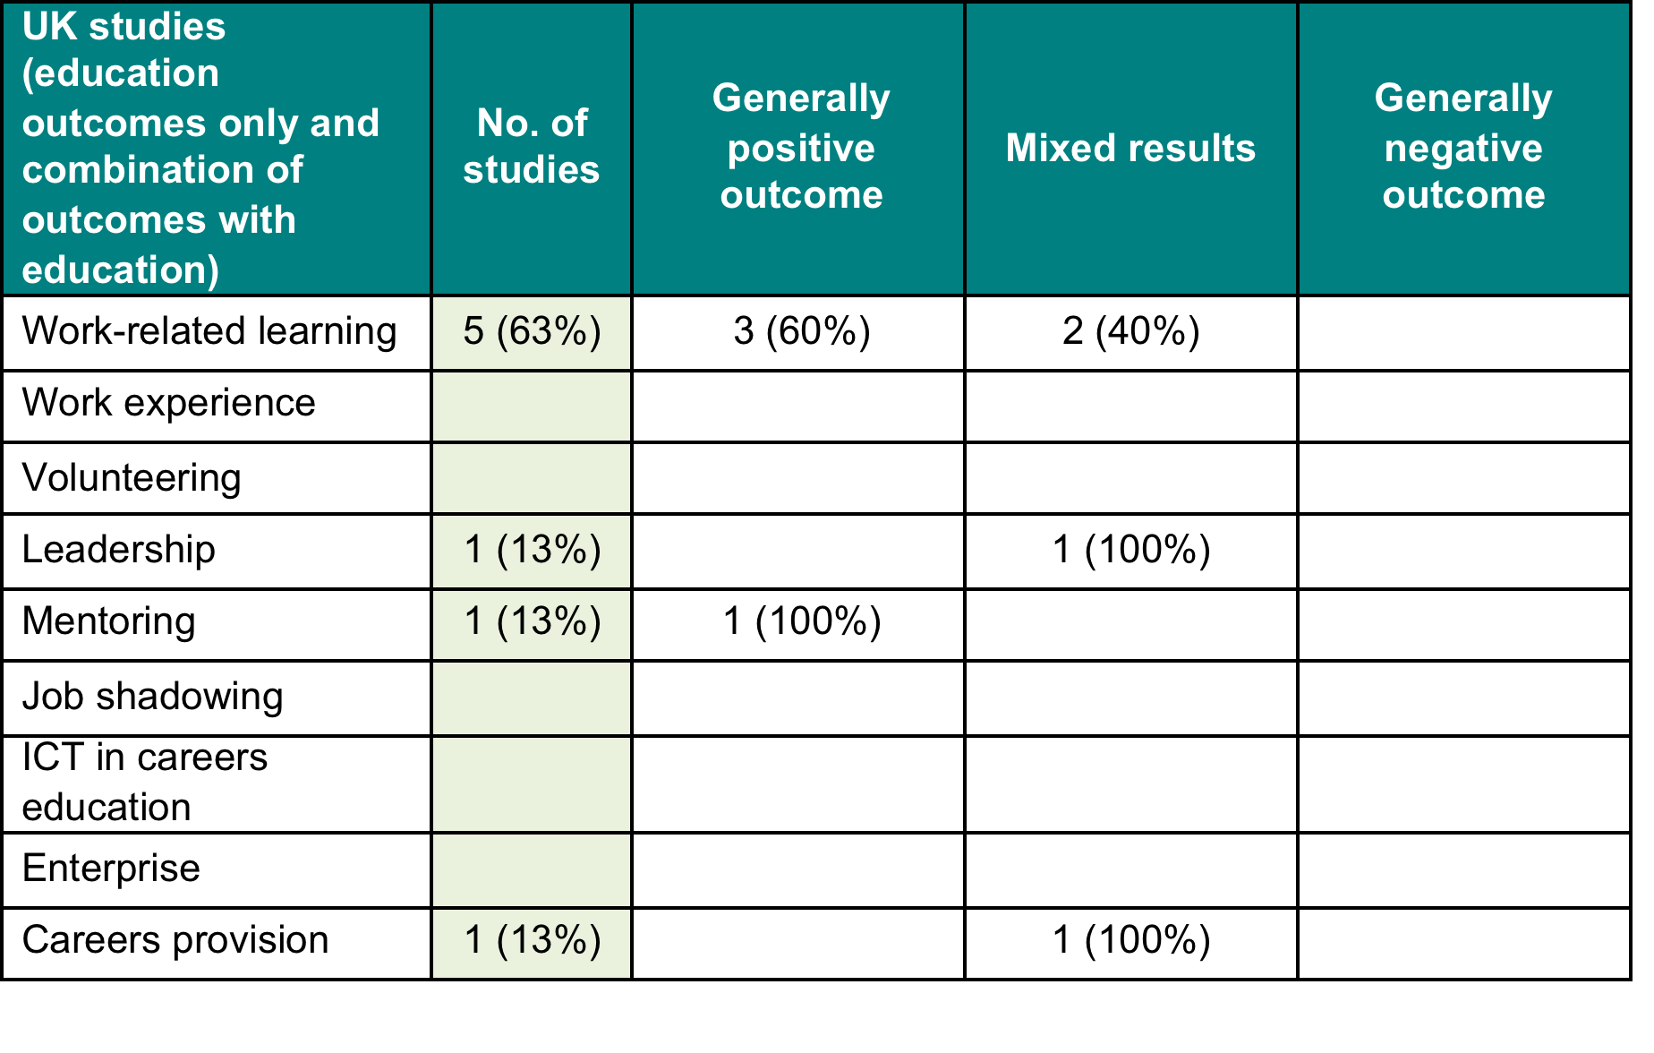
Notes:
Negative educational outcomes - While some studies classified as ‘mixed’ in terms of the educational outcomes which they described found no evidence of impact, we found little evidence of negative outcomes: that pupils undertaking an intervention consistently performed worse than peers in academic assessments. It is Tran and Nathan (2010) who unambiguously find negative educational outcomes linked to a problem-solving focused, project-based programme of study “aimed at showing students how engineering skills, including those from maths, science and technology, are used to solve everyday problems.” The programme, Project Lead the Way, is delivered over five nine-week courses between Grades 6 and 8 in the US. It is unknown what extent, if any, real-world learning resources are used within the curriculum or whether it was delivered within the context of careers provision. Compared to a matched group of students (controlled for prior achievement), who did not enrol in the programme, participating students made significantly smaller gains in maths assessments and no measurable advantages in science assessment. This was the only study to find evidence of pedagogic disadvantage or that an opportunity cost applied related to participation in an episode of careers education.
The lack of evidence associating career education activities with poorer academic attainment is a significant finding given the potential opportunity costs involved in what is a time-consuming activity for young people which often takes place during the school day, displacing valuable teaching and learning time.

Slide 27
An example
Illustrative studies on impact on attainment
Page 25 -26
Miller (1999)
176 students split between mentored control group) from seven schools took the Year Eleven Learning Information System (YELLIS) test devised by the University of Durham. GCSE results were matched against the YELLIS predictions using the standard scoring system (i.e. A* = 8 points to G = 1 point) (1996/7 school year).
Miller examines a mentoring programme designed to support Year 11 pupils, identified as being on the borderline of achieving 5 GCSEs A*-C. 46 mentored girls scored an average 2.26 GCSE points above YELLIS prediction compared to 1.87 GCSE points for the 43 control group girls. The difference between these scores gives a measure of the value added by mentoring of 0.39.
The 44 mentored boys had an average score of –1.72 GCSE points below YELLIS compared to –2.13 for the 49 control group boys (mentoring value added = 0.41).

Slide 28

WHAT WORKS? ECONOMIC OUTCOMES
Notes:
On economic outcomes related to careers education, a literature using Level 3 and 4 methodologies does exist, linked mainly to wage premiums using national longitudinal databases. Our initial review identified, 40 pieces of research literature. Having set aside literature studies related to part-time employment, 27 research studies on careers education meeting the review criteria were identified. They are reported below.
The literature relates overwhelmingly to the United States. Of the 27 studies identified, 19 relate to the US; six relate to the UK, including England; one to Canada; one to the Netherlands; and one to Finland.
Studies either describe a programme(s) of activity, for example, mentoring, learning, use of financial incentives, which involve more than one intervention or, on occasion, look systematically at the impacts of different interventions in isolation, for example, job shadowing, work experience and career talks. Within the 27 articles of research literature, it is possible to identify other more generalised studies providing assessments of the impact of different interventions on the economic outcomes of pupils.

Slide 29
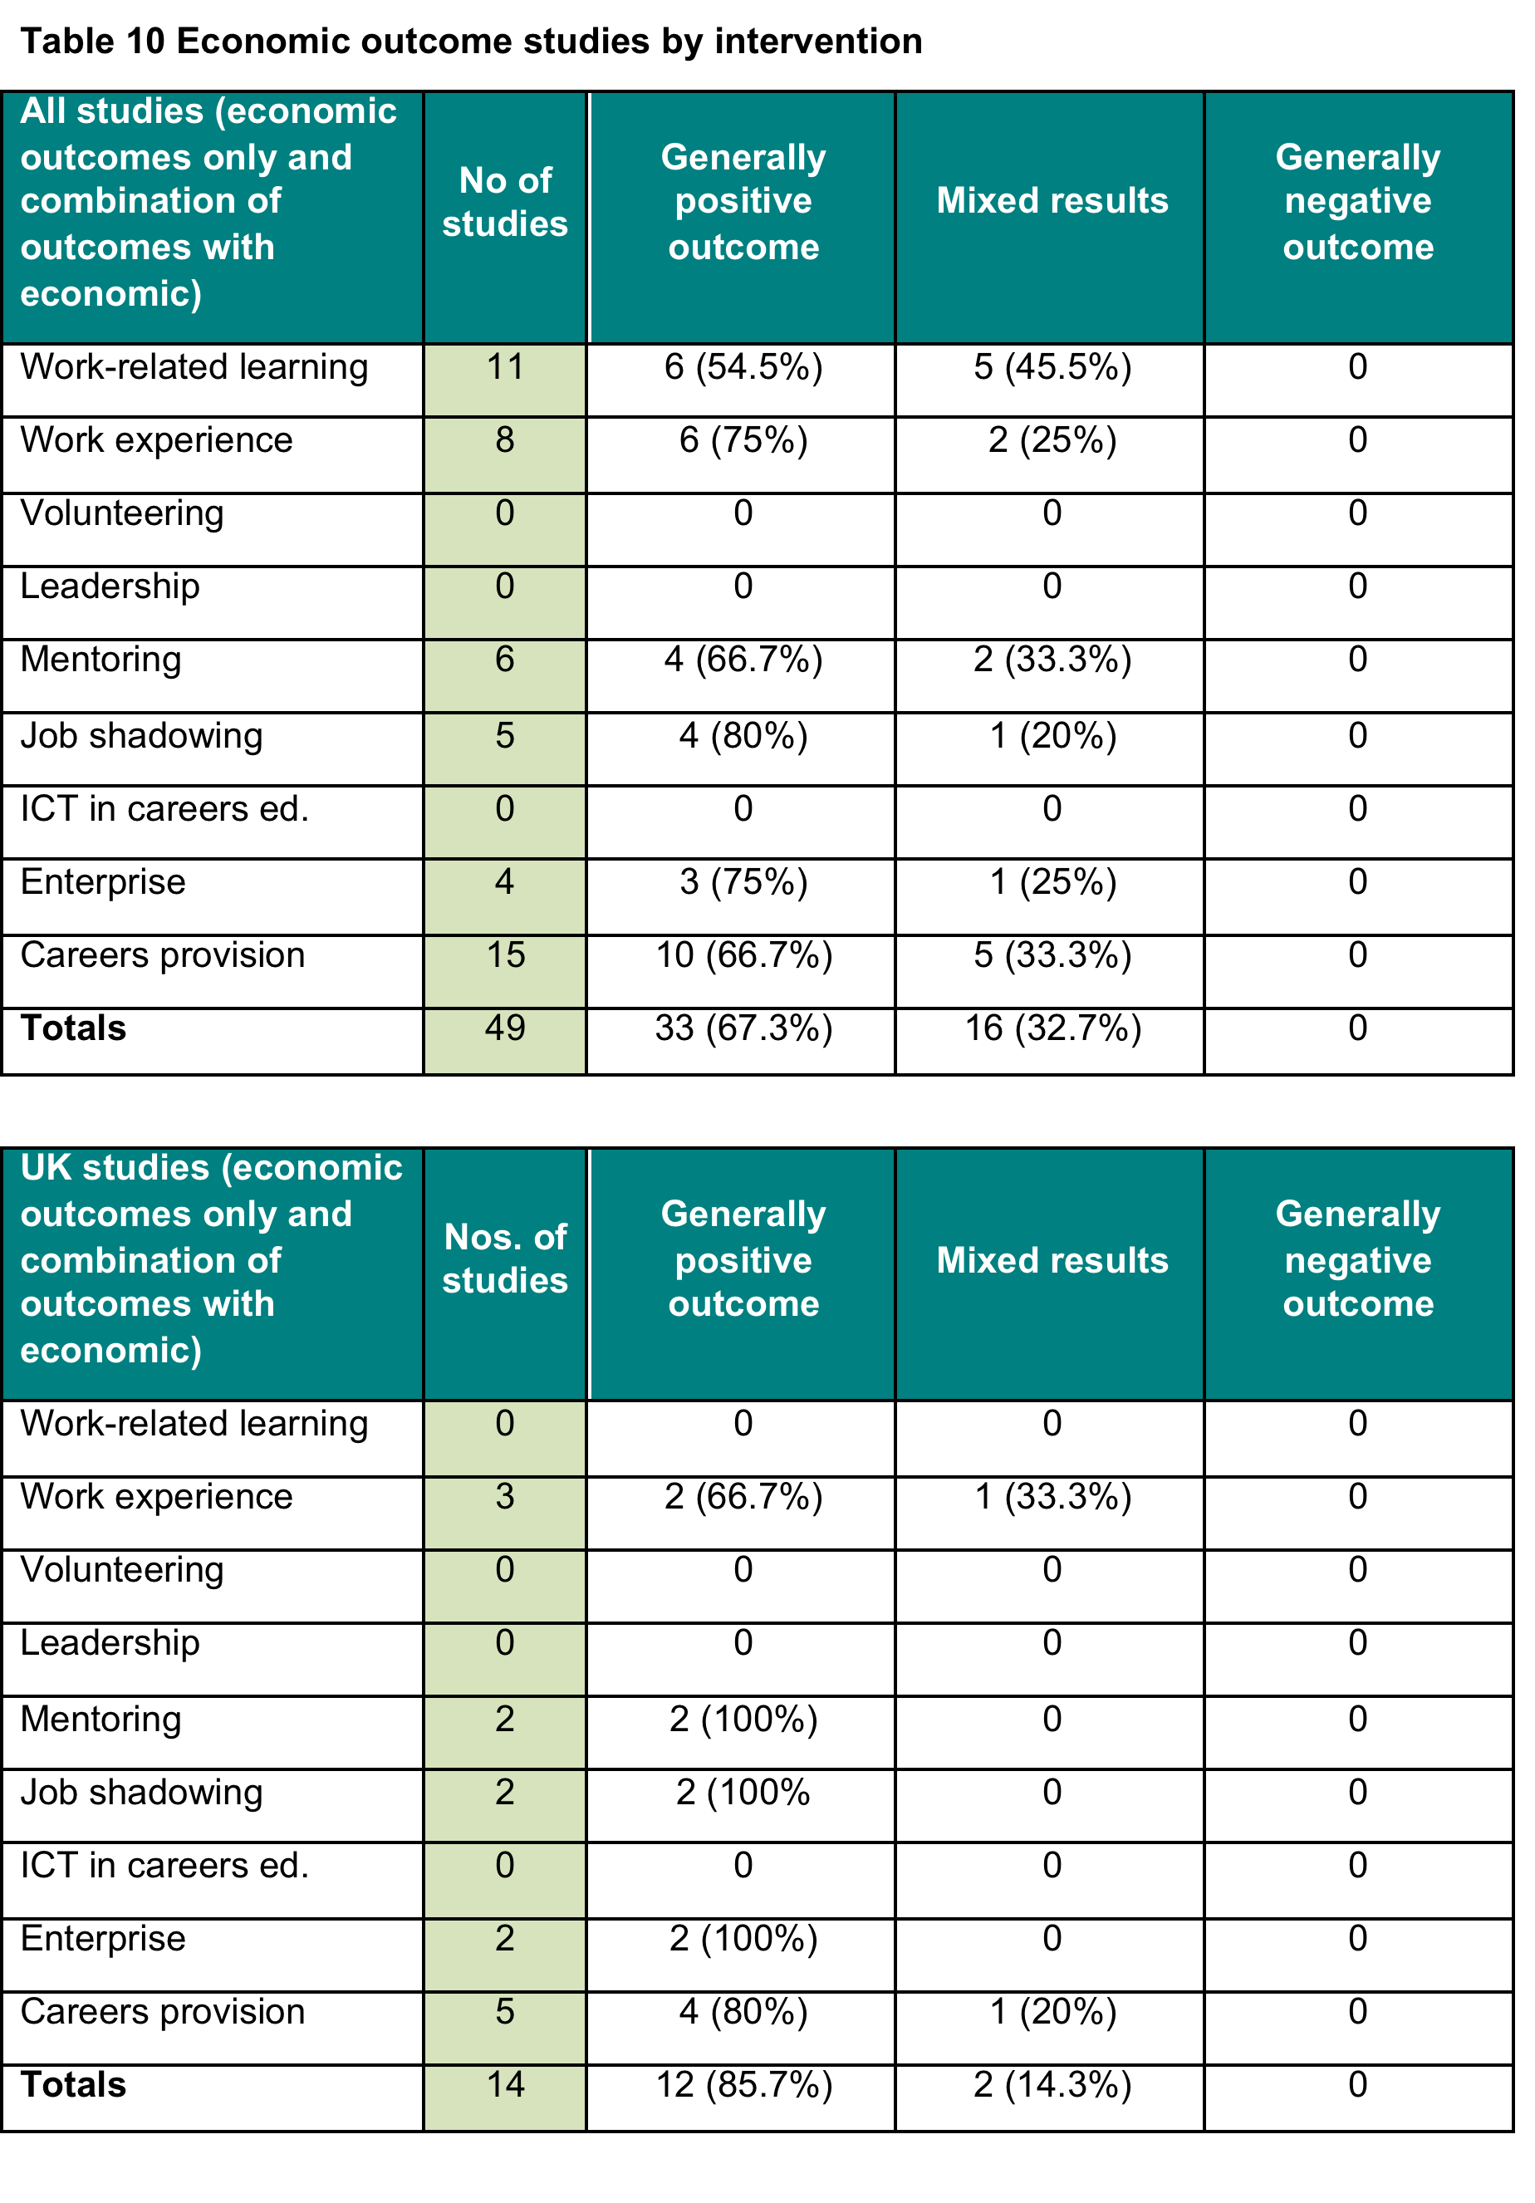
Notes:
There were no UK studies identified focusing on volunteering, leadership and ICT within careers education testing for improvements in economic outcomes. The literature on ICT and careers education is negligible, particularly in relation to young people as well as schools and colleges’ use of labour market information or intelligence (LMI). Research findings on how young people use the internet for career support to improve their economic outcomes demonstrates their information search and retrieval strategies were limited, that few were concerned about the reliability and validity of the information they found, paying little attention to the provider and provenance of the information (Bimrose et al., 2010; Howieson & Semple (2013).
Bimrose J., Barnes S. A., Atwell G. (2010) An investigation into the skills needed by Connexions Personal Advisers to develop internet-based guidance. Reading: CfBT Education Trust.
Howieson, C. & Semple, S. (2013) The Impact of Career Websites: what the evidence, British Journal of Guidance and Counselling, 41(3), 287–301.

Slide 30
An example
Kemple & Wilner, 2008
A longitudinal, randomised control trial of. 1,764 teenagers applying to undertake US work-related learning programme randomly allocated to intervention and control group and followed 8 years after high school graduation.
The study examines the impact three-year (1 day a week), occupationally-focused US study programme, rich in employer engagement. At age 26, alumni of the programme earned, on average 11% ($175) a month more than comparable peers from the control group. Results strongest for young men, averaging a 16% age premium. Female results not statistically significant. The intervention and control groups achieved and were employed to comparable extents.

Slide 31

Notes:
While the literature is limited, a clear pattern does emerge from consideration of the studies. No piece was found to evidence negative economic outcomes for young people; 37% were judged to offer mixed results; and, 63% are associated with positive economic outcomes. The literature investigating economic outcomes related to the engagement of young people in careers education focuses primarily on measuring variations in employment levels (including experience of being Not in Education, Employment or Training (NEET)), occupational status and earnings. A number of studies provide clear statements of wage premiums related to school-mediated activity and these provide insight into the extent of employment boosts detected. To provide a clear insight into the potential extent of impact, we have isolated studies which detect variation in earnings between young adults. Variation in wages represents a transparent indicator of the value applied by employers to the outcome of careers education as witnessed in some distinctive element of attitude, behaviour, skill or knowledge possessed by a young adult.
It also reminds us that the subject of careers education is relevant to both education and labour market policy arenas. Where wage premiums are detected, it will be argued that employers are likely to be recognising higher levels of productivity – an implication of very considerable interest.
Granovetter’s conception of the ‘strength of weak ties’ as developed by Raffo (and other sociologists), to make use of employer contacts to gain ‘non-redundant trusted information’ about the operation of the labour market: information which transcends the socially constructed constraints of family networks (p.17).
Kashefpakdel and Percy (2016) making sense of wage premiums linked to still more incidental interventions – career talks with people from outside of school – also look to Granovetter to explain their findings. Noting the wage boosts associated with teenage perceptions of career talks being ‘very helpful’, they argue, after Granovetter, that teenagers gained benefit from exposures to the labour market which provided them with “new and useful” information.

Slide 32
  Which interventions can be expected to be most effective?
Job shadowing (80%) of 5 assessments indicating largely positive outcomes);
Work experience (75% of 8 assessments);
Careers provision (67% of 10 assessments);
Mentoring (67% of 6 assessments);
Work-related learning (55% of 11 assessments).
Notes:
A theme of the wider literature is the extent to which careers education can be best situated within a broader conception of the lived experience of a young person. Where providing a young person with access to trusted useful information and experiences relevant to ultimate career progression, experiences will build on and interact with preceding family-based access to such resource. The analysis suggests both that young people at greatest distance from the labour market of their aspirations within their home lives can be expected to gain greatest value from careers education and that schools can use careers education as a strategic resource to democratise access to resources of significant value in career progression. As articulated by Erickson and colleagues (2009), such interventions can serve to compensate for lack of resource, but also can serve to attenuate inequalities.
Stanley, J. & Mann, A. 2014. “A Theoretical Framework for Employer Engagement” in Mann, A., Stanley, J. & Archer, L. eds. Understanding Employer Engagement in Education: Theories and Evidence. London: Routledge ; Jones, S., Mann, A., & Morris, K. 2015. “The ‘Employer Engagement Cycle’ in Secondary Education: examining the testimonies of young British Adults” Journal of Education and Work. DOI: 10.1080/13639080.2015.1074665.
Erickson, D., McDonald, S., & Elder, G.H. (2009) Informal Mentors and Education: Complementary or Compensatory Resources? Sociology of Education. 82, 344-67.

Slide 33
What works? social outcomes
Measurements of social outcomes vary considerably across the literature
Use of measurement or inventory tools
Degree of exposure to work experience
Not a single approach – multi-dimensional
Notes:
On social outcomes related to careers education, a literature using Level 3 and 4 methodologies does exist. A total of 28 studies were identified including part-time work studies. From this, 25 studies were identified as specifically relevant to careers-focused education. There is strong overlap between social outcomes and education and economic outcomes, for example, refer to Golden and colleagues. (2010), Gutman and colleagues (2014), Kemple and Willner (2008), and Staff and colleagues (2010). Enhancing social mobility is a common thread featured in the literature linked to ensuring fairness for individuals, prosperity for the economy, and cohesion for society as a whole (Currie et al., 2007; Neumark & Rothstein, 2003; Hooley et al., 2014, for example).
Generally, it is argued that by providing careers- focused education it should be possible to enhance the individuals’ capacity to navigate education and employment systems more effectively, particularly for those most disadvantaged. Ultimately, the goals are to demystify learning and labour market pathways, to facilitate access to networks beyond those that individuals normally have access to; and to provide information, guidance and support that nurtures decision-making, career adaptability, resilience and employability.
Those studies focusing on ‘social outcomes only’ there were 13 studies (n=13) related to the US, 8 studies (n=8) from the UK and 2 studies (n-2) from The Netherlands, 1 study from Australia (n=1) and 1 study from Canada (n=1).

Slide 34
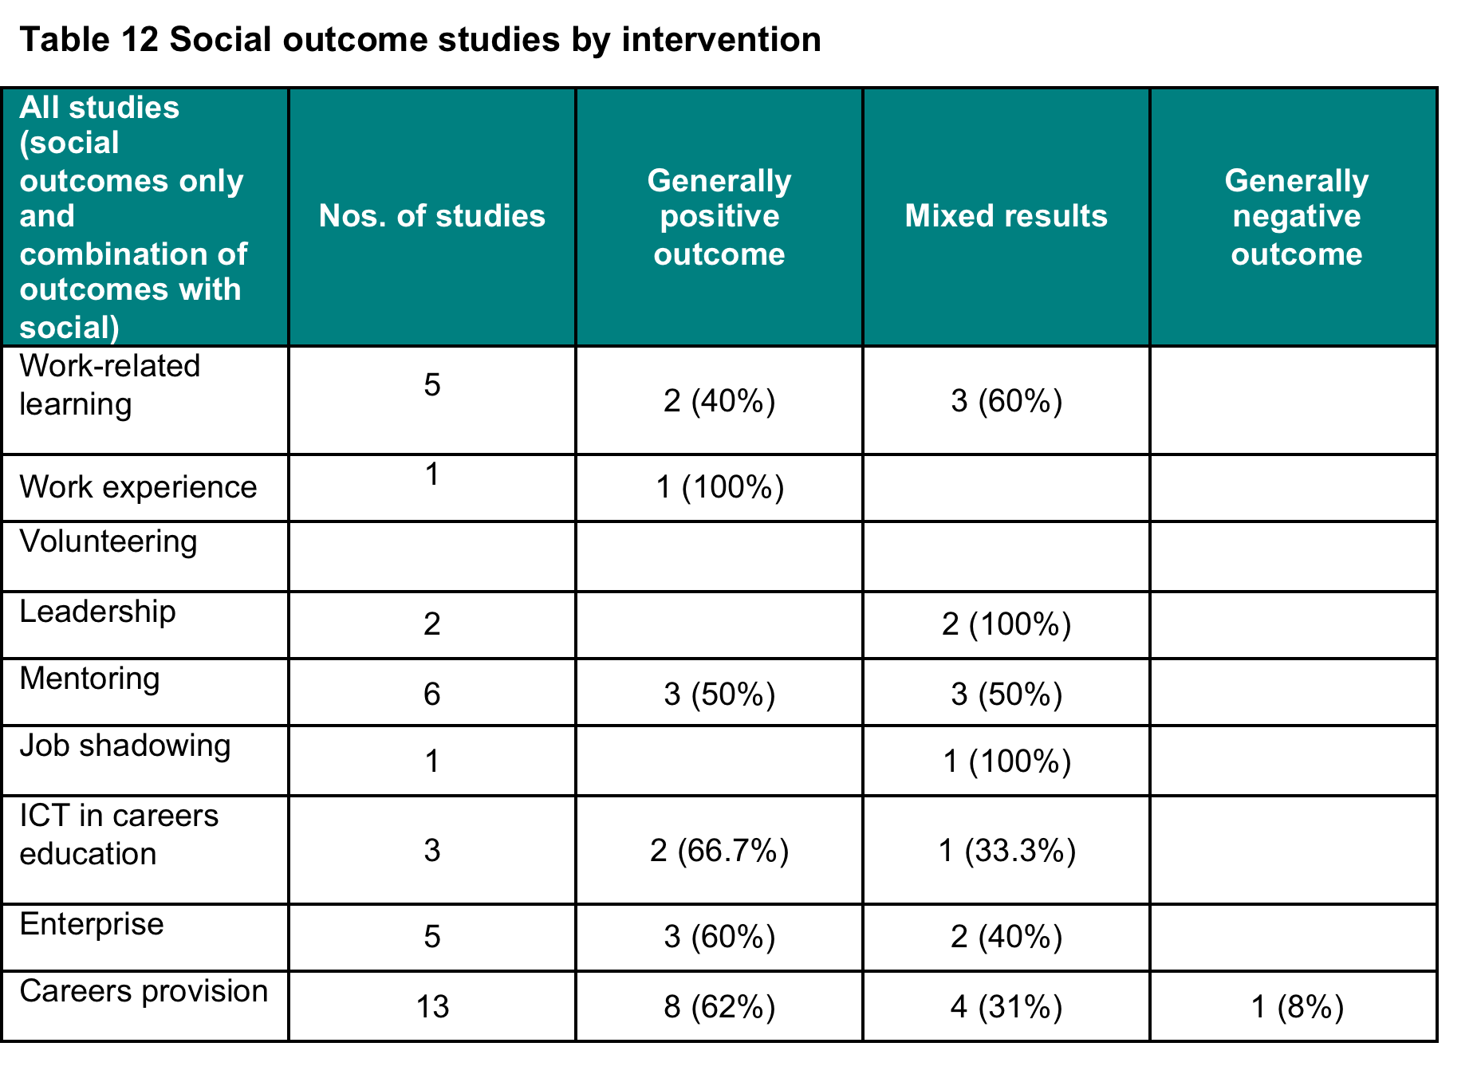

Slide 35
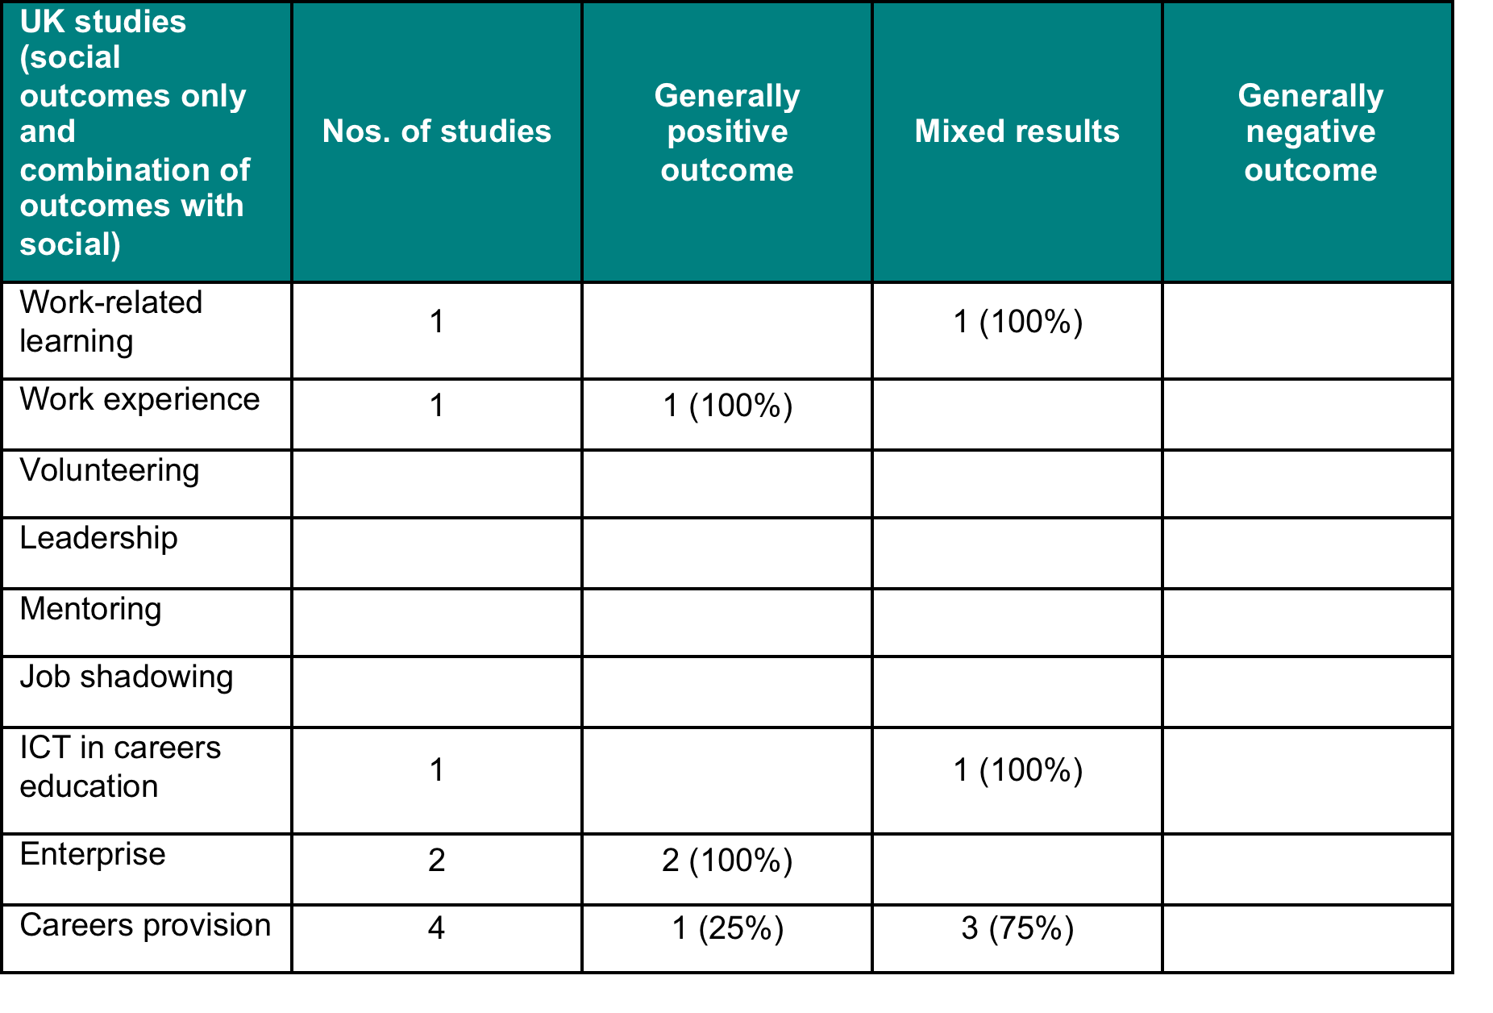
Notes:
Beyond this, there is a substantial body of literature on ‘career adaptability’ (Savickas et al., 2009; Savickas, 2011) part of which features career resilience (Lyons, Schweitzer, & Ng, 2015). In the context of our literature review, resilience is defined as “the process of bending and rebounding to overcome adversity” (Hunter, 2001, p. 172) as noted by Lengelle and colleagues (2016). This is a multi-dimensional phenomenon that varies according to contexts, internal variables, and external changes (Chiaburu, Baker, & Pitariu, 2006). Resilience is often viewed as a positive outcome “which is defined by the presence of positive mental health (such as positive self-concept and self-esteem, academic achievement, success at age-appropriate developmental tasks, etc.) and the absence of psychopathology, despite exposure to risk” Metzl and Morrell (2008). This concept is also interpreted as a dynamic learning process dependent upon interactions between individual and contextual variables that evolve over time. In this sense, resilience refers to the capability to ‘bounce back’ from negative emotional experiences associated with adversity, uncertainty and threat (Tugate & Fredrickson, 2004). It should be noted, quasi-experimental and experimental studies focusing on exclusively on resilience within careers-focused education are not included in this review but they do merit a more detailed analysis outside of this literature review.
The literature on careers education highlights a requirement for some form of effective ‘dialogue’ and ‘action’ in which personal meaning is attached to concrete experiences of learning and work. See for example, Buckler and colleagues (2015); Currie and colleagues (2007); and Morris (2004). Kuijpers and colleagues (2011) strongly argues the learning environment has to be both practice-based and dialogical. To achieve a dialogue, the thoughts and feelings of young people with respect to their views and experience of work (or lack of it) must be given a central place in the schooling conversation. This is highly relevant in the context of young people being the seekers and recipients of a range of differing types and variation in the quality of careers information and LMI both online and offline. However, there is scant literature available on ICT and careers education that includes the use of learning and labour market information and intelligence (LMI). The use of technologies (UKCES, 2014), combined with other factors such as changes in consumer behaviours and the availability of more ‘open source’ data, has resulted in profound shifts in how individuals utilise services in a rapidly changing world. Alongside this, centralised versus localised policy shifts also raise new questions concerning the adaptation of available careers education for young people, particularly amongst the most vulnerable groups.

Slide 36
Three levels
Prevention measures aimed at keeping young people switched on to learning, encouraging them not to close down opportunities too early, broadening horizons and challenging inaccurate assumptions, for example using alumni (Buckler et al., 2015); enterprise measures (Peter & Kennedy, 2003; Athayde, 2006 & 2012); self efficacy approaches (Mc Combe-Beverage, 2012).
Integration measures aimed at developing curriculum approaches that inform and support young people in their transitions into learning and/or work, for example, focusing on cross-curricular themes (Henderson, 1995); work experience (Hillage, 2011); career exploration activities (Morris, 2004); mentoring (Berstein et al., 2009).
Recovery measures aimed at re-energising or reconnecting young people to learning that meets their individual needs, for example, career maturity (Legume & Hoare, 2004); self determination (Powers et al., 2012).
Notes:
This may also include preventing young people from switching off or becoming disaffected in the first place, particularly those who are most at risk of ‘dropping out’ and taking action that engages young people, families and communities as a whole.

Slide 37
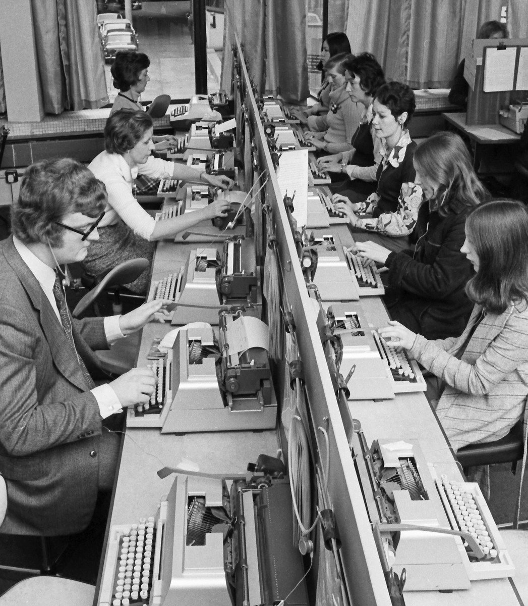
Practical activities
Career reflection
Career exploration
Career action
Networking
Learning environment
Career dialogue
Career conversations students have in the workplace
Notes:
Career reflection: making concrete the thinking about one’s own motivation and aptitudes, self-regulation, self-determination, and resilience to cope with unforeseen setbacks e.g. McComb-Beverage, 2012; Peterman 2003; Legum, & Hoare, 2004; Kuijpers & Meijers, 2009.
Career exploration: giving shape to one’s own career path by exploring the options for study and work e.g. Athayde, 2009 & 2012; Furstenberg, & Neumark, 2005; and Kuijpers & Meijers, 2009.
Career action: opportunities to make sense of and act upon the learning gained from differing types of interventions e.g. Orthner, et al., 2013; and Kuijpers & Meijers, 2009.
Networking: building and maintaining a network of key contacts e.g. Bernstein et al., 2009; Rhodes & Resch, 2000; and Kuijpers & Meijers, 2009.
Learning environment: stimulating real-life experiences with work and a dialogue about these experiences e.g. Morris, 2004; Gutman et al., 2014; and Kuijpers & Meijers, 2009.
Career dialogue: young people having meaningful conversations with teachers, parents/carers, employers/employees, alumni, trained and qualified career development professionals e.g. Buckler et al., 2015; Powers et al., 2012; Schwartz et al., 2011; Hughes et al., 2004; Hooley et al., 2014.
Career conversations students have in the workplace: gaining exposure to and experience of work in simulated and real-life situations, e.g. Hillage et al., 2011; and Kuijpers & Meijers, 2009.

Slide 38
An example…
Kuipers & Meijers, 2009
The effects of career education and guidance among students (ages 12–19) enrolled in prevocational and secondary vocational education in The Netherlands. A total of 3499 students and 166 teachers from 198 classes in those 35 schools participated in the study.
Randomised field experiment with regression analyses applied.
Career identity was measured with an instrument, consisting of 88 items (Cronbach’s a = .81), that was based on studies by Meijers (1995) and Meijers and Wardekker (2002).
All multi-item scales had an adequate Cronbach's alpha (i.e., N0.70), with the exception of the three-item Locus of Control Scale, which only had an alpha equal to 0.62.
Results showed that career competencies positively contributed to learning motivation, experienced quality of study choice, experienced fit of choice with learning tasks, and experienced fit of internship. Career identity positively contributed to career outcomes, and career dialogue contributed more than traditional interventions have with respect to career outcomes. The amount of variance due to differences between schools and between classes is negligible, although the class variance is statistically significant.
Note: The additional variance is due to the total effect of all learning environment variables, in addition to student and school variables (varies from 7% to 11% for career reflection, career forming and career networking). The corresponding effect sizes are characterized as small to moderate.

Slide 39
What does the literature review tell us?
The outcomes linked to schools’ careers education provision, including employer engagement, are primarily positive
60% of studies looking at educational outcomes are positive (only 2% negative).
67% of studies looking at economic outcomes are positive, none are negative
62% of studies looking at social outcomes are positive (only 3% negative)
Notes:
The remainder of studies produced outcomes, which were overwhelmingly mixed. It is extremely difficult to find high quality research studies into aspects of careers education, as defined in this review, which are detrimental to young people.
Too often the studies reviewed investigate wildly different aspects of the outcome areas, presenting challenges to reviewers seeking simple and clear statements of impact.

Slide 40

Drilling down
Some evidence to suggest that impacts on attainment can be expected to be relatively modest, recognising that impacts can be expected to vary, perhaps considerably, by individual circumstance and character of intervention delivery
Good evidence to show that earnings premiums are commonly sizeable for young adults especially when they engage with employers within teenage careers focused provision
Good evidence that careers education also underpins a wide range of beneficial social outcomes

Slide 41
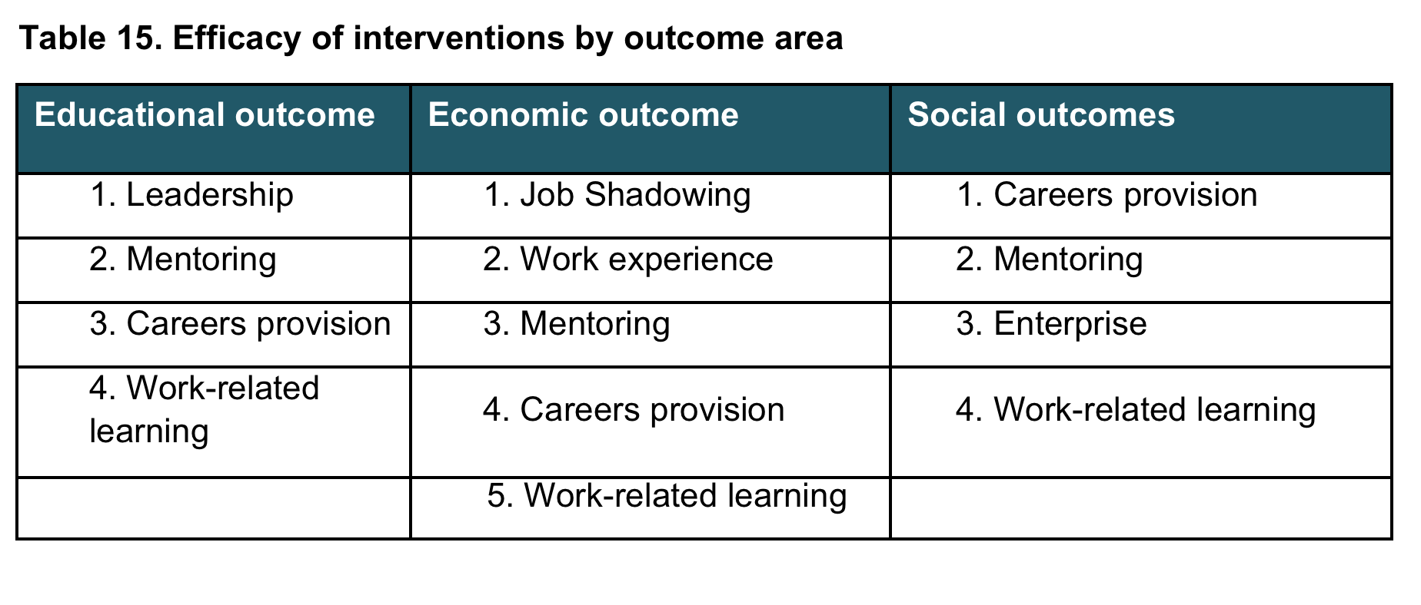
Notes:
The literature is slender, but it is not a blank page. There is a need, in filling in our collective knowledge, to build iteratively on existing studies and address, as a priority the main gaps in the literature. There is a call for new studies that include a focus on:
How careers education can support the greatest boosts to academic achievement of the largest numbers of young people, including understanding how identifiable groups of young people can be expected to respond to different interventions. This would require combining quantitative and qualitative approaches to further unlock the ‘black box’ of causality.
Personalised and targeted careers education (and career guidance) for young people (and parents), particularly those in lower socio-economic groups; for young immigrants and those from other disadvantaged ethic groupings; for young people who are disabled or have special educational needs.
Careers education and systems for tracking students’ enrolment and progression in learning and work over time, using data available from learning information and HM Revenue and Customs, to learn more about career trajectories. From this, more could be learned about ways of identifying cycles of intergenerational poverty and evidence of what helps to break cyclical trends.
The effectiveness of ICT in careers education (and career guidance) online and or the use of ICT and labour market information and intelligence (LMI) in the classroom.
Understanding the career guidance process and the ‘meaning making’ this provides for young people in receipt of learning and labour market information.
The importance of social and cultural capital as a resource for schools e.g. opportunities for young people to broaden their networks and expand their horizons.

Slide 42

Use of technology and LMI – extremely low profile

Slide 43
Where Next?
In countries such as Austria, Finland, Germany, Scotland, Switzerland careers education and guidance feature prominently in their education systems (OECD, 2015)
A clear need for research which is longitudinal, and is therefore capable of identifying longer-term and possibly more deep-seated effects, not merely in terms of individuals’ pathways and assessment of opportunity structures (e.g. take-up of learning/job opportunities), but also their career behaviours, attitudinal shifts and perceptions of career identity, is of great importance.

Slide 44

Thank you to our sponsors: EEF with support from the Bank of America Merill Lynch
We are continuing with our joint research – join us!
deirdre.hughes@warwick.ac.uk
anthony.mann@educationandemployers.org

