Slide 1

Schools and the twenty-first century labour market: perspectives on structural change
Dr Anthony Mann and Professor Prue Huddleston
British Journal of Guidance and Counselling

Slide 2
Research context
Young people have never left education more highly qualified, with more years of schooling…
Any 5 GCSEs | 1990/91 | 37% |  | % in FT education @ 17 | 1990/91 | 43%
 | 2011/12 | 81% |  |  | 2013/14 | 77%
http://researchbriefings.parliament.uk/ResearchBriefing/Summary/SN04252 |  |  |  | https://www.gov.uk/government/uploads/system/uploads/attachment_data/file/436526/Main_text_16-18_participation_SFR19_2015.pdf; http://researchbriefings.parliament.uk/ResearchBriefing/Summary/SN04252
5 GCSES inc. English+Maths | 1995/96 | 35% |  | % of UK workforce with degree | 1992 | 17%
 | 2015/16 | 59% |  |  | 2013 | 38%
https://www.gov.uk/government/uploads/system/uploads/attachment_data/file/467603/SFR37_2015.pdf; https://www.gov.uk/government/uploads/system/uploads/attachment_data/file/559919/SFR48_2016.pdf |  |  |  | https://www.ons.gov.uk/employmentandlabourmarket/peopleinwork/employmentandemployeetypes/articles/graduatesintheuklabourmarket/2013-11-19

Slide 3
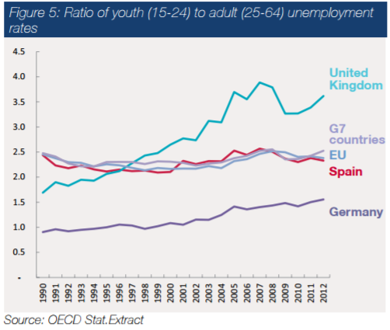
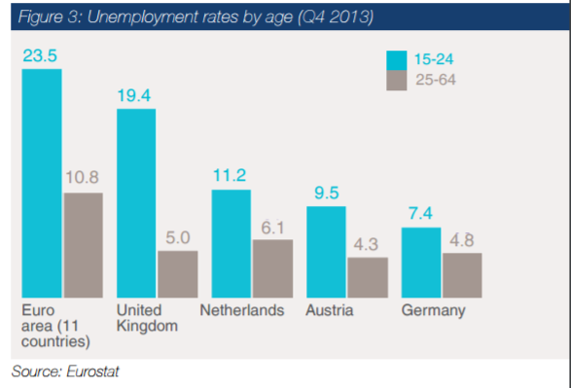
Research context
…but are facing record levels of discrimination in the labour market, seen in the ratio of youth:adult unemployment…
https://www.gov.uk/government/uploads/system/uploads/attachment_data/file/326119/14.07.02._Youth_Report_for_web_V3.pdf

Slide 4
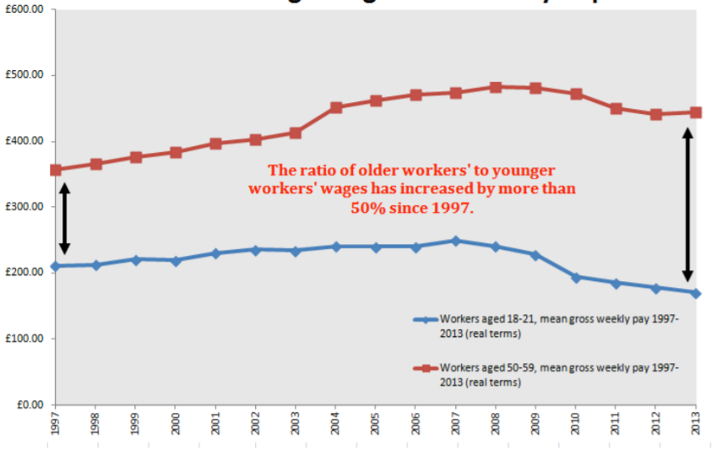
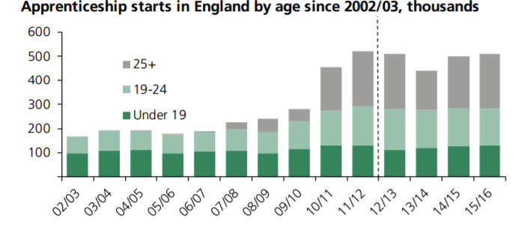
Research context
…comparative earnings and success in Apprenticeship recruitment.
http://www.if.org.uk/wp-content/uploads/2014/02/Squeezed-Youth_Final.pdf; http://researchbriefings.parliament.uk/ResearchBriefing/Summary/SN06113

Slide 5

Methodology
Interviews with policy commentators
Kay Carberry, Assistant General Secretary, Trades Union Congress (TUC)
Peter Cheese, Chief Executive of the Chartered Institute of Personnel and Development
Chris Husbands, Director of UCL Institute of Education
Ewart Keep, Chair of Education, Training and Skills at the University of Oxford
Hugh Lauder, Professor of Political Economy at the University of Bath and Editor of the Journal of Education and Work
David Pollard, head of Education and Skills at the Federation of Small Businesses
Andreas Schleicher, Director of Education and Skills, Organisation for Economic Co-operation and Development (OECD)
Lorna Unwin, Professor of Vocational Education at the UCL Institute of Education and Editor of the Journal of Vocational Education and Training

Slide 6

Methodology
Focus groups with recruiters
Twenty five representatives: experienced recruiters
Sourced through CIPD and EET networks
Variety of sizes and sectors
Three events: London and Leicester
Semi-structured questioning

Slide 7
Three themes emerged from discussions
Structural changes in the operation of the youth labour market (driven by technological change, globalisation, labour market deregulation, inequality and marketization of higher education and training) have implications which schools and colleges can do something about relating to:
(1) Complexity: The increasing complexity of the labour market has required
greater levels of more authentic careers provision.
(2) Competition: School to work transitions have become more fractured with young people demanding that they leave education with greater levels of recruitment skills and resilience to compete for employment.
(3) Workplace Change: A rapidly growing number of jobs demand not just knowledge itself, but its effective application in new situations, drawing on skills often delivered by schools as enterprise education.

Slide 8
Theme one: the implications of growing complexity
If we think of young people making investment decisions as they decide on the qualifications, training and experience (collectively, the human capital) they plan to accumulate prior to leaving education to optimise their ultimate earnings in the labour market, we need to recognise the importance of access to good information about what that labour market actually wants and demands in order for properly informed decision making to take place. In the absence of good labour market signalling, it can be no surprise that poor investment decisions will be made and the widely evidenced skills mismatches in the British economy become a predictable result. Hugh Lauder.

Slide 9
Theme one: the implications of growing complexity
It is absolutely apparent that if we want to do anything to make transitions into an increasingly complex working world easier for young people, it is essential that high quality careers information advice and guidance is available. Without that, we might as well give up, it is that important. …We need to help young people become far more discerning consumers of the provision available to them. Ewart Keep.

Slide 10
Theme one: the implications of growing complexity
Even some post-graduates are spectacularly naïve. They’ve just done years studying mechanical engineering and when it comes to interview it turns out that they are not actually interested in working in mechanical engineering! FG.
Young people do the course which is funded, not the course which is best for the job. The advice they get isn’t smart enough. FG.
All they’ve got to do is let us in and tell their young people about what we do. And it needs to be done at the right time. When they’re about to leave it’s too late. We need to come in 2–3 years before they pick their options… FG.
Work experience should be compulsory and more structured. Young people, they need more exposure to the workplace and different jobs. Work experience is great at showing them what they would get if they went into this job or that job and what would be expected. FG.

Slide 11
Theme one: the implications of growing complexity
Summary
Jobs are changing and rapidly, making it harder for young people to relate their educational choices to employment ambitions, enhancing risk of skills mismatch and young people getting caught out
Marketization of higher education and training can be expected to further distort signaling
Enhanced careers provision enriched by multiple first-hand experiences of the labour market addresses growing complexity

Slide 12
Theme two: the implications of growing competition
Over the last generation, employers have become spoiled for choice – competition for employment has been so great that employers can, and do, impose increasingly demanding barriers to entry. It has become the norm for employers to operate in ever more flexible labour markets where they feel fewer and fewer responsibilities to train new staff.
They have the choice of hiring in older workers with experience, migrants and of recruiting graduates to non-graduate jobs, as we see in some call centres now, and have taken it. Schools and colleges simply cannot give young people the degree of job readiness demanded by a growing number of employers. Ewart Keep.

Slide 13
Theme two: the implications of growing competition
The policy emphasis on ‘staying on’ and HE expansion has precluded attention to other routes. It has also led to a displacement problem–those with higher level qualifications are now doing intermediate level jobs. The increase in supply of graduates is out of kilter with the level of demand. There is simply a mismatch between supply and demand. Lorna Unwin.
Young people don’t know what they want to do in life. Schools don’t sit down with them to talk about jobs, what they have to offer and how work works. They don’t understand how to apply for a job, what CVs should look like, how to get themselves a job. FG.

Slide 14
Theme two: the implications of growing competition
Technological change has now made it possible for a young jobseeker to send out hundreds of CVs every day in search of employment and we hear terrible stories of despairing young people who have applied for countless jobs without any success while employers have to deal with thousands of people applying for vacancies. The bureaucratisation of recruitment catches young people out..
This is not the way that people optimise their chances of getting jobs. Most jobs are found through informal contacts, job centres and well researched targeted approaches. Through their behaviour, it is clear that very many young people just don’t get how recruitment actually works and there is a real need for schools to step up and give them better advice. Peter Cheese.

Slide 15
Theme two: the implications of growing competition
Summary
Young people are facing greater competition for entry level employment
They are less able to draw on personal contacts to secure early employment
Schools and colleges need to do more to help them understand recruitment, how hard the early labour market can be (resiliency and information) and prepare them practically for recruitment competitions

Slide 16
Theme three: the implications of workplace change
I suppose the thing is the young people do have lots of skills, but they’re not necessarily skills we recognise because we don’t ask for them. FG.
It would be true to say that small businesses feel that the gap between what young people leave education with, and what they most value, is growing ever larger. At the heart of the gap, are employability skills. By this I don’t mean technical ability, literacy or numeracy; though the quality of workplace functional skills is a concern. The skills our members have identified are the interpersonal skills needed to function well in the working environment: these include attitude and willingness to work, a desire for responsibility, teamwork and problem solving. David Pollard.

Slide 17
Theme three: the implications of workplace change
What C21 employers increasingly value:
The ability to be personally effective in applying knowledge to solve new problems. Andreas Schleicher.

Slide 18
Theme three: the implications of workplace change
…entrepreneurship education is much more important now than it was a generation ago because it teaches those skills and personal attributes which oil the modern labour market.
It should be.. written into every subject. The art of being enterprising – solution-focused attitudes, spotting opportunities, connecting dots and dealing with uncertainties.
The great goal of such teaching is not in ensuring deep conceptual understanding as an end in itself, important as that is, but in fostering the ability of young people to apply the knowledge they have accumulated in new situations.
In this way, we give them the confidence and intellectual resource to embrace and deal with the myriad unfamiliar problems they will encounter through life. Andreas Schleicher.

Slide 19
Theme three: the implications of workplace change
The labour market demands new recruits who are able to take initiative and make things happen; young people with grit and resiliency, who will stick at things, work well with different people and do not give up. In pedagogic terms, there are tried and tested means of teaching young people to apply emerging knowledge in unfamiliar contexts. Enterprise styles of learning are considerably more effective if they engage real people from real workplaces in their delivery. Chris Husbands.

Slide 20
Theme three: the implications of workplace change
Summary
The C21 labour market increasingly demands new recruits to be personally effective in applying knowledge in new situations
Young people are entering the labour market with limited experience of what employers increasingly value
Schools and colleges need to respond by embedding enterprise/applied learning styles, rooted in real world experiences, into teaching and learning across the curriculum

Slide 21
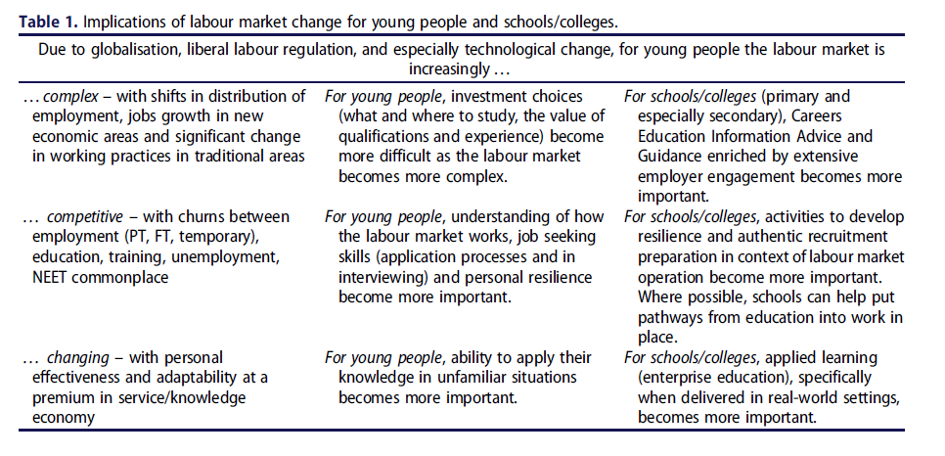
Summary

Slide 22
Thank you
Dr Anthony Mann (Education and Employers)
Anthony.Mann@educationandemployers.org
Professor Prue Huddleston
P.J.Huddleston@warwick.ac.uk
Links
http://www.tandfonline.com/doi/abs/10.1080/03069885.2016.1266440?journalCode=cbjg20
http://www.educationandemployers.org/research/how-should-our-schools-respond-to-the-demands-of-the-twenty-first-century-labour-market-eight-perspectives/
http://www.educationandemployers.org/research/what-do-recruiters-think-about-todays-young-people-insights-from-four-focus-groups/

