Slide 1

CEC seminar 20.03.17
Anthony Mann
Director of Policy and Research
Education and Employers
Anthony.Mann@educationandemployers.org
Research library: www.educationandemployers.org/research-main
Research twitter: @Edu_EResearch

Slide 2
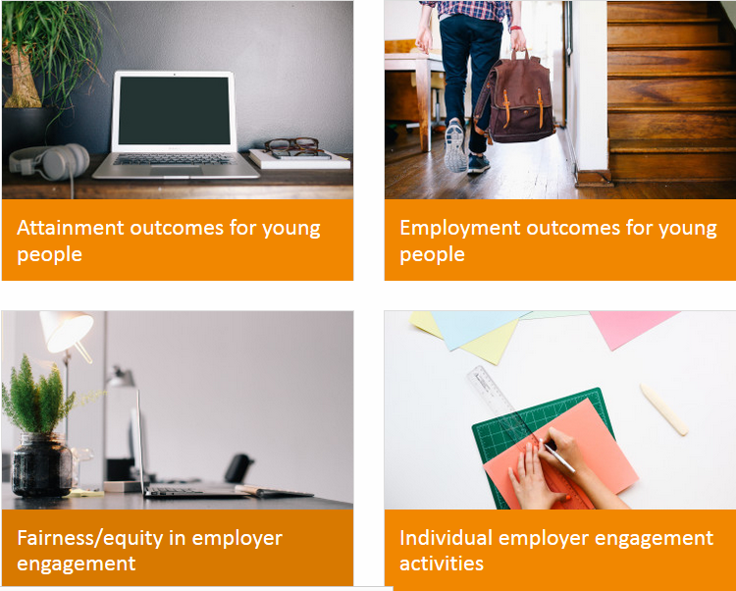
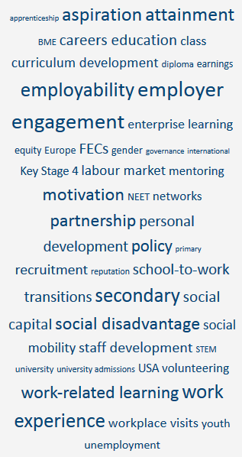

Free research library…
www.educationandemployers.org/research-main

Slide 3
A presentation in three parts
Subject: employer engagement in education
Contemporary transitions: young Britons reflect on life after secondary school and college
Schools and the twenty-first century labour market: perspectives on structural change
Implications for practice

Slide 4

One
@Edu_EResearch

Slide 5
In the past…
Mann, A.& Percy, C. “Employer engagement in British secondary education: wage earning outcomes experienced by young adults.” Journal of Education and Work 27:5, 496-523
Percy, C. & A. Mann. 2014. “School-mediated employer engagement and labour market outcomes for young adults: wage premia, NEET outcomes and career confidence.” In Mann. A. et al. Understanding Employer Engagement in Education: Theories and Evidence. London: Routledge

Slide 6

New study
Survey of 1,744 young people aged 19-24 in 2016 by Yougov
Twice the size compared to 2011 survey
Socially, geographically and demographically evenly distributed
Frequency tables and descriptive, cross-tabulations and regressions using SPSS
Control variables: school type, parental education, free school meal, gender, ethnicity, region, education level, age

Slide 7
Content of the report
Young adults’ recollection of school and college action to prepare them for the working world
Young adults’ perceptions of how well their schools and colleges prepared them for working life
Young adults’ perceptions on how schools and colleges could have better prepared them for the working world
What schools and colleges did to help young adults succeed in the adult working world

Slide 8
Young adults’ recollection of school and college action to prepare them for the working world

Slide 9
Distribution of employer engagement activities
Between the ages of 14 and 19, did your school or college ever arrange for you to take part in any activities which involved employers/local business people? E.g. work experience, mentoring, enterprise competitions, careers advice, CV or interview workshops, workplace visits. If so, on how many different occasions (more or less) did it happen?”
Participation in selected teenage engagements with employers
 | Percentage undertaking at 14-16 | Percentage undertaking at 16-19
Work experience | 74% | 25%
Job shadowing | 9% | 8%
Enterprise competitions | 10% | 6%
Mentoring | 2% | 4%
Career advice with employers | 19% | 16%
Part-time employment | 18% | 39%
 | Percent in 2016
Never | 19%
Once | 36%
Twice | 23%
Three times | 9%
Four or more times | 13%
Average number | 1.60

Slide 10
Distribution of employer engagement activities
Volume of activities by school type, 14-16
Volume by Indicators of social disadvantage: Free school meal and parental education
N= 1,676 |  |  | School type
 |  |  | comprehensive school | Grammar / selective state school | Independent / fee-paying school
 | Never |  | 18.5% | 10.6% | 28.0%
 | Once |  | 39.3% | 29.4% | 23.6%
 | Twice |  | 22.7% | 33.2% | 16.1%
 | Three times |  | 8.3% | 10.6% | 10.6%
 | Four or more times |  | 11.3% | 16.2% | 21.7%
Average number of activities 2016 |  |  | 1.54 | 1.92 | 1.74
N=1,659 | FSM
 | No | Yes
Average number of activities | 1.63 | 1.50
N= 1,680 | parents/carers went to university?
 | No, neither of them did | Yes, at least one of them did
Average number of activities | 1.55 | 1.71

Slide 11
Young adults’ recollection of school and college action to prepare them for the working world
Key findings:
Young adults attending selective and/or fee-paying institutions routinely recall greater levels of school-mediated employer engagement in terms of specific activities
Young adults in 2016 recall 1.6 school-mediated engagements with employers: 22% greater employer engagement than in 2011
Disadvantage is associated with lower levels of engagement: former recipients of Free School Meals and children of parents without experience of higher education recall lower levels of engagement

Slide 12
Young adults’ perceptions of how well their schools and colleges prepared them for working life

Slide 13
a) Most young people educated in the state sector think that their schools prepared them poorly for adult working life; b) Young adults who experienced greater volume of school-mediated employer engagement feel better prepared for the adult working world
P-Value: 0.00 School type at age 16 N= 1,676 |  |  | Looking back, how well do you feel that your school/college prepared you for adult working life?
 |  |  | Very well | Quite well | Quite poorly | Very poorly
 | Non-selective state school, i.e. comprehensive school | % | 4.4% | 39.2% | 43.4% | 13.0%
 | Grammar / selective state school | % | 8.5% | 49.4% | 35.7% | 6.4%
 | Independent / fee-paying school | % | 16.1% | 45.3% | 24.2% | 14.3%
Total |  | Count | 102 | 691 | 679 | 204
 |  | % | 6.1% | 41.2% | 40.5% | 12.2%
P-value: 0.00 Volume of activities N=1,756 |  |  | Looking back, how well do you feel that your school/college prepared you for adult working life?
 |  |  | Very well | Quite well | Quite poorly | Very poorly
 | Never | % | 7.8% | 26.3% | 41.5% | 24.5%
 | Once | % | 3.8% | 36.2% | 47.2% | 12.9%
 | Twice | % | 3.7% | 48.5% | 40.1% | 7.6%
 | Three times | % | 9.9% | 55.3% | 28.3% | 6.6%
 | Four or more times | % | 12.8% | 55.1% | 26.0% | 6.2%
Total |  | Count | 109 | 724 | 704 | 219
 |  | % | 6.2% | 41.2% | 40.1% | 12.5%

Slide 14
a) Most employer engagement wasn’t helpful in making decisions at age 16 unless teenagers recalled 4+ activities b) Most employer engagement wasn’t helpful in applying for university unless teenagers recalled 4+ activities c)Most employer engagement wasn’t helpful in applying for a full-time job, but participation in 3+ activities made a big difference
 | Decision making at age 16 (e.g. whether to stay on, what and where to study, whether to try and get a job)
 | Very helpful / Fairly helpful | Not very helpful / Not at all helpful
Once | 25% | 75%
Twice | 31% | 69%
Three times | 49% | 51%
Four times or more | 51% | 49%
 | Applying for university
 | Yes | No
Once | 33% | 67%
Twice | 38% | 62%
Three times | 47% | 53%
Four times or more | 53% | 48%
 | Applying for a full-time job
 | Yes | No
Once | 21% | 79%
Twice | 32% | 68%
Three times | 42% | 58%
Four times or more | 48% | 52%

Slide 15
If you found the activities helpful, tell us the reason…
When applying for university… | Valid Percent
It provided me with something to write about in my UCAS application | 64.3
It provided me with something to talk about at interview | 30.3
It helped me to decide the subject I wanted to study | 33.8
It helped me to decide on the institution I wanted to study at | 18.5
It gave me the confidence to apply | 22.4
It helped me to decide which subjects/options to choose while still at school/college | 29.5
It motivated me to work as hard while in school/college | 34.4
I used someone I met as a referee | 26.7
Total responded | 465
When applying for jobs… | Valid Percent
It gave me with something to use in a job application | 47.5
It gave me the motivation to succeed | 19.7
It gave me something to talk about at a job interview | 37.5
It gave me the confidence to apply for a particular job | 31.4
I learned how to produce a good CV or application | 49.1
It helped me to practice my interview skills | 39.2
It taught me what it is really like to work in a particular job | 32.8
It helped me to make better choices about what I studied whilst still in education/training | 18.1
It helped me to understand what I needed to do to get a particular job | 25.2
I met someone who offered me a proper job (e.g., part-time job) which proved useful | 12.7
I met someone who gave me a reference | 34.4
I met someone who gave me good advice | 31.2
I improved my soft skills / employability skills (eg, communicating, team working) | 44.6
Total responded | 240

Slide 16
Young adults’ perceptions of how well their schools and colleges prepared them for working life
Key findings:
Most young people educated in the state sector think that their schools prepared them poorly for adult working life
Young adults who experienced greater volume of school-mediated employer engagement feel better prepared for the adult working world
Most employer engagement was not helpful ( making decisions at age 16, applying for university, applying for jobs) unless teenagers recalled 3-4+ activities

Slide 17
Young adults’ perceptions on how schools and colleges could have better prepared them for the working world

Slide 18
Given what you know now, would you have welcomed more help in any of the following areas while at school/college?
How to create a good CV, or write a good application | 60%
How to perform well at interview | 60%
How the tax/benefit systems work | 59%
How employers actually recruit | 56%
How to manage money once you had income | 55%
How the world of work is changing and which skills are likely to be demanded in future | 49%
How to find a job | 48%
How to find out what different jobs require in terms of skills, attitudes and qualifications | 47%
How job centres and employment agencies work | 36%
How to run your own enterprise/business | 36%
How to get a part-time job whilst still at school or college | 34%
How to get into University | 27%
How to get an Apprenticeship | 24%
How common it is to do a job which people of your gender don’t normally do | 21%
Male | Female | Non-selective State | Independent School | Free School Meals | Parent with no degree | Ethnic minority | White British
57% | 64% | 63% | 44% | 58% | 64% | 50% | 63%
56% | 65% | 63% | 48% | 61% | 65% | 51% | 63%
53% | 65% | 61% | 54% | 53% | 60% | 51% | 61%
53% | 59% | 58% | 49% | 49% | 59% | 46% | 58%
48% | 63% | 58% | 46% | 52% | 59% | 48% | 57%
47% | 51% | 50% | 45% | 46% | 51% | 42% | 51%
43% | 53% | 50% | 40% | 47% | 51% | 45% | 49%
43% | 51% | 49% | 39% | 49% | 51% | 41% | 48%
32% | 40% | 38% | 29% | 35% | 37% | 31% | 37%
36% | 35% | 36% | 33% | 33% | 37% | 36% | 36%
32% | 37% | 35% | 27% | 36% | 36% | 36% | 34%
26% | 30% | 30% | 13% | 30% | 31% | 30% | 27%
23% | 24% | 25% | 17% | 25% | 26% | 24% | 24%
16% | 25% | 22% | 15% | 18% | 22% | 23% | 21%

Slide 19
Young adults’ perceptions on how schools and colleges could have better prepared them for the working world
Key finding:
Young adults would have welcomed greater preparation for the working world from their schools and colleges – with greatest demand from young women and adults from disadvantaged backgrounds and greatest demand for practical information and job-finding skills

Slide 20
What schools and colleges did to help young adults succeed in the
adult working world

Slide 21
Higher volumes of school-mediated employer engagement are associated with reduced incidence of NEET
Control variables
Percentage Correct: 92.7% |  | B | S.E. | P-value | Odds of becoming NEET
 | One | -.577 | .251 | .022 | 44% less likely comparing to those who did zero activity
 | Two | -.791 | .301 | .009 | 56% less likely comparing to those who did zero
 | Three | -1.879 | .650 | .004 | 85% less likely comparing to those who did zero
 | Four or more | -1.907 | .554 | .001 | 86% less likely comparing to those who did zero
  Age
  Highest qualification (L1-L5)
  Ethnicity (white vs non-white)
  Region of UK
  School type 14-16
  School type 16-19
  Gender
  Parental education
  Free School Meal
  → 1,536 individuals

Slide 22
Undertaking individual employer engagement activities is associated with reduced incidence of being NEET
At 14-16…
Career talks with employers | 81% less likely to be NEET than peers who did not do the activity
Enterprise competition with employers | 75% less likely to be NEET than peers who did not do the activity
Work experience | 45% less likely to be NEET than peers who did not do the activity
At 16-19…
Career talks with employers | 78% less likely to be NEET than peers who did not do the activity
Enterprise competition with employers | 80% less likely to be NEET than peers who did not do the activity
Work experience | 44% less likely to be NEET than peers who did not do the activity

Slide 23
Young adults experienced wage premiums linked to individual activities where they felt their school(s) had prepared them well for adult life
Employer engagement activity | Premium (expressed in percentage terms) | Premium (expressed in cash terms)
Volume of engagements where engagement in general found to be useful in getting a job – one engagement | 3.7% | £585
Volume of engagements where engagement in general found to be useful in getting a job – four plus engagement | 14.8% | £2,340
Volume of engagements where engagement in general found to be useful in getting a job – one engagement | 4.1% | £648
Volume of engagements where engagement in general found to be useful in getting a job – four plus engagements | 16.4% | £2,592
Volume of engagements where engagement in general found to be useful in getting into university – one engagement | 5.5% | £869
Volume of engagements where engagement in general found to be useful in getting into university – four plus engagements | 22% | £3,476
Enterprise competition at 14-16 where respondent felt school had prepared them well for adult working life | 11% | £1,739
Mentoring at 14-16 where respondent felt school had prepared them well for adult working life | 19% | £3,004
Job Shadowing at 14-16 | 11% | £1,739
Mentoring at 16-18 where respondent felt school had prepared them well for adult working life | 18% | £2,846

Slide 24
What schools and colleges did to help young adults succeed in the adult working world
Key findings:
Higher volumes of school-mediated employer engagement are associated with reduced incidence of NEET
Undertaking individual employer engagement activities is associated with reduced incidence of being NEET
Pre-16 participation in Job shadowing is associated with an adult wage premium of 11%
Young adults who found their school-mediated employer engagement activities ‘helpful in getting a job’, earned up to 16.4% more than peers who did not take part in any activities
Young adults experienced wage premiums linked to individual activities when undertaken within school(s) which they felt had prepared them well for adult life
Wage premiums of up to £3,500 can be identified linked to teenage participation in school-mediated employer engagement activities

Slide 25

Implications for policy and practice
Quantity matters: greater volume of school-mediated employer engagement is associated with better economic outcomes
Quality matters: more highly regarded employer engagement is associated with better economic outcomes
Equity matters: access to school-mediated employer engagement is not fairly distributed

Slide 26
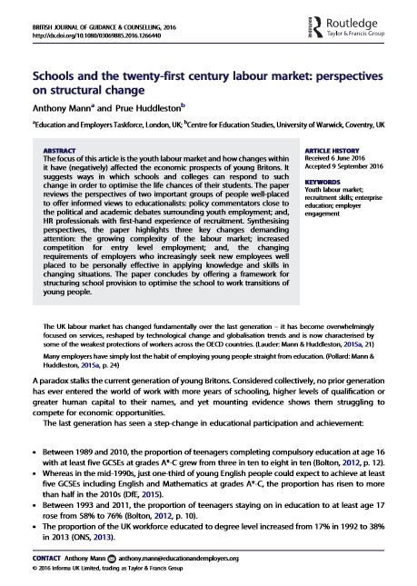
Two
@Edu_EResearch

Slide 27
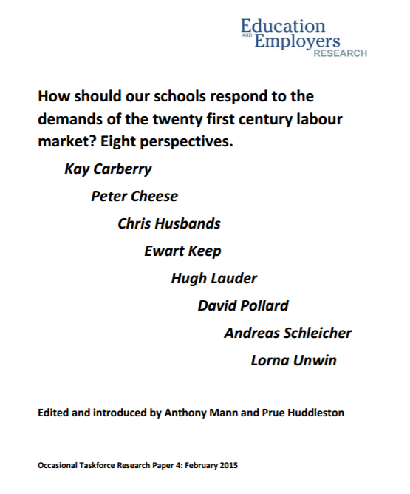
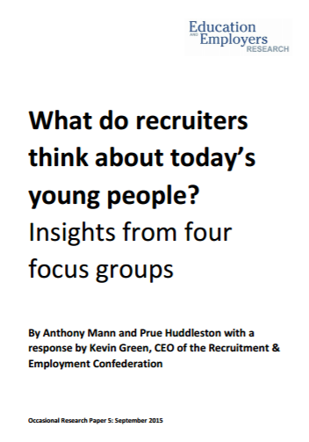
Schools and the twenty-first century labour market
Anthony Mann and Prue Huddleston (2016) “Schools and the twenty-first century labour market: perspectives on structural change” British Journal of Guidance and Counselling

Slide 28
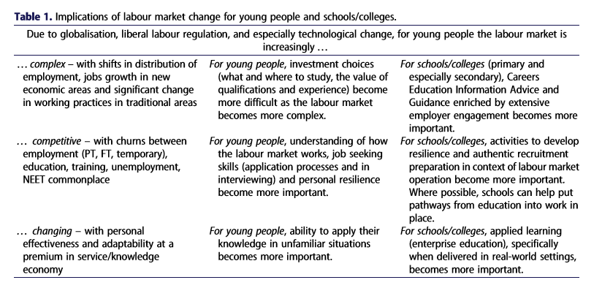

Slide 29

Three
@Edu_EResearch

Slide 30

So please…
Do a lot – throw mud with wild abandon
Be authentic – keep it real
Do different things focused around:
          Enhancing young people’s understanding of jobs and careers
          Provding young people with knowledge and skills demanded by the contemporary labour market
          Providing young people with knowledge and skills demanded for successful school to work transitions
          Enriching education and underpinning pupil attainment.
Start young – from primary onwards
Be coercive at times – they don’t know what they don’t know
Be professional – high quality, impartial careers provision
And … ask the kids what they think about their experiences!

Slide 31

Thank you: stay in touch
Anthony.Mann@educationandemployers.org
Research library: www.educationandemployers.org/research-main
Research twitter: @Edu_EResearch

