Slide 1
14 – 19 Careers transitions. The Case for Employer Engagement: Impact findings from Learner Focus Groups with FE learners in London
Dr Sean Richards

Slide 2
Background
National Careers Service Inspirations Activity:
Mechanical Engineer and Senior Recruitment Executive talked to Level 2 and 3 BTEC Engineering Students at a Further Education College in London.
Sean Richards

Slide 3
Focus Group with 15 learners What are the impacts of employer engagement activities on learners’ Thinking and Behaviour?
Sean Richards

Slide 4
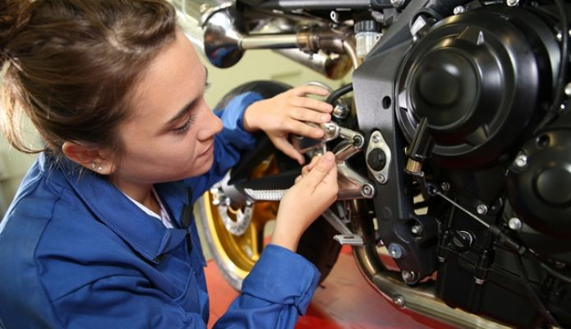
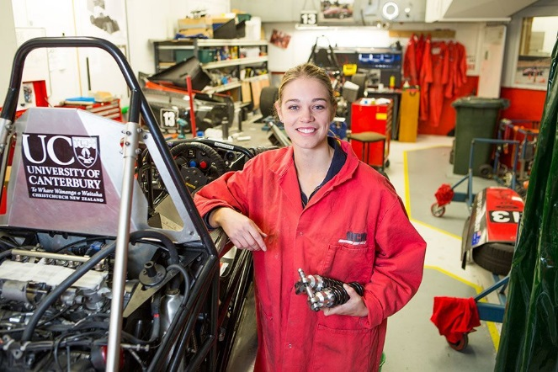
Impacts
on learners’ thinking
What did learners’ remember about the activity?

Slide 5
What did learners identify as important and why?
Salaries & Promotion Prospects
Routes: quickest, cheapest, best
Qualifications: shelf-life, value and portability
Job Satisfaction : enhancing personal satisfaction.
Opportunities to Travel

Slide 6
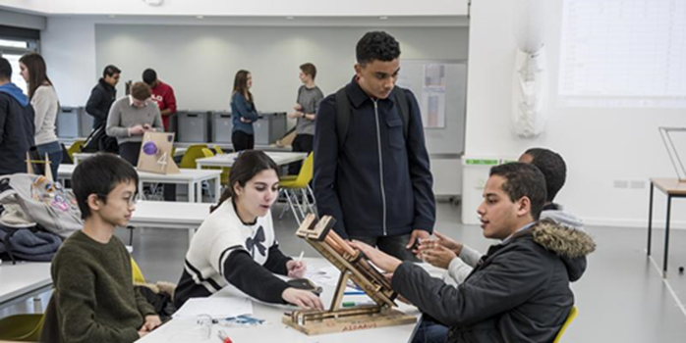
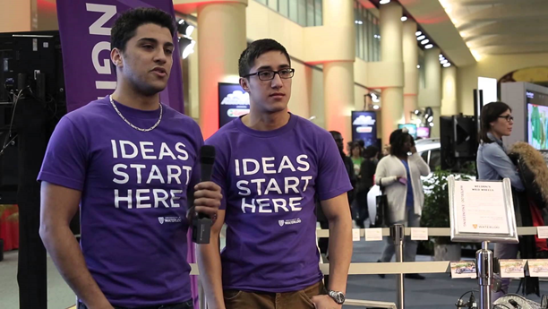
Apprentices Talks What judgements did learners make regarding the relevance of the activity?

Slide 7
Students’ comments: I certainly think that hearing about the journey of someone who has gone down the route you are going down is very helpful. They can tell you what stuff to look out for and which are the best routes to go down. Yeah I think that’s the key.

Slide 8
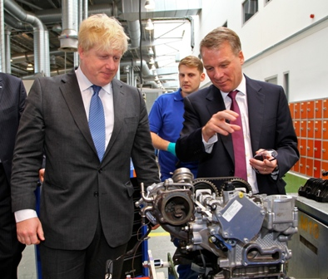
Did the activity provide new information?
Did this build upon what they already knew?
Students’ comments:
Having them come in was a really good idea. You can actually see someone who has got experience of being an engineer. They can also suggest you stuff, and it’s really useful.

Slide 9
Did the activity change the ways learners’ thought about their careers ideas?
Students’ comments:
Yes that’s why I want to be involved in mechanics.
I really enjoy creating things and learning different things. It’s helping me to organise things for the future.
Sean Richards

Slide 10
Did learners report the activity as motivating, and improving their confidence in their career directions?
Did they express resilience to possible problems and setbacks?
Did they have positive and realistic attitudes and expectations towards their career outcomes?
Yes, yes and yes!
Sean Richards

Slide 11
Impacts of Employer Talks
on learners’ behaviours
• Did learners ‘bank’ the knowledge or resources gained from the activity for future reference and if so how? This varied, some did, others did not.

Slide 12
Did learners use the information to update their CV’s and/or personal statements and/or use ideas for writing job applications and/or help with job interviews?
Yes, where there were appropriate opportunities.

Slide 13
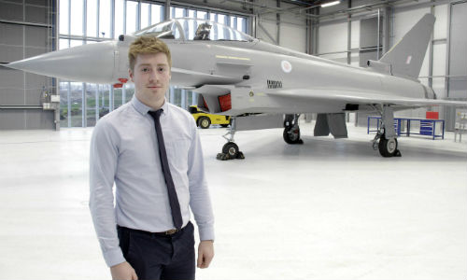
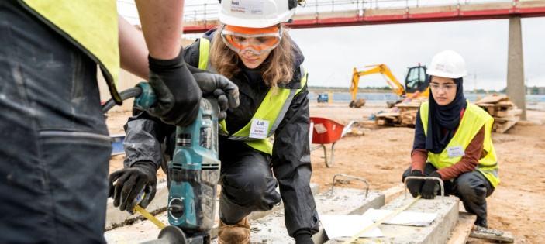
• Learners’ post-event careers research activities.
Did students independently delve further into the information they received by later conducting new internet or company searches, or other activities?
Yes, some did.

Slide 14
Connection of activities to learners’ programmes of study
Did the activity reinforce or extended their learning from course work. Not uniformly or to a great extent - needs further analysis.
Did the activity connect with the knowledge and experience learners gained at work placements? Yes, directly in most cases.
Did learners use the information from the activity or from post-activity research in their current coursework, reflective logs, or other school or college-based projects. Not uniformly or to a great extent - needs further analysis.

Slide 15
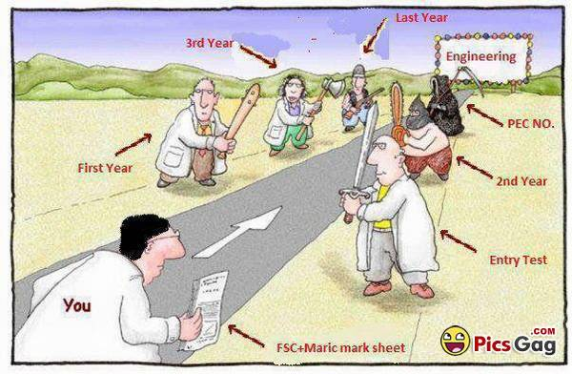
How well did the activity help learners to make informed choices regarding their future careers?

Slide 16
What did learners say would improve the events?
Students rarely suggested improvements for the specific activities, but asked for more employer talks and would welcome these from a wide range of industry specialists.

Slide 17
I was already thinking about it (apprentiship) because I’m really a hands-on person; I think I’d learn more than if I go to university. But work experience helps a lot. And I think it provides more of a guarantee that you will get the work you want to do because work is not guaranteed when you go to university and I think that because with an apprentiship employers know you already - they are more likely to take you on.
Female Engineering student

Slide 18
Challenges and Opportunities
Sainsbury Review.
Closing the circle and sowing the seams together.
Bringing CEIAG - EE activities and learner’s Programmes of Study closer together.
Implications for examining boards and awarding bodies.
Professional development for teachers, assessors, employers and careers professionals.
Sean Richards

Slide 19
Work in progress.
Inspirations and Walworth Academy
Key Features:
Impacts of Innovations in school-based CEIAG
Interviews with Year 12 and 13 learners to provide detailed case studies of impacts
Work Readiness - Traffic Light Badge System
Detailed cohort destination data to examine medium and longer-term impacts

