Slide 1
Career education and guidance that works
Interactive Workshop
Professionalising your delivery
Claire Johnson
CDI Professional Development Manager

Slide 2
How to demonstrate that you are a professional
According to the Network for Innovation in Career Guidance and Counselling in Europe (NICE), three of the ways of demonstrating being a professional are:
recognising the need to develop own competence continuously;
integrating current theory and research into practice;
publicly advocating for the profession in the interest of clients.
This workshop will enable you to think through how you currently do this and find out more about how the CDI as the professional body for the sector can support you.
Notes:
Others are: regulating relations with clients/stakeholders et al; building relationships; deadline with conflicts; reflective practice; critical thinking; ethical standards; keeping up to date with societal and technological developments; supporting policy making and respecting human rights. PAGE 38 of book.

Slide 3
Discussion
What do you do now
What are the barriers?
to develop own competence continuously?
to integrate current theory and research into practice?
to publicly advocate for the profession in the interest of clients?
Notes:
Split into three groups. One group to look at each of these, say what they do now and what the barriers are.

Slide 4
What the CDI can do to help

Slide 5
Professional Skills and Knowledge and determining what needs developing

Slide 6
Sources of help: CPD Resources Area

Slide 7
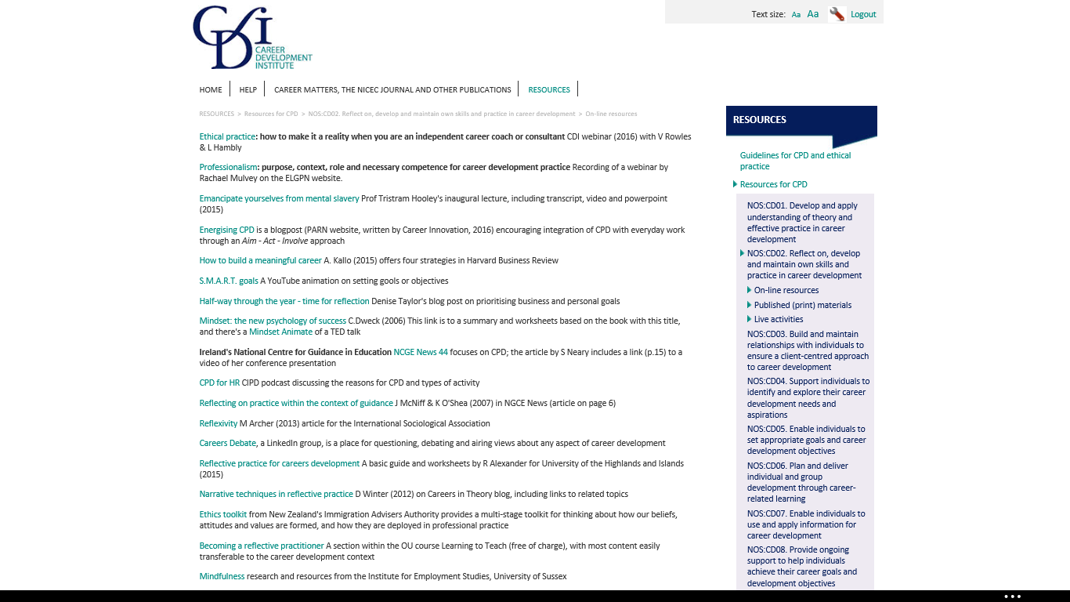

Slide 8
Other Sources of Support for your CPD
A to Z of Careers for ideas on different ways CPD can be undertaken.
CDI Communities of Interest where you can ask questions and debate topics.
CDI Webinar Recordings if you missed the free live sessions
Guides on online learning and accessing research help you to find more sources of CPD.
Don’t forget that reading Career Matters and items in News via Email are also useful sources of CPD
CDI Training and Events, News & Resources and Getting Qualified sections, including the CDI Academy and the new CDI Certificate in Careers Leadership.
CPD Monthly Newsletters

Slide 9
Integrating current theory and research into practice
Sources of research
Education and Employers Research:
http://www.educationandemployers.org/research-main/
NICEC Journal – free to CDI members
Institute for Employment Research:
http://www2.warwick.ac.uk/fac/soc/ier/
International Centre for Guidance Studies
https://www.derby.ac.uk/research/icegs/
Coming soon: Research section in the CDI Resources Area
British Journal of Guidance and Counselling
Events
Days like today
NICEC/CDI: At the Cutting Edge - Research into Practice Series
CDI Annual Conference: 4th and 5th December 2017
Activities
Becoming a Practitioner Researcher

Slide 10
2017 the CDI Year of Advocating for the career development profession
The CPD newsletter in April focused on advocating for the profession and included the following ideas:
Vocation, Vocation, Vocation (p23-32) in which Bill Law challenges us to define our credibility, our expertise, our connectedness and our independence.
Economic Benefits of Career Guidance in which (Hooley & Dodd, 2015) trace the benefits from the individual level (income), to secondary level (increased tax payments and saved benefit and health costs) and to national macro-economic benefits.
Looking specifically at schools, Cost to the Economy of Government Policy on Career Guidance (Taylor, 2013) argues for better funding for career education.
Career guidance, health and well-being is discussed by Peter Robertson in Career Matters January 2017 This follows from a longer article The well-being outcomes of career guidance (Robertson, 2013 in British Journal of Guidance and Counselling) which is available free-of-charge on the BJGC website.

Slide 11
2017 the CDI Year of Advocating for the career development profession (continued)
Advocating benefits to schools and their students: Good career guidance has benefits for schools as well as their students. An OECD study found a ‘ relationship between participation in career development activities and more positive attitudes towards the utility of schooling’. In the UK, the Gatsby Guide to Good Career Guidance notes benefits including better motivation leading to higher attainment and reduced drop-out rates (section 5.4).
Social justice: A good starting point is the opening editorial by Hooley and Sultana in the NICEC Journal 36 (April 2016) All six articles in this issue of the NICEC Journal address the same theme.
Older workers want career development not retirement planning is the headline of an ACAS blog, reporting research by Ashridge Executive Education . Arguments for the benefit of addressing the career development needs of older people were developed by the Mid-Life Career Review . Useful resources for career practitioners in meeting the needs of older workers were developed during the project.

Slide 12
UK Register of Career Development Professionals
Register is the sector equivalent of Chartered Status
Proof that you hold a QCF Level 6 or above /SCQF Level 11 qualification in career development
Adherence to the Code of Ethics
25 hours CPD requirement
Use of the post nominal RCDP and logo to confirm and promote registered status and the use of the word Registered before your job title
Find a Career Development Professional
Notes:
The Career Progression Pathway will show how people can progress to the UK Register of Career Development Professionals
Brochure covers the details.
Register was cited in the Non Statutory Advice on Career Guidance and Inspiration in schools as a means of assuring independent career guidance provision

Slide 13
And finally………………..
Chapters
CPD in the career development sector
Being a professional in the career development sector
Reflecting on practice
Becoming a practitioner researcher
CPD for self employed practitioners
The internet, social media and international CPD opportunities
National Occupational Standards and Competence Frameworks
A- Z of CPD and developing your own career
Moving on – what are you going to do next?

