Slide 1

Career education and guidance that works
Notes:
Congratulate Wolverhampton Commission, Council and partners on their work

Slide 2
Overview
The journey so far
Lessons learned
Practice matters
Where next?

Slide 3

Politics

Slide 4

Industrial Strategy
“Our improved education and skills system must be supported by high quality careers provision…Careers provision continues to be patchy and inconsistent…both in schools and later in life. The government is reviewing the current careers offer for people of all ages, and will build on the best international evidence to publish a comprehensive strategy later this year for careers information, advice and guidance” (p.45)
Notes:
“You have a job but you don’t always have job security. You have your own home, but you worry about paying a mortgage. You can just about manage but you worry about the cost of living and getting your kids into a good school.” (Theresa May, Prime Minister, November 2016)

Slide 5

Preparing … for a new future
Notes:
Big challenges: Invite the audience to identify the 8 big themes recently discussed in Davos (January 2016).
The Wealthy Few
The number of people whose wealth is equal to that of the poorest half of the world’s population since 2010
2015…………………………..62
2014…………………………………. 80
2013……………………………………… 92
2012…………………………………………….....159
2011………………………………………………………….177
2010……………………………………………………………………388
Source: Forbes & Credit Suisse Global Wealth Databook 2014 and 2015
The Construction Index has reported on a survey by the CITB that found that while 92 per cent of parents thought that apprenticeships were a good option for young people, only 32 per cent though they were a suitable option for their own child.
Half Of UK Workforce Could be Self-Employed by 2020 The ongoing trend for increased interest in working freelance could lead to 50 per cent of the country being self-employed by the year 2020. This is according to a new study, which looked into the future of freelancing in the UK. Entitled The Evolution of the On-demand Economy,
YouGov survey obtained views from over a thousand parents, 79 percent of whom felt their child did not have a clear activity of what they wanted to do after finishing education.

Slide 6

Context
Operation of the youth labour market and expectations of young people
Technological change, forces of globalisation and BREXIT
Job quality and skills requirements
Curriculum reform – academic and vocational e.g. new
‘T levels’
Institutes of Technology
STEM
Infra-structure and culture change
NEW MINISTERS?
Notes:
The typical twenty-first century Briton can expect to work in a dozen or more different jobs across a number of different career areas.
Today, the average person changes jobs ten to fifteen times (with an average of 11 job changes) during his or her career, which means a good amount of time is spent changing employment. Retrieved from: http://jobsearch.about.com/od/employmentinformation/f/change-jobs.htm.
Digital architect Designs a selection of virtual buildings for advertisers and retailers to market their products
• Home carer Helps care for elderly people in their own homes
• Elderly well-being consultant Specialises in holistic and personalised care for the elderly
• Body part maker Creates living body parts for athletes and soldiers
• Nano-medic Creates very small implants for health monitoring and self-medication
• Vertical farmer Farms crops upwards rather than across flat fields to save space
• Waste data handler Disposes of your data waste in a responsible way
• Climate controller Manages and modifies weather patterns
• Avatar manager Designs and manages holograms of virtual people
• Memory augmentation surgeon Helps preserve and improve memory in an ageing population
• Time broker Handles time banked by customers in lieu of money for goods or services
• Personal branding manager Develops and manages your personal brand
• Child designer Designs offspring that fit parental requirements
• Omnipotence delimiter Reins in our belief that anything is possible and we are all-powerful
• Personal medical apothecary Provides a bespoke range alternative therapies.
• Haptic programmer Develops technology around the science of touch, such as gloves that make your hand feel warm, or wrapped in velvet.

Slide 7

Change and uncertainty

Slide 8
New challenges
UK Office for Budgetary Responsibility (OBR) estimates more fiscal tightening over the next four years, particularly in the public sector (Oxford Economics, 2017)
Local authorities in England lost 27 per cent of their spending power between 2010/11 and 2015/16 in real terms. Some services have experienced cumulative cuts to the order of 45 per cent (JRF, 2015)
National Audit Office indicates schools in England must reduce spending by 8per cent per pupil by 2020 - the biggest real terms cut in a generation (NAO, 2016)
Notes:
Almost half of UK business leaders worried about post-Brexit skills shortages and fear they will not find enough suitable personnel (IoD, 2016)
Concerns that skills gaps in sectoral areas which rely heavily on overseas workers will be hard hit, including the teaching profession (DfE, 2016)
The UK has the 5th highest level of mismatch, with 28.9 per cent of its workforce in jobs not suited to their skill level. Of this, 15 per cent of the workforce has a higher than average education level for their occupation (ILO, 2014)

Slide 9
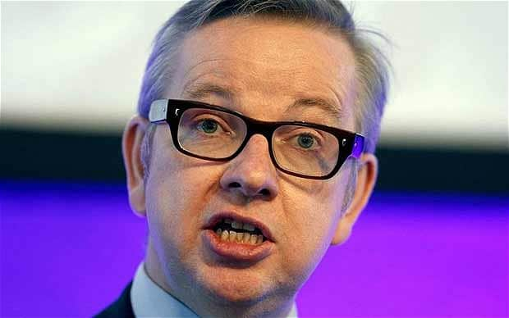
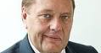




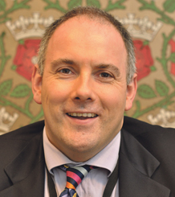

Ministerial focus – 2012 -2017

Slide 10

Themes
Social mobility
Devolution: centralism & localism
Opportunity Areas x 12
NEET and EET data mining
An all-age careers strategy
QUESTION: How do we future proof careers education, information, advice and guidance that works for young people, parents, teachers, governors, employers?

Slide 11
Lessons learned: Infrastructure
Schools, colleges, universities
Local authorities - targeted services
National Careers Service - Inspiration agenda
Careers and Enterprise Company
Jobcentre Plus in schools
National Citizenship Service
HE and Apprenticeships e.g. UCAS and NAS
Other local and national initiatives e.g. LEPs, charities, social enterprises, sole traders…
Statutory guidance……a new careers strategy

Slide 12
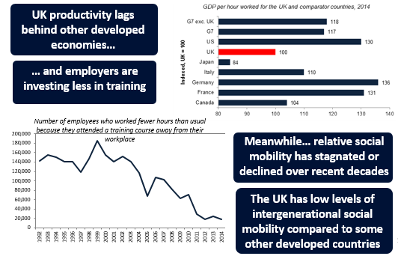
Learns learned: social mobility

Slide 14

Challenges
Keep more people switched on to learning
Encourage them not to close down opportunities too early
Broaden horizons and challenge inaccurate assumptions
Create relevant experiences and exposure to the world of work
https://youtu.be/a5Y-ONvC2rM

Slide 15


Policy and practice
Interest
Disinterest

Slide 16


Slide 17
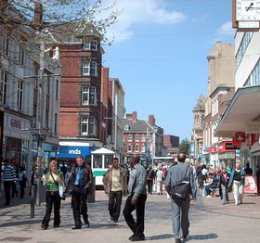



Geography matters… economy population centre labour market education centre
HY MATTER

Slide 18
Gatsby Principles (2014) & Area Frameworks (2017 - 2022)
A stable programme
Learning from careers and LMI
Addressing the needs of each pupil
Linking curriculum learning to careers
Encounters with employers and employees
Experiences of workplaces
Encounters with FE and HE
Personal Guidance
Young People
Access to impartial, independent and personalised careers education, information, advice and guidance
At least 100 hours of experiences of the world of work for all young Londoners and a digital portfolio
Leadership and accountability
An explicit publicised careers policy and careers curriculum in every secondary school and college
A governor with responsibility for ensuring the institution supports all students to relate their learning to careers and the world of work from an early age

Slide 19

Gatsby Principles (2014) & Regional Frameworks (2017 - 2022)
Support for a high quality careers work
Up-to-date, user-friendly labour market intelligence/information (LMI)
Formation and development of ‘careers clusters’ to share resources
A local mechanism – linking education to business and the careers community
A CAREERS CURRICULUM: Stimulate careers dialogue, connect to learning outcomes and provide resources for teaching and learning
Notes:
WOOPs STEM Strategy and Action Plan

Slide 20
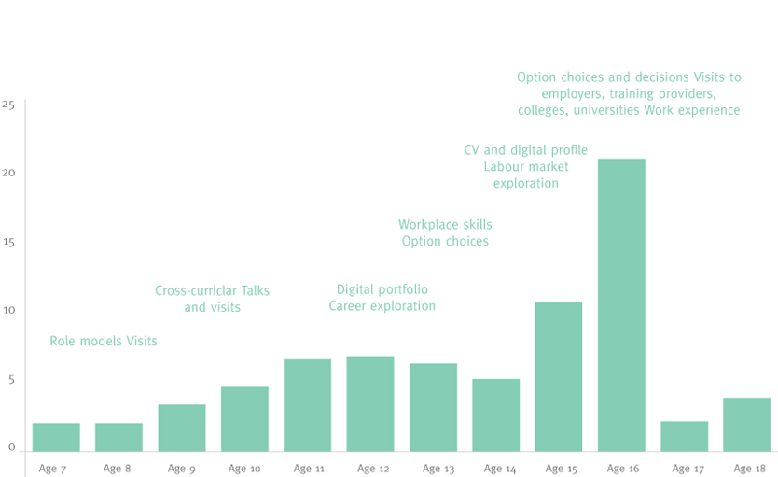
﻿More exposure to the world of work
Notes:
Research findings underpinning the 100 hours experiences of the world of work.

Slide 21
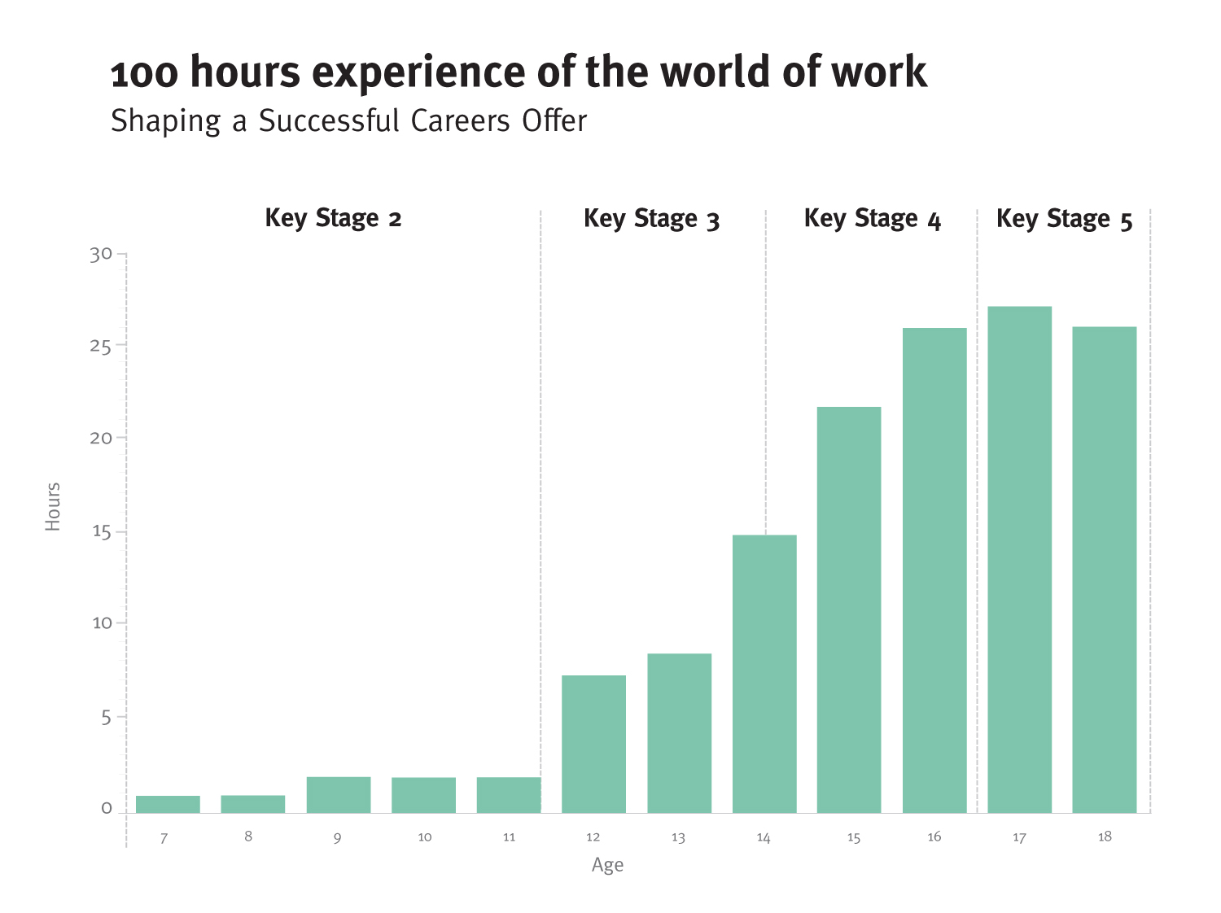

Slide 22
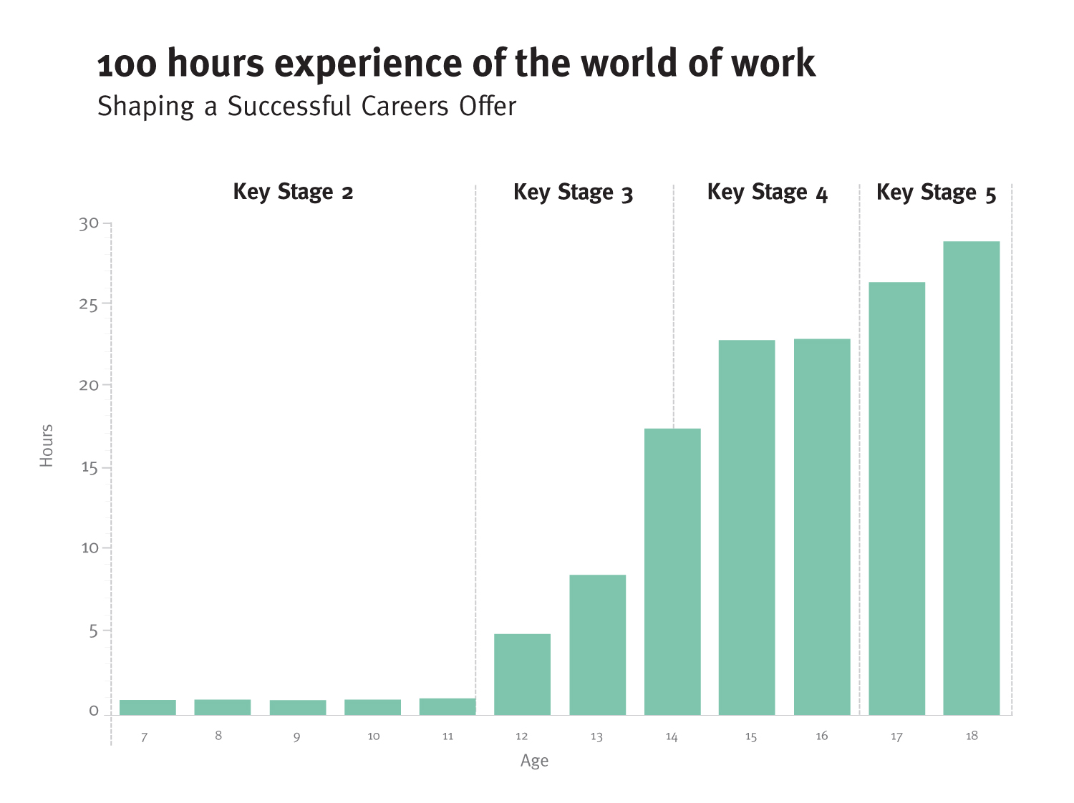

Slide 23
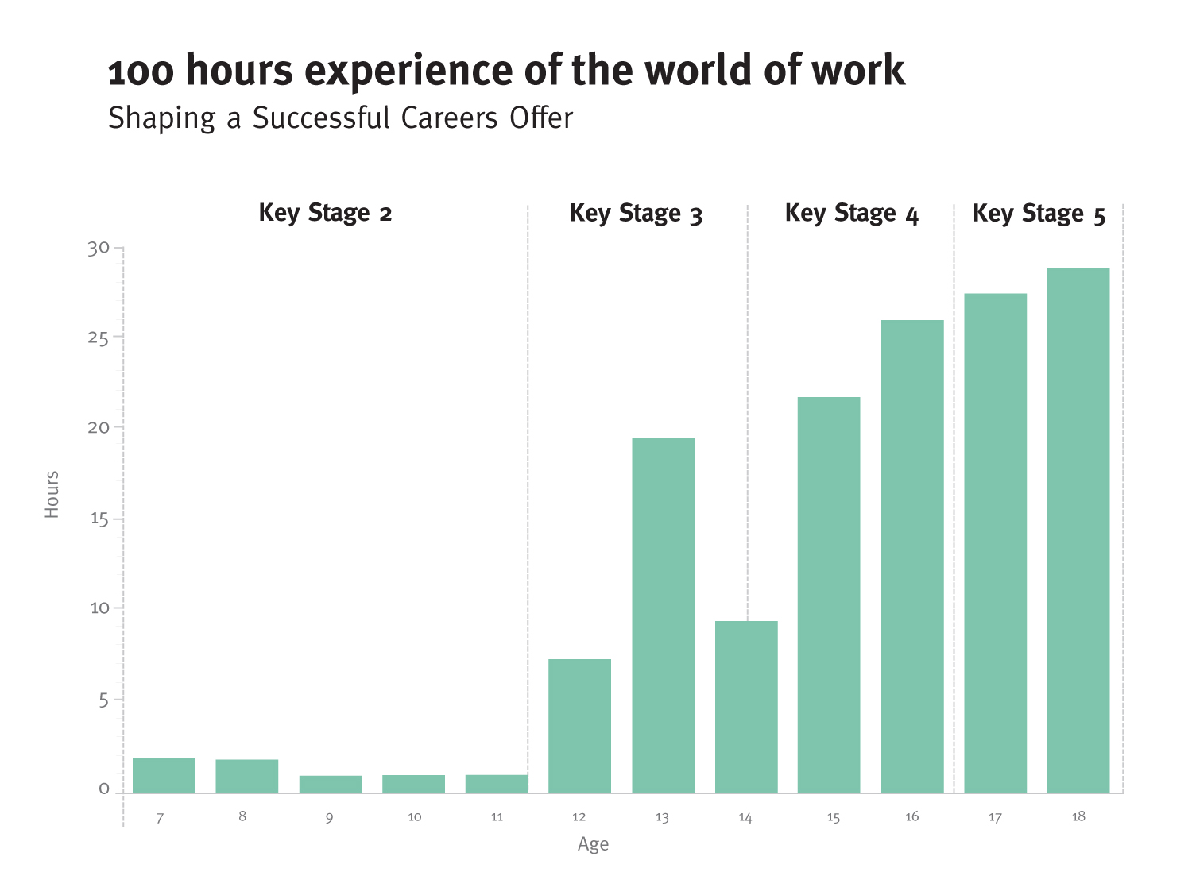

Slide 24
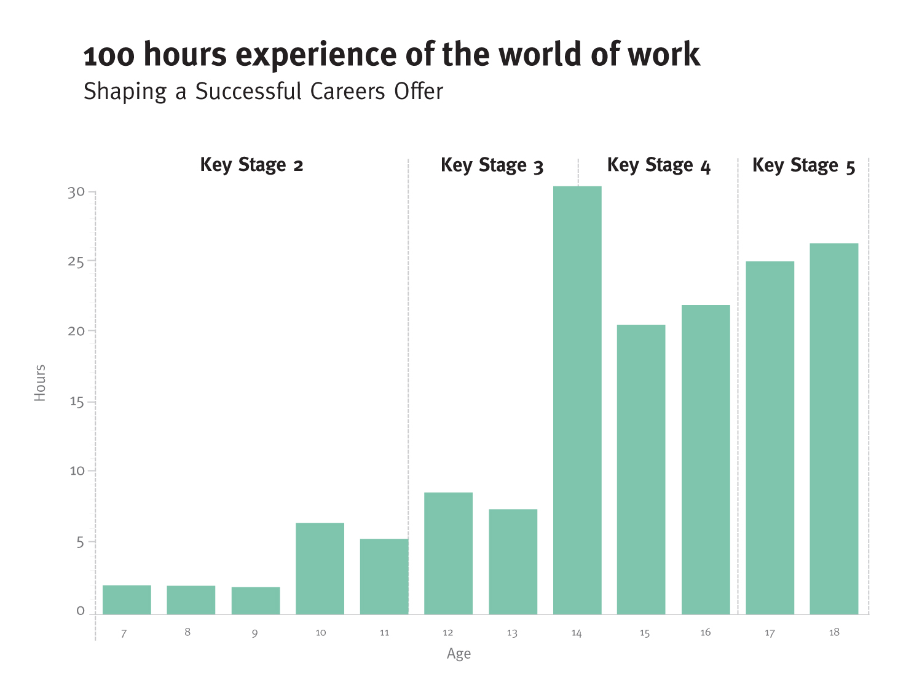

Slide 25
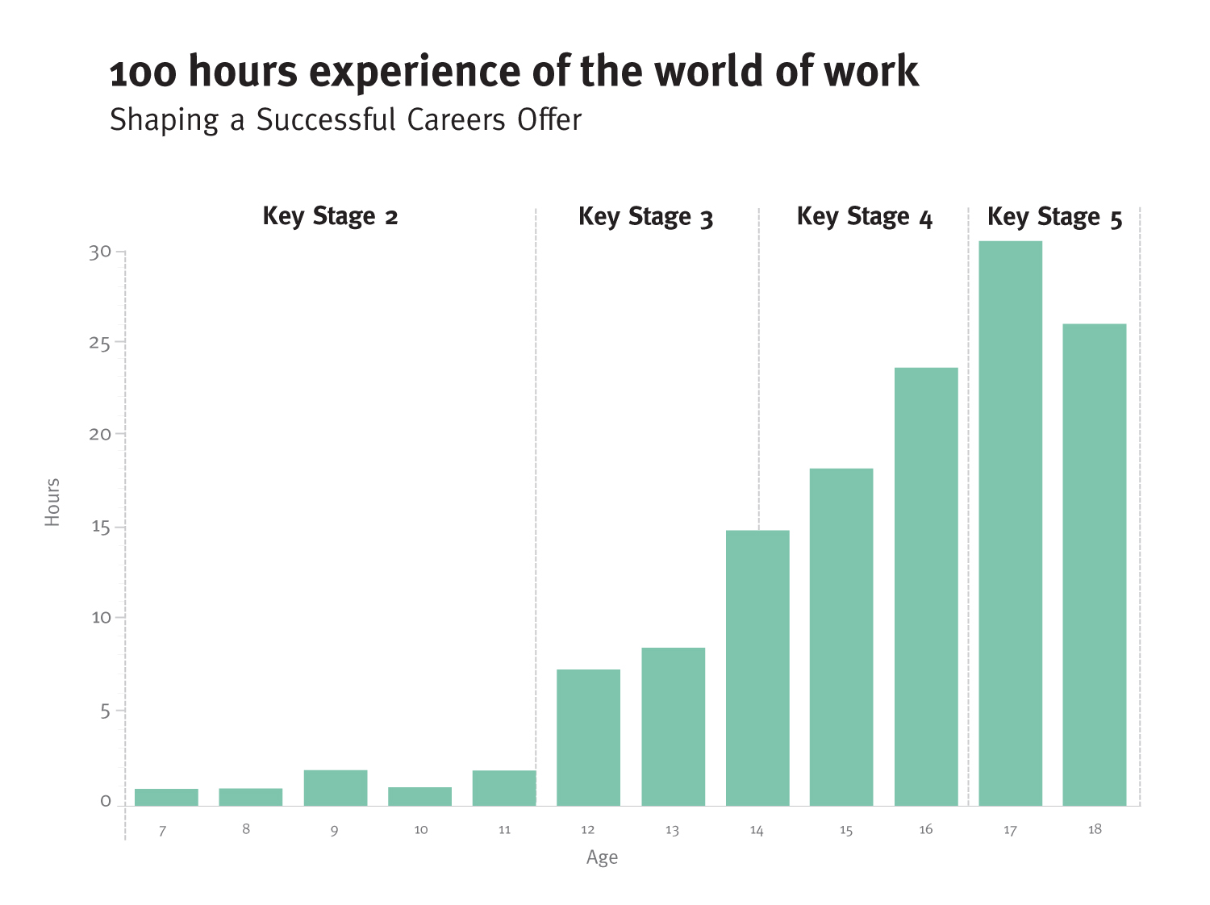

Slide 26
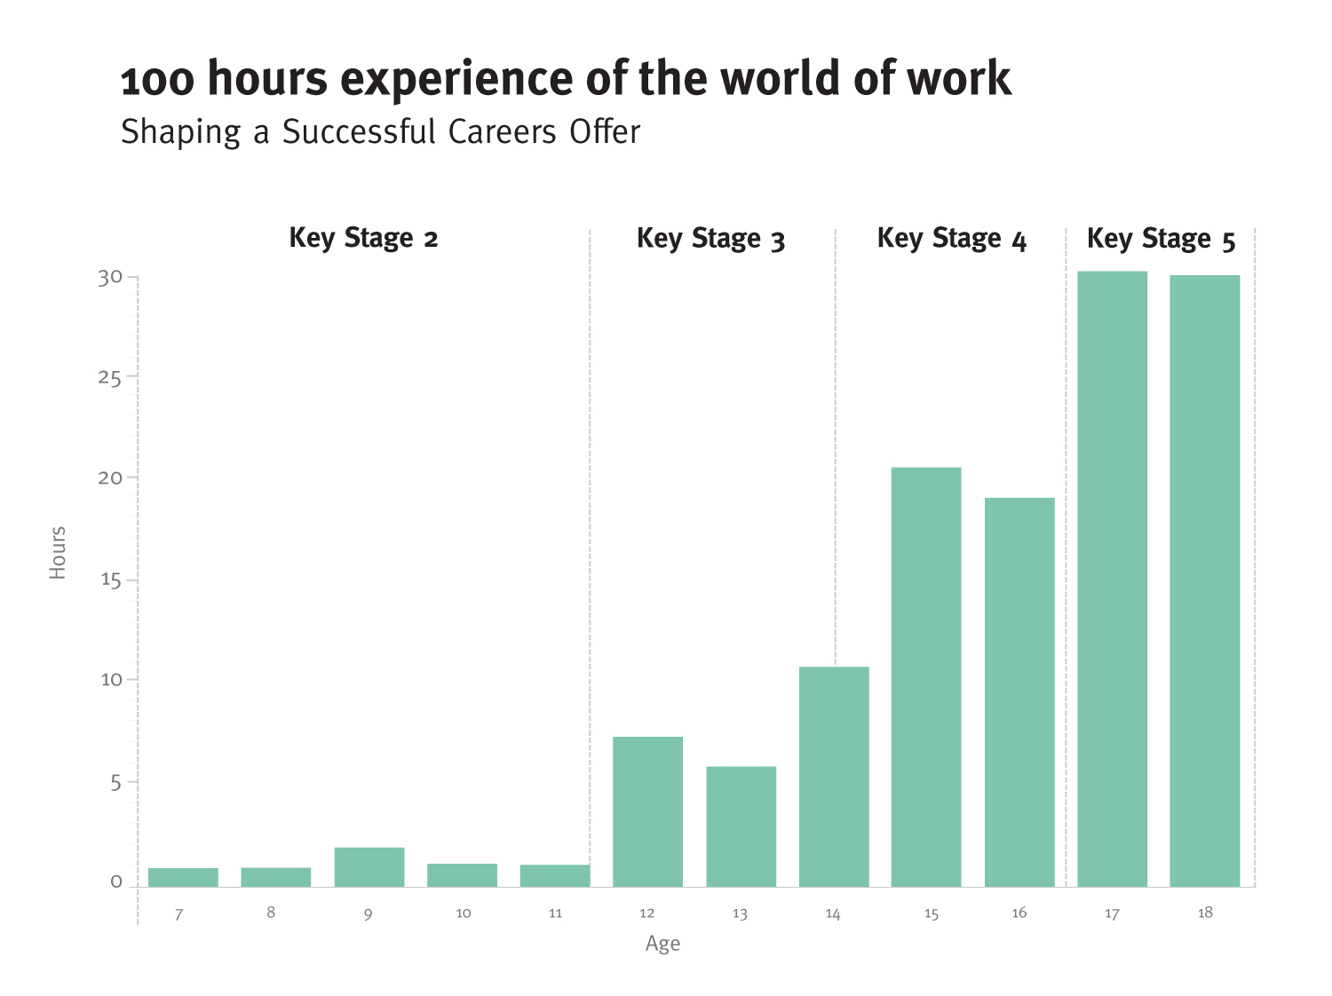

Slide 27
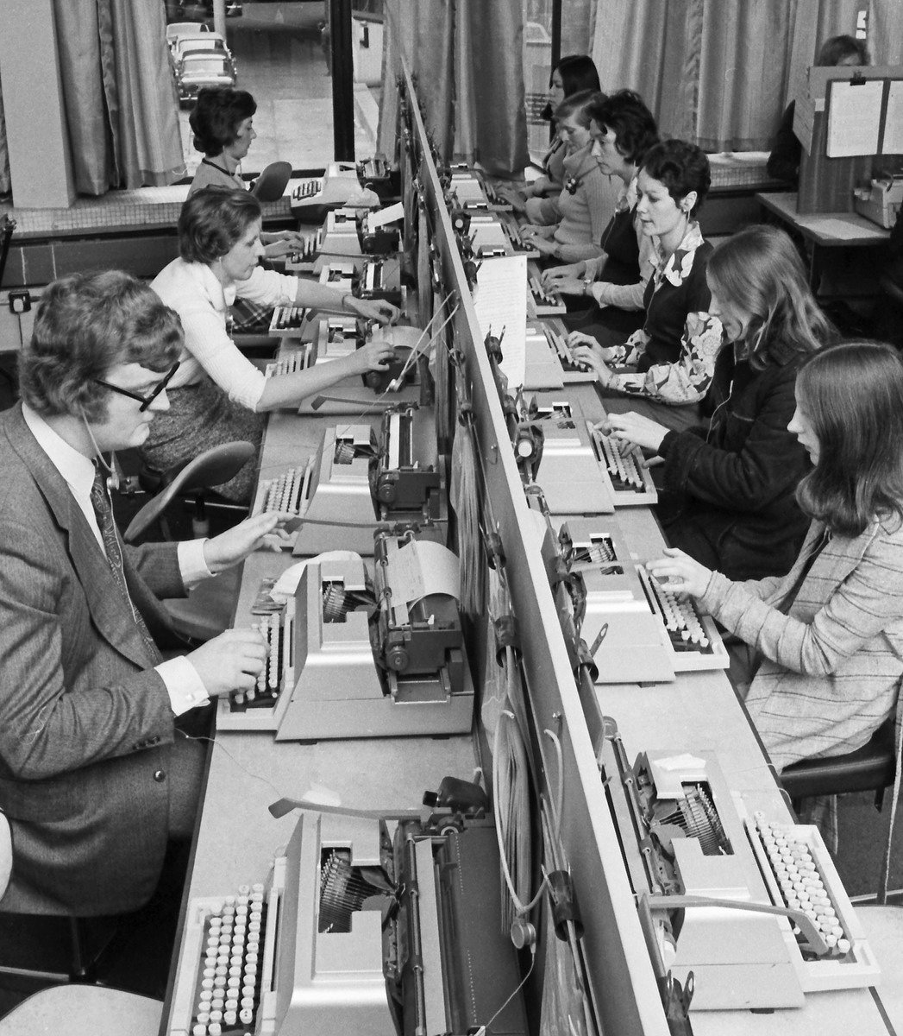
Authentic & personalised exposure to the world of work
Motivation for work – resilience, motivation & confidence
Career skill – self awareness, decision making, behaviour & job search
Getting into work – quals, earnings
- Social & cultural capital
- Learning environs
Notes:
Career dialogue: young people having meaningful conversations with teachers, parents/carers, employers/employees, alumni, trained and qualified career development professionals e.g. Buckler et al., 2015; Powers et al., 2012; Schwartz et al., 2011; Hughes et al., 2004; Hooley et al., 2014.
Career reflection: making concrete the thinking about one’s own motivation and aptitudes, self-regulation, self-determination, and resilience to cope with unforeseen setbacks e.g. McComb-Beverage, 2012; Peterman 2003; Legum, & Hoare, 2004; Kuijpers & Meijers, 2009.
Career exploration: giving shape to one’s own career path by exploring the options for study and work e.g. Athayde, 2009 & 2012; Furstenberg, & Neumark, 2005; and Kuijpers & Meijers, 2009.
Career action: opportunities to make sense of and act upon the learning gained from differing types of interventions e.g. Orthner, et al., 2013; and Kuijpers & Meijers, 2009.
Networking: building and maintaining a network of key contacts e.g. Bernstein et al., 2009; Rhodes & Resch, 2000; and Kuijpers & Meijers, 2009.
Learning environment: stimulating real-life experiences with work and a dialogue about these experiences e.g. Morris, 2004; Gutman et al., 2014; and Kuijpers & Meijers, 2009.
Career conversations students have in the workplace: gaining exposure to and experience of work in simulated and real-life situations, e.g. Hillage et al., 2011; and Kuijpers & Meijers, 2009.

Slide 28




New Forms of Careers Dialogue
Experience
Dialogue
Exploit chances
Estimate chances
Choice for next step
Networking
Reflection on qualities
Identity
Experiences of Work
Performances
Evidence
Network
and motives
Career action
Work exploration
Create chances
Discover chances
Notes:
Leadership and vision essential as confirmed by evidence-base.

Slide 29
Thank you!
CONTACT: Deirdre Hughes
Email: deirdre.hughes3@btinternet.com
Visit: http://www2.warwick.ac.uk/fac/soc/ier/people/dhughes

Slide 30
References
Hughes, D. & Meijers (in press) New School for Old School: Guidance and Counselling, Editors, International Symposium Series, British Journal for Guidance and Counselling, Vol, 45, No.2, April 2017.
Hughes, Mann et al. (2016) International Literature Review: Careers Education with Education and Employers, London. Visit: https://educationendowmentfoundation.org.uk/public/files/Publications/Careers_review.pdf
Hughes, D., Adriaanse, K., & Barnes, S-A. (2016a) Adult Education: Too important to be left to chance, commissioned by the All Parliamentary Group for Adult Education in England, London: House of Commons, Westminster
Hughes, D. (2016) Informed and impartial careers information, advice and guidance: reaching out to support the apprenticeship agenda? In Way, D. (ed.) A Race To The Top – Achieving 3 million more apprenticeships by 2020, University of Winchester Press, July 2016.

