Slide 1
Indicators of successful transitions: Teenage attitudes and experiences related to the world of work
Dr Elnaz T. Kashefpakdel
Head of Research | Education and Employers
Elnaz.Kashef@educationandemployers.org
@Edu_EResearch

Slide 2
This research was completed with the generous funding of the Commercial Education Trust (CET)

Slide 3
Aim of this research
Review longitudinal data in order to identify indicators of adult economic outcomes linked to teenage work-related attitudes and experiences in order to create a new resource for UK schools seeking to judge the preparedness of young people for the adult working world.
By making insights from longitudinal data more easily accessible, opportunity exists to provide schools with a new tool to be used with pupils of the widest range of abilities and aspirations.
Because this is the first time that such a project has been attempted the research team has proceeded with caution, working with schools staff to confirm the prospective utility of the resource.

Slide 4
Synthesising Indicators
a/ Literature review: A systematic search of academic literature
To identify relevant UK which explores the relationships between adult economic outcomes and teenage school-mediated work-related perceptions and experiences, which can be measured and influenced by teaching staff, 2000 onwards, Longitudinal
b/ Extracted the indicators from each study that fit the criteria
c/ Conducted additional analysis using longitudinal databases
d/ Studied the underlying themes and designed the toolkit

Slide 5
Underlying themes
Theme one: Thinking about the future
Teenage certainty about career aspirations are associated with better adult economic outcomes.
Higher teenage occupational aspirations are associated with better adult economic outcomes.
Teenage plans to stay in education after age 16 are associated with better adult economic outcomes.
Teenagers with realistic understanding of the education required to achieve career ambitions can expect better adult economic outcomes than peers.
Teenagers who believe their family networks will help them find work after leaving education can expect better adult economic outcomes than peers

Slide 6
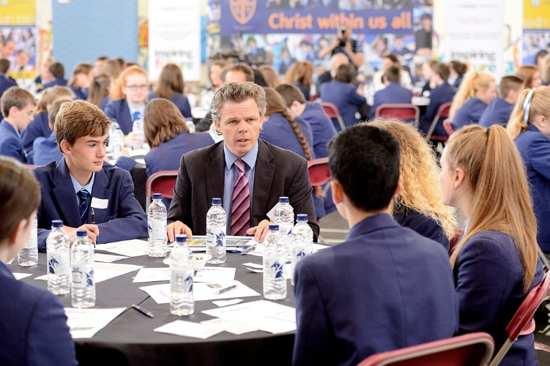
Theme two: Talking about the future
Teenage participation in school-based careers talks with outside speakers is associate with better adult economic outcomes
Teenagers who speak to teachers about their educational plans can expect better adult economic outcomes than peers who don’t

Slide 7
Theme three: Experiencing the future
Teenagers who engage in higher volume school-mediated employer engagement activities can expect better adult economic outcomes than peers
Teenagers who combine part-time employment with full-time education can expect better adult economic outcomes than peers

Slide 8
Theme four: Thinking about school
Teenagers who see value in their schooling can expect better adult economic outcomes than peers who think school is a waste of time

Slide 9
First attempt
Short questionnaire with 13 questions split between 4 sections based on the themes identified
Each section to be scored and evaluated individually (cumulative score not tested)
Allow schools staff to come to an overall view on the preparedness of a young person and to identify particular areas where a student may need more targeted guidance
Scoring system to be used by schools staff.
The scoring system reflects the effect sizes (in terms of wage premiums or
reduced likelihood of being NEET) found in each individual longitudinal study used
Effect Size (%) | Score given
0 | 0
1 – 5 | 1
6 – 10 | 3
11+ | 5

Slide 10
Initial questionnaire
General information
Q1. Your name
Q2. What year group are you in?
Thinking about the future
Q3. What are your plans after year 11?
• I will stay in full-time education
• I will leave full-time education
• I’m not sure
Q4. Nearly everyone your age has some sort of idea of what they want to do in life. Is there a particular job or jobs which you would like to do when you leave education? [If no, go to Question 6a].
• Yes • No
Q5. If you do have a job in mind, what is it? (If you have more than one job in mind, please write the one you are most serious about pursuing.) …………………………………………………….

Slide 11
Q6a. Which level of qualification do you plan on achieving?
• No qualifications • A vocational qualification (e.g. BTEC or NVQ)
• GCSEs • An undergraduate degree
• A-Levels • After I have a postgraduate qualification
• I’m not sure
Q6b. Thinking about the job you chose in Q5. How would you go about achieving it? (E.g. which qualifications, training programmes, subjects would be useful to you?) …………………………
Q7. When you leave full-time education is there anyone in your family or anyone else you know who can help you get a job?
• Yes • No • I’m not sure
Talking about the future
Q8. Have you ever talked to your teachers about what you plan to do next in terms of education?
• Yes • No
Q9. Have you ever had careers talks from people outside of school? If so, how many?
• 0 • 1 – 2 • 3 – 4 • 5+
Q10. Did you find these career talks from people outside of school very helpful?
• Yes • No

Slide 12
Experiencing the future
Q11. Since being in secondary school, how many times have you come into contact with employers/local business people through the school (e.g. careers sessions, work experience, CV workshops)?
• Never • Once or twice • Three or more times
Q12. Have you ever had a paid part-time job?
• Yes • No
Thinking about school
Q13. Thinking about the jobs you might do in the future, do you think that your time at school has been useful?
• Yes, it has been useful • No, it has been largely a waste of time • I’m not sure

Slide 13
Tested by staff in five 11-18 comprehensive schools and one 11-18 grammar school
Participants included careers advisors, careers coordinators, subject teachers and members of senior management teams
The questionnaire was used with a cohort of 788 year 9 – 11 students
Disseminated the paper-based survey to young people with whom they had some degree of familiarity, so the validity of the results could be confirmed
Results were then collected and marked against the scoring system
Teachers were then asked to provide feedback to the research team about the general usefulness of the tool
Testing phase

Slide 14
Feedback from practitioners
The effectiveness of the indicators in identifying pupils appropriately requiring greater careers intervention
The relevance of indicators to all types of pupil (age, progression routes)
The potential use of the indicators as before and after test to determine whether an intervention actually worked
The need for improvement in indicators including analysis of answers in order to interpret data (resources required, marking system, staff available to give guidance)
The mechanisms through which indicators might be delivered electronically as well as in paper format.
Vocational routes to be included and to carry a weight in the scoring system

Slide 15
Feedback from practitioners
The definition of careers talks needed to be made more specific, as well as the time period the question referred to.
Young people became confused with the phrase ‘outside of school’, believing it meant talks from an external organisation.
The survey needs to give guidance that helpful does not necessarily mean that the talk was helpful in deciding on a career. Sometimes it can help a young person decide they did not want to pursue that career.
On the question about the attitudes toward school, school staff thought we should be clear whether this is in relation to school in general, or life skills and careers provision provided during school.

Slide 16
Confirmed format
General information
Q1. Your name
Q2. What year group are you in?
Q3. What are your plans after year 11?
*This includes A-levels, apprenticeships, traineeships and other qualifications*
Thinking about the future
Q4. Nearly everyone your age has some sort of idea of what they want to do in life. Is there a particular job or jobs which you would like to do when you leave education? [If no, go to Question 6a].
• Yes • No
Q5. If you do have a job in mind, what is it?
*If you have more than one job in mind, please write the one you are most serious about pursuing*………………..

Slide 17
Q6a. Which level of qualification do you plan on achieving?
• No qualifications • A vocational qualification (e.g. BTEC or NVQ)
• GCSEs • An undergraduate degree (or equivalent provided by an apprenticeship)
• A-Levels (or equivalent provided by an apprenticeship) • A postgraduate qualification
• I’m not sure
Q6b. Thinking about the job you chose in Q5. How would you go about achieving it? (E.g. which qualifications, training programmes, subjects would be useful to you?)…………………………..
Q7. When you leave full-time education is there anyone in your family or anyone else you know who can help you get a job (any job at all)?
• Yes • No • I’m not sure
Talking about the future
Q8. Have you ever talked to your subject teachers or other teaching staff about what you plan to do next in terms of education?
• Yes • No

Slide 18
Q9. Have you ever had a careers talk from someone from outside of school during your time at secondary school? If so, how many?
*Careers talks involve someone from a local business coming into school to talk about their own career and education. This could be in an assembly, in a careers class, or to a small group of students interested in a particular career.*
• 0 • 1 – 2 • 3 – 4 • 5+
Q10. Did you find these careers talks from people outside of school very helpful?
*You may have found a careers talk helpful even if it helped you realise you DID NOT want to go into a certain profession*
• Yes • No
Experiencing the future
Q11. Since being in secondary school, how many times have you come into contact with employers/local business people through the school?
*This may include careers talks, careers fairs, careers carousels, work experience, CV workshops, and enterprise days.*
• 0 • 1 – 2 • 3+
Q12. Have you ever had a paid part-time job?
• Yes • No

Slide 19
Thinking about school
Q13. Thinking about the jobs you might do in the future, do you think that your time at school has been useful?
• Yes, it has been useful • No, it has been largely a waste of time • I’m not sure

Slide 20
Final remarks
This project set out to provide schools with a practical mechanism for identifying whether pupils (regardless of their attainment levels) are on track for better adult economic outcomes than might be expected of their comparable peers.
This set of ‘indicators’ was developed in light of information collected from longitudinal studies as identified within peer review academic literature or research by the Education and Employers research team working to the same standards
These indicators provide evidence that the holding of a particular work-related attitude or participation in specific activities as teenagers can, on average, be associated with better economic outcomes.

Slide 21
Next steps…
We launch the report on the 12th October
We aim to test this further with a larger pool of schools
We have a toolkit now to download, please send us an email!
Thank you for your time!
Contact: elnaz.Kashef@educationandemployers.org

