Slide 1
What impact can employer engagement have on young people?
Evidence Review
Dr Elnaz T. Kashefpakdel
Head of Research | Education and Employers
Elnaz.Kashef@educationandemployers.org
@Edu_EResearch

Slide 2
Research into employer engagement in education
Since 2009, we have:
run four research conferences uniquely focused on the subject with Andreas Schleicher, Simon Field (OECD), Alison Wolf, Bob Schwartz (Harvard)
addressed audiences in Australia, Belgium, Canada, Demark, Greece (CEDEFOP), Italy, Sweden, US (Harvard), Malta as well as UK Ministries of Education, Business and Treasury.
been responsible for 30+ research publications including first collection of research essays on the subject, and the second on the way
www.educationandemployers.org/research-main

Slide 3
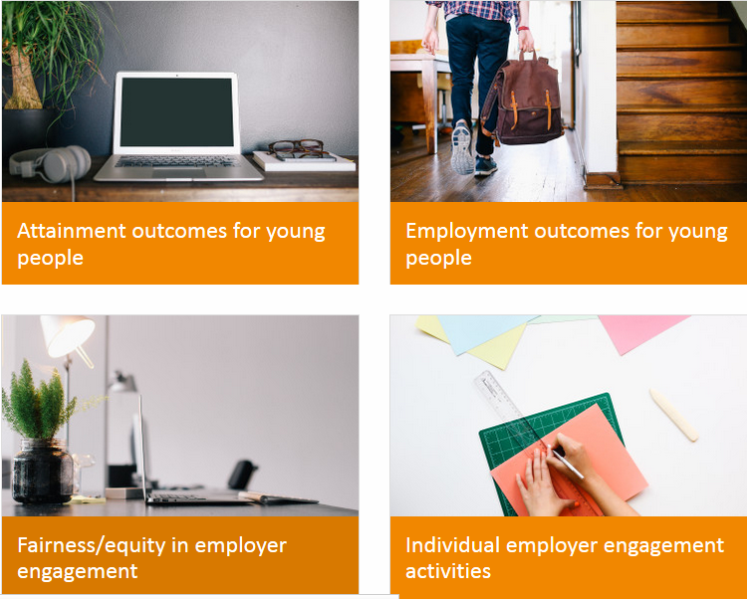
Free online library…
http://www.educationandemployers.org/research-main/

Slide 4
The importance of employer engagement has become more apparent to both government and practitioners and we played a large role in providing evidence:
What difference employer engagement makes to young people?
Why does it make a difference?
What are the implications for practice?
Why is employer engagement is more important now than it was a generation ago?
How delivery can be optimised?

Slide 5
What difference employer engagement makes to young people?

Slide 6
Literature suggests that teenage engagement with workplaces makes a difference to adult outcomes..
Teenage part-time employment is associated with reduced NEET outcomes (UK) and improved earnings (US study)
Crawford, C., Duckworth, K., Vignoles, A. & G. Whyness. 2011. Young people’s education and labour market choices aged 16/17 to 18/19. London: Department for Education
Ruhm, C. (1997) “Is high school employment consumption or investment?” Journal of labour economics. 15:4, 735-776
Teenage informal contacts with people in the labour market are associated with better employment outcomes (Finnish & US studies)
M. Jokisaari. 2007. “From newcomer to insider? Social networks and socialisation into working life” in Youth and Social Capital edited by Helver, H. & J. Bynner. London: Tufnell Press
McDonald, S., Erickson, L.D., Johnson, M.K. & G.H. Elder. 2007. “Informal mentoring and young adult employment.” Social Science Research, 36, 1328-1347

Slide 7
… that teenagers with career aspirations aligned with educational expectations do better than the misaligned – of whom there are many (UK & US studies)..
The aligned at 16 are much less likely to be NEET by 19 than comparable misaligned peers
Yates, S., Harris, A., Sabates, R. & J . Staff. 2011. “Early occupational aspirations and fractured transitions: a study of entry into ‘NEET’ status in the UK.” Journal of Social Policy. 40, 513-534
The misaligned at 16 earn less than comparable peers at age 34
Sabates, R., Harris, A.L. & J. Staff. 2011. “Ambition gone awry: the long term socioeconomic consequences of misaligned and uncertain ambitions in adolescence.” Social Science Quarterly. 92, 4: 1-19

Slide 8
…careers education is associated with better education and employment outcomes.
Education Endowment Foundation funded literature review (2016):review of 73 publications with Randomised Control Trials and quasi experimental studies, OECD countries since 1996:
60% provided largely positive findings evidencing improvements in educational outcomes. Only one study suggested negative impacts. Remainder: mixed results.
67% provide evidence of largely positive economic outcomes; 33% evidence mixed with no distinct patterns in terms of outcomes.

Slide 9
Study one 2013-14
“Employer engagement in British secondary education: wage earning outcomes experienced by young adults.” Journal of Education and Work 27:5, 496-523
“School-mediated employer engagement and labour market outcomes for young adults: wage premia, NEET outcomes and career confidence.” In Mann. A. et al. Understanding Employer Engagement in Education: Theories and Evidence. London: Routledge

Slide 10
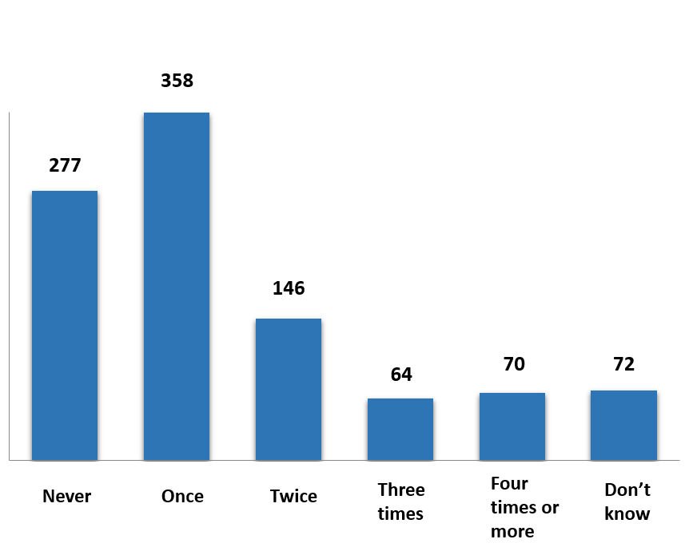
YouGov survey - 1,002 UK respondents aged 19-24
Question: Some schools and colleges arrange for their students (aged between 14 and 19) to take part in activities which involve employers of local business people providing things like work experience, mentoring, enterprise competitions, careers advice, CV or interview workshops, workplace visits, taking part in classroom discussions.
Did you take part in such activities between those ages? If so, on how many different occasions (more or less) did it happen?”

Slide 11
Income variable: annual salary before income tax or any other deductions (if full-time employment 19-24)
800
Less than £10,000 a year
£15,001 to £16,000
£20,001
to
£25,000
£25,001
to
£30,000
More than £30,000
N/A

Slide 12
Interval regression: Average correlation of £500 - £1,300 between wage and each extra employer contact
Control variables
Variable
P-Value
Value
Age
Highest qualification (L1-L5)
Ethnicity (white vs non-white)
Region of UK
School type 14-16
School type 16-19
Gender
Age
0.02
£900
Employer contacts
0.03
£900
Independent school (16-19)
0.04
£4,000
Highest qual level
0.01 - 0.08
£5,000-£8,000
→ 169 individuals

Slide 13
Employment outcomes- NEET Status
Students who do two or more engagement activities could be on average up to 20% less likely to become NEET compared to their peers who did no engagement activity.
NEET
[%]
→ 850 individuals
# School mediated employer contacts, age 14-19

Slide 14
Employment outcomes- Career confidence
Statistically significant positive relationships between volume of engagement and career confidence

Slide 15
Study two: 2016
“Career Education that works: An economic analysis using the British Cohort Study” Journal of Education and Work.
http://dx.doi.org/10.1080/13639080.2016.1177636

Slide 16
The 1970 British Cohort Study provides a large, robust longitudinal dataset to explore pathways to labour market
Survey background
Follows ~17,000 people born in England, Scotland and Wales in a single week of 1970
Data is available at Birth, age 5, 10, 16, 26, 30, 34, 38 and 42 - most recent data from 2012
We gather data for background variables at birth to age 16
Survey attrition means ~48% loss of respondents from birth to age 26

Slide 17
Variables of interest
Full-time weekly income in 1996 (age 26)
Approximately 38% of full time employed individuals reported a weekly income between £200 and £300; Male earns more than female on average (£238 vs. £192 per week)
Academic ability at age 16 is strongly associated with earning at age 26; the high achievers on average earn more. (on average 7%)
Young people‘s wage from more privileged families is higher than families with lower social classes (on average 4.3%)

Slide 18
Career talks with an outside speaker (1986) - overview
# Career talks with outside speakers aged 15-16
66% did at least one, with many doing two or more, allowing us to test the idea: “more is more”
Typically held during school day, decided by school – less individual agency

Slide 19
Including control variables, the average effect at year 10 is 0.8% - statistically significant at 5% (At year 11 the relationship is not statistically significant)
Control variables (Bold = Incl. in final analysis)
Results
Academic ability
Teacher assessment of academic ability at 16
Maths - CSE/O-level results
Highest level of qualification at 26
Cognitive assessment age 5 (hum. fig. drawing
Regression :
Number of talks at year 10 vs. Ln(wage) at age 26
Co-eff: 0.8%
Stnd-error: 0.3%
P-value: 0.00
R^2 24%
N 784 (outliers excluded)
Socio-economic status
Father socio-economic status
Mother socio-economic status
In receipt of council housing (or benefits)
Benefits received from government
Early home learning environment
Frequency of parents reading to child age 5
Mother’s interest in child’s education age 5
Amount of TV watched age 10
Demo-graphics
Gender
Whether has a UK parent

Slide 20
Individuals who found career talks very helpful display a stronger wage premium
Did you find the careers talks useful?
Regression, Career talks co-eff
Model | Did not find helpful | Found very helpful
Yr 10 – With Controls | 0.8% N = 84 | 1.6%** N = 126
Yr 11 – With Controls | -0.1% N = 253 | 0.9%* N=261
* Sig at 10%; ** Sig. at 5%

Slide 21
Study three: 2017
“Contemporary transitions: Young Britons reflect on life after secondary school and college. London: Education & Employers with Barclays LifeSkills.
http://www.educationandemployers.org/research/contemporary-transitions-young-britons-reflect-on-life-after-secondary-school-and-college/

Slide 22
Methodology
Survey of young people aged 19-24 in 2016 by Yougov
Twice the size compared to 2011 survey
Socially, geographically and demographically evenly distributed
Originally the survey included 18 year olds but we excluded them as they might be still in education and their views affect the analysis in a biased way
Frequency tables and descriptive, cross-tabulations and regressions using SPSS
Control variables: school type, parental education, free school meal, gender, ethnicity, region, education level

Slide 23
Distribution of employer engagement activities
Between the ages of 14 and 19, did your school or college ever arrange for you to take part in any activities which involved employers/local business people? E.g. work experience, mentoring, enterprise competitions, careers advice, CV or interview workshops, workplace visits. If so, on how many different occasions (more or less) did it happen?”
Participation in selected teenage engagements with employers
 | Percentage undertaking at 14-16 | Percentage undertaking at 16-19
Work experience | 74% | 25%
Job shadowing | 9% | 8%
Enterprise competitions | 10% | 6%
Mentoring | 2% | 4%
Career advice with employers | 19% | 16%
Part-time employment | 18% | 39%
 | Percent in 2016
Never | 19.0
Once | 36.3
Twice | 23.1
Three times | 8.7
Four or more times | 12.9
Average number | 1.60

Slide 24
Distribution of employer engagement activities
Rank | Region | Average number of engagements
1 | South East | 1.77
=2 | East Midlands | 1.76
=2 | West Midlands | 1.76
4 | London | 1.62
5 | Wales | 1.58
6 | Yorkshire and the Humber | 1.57
=7 | East of England | 1.56
=7 | North West | 1.56
9 | South West | 1.52
10 | North East | 1.46
11 | Scotland | 1.45
While South East has done the greatest number of activities, North East and South West have organised the least number of employers engagement activities across schools in the area.

Slide 25
Distribution of employer engagement activities by social indicators
Volume of activities by school type, 14-16
Volume by Indicators of social disadvantage: Free school meal and parental education
N= 1,676 |  |  | School type
 |  |  | comprehensive school | Grammar / selective state school | Independent / fee-paying school
 | Never |  | 18.5% | 10.6% | 28.0%
 | Once |  | 39.3% | 29.4% | 23.6%
 | Twice |  | 22.7% | 33.2% | 16.1%
 | Three times |  | 8.3% | 10.6% | 10.6%
 | Four or more times |  | 11.3% | 16.2% | 21.7%
Average number of activities 2016 |  |  | 1.54 | 1.92 | 1.74
N=1,659 | FSM
 | No | Yes
Average number of activities | 1.63 | 1.50
N= 1,680 | parents/carers went to university?
 | No, neither of them did | Yes, at least one of them did
Average number of activities | 1.55 | 1.71

Slide 26
a) Most young people educated in the state sector think that their schools prepared them poorly for adult working life; b) Young adults who experienced greater volume of school-mediated employer engagement feel better prepared for the adult working world
P-Value: 0.00 School type at age 16 N= 1,676 |  |  | Looking back, how well do you feel that your school/college prepared you for adult working life?
 |  |  | Very well | Quite well | Quite poorly | Very poorly
 | Non-selective state school, i.e. comprehensive school | % | 4.4% | 39.2% | 43.4% | 13.0%
 | Grammar / selective state school | % | 8.5% | 49.4% | 35.7% | 6.4%
 | Independent / fee-paying school | % | 16.1% | 45.3% | 24.2% | 14.3%
Total |  | Count | 102 | 691 | 679 | 204
 |  | % | 6.1% | 41.2% | 40.5% | 12.2%
P-value: 0.00 Volume of activities N=1,756 |  |  | Looking back, how well do you feel that your school/college prepared you for adult working life?
 |  |  | Very well | Quite well | Quite poorly | Very poorly
 | Never | % | 7.8% | 26.3% | 41.5% | 24.5%
 | Once | % | 3.8% | 36.2% | 47.2% | 12.9%
 | Twice | % | 3.7% | 48.5% | 40.1% | 7.6%
 | Three times | % | 9.9% | 55.3% | 28.3% | 6.6%
 | Four or more times | % | 12.8% | 55.1% | 26.0% | 6.2%
Total |  | Count | 109 | 724 | 704 | 219
 |  | % | 6.2% | 41.2% | 40.1% | 12.5%

Slide 27
Young adults’ career ambitions
More than half of young people find it difficult to pursue their career ambitions in the current labour market
Young people with greater experiences of the world of work appear to find it easier to pursue their career ambitions (its all about volume)
Thinking about what you have done since leaving school or college, how difficult/easy has it been for you to pursue your career ambitions? |  | %
 | Very difficult | 16.0%
 | Quite difficult | 40.0%
 | Fairly easy | 28.1%
 | Very easy | 4.2%
 | I don’t have career ambitions | 11.8%
P-value: 0.00 |  | Thinking about what you have done since leaving school or college, how difficult/easy has it been for you to pursue your career ambitions?
 |  | Very-quite difficult | Fairly-very easy | I don’t have career ambitions
 | Never | 60.2% | 23.1% | 16.8%
 | Once | 59.3% | 28.4% | 12.2%
 | Twice | 55.8% | 34.8% | 9.4%
 | Three times | 47.4% | 42.1% | 10.5%
 | Four or more times | 46.3% | 45.4% | 8.4%
Average |  | 1.49 | 1.89 | 1.33

Slide 28
Young adults experienced wage premiums linked to individual activities where they felt their school(s) had prepared them well for adult life
Employer engagement activity | Premium (expressed in percentage terms) | Premium (expressed in cash terms)*
Volume of engagements where engagement in general found to be useful in getting a job – one engagement | 4.1% per activity | £648
Volume of engagements where engagement in general found to be useful in getting into university – one engagement | 5.5% per activity | £869
Enterprise competition at 14-16 where respondent felt school had prepared them well for adult working life | 11% | £1,739
Mentoring at 14-16 where respondent felt school had prepared them well for adult working life | 19% | £3,004
Job Shadowing at 14-16 | 11% | £1,739
Mentoring at 16-18 where respondent felt school had prepared them well for adult working life | 18% | £2,846
* Based on the average salary reported by our sample

Slide 29
Higher volumes of school-mediated employer engagement are associated with reduced incidence of NEET
@Edu_Eresearch
Control variables
Percentage Correct: 92.7% |  | B | S.E. | P-value | Odds of becoming NEET
 | One | -.577 | .251 | .022 | 44% less likely comparing to those who did zero activity
 | Two | -.791 | .301 | .009 | 56% less likely comparing to those who did zero
 | Three | -1.879 | .650 | .004 | 85% less likely comparing to those who did zero
 | Four or more | -1.907 | .554 | .001 | 86% less likely comparing to those who did zero
Age
Highest qualification (L1-L5)
Ethnicity (white vs non-white)
Region of UK
School type 14-16
School type 16-19
Gender
Parental education
Free School Meal
→ 1,536 individuals

Slide 30
Undertaking individual employer engagement activities is associated with reduced incidence of being NEET*
At 14-16…
Career talks with employers | 81% less likely to be NEET than peers who did not do the activity
Enterprise competition with employers | 75% less likely to be NEET than peers who did not do the activity
Work experience | 45% less likely to be NEET than peers who did not do the activity
At 16-19…
Career talks with employers | 78% less likely to be NEET than peers who did not do the activity
Enterprise competition with employers | 80% less likely to be NEET than peers who did not do the activity
Work experience | 44% less likely to be NEET than peers who did not do the activity
* We asked the respondents about their economic activity on the day of the questionnaire

Slide 31
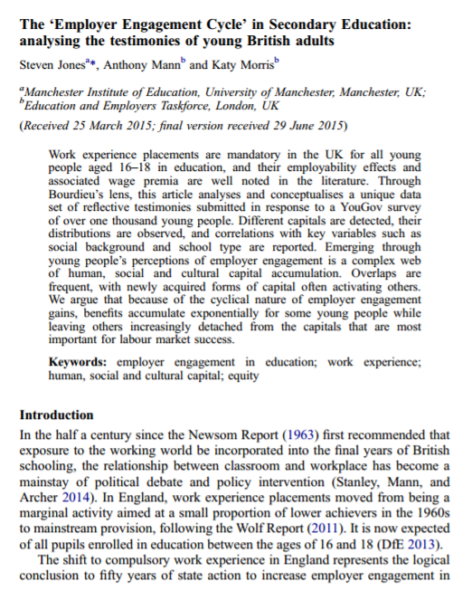
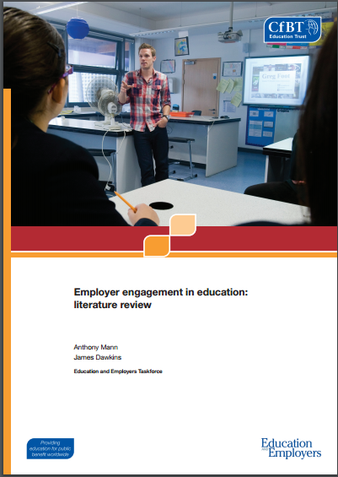
Why does it
make a difference?
“The ‘Employer Engagement Cycle’ in Secondary Education: analysing the testimonies of young British adults” Journal of Education and Work 29, 7: 834-856

Slide 32
What makes the difference? Some options…
Human capital:
technical skills, employability skills, attainment, qualifications (Becker)
Social capital:
‘norms’ and support networks, access to non-redundant trusted information (Granovetter)
Cultural capital:
attitudes and assumptions; confidence in aspirations, language and presentation,
‘a fish in water’ (‘business awareness’) (Bourdieu)
(We must control for access to finance capital)

Slide 33
Effects appear most driven by cultural capital acquisition

Slide 34
Social capital
Helpful in deciding on a career
 | Useful | A lot of use
1-2 career talks | 55% | 8%
3+ career talks | 84% | 28%
“Told us from experience. Told us straight.”
“You got advice that seemed more genuine.”
“I trusted the word of someone in the working world as opposed to a careers advisor or teacher ‘telling’ you what to do.”
“Following my work experience placement I obtained permanent part-time work at the same business. This steady job helped as a stepping stone into the working world.”

Slide 35
Cultural capital
Changing attitudes to education (young people)
Elimination of options and visualisation of potential new pathways
“I did work experience at a hairdressers. It made me realise that I wanted to go to university so that I got a good job and didn’t have to fall back on boring jobs like hairdressing.” (young adult)
Academic motivation and personal confidence
“My work experience placement made me determined to work hard in education and aim for a worthwhile job I will enjoy.” (young adult)
“You see the change in attendance, behaviour. They realise how important it is to get English and Maths. Impact on motivation is huge” (teacher)
“My kids learn that you don’t need to be unemployed when you leave school” (Special school teacher)

Slide 36
Why is employer engagement is
more important now than
it was a generation ago?

Slide 37
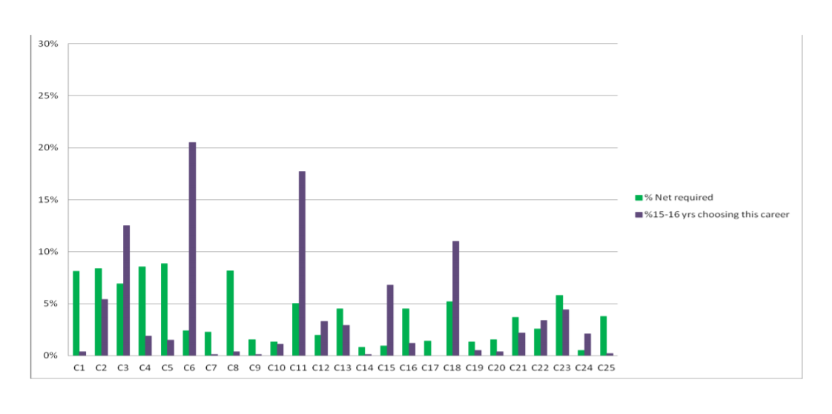
Teenage career aspirations have nothing in common with labour market demand
Source: Mann et al. 2012. Nothing in common. London: Education & Employers and UKCES

Slide 38
Due to globalisation, liberal labour regulation, and especially technological change, for young people the world of work is increasingly…
..complex– with shifts in distribution of employment, jobs growth in new economic areas and significant change in working practices in traditional areas | For young people, investment choices (what and where to study, the value of qualifications and experience) become more difficult as the labour market becomes more complex. | For schools/colleges (primary and especially secondary), Careers Education Information Advice and Guidance enriched by extensive employer engagement becomes more important.
…competitive – with churns between employment (PT, FT, temporary), education, training, unemployment, NEET commonplace | For young people, understanding of how the labour market works, job seeking skills (application processes and in interviewing) and personal resilience become more important. | For schools/colleges, activities to develop resilience and authentic recruitment preparation in context of labour market operation become more important. Where possible, schools can help put pathways from education into work in place.
…changing – with personal effectiveness and adaptability at a premium in service/knowledge economy | For young people, ability to apply their knowledge in unfamiliar situations becomes more important. | For schools/colleges, applied learning (enterprise education), specifically when delivered in real-world settings, becomes more important.

Slide 39
What are the
implications for
practice?

Slide 40
Implications for Practitioners
What does the evidence tell us?
Jordan Rehill
Research Assistant – Education and Employers
Jordan.rehill@educationandemployers.org
@Edu_EResearch
www.educationandemployers.org/research-main

Slide 41
The following advice is based on wider research and a number of our new:
What works? Careers events and transition skills (2017)
Towards an employer engagement toolkit (2017)
Contemporary transitions (2017)
Notes:
Give outlines/methodologies of studies

Slide 42
More is more

Slide 43
Pupils should interact with a lot of employers
1. The views of young Britons (aged 19—24) on their teenage experiences of school-mediated employer engagement (Mann and Kashefpakdel, 2014)
Those who did 3 or more activities
16% more likely to say they found the events useful in getting a job
28% more likely to say the activities were helpful in deciding on a career
*The more young people attend events, the more helpful they became. Those who found the careers talk ‘very helpful’ took part in a greater number of events*
2. ‘Career education that works: An economic analysis using the British Cohort Study’ (Kashefpakdel and Percy, 2014)
For each career talk :
Up to 1.6% wage increase (compared to peers who did none)
Notes:
The more interactions a young person has with people from the world of work through careers events, the better. Over recent years, several influential studies have shown that attending more of employer-led careers events can and does amplify the outcomes experienced by young people
Schools and colleges should give students the opportunity to take part in as many career development activities as possible.

Slide 44
a) Most employer engagement wasn’t helpful in making decisions at age 16 unless teenagers recalled 4+ activities b) Most employer engagement wasn’t helpful in applying for university unless teenagers recalled 4+ activities c)Most employer engagement wasn’t helpful in applying for a full-time job, but participation in 3+ activities made a big difference
3. Contemporary Transitions (Mann et al, 2017)
 | Decision making at age 16 (e.g. whether to stay on, what and where to study, whether to try and get a job)
 | Very helpful / Fairly helpful | Not very helpful / Not at all helpful
Once | 25% | 75%
Twice | 31% | 69%
Three times | 49% | 51%
Four times or more | 51% | 49%
 | Applying for university
 | Yes | No
Once | 33% | 67%
Twice | 38% | 62%
Three times | 47% | 53%
Four times or more | 53% | 48%
 | Applying for a full-time job
 | Yes | No
Once | 21% | 79%
Twice | 32% | 68%
Three times | 42% | 58%
Four times or more | 48% | 52%

Slide 45
Pupils should interact with more volunteers within sessions
A survey of 291 14-18 year old students across careers events (talks, fairs, carousels) at 7 schools and colleges
Students were asked: Do you agree with these statements? (1 being totally disagree and 10 being totally agree)
Statement | Number of volunteers seen
 | 1 - 4 volunteers | 6 - 10+ volunteers
How helpful did you find the event you took part in today? | 6.75 | 7.91
Today’s event motivated me to study harder | 6.28 | 7.35
Today’s event made me confident in what I want to do in the future | 6.5 | 6.83
Today’s event helped me think of the different possible routes to employment (e.g. apprenticeships, university, training etc.) | 6.41 | 7.41
As a result of talking to volunteers, I learnt something new and useful in terms of pursuing a career ambition | 6.16 | 7.98
Notes:
Analysis of young people’s survey data collected at the careers events attended for this study shows that the number of volunteers encountered has a beneficial effect on the outcomes that can be expected. Young people who had interacted with six or more volunteers reported more positive responses across the attitudinal questions we asked. Those who saw six or more volunteers were 15% more likely to say they had learnt something new and useful, 13% more likely to say the event made them think of different routes to employment and 14% more likely to say they were motivated to study harder than peers who encountered fewer volunteers.

Slide 46
Mix it up

Slide 47
Pupils should do different activities
We asked 390 teachers with first hand experience of a wide range of employer engagement activities
In their informed opinion these activities are effective in achieving a variety of achieve important outcomes within and after schooling
As a minimum, pupils should take part in one or more activity over key stages 3 and 4 each related to:
Sustained engagement with the working world.
Activities include: Work experience, Community volunteering and Mentoring.
Effective in improving: Self-management, accessing part-time work.
The development of career exploration and recruitment skills.
Activities include: Career talks, Career fairs, Workplace visits, Mock Interviews and Job shadowing.
Effective in improving: Understanding of the world of work, Career thinking, Decision making
Skill development through Enterprise activities
Activities include: One-day and Long form enterprise competitions.
Effective in improving: Problem-solving, Team working skills
Notes:
390 Teachers with first-hand experience of a wide range of employer engagement activities argue that different activities are more effective in achieving different outcomes. Different people respond to different work related activities in different ways. Effective provision involves use of a range of different activities – with an emphasis on real-world experience.
Within these activities, it is those which most routinely place pupils into first-hand encounters with workplaces and working professionals, highlighted in bold above, which are most highly regarded by schools’ staff.

Slide 48
Higher and lower achievers should be considered separately
For lower achievers
The results suggest that young people with lower levels of achievement will benefit more from sustained engagement with the working world (work experience, mentoring) and interventions which directly integrate employer engagement into teaching and learning (learning resources, classroom teaching).
For higher achievers
By contrast, higher achievers are expected to respond to less substantial interventions (careers fairs, mock interviews).
It may be possible to read into these views that it is lower achievers whose confidence in education is weakest, who require the deepest exposures to the labour market to challenge embedded assumptions
Notes:
390 Teachers with first-hand experience of a wide range of employer engagement activities argue that different activities are more effective in achieving different outcomes. Different people respond to different work related activities in different ways. Effective provision involves use of a range of different activities – with an emphasis on real-world experience.
investigates what schools staff think about the impact of those activities in terms of employability skills, attainment and pupil progression
Within these activities, it is those which most routinely place pupils into first-hand encounters with workplaces and working professionals, highlighted in bold above, which are most highly regarded by schools’ staff.

Slide 49
Start earlier

Slide 50
Earlier is better
Career education that works (Kashefpakdel and Percy, 2014)
For each career talk with someone from outside of the school experienced at age 14-15 young people benefited from a 0.8% wage premium when they were 26.
These findings are statistically significant at 5%, meaning that there is a 95% certainty this correlation did not occur by chance.
This relationship was not found for those aged 15-16, which implies that career talks had a greater value for the younger cohort.
In primary education
Children start to rule career options in or out at an early age and girls and boys hold stereotypical views about male and female careers by age 7.
78.9% of primary school teachers who responded to the survey agree that engagement with the world of work can help to challenge gender stereotyping about jobs and subjects studies.
Notes:
It is evidenced that the early years of a child’s life are a key time in the formation of their attitudes and expectations. Children start to rule career options in or out at an early age and girls and boys hold stereotypical views about male and female careers by age 7. One way of tackling is to make sure they meet professionals of both genders who work in a variety of roles and sectors.

Slide 51
.
Keep it real

Slide 52
Research suggests, and both students and practitioners agree that it matters who delivers information within careers events. It is important that the people providing information to pupils about jobs and careers can draw on personal, first-hand experience of the same professions
Students insights
Why is this important?
Providing a form of social capital
Providing new and useful information from a wider pool of professionals
Practitioners
Careers events in general (careers fairs, talks, carousels) are more effective when…The presenter is clearly someone from the world of work.
 | Strongly agree | Agree | Don’t know | Don’t think it makes a difference | Disagree | Strongly Disagree | Total
Number | 22 | 15 | 0 | 1 | 0 | 0 | 38
% | 57.8% | 39.5% | 0% | 2.7% | 0% | 0% | 100%
Notes:
It appears that that these interactions offer a certain authenticity which young people appreciate in comparison to other sources. Previous research has shown that direct interactions with employers was perceived to be of more value to young people when thinking about their career choices than information gathered from close ties such as parents or friends or that derived from online sources or media.
These interventions can be seen as providing a form of social capital, expanding the effective personal networks of young people by giving them access to larger numbers of professionals with more varied types of experience than would be available from family-based social networks. Such interventions have been seen to add particular value by increasing access to ‘non-redundant, trusted information’ about the availability of economic opportunities and the suitability of a potential applicant for potential jobs.
When surveyed after the events organised for this report a large majority of students agreed that as a result of talking to volunteers, they had learnt something new and useful in terms of pursuing a career ambition. When the question of authenticity was put to a panel of 38 experienced practitioners they overwhelmingly agreed that careers events were most effective when the presenter was clearly someone from the world of work.

Slide 53
469 young people (12-16)
Mann and Caplin 2012
Careers information derived from direct
interactions with employers was perceived
to be of more value to young people
when thinking about their career choices
than information gathered from close ties
such as parents or friends or that derived
from online sources or media.
Notes:
It appears that that these interactions offer a certain authenticity which young people appreciate in comparison to other sources. Previous research has shown that direct interactions with employers was perceived to be of more value to young people when thinking about their career choices than information gathered from close ties such as parents or friends or that derived from online sources or media.
These interventions can be seen as providing a form of social capital, expanding the effective personal networks of young people by giving them access to larger numbers of professionals with more varied types of experience than would be available from family-based social networks. Such interventions have been seen to add particular value by increasing access to ‘non-redundant, trusted information’ about the availability of economic opportunities and the suitability of a potential applicant for potential jobs.
When surveyed after the events organised for this report a large majority of students agreed that as a result of talking to volunteers, they had learnt something new and useful in terms of pursuing a career ambition. When the question of authenticity was put to a panel of 38 experienced practitioners they overwhelmingly agreed that careers events were most effective when the presenter was clearly someone from the world of work.

Slide 54
Level the playing field

Slide 55
a) Most young people educated in the state sector think that their schools prepared them poorly for adult working life; b) Young adults who experienced greater volume of school-mediated employer engagement feel better prepared for the adult working world
P-Value: 0.00 School type at age 16 N= 1,676 |  |  | Looking back, how well do you feel that your school/college prepared you for adult working life?
 |  |  | Very well | Quite well | Quite poorly | Very poorly
 | Non-selective state school, i.e. comprehensive school | % | 4.4% | 39.2% | 43.4% | 13.0%
 | Grammar / selective state school | % | 8.5% | 49.4% | 35.7% | 6.4%
 | Independent / fee-paying school | % | 16.1% | 45.3% | 24.2% | 14.3%
Total |  | Count | 102 | 691 | 679 | 204
 |  | % | 6.1% | 41.2% | 40.5% | 12.2%
P-value: 0.00 Volume of activities N=1,756 |  |  | Looking back, how well do you feel that your school/college prepared you for adult working life?
 |  |  | Very well | Quite well | Quite poorly | Very poorly
 | Never | % | 7.8% | 26.3% | 41.5% | 24.5%
 | Once | % | 3.8% | 36.2% | 47.2% | 12.9%
 | Twice | % | 3.7% | 48.5% | 40.1% | 7.6%
 | Three times | % | 9.9% | 55.3% | 28.3% | 6.6%
 | Four or more times | % | 12.8% | 55.1% | 26.0% | 6.2%
Total |  | Count | 109 | 724 | 704 | 219
 |  | % | 6.2% | 41.2% | 40.1% | 12.5%
Notes:
Young British adults who reported the lowest levels of employer engagement in their education came, on average, from more disadvantaged backgrounds: those who had received free school meals, whose parents had not attended university.
Moreover, young people reporting the highest levels of engagement were more likely to go to independent and grammar schools, and go on to achieve higher level qualifications

Slide 56
Listen to young people
Notes:
Students earn more in later life, and are less likely to become NEET when they find employer engagement activities helpful. Schools could maximise these impacts by listening to students needs in terms of knowledge, information and experiences in the transition to the world of work. It is then beneficial that careers provisions are designed considering what young people would find helpful to hear about.

Slide 57
It is then beneficial that careers provisions are designed considering what young people would find helpful to hear about.
Education and Employers 2017
Respondents who felt their teenage employer engagement to have been helpful went on to earn more and experience lower rates of being NEET than peers.
Consistently it was the young adults who recalled the most engagements who found the activities undertaken to have proved to have been more helpful to them
Kashefpakdel and Percy 2016
In their study students who took part in career talks at 14/15 and found them ‘very helpful’ witnessed a 1.6% increase in earnings per career talk at age 26.
Notes:
Students earn more in later life, and are less likely to become NEET when they find employer engagement activities helpful. Schools could maximise these impacts by listening to students needs in terms of knowledge, information and experiences in the transition to the world of work.
It is then beneficial that careers provisions are designed considering what young people would find helpful to hear about.

Slide 58
What do young people want?
Given what you know now, would you have welcomed more help in any of the following areas while at school/college?
How to create a good CV, or write a good application | 60%
How to perform well at interview | 60%
How the tax/benefit systems work | 59%
How employers actually recruit | 56%
How to manage money once you had income | 55%
How the world of work is changing and which skills are likely to be demanded in future | 49%
How to find a job | 48%
How to find out what different jobs require in terms of skills, attitudes and qualifications | 47%
How job centres and employment agencies work | 36%
How to run your own enterprise/business | 36%
How to get a part-time job whilst still at school or college | 34%
How to get into University | 27%
How to get an Apprenticeship | 24%
How common it is to do a job which people of your gender don’t normally do | 21%

Slide 59
Preparation & Follow up
Notes:
Schools and colleges can expect greater impacts when they contextualise and prepare young people for they engage with the world of work. Students consistently find employer engagement activities more useful if they have had time to think about their wider ambitions and prepare themselves.

Slide 60
Students consistently report that employer engagement activities were more useful if they have had time to think about their wider ambitions and prepare themselves prior to an event taking place.
A number of educational professionals noted that whilst advice from people from the world of work was a crucial element in any careers provision, follow up advice from a careers professional helped to consolidate and make sense of the information provided.
Wider literature agrees:
a young person’s career awareness and confidence are greatly improved when they have attended a wraparound preparation and follow up session with a careers professional, compared to a careers fair alone
Notes:
Positive impacts can be expected to be optimised when young people are well prepared for careers events and undertake follow up activities after the activity. Schools and colleges should set aside time for students to prepare before an event begins.

Slide 61
Be coercive
Notes:
Young people don’t know what they don’t know. Assumptions shape attitudes and attitudes guide decisions and the assumptions teenagers have about jobs are often very deeply held. Exposure to people from different roles and backgrounds is a perfect way to challenge often unspoken assumptions, and build confidence through speaking and listening.

Slide 62
A new toolkit to capture some of the indicators of successful transitions …
Notes:
Add CET logo

Slide 63
Aim of this research
This study aims to harness insights from UK longitudinal studies to help careers professionals and other school teaching staff identify and prioritise pupils who require greater levels of careers provision as they approach key decision making points.
Comprised of a questionnaire and scoring system, the toolkit has been designed to be comprehensive – relevant to students at all attainment levels – by making use of robust UK longitudinal data which compares students of similar characteristics (for example, socio-economic background, geographical area, attainment levels) to identify which factors which make a difference to economic outcomes (earnings and and employment) in later life.
Importantly, the study identifies attitudes and experiences (we term them ‘indicators’) which schools can influence in order to better prepare their young people for adult working life. The approach adopted is primarily designed to allow schools to identify students requiring greater levels of support to help them become well prepared.
Notes:
Add CET logo

Slide 64
The questionnaire
Short questionnaire with 13 questions split between 4 sections based on the themes identified
Each section to be scored and evaluated individually (cumulative score not tested)
Allow schools staff to come to an overall view on the preparedness of a young person and to identify particular areas where a student may need more targeted guidance
Scoring system
Reflects the effect sizes found in the research studies
E.g. In one of the studies used, teenagers who spoke to teachers about their future plans were 13% less likely to be NEET (on the day of the survey). If a young person indicated on the questionnaire they had done this, they would be awarded a score of 5, as the effect size is above 11%.
Effect Size (%) | Score given
0 | 0
1 – 5 | 1
6 – 10 | 3
11+ | 5

Slide 65
Underlying themes
Theme one: Thinking about the future
Theme two: Talking about the future
Theme three: Experiencing the future
Theme four: Thinking about school
Notes:
Theme one: Thinking about the future
Teenage certainty about career aspirations
Higher teenage occupational aspirations
Teenage plans to stay in education after age 16
Alignment
Theme two: Talking about the future
Teenage participation in school-based careers talks with outside speakers is associate with better adult economic outcomes
Teenagers who speak to teachers about their educational plans can expect better adult economic outcomes than peers who don’t

Slide 66
The trial
Distributed to 6 schools who used the questionnaire 788 students in between Year 9 and Year 11.
We asked experienced careers advisors/school career staff to explore how effective the questionnaire and mark scheme was in identifying:
- Students (at all levels of achievement) who required greater attention
How students perceived the quality of careers events that had been provided for them

Slide 67
Findings
Feedback from schools proved to be positive.
All schools felt the questionnaire and scoring system enabled staff to identify and prioritise young people requiring greater support.
5 out of the 6 expressed a desire to use the tool in their schools if it became available
4 of the 6 practitioners thought the indicators would also be useful if used as a before and after test, to help assess whether a career intervention has actually worked.
Notes:
Feedback from schools proved to be positive. All schools felt that the indicators enabled staff to identify young people requiring greater support. Five out of the six schools expressed a desire to use the questionnaire and scoring system in their schools if it became available. They highlighted that it helped them target the young people who needed greater provision and allowed them to prioritise which young people needed most pressing support. Four of the six practitioners thought the indicators would also be useful if used as a before and after test, to help assess whether a career intervention has actually worked. The indicators were found to be particularly useful for those in year 11, but had more limited use amongst the year 9 respondents in this sample. Practitioners highlighted that this may be due to the patterned nature of careers guidance provision in UK schools, with many careers programmes begin in earnest as students begin year 11, meaning younger students will often score poorly in the experiencing the future and talking about the future sections. The indicators may then we best marketed as a tool for assessing year 11 students overall preparedness.

Slide 68
Confirmed format
General information
Q1. Your name
Q2. What year group are you in?
Q3. What are your plans after year 11?
*This includes A-levels, apprenticeships, traineeships and other qualifications*
Thinking about the future
Q4. Nearly everyone your age has some sort of idea of what they want to do in life. Is there a particular job or jobs which you would like to do when you leave education? [If no, go to Question 6a].
• Yes • No
Q5. If you do have a job in mind, what is it?
*If you have more than one job in mind, please write the one you are most serious about pursuing*………………..

Slide 69
Q6a. Which level of qualification do you plan on achieving?
• No qualifications • A vocational qualification (e.g. BTEC or NVQ)
• GCSEs • An undergraduate degree (or equivalent provided by an apprenticeship)
• A-Levels (or equivalent provided by an apprenticeship) • A postgraduate qualification
• I’m not sure
Q6b. Thinking about the job you chose in Q5. How would you go about achieving it? (E.g. which qualifications, training programmes, subjects would be useful to you?)…………………………..
Q7. When you leave full-time education is there anyone in your family or anyone else you know who can help you get a job (any job at all)?
• Yes • No • I’m not sure
Talking about the future
Q8. Have you ever talked to your subject teachers or other teaching staff about what you plan to do next in terms of education?
• Yes • No

Slide 70
Q9. Have you ever had a careers talk from someone from outside of school during your time at secondary school? If so, how many?
*Careers talks involve someone from a local business coming into school to talk about their own career and education. This could be in an assembly, in a careers class, or to a small group of students interested in a particular career.*
• 0 • 1 – 2 • 3 – 4 • 5+
Q10. Did you find these careers talks from people outside of school very helpful?
*You may have found a careers talk helpful even if it helped you realise you DID NOT want to go into a certain profession*
• Yes • No
Experiencing the future
Q11. Since being in secondary school, how many times have you come into contact with employers/local business people through the school?
*This may include careers talks, careers fairs, careers carousels, work experience, CV workshops, and enterprise days.*
• 0 • 1 – 2 • 3+
Q12. Have you ever had a paid part-time job?
• Yes • No

Slide 71
Thinking about school
Q13. Thinking about the jobs you might do in the future, do you think that your time at school has been useful?
• Yes, it has been useful • No, it has been largely a waste of time • I’m not sure

Slide 72
To summarise
A tool to help teachers identify the preparedness of a young person and where they could take part in more activities
Based on academic literature – ‘Indicators’
Drilled down and themed the findings
Created questionnaire and scoring system
Trialled it with practitioners

Slide 73
Next steps
We launched the report on the 12th October
We aim to test this further with a larger pool of schools
We have a toolkit now to download, please send us an email!

Slide 74
Thank you
www.educationandemployers.org/research-main
@Edu_Eresearch

