Slide 1



Supporting 14-19 Transitions to Education and Work
Centre for Post-14 Education and Work in conjunction with Education and Employers Research

Slide 2
Chair’s Welcome and Opening Remarks
Dr Lynne Rogers
Co-Director, Centre for Post-14 Education and Work, UCL Institute of Education

Slide 3

RESTRICTED - Policy
Planning 14-19 Education - new approaches to curriculum and transition
Olly Newton
Director of Policy and Research, Edge Foundation
Education and Employers / IoE Seminar
UCL 18 April 2018

Slide 4
There is a very large skills gap in the British economy
Job vacancies due to skills shortages
209,000
Existing workers not fully proficient in their role
1.4 million
Engineering technicians required by 2020
450,000
Additional workers required with digital skills
745,000
Sources: UKCES Employer Skills Survey (2015); Royal Academy of Engineering (2013); House of Commons, Digital Skills Enquiry (2015)

Slide 5
The size of the skills gap is growing bigger every year
Employers concerned about filling high skill roles
In manufacturing alone, the proportion of businesses concerned about filling high skilled roles increased 11 %pts between 2015 an 2016.
69%
55%
2015 2016
Vacancies reported due to skills shortages
91,000
209,000
2011 2015
Sources: CBI Employer Perspectives Survey; UKCES Employer Skills Survey

Slide 6
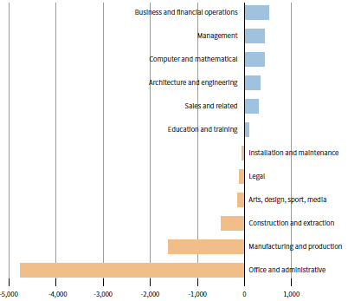
The growth of the skills gap will be accelerated by two factors
The Fourth Industrial Revolution
Brexit
Employment outlook across sectors (2015-2020)
Around 2.1 million EU nationals are working in the UK.
11% of all NHS staff are non British.
Sources: World Economic Forum (2015), The Future of Jobs; ONS, Employment and Labour Market Statistics; Health and Social Care Information Centre

Slide 7
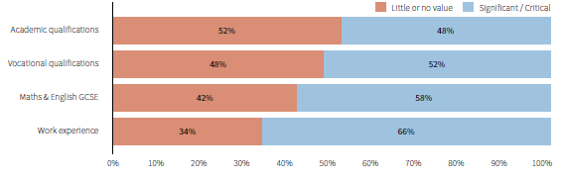
Employers are clear about the experience and skills they need (1)
Value placed by employers on different qualifications and experience when hiring
Source: DfE (2017), Employer Perspectives Survey 2016

Slide 8
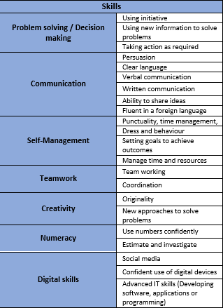
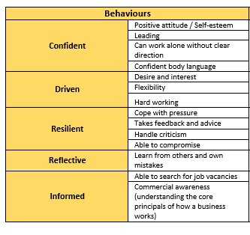
Employers are clear about the experience and skills they need (2)
Source: Research by EETF and Edge – not yet published

Slide 9
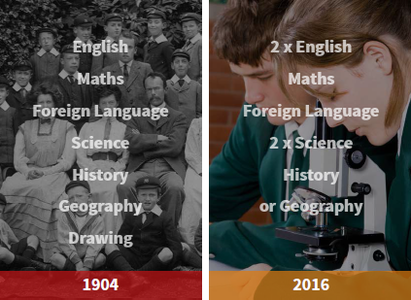
The challenges start in school with a narrow curriculum
Comparison of subjects in the 1904 curriculum with the English Baccalaureate (EBacc)
Source: The Edge Foundation (2015), 14-19: A New Baccalaureate

Slide 10
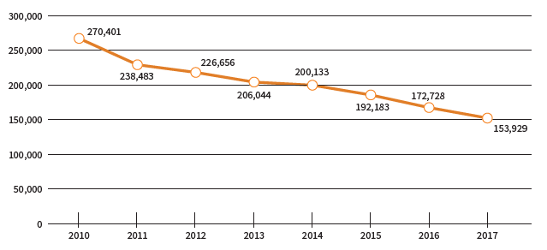
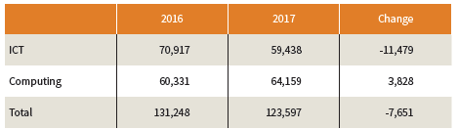
This curriculum squeezes out the subjects that would train our future engineers and computer scientists
Reduction in Design and Technology GCSE Entries (2010-2017)
We should:
Increase bursaries for D&T teacher training (currently £12,000) to the same level as maths (currently £25,000).
Introduce a capital fund to provide match funding for equipment where this is supported by local businesses.
Reduction in Computing-related GCSE Entries (2016-2017)
Source: Joint Council on Qualifications (JCQ) annual data on GCSE entries

Slide 11
Further Education is undervalued
Average funding available per student (2015)
Drop in FE funding
11-16 Secondary School
In 1990–91, spending per student in FE was nearly 50% higher than in secondary schools.
By 2015–16 it was 10% lower than schools.
FE has been the only major area of education spending to see cuts since 2010.
£6,300
16-18
education
£5,600
Higher Education
(Tuition fee cap)
£9,250
Source: Institute for Fiscal Studies (2017), Long-run comparisons of spending per pupil across different stages of education

Slide 12
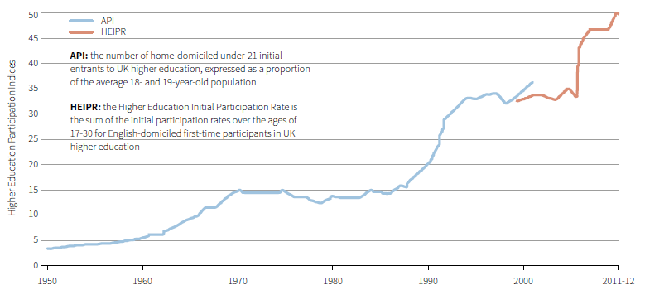
The proportion of young people going into Higher Education has risen rapidly in recent decades
Growth in Higher Education participation rates since 1950
Source: The Edge Foundation (2017), Our Plan for Higher Education

Slide 13
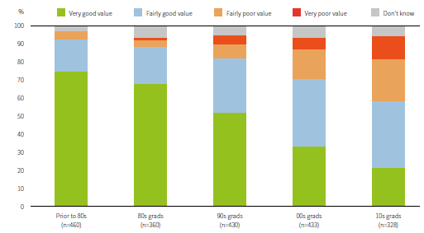
Perceptions of value for money from HE have reduced dramatically
Perceptions among graduates of whether their degree offered good or poor value for money
Source: The Edge Foundation and YouGov (2017), quoted in Our Plan for Higher Education. Survey of 1,000 graduates.

Slide 14
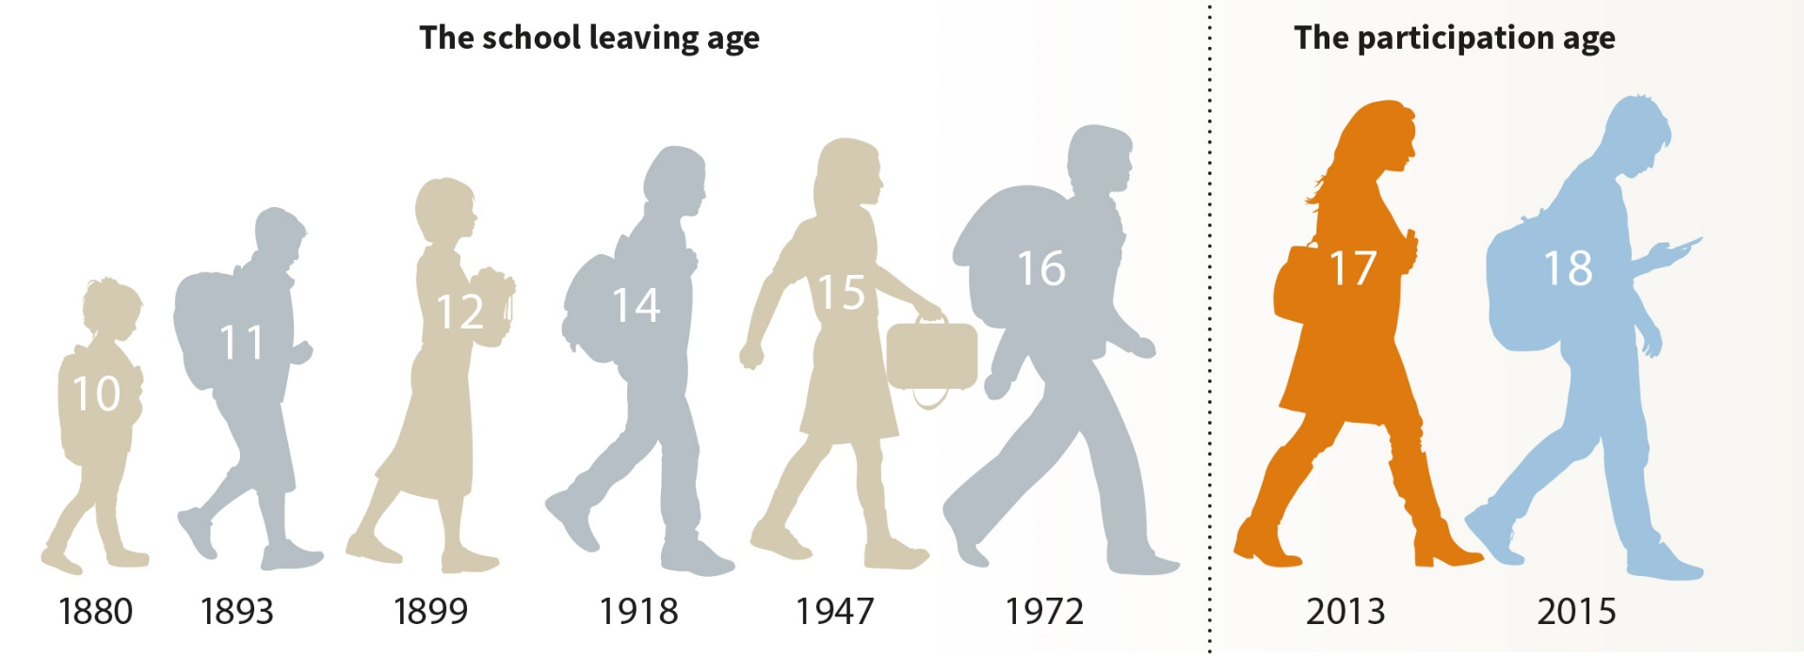


Addressing these starts with a coherent 14-19 phase

Slide 15

Our plan for 14-19 education has eight points

Slide 16
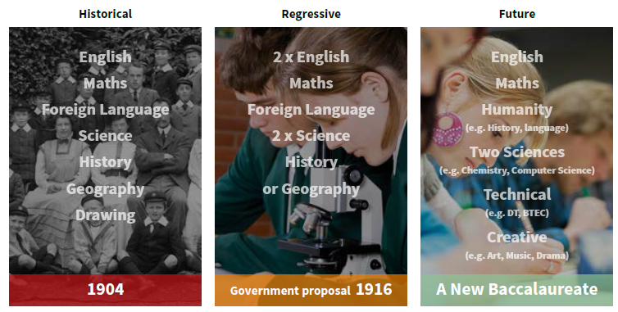


A broad and balanced curriculum…

Slide 17

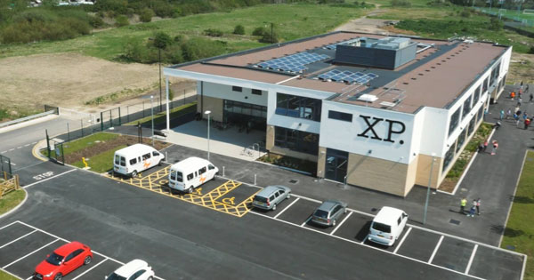

…made relevant through PBL and Real World Learning

Slide 18
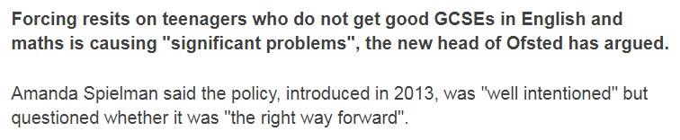
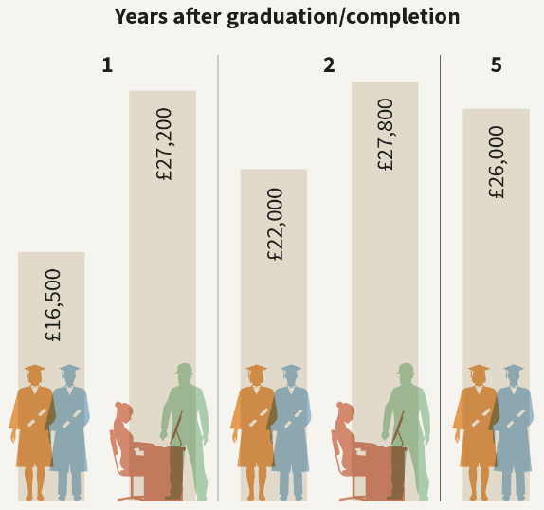
GCSEs and Apprenticeships repositioned
440,300 Apprenticeship starts in 2016/17
Just 108,600 of them aged 16-18, a fall from 2015/16

Slide 19
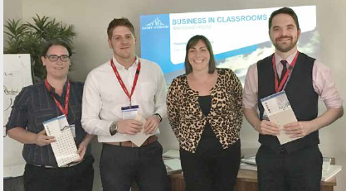
Teachers and employers working in partnership
A planned programme of career guidance, work experience & employer engagement throughout secondary school
Teachers with time to plan, exciting CPD opportunities and the chance to work with employers

Slide 20
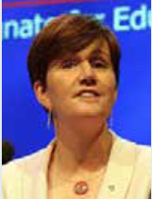


In a collaborative system driven by destinations
An entitlement for young people to access a range of pathways, driving collaboration between institutions
A performance management system driven by the destinations that young people achieve

Slide 21

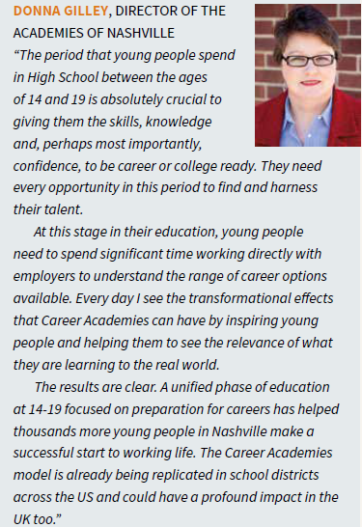

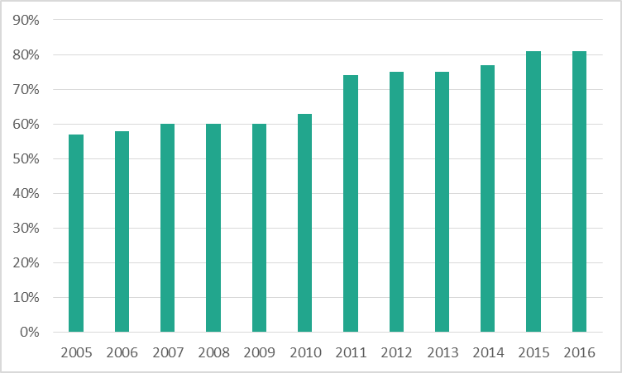
…and we know it works from international examples

Slide 22
Refreshments

Slide 23

Engaging learners and supporting transitions 14-19
Sharing Good Practice
Julie Surridge
Schools Liaison Manager
Havering College of Further and Higher Education

Slide 24
School Partnerships
There is a local partnership with 21 schools
12 schools are 11-16
6 schools are 11-18
3 schools are SEND
All of the learners have a local guarantee

Slide 25
Engagement Activities
Assemblies
Careers Events
STEM Events
Specialised Industry Events
Annual Taster Days
Interview Technique Sessions
CV Writing Sessions

Slide 26
Local Partnerships
Education Services
Careers Service
Pupil Referral Units

Slide 27
Employer Engagement Programme
Employer Forums
Recruitment Events
Traineeships
Apprenticeships
Careers College Employer Links
Online Adult Courses

Slide 28
Work Related Learning for Students
Skills & Apprenticeship Hub
Enterprise & Employability Tutorials
Job Shop
Work Experience

Slide 29
You are welcome to visit us at Havering College if you would like to see our ideas in practice.
Please feel free contact me on the details below
Julie Surridge jsurridge@havering-college.ac.uk
Tel: 01708 462898

Slide 30
PRACTICAL APPROACHES TO MEETING THE GATSBY BENCHMARKS
Jake Armstrong
Careers, Work-Related Learning and Pathways Lead
Addey and Stanhope School
Wednesday 18th April 2018

Slide 31

THE NEED FOR CAREERS EDUCATION
Notes:
A3 paper recording thoughts and discussion points on post-it notes. A couple of thoughts from each table.

Slide 32
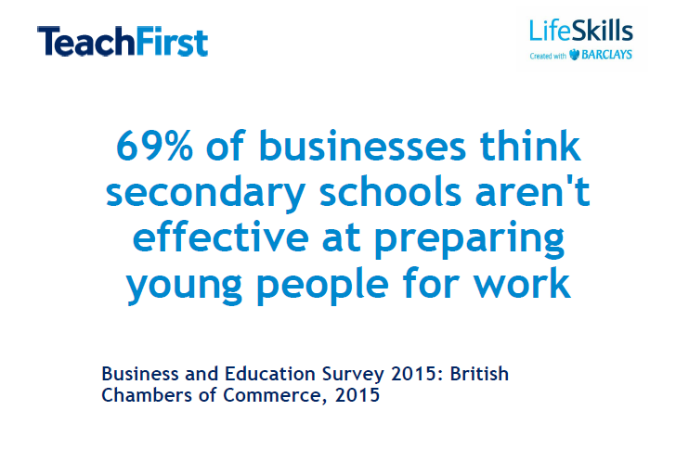

Slide 33
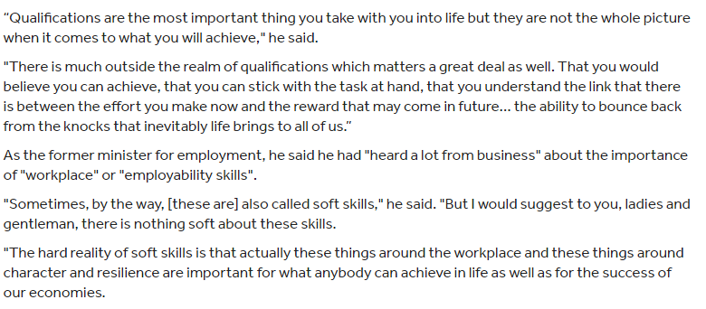
Damian Hinds, Education Secretary
Notes:
https://www.tes.com/news/school-news/breaking-news/damian-hinds-technology-will-ease-teachers-workloads-not-steal-their

Slide 34
There is wide recognition of the importance of such life skills, with 88% of young people, 94% of employers and 97% of teachers saying that they are as or more important than academic qualifications. In fact, more than half of teachers (53%) believe that life skills are more important than academic qualifications to young people’s success and 72% believe their school should increase their focus on teaching life skills.
Life Skills, Sutton Trust Report

Slide 35


Slide 36
“Across the sample, children’s aspirations (from the age of 7) appear to be shaped by gender-specific ideas about certain jobs. Boys overwhelmingly aspire to take on roles in traditionally male dominated sectors and professions.”
Drawing the Future report, January 2018
A survey that asked over 20,000 primary school children aged between seven and eleven to draw a picture of what they wanted to do when they grew up.

Slide 37


Slide 38
“By a considerable margin (over 10 percentage points), the most popular job for children in the UK was either a sportsman and sportswoman with a total of 21.3% of children drawing it as a the job they would like to do when they were older.”
Drawing the Future report, January 2018
A survey that asked over 20,000 primary school children aged between seven and eleven to draw a picture of what they wanted to do when they grew up.

Slide 39
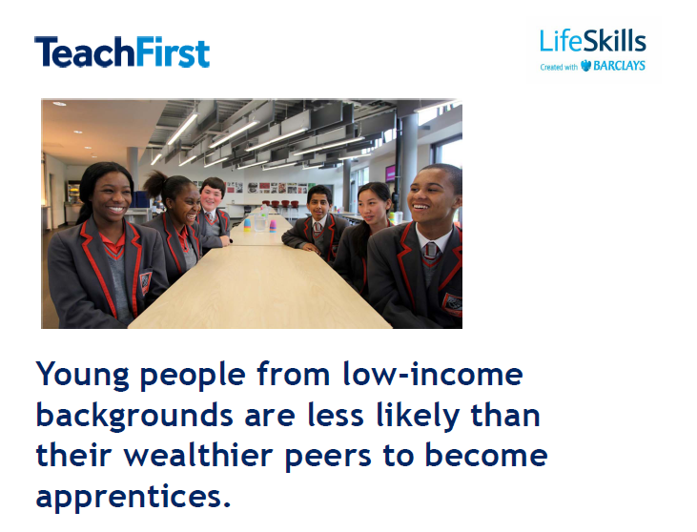

Slide 40


Slide 41
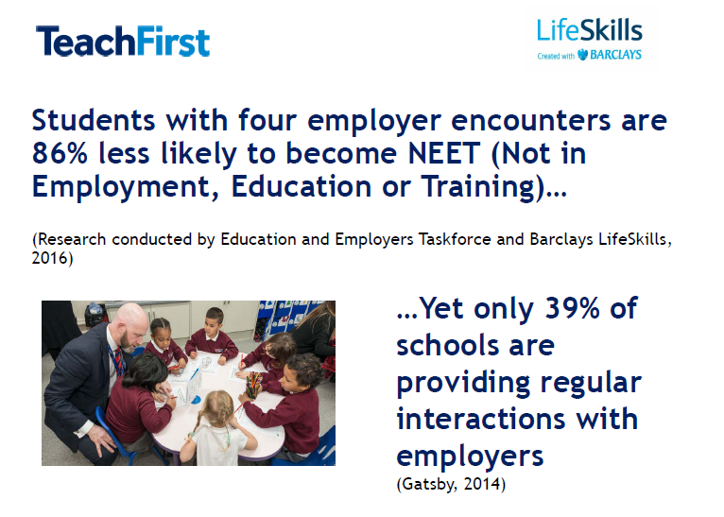

Slide 42
“Gender patterns also emerge in STEM-related (science, technology, engineering and maths) professions. Over four times the number of boys wanted to become Engineers (civil, mechanical, electrical) compared to girls. Moreover, nearly double the number of boys wanted to become scientists compared to girls in our sample. However, strikingly, two and half times the number of girls wanted to become Doctors compared to boys, and nearly four times the number of girls wanted to become Vets compared to boys.”
Drawing the Future report, January 2018
A survey that asked over 20,000 primary school children aged between seven and eleven to draw a picture of what they wanted to do when they grew up.

Slide 43


Slide 44
Three quarters of young people believe that better life skills would help them get a job in the future, and 88% say that they are as or more important than getting good grades. However, only 1 in 5 pupils say that the school curriculum helps them ‘a lot’ with the development of life skills.
Life Skills, Sutton Trust Report

Slide 45


Slide 46
89% of employers prioritise the 'soft' skills of school and college leavers, with 50% saying they feel school leavers lack skills such as communication and teamwork.
CBI Annual Report 2017

Slide 47


Slide 48


Slide 49
“There also seems to have been a shift in the aspirations of children, built largely upon new communication methods and the growth of online and console based gaming. For more and more children and young people online celebrities and YouTube gaming ‘vloggers’ have taken the place of TV and movie stars.”
Drawing the Future report, January 2018
A survey that asked over 20,000 primary school children aged between seven and eleven to draw a picture of what they wanted to do when they grew up.

Slide 50
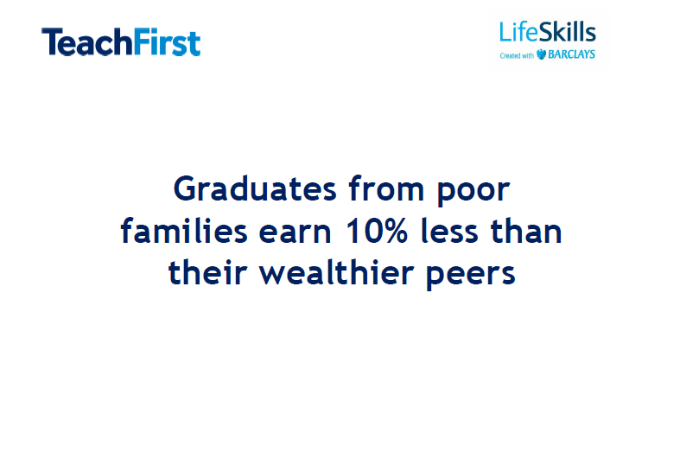

Slide 51





MAKING SENSE OF IT ALL
Notes:
Awareness of jobs/careers but also an awareness of pathways and destinations at appropriate levels.

Slide 52


Slide 53

CAREERS STRATEGY AND
STATUTORY GUIDANCE
Careers strategy
Careers statutory guidance
Notes:
And then a new careers strategy and statutory guidance was launched – immediate provider access policy statement required – GB #7.

Slide 54
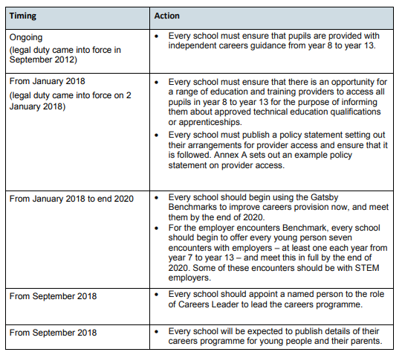
TIMEFRAME FOR IMPLEMENTATION
Notes:
Briefly discuss with delegates.

Slide 55

CAREERS LEADER
Notes:
How many schools/colleges here have a designated careers leader? Get a picture. Are all delegates here careers leaders?

Slide 56
THE GATSBY BENCHMARKS
A stable careers programme
Learning from career and labour market information
Addressing the needs to each pupil
Linking curriculum learning to careers
Encounters with employers and employees
Experiences of workplaces
Encounters with further and higher education
Personal guidance
Notes:
Strategy and statutory guidance places a significant focus on schools meeting the Gatsby Benchmarks. What are they? Ask delegates to write all of them down! GB Bingo! Prize for delegates that get all eight in the correct order.

Slide 57
WHERE ARE YOU NOW?
Gatsby Benchmark: | RAG Rating:
A stable careers programme
Learning from career and labour market information
Addressing the needs of each pupil
Linking curriculum learning to careers
Encounters with employers and employees
Experiences of workplaces
Encounters with further and higher education
Personal guidance
Notes:
Use the offline Compass questions to guide RAG rating. No more than 10 minutes – link to information in the pack – CDI guidance and CDI SEND guidance – what good looks like. Record overall here.

Slide 58

THE COMPASS AND TRACKER TOOL
Notes:
This is a great place to get started. Very focused questions that allow you to form the basis of your careers programme/strategy. Tracker tool allows you set SMART targets and completion dates.

Slide 59


Notes:
Practical approaches that are cost-effective.

Slide 60

Notes:
Practical approaches that ‘try’ to minimise workload.

Slide 61
WORKING TOGETHER
SHARED LANGUAGE AND
DIALOGUE ABOUT CAREERS
CREATING AN AWARENESS
OF OPPORTUNITIES
NOT INCREASING WORKLOAD
HELPFUL RESOURCES

Slide 62

AN ENTERPRISE ADVISER
Notes:
Link on image takes you to the CEC website where you register you interest and speak with your local enterprise coordinator.

Slide 63

CELP!
Careers and Employability Leadership Programme
Teach First programme
18 months
No cost to school
Notes:
End result – a comprehensive careers strategy and programme.

Slide 64



PRACTICAL APPROACHES
Notes:
There are some amazing free resources. START helps to meet GB 1, 2, 3, 5 and 7. Quick demo to delegates. Mention the tracking service (paid for) and the locker. www.startprofile.com

Slide 65

PRACTICAL APPROACHES
Notes:
GB 1, GB 3, GB 4, GB 5, GB 6, GB 7 and GB 8 – tracking, monitoring and evaluation – use existing systems – don’t reinvent the wheel. Show delegates my tracking/monitoring systems.

Slide 66
THE TRICKY BENCHMARKS!
4. Linking curriculum learning to careers
5. Encounters with employers and employees
6. Experiences of workplaces
8. Personal guidance
Notes:
In my opinion, GB 4 is causing me the most difficulty. GB 5 – a meaningful encounter per year. A ‘meaningful encounter’ is one in which the student has an opportunity to explore what it is like to learn in that environment. Work experience/insight days/local businesses. Personal guidance - £££.

Slide 67
LINKING CURRICULUM LEARNING TO CAREERS
Inspiring the Future
STEM opportunities
Alumni network
Staff contacts
Start Profile
Display materials – Prospects Education
CPD

Slide 68
ENCOUNTERS WITH EMPLOYERS
AND EMPLOYEES
Inspiring the Future
STEM opportunities
Alumni network
Staff contacts
Start Profile
Career’s hub/working group – share ideas and attend each other’s events
Speakers 4 Schools
ER Events
Urban Synergy
Job Centre Plus – Support or Schools (accessed via The Careers and Enterprise Company)

Slide 69
EXPERIENCES OF WORKPLACES
Alumni network
Staff contacts
Speakers 4 Schools Next Gen
Local Authority Work Experience programme
Work Finder
Urban Synergy

Slide 70
PERSONAL GUIDANCE
When?
CDI Register
Local Authority
Structure - group interviews vs. 1-2-1.
Action planning.
Monitoring and evaluation.

Slide 71
ENABLING ENTERPRISE

Slide 72






TOP TIPS
Notes:
One step at a time! Careers briefing. Drop down days and big events that target a lot of students. U-Explore and START – to good to ignore! Website. 1-2-1 Interviews. CDI.
Big events – Year 9 Options, Pathways Event, Creative Curriculum Day etc.

Slide 73

THANK YOU!

Slide 74
TAKEAWAY
Presentation with links
CDI guidance on meeting each Gatsby Benchmark
CDI guidance for SEND students on meeting each Gatsby Benchmark
START mapped to Gatsby Benchmark
Compass questions for each Gatsby Benchmark
Aspiration Survey
Destination Survey
Spreadsheet templates
Electronic copies of resources

Slide 75
CONTACT DETAILS
Name: | Email address:

Slide 76
CONTACT DETAILS
Name: | Email address:

Slide 77
CONTACT DETAILS
Name: | Email address:

Slide 78
Chair’s Concluding Remarks
Dr Lynne Rogers
Co-Director, Centre for Post-14 Education and Work, UCL Institute of Education

Slide 79
Buffet Lunch

