Slide 1
Skills competitions Experiences of past competitors
Dr Andrea Laczik
5th International Conference on Employer Engagement and Training 5-6 July 2018

Slide 2
Outline
Aim of the research
What does the literature say?
Methodology
Findings
Conclusion
Ideas for further research

Slide 3
Aims of the research
The research is based on former competitors’ experiences
to identify how skills competitions support their skills development;
to find out how (if) their skills competitions’ experiences are used to secure employment and/or progression in a job;
to identify other (other than skills development) benefits of taking part in competitions;
to better understand some personal experiences with skills competitions at different levels.

Slide 4
What does the literature say?
Very little literature on skills competitions
NAS commissioned (2012-13) a suite of three projects to better understand how World Skills Competitions support skills development.
P1: focused on competitors characteristics and natural abilities
P2: focused on the learning environment within the work environment
P3: focused on broader benefits to all stakeholders (competitors, training managers, FE lecturers, employers, family/friends) and society.
More literature exist in Finland and Australia

Slide 5
Methodology - Survey
Small scale pilot study between November 2017 and March 2018
Mixed method approach using on-line survey and telephone interviews (15 interviews)
Interviewees have not competed at national and international levels.
About the survey respondents: 255 responses
Age: 193 were born between 1992 and 1998
39% were doing apprenticeships and 51% were in college while competing
91% never competed in WS International
34% did not achieve position (26% received a gold medal)
Good spread of sectors
95% of competitors were encouraged by their tutor/teacher to enter competition
Notes:
Construction & Logistics: 22%; Engineering & Technology: 32%; Digital & Business: 6%; Health & Hospitality: 17%; Creative & Design:24%

Slide 6
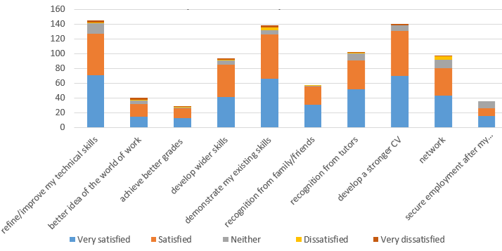
Meeting young people’s expectations
More than half of respondents expected to improve their technical skills, demonstrate existing skills and develop a stronger CV and were satisfied or very satisfied with how the competition(s) helped them to achieve this.

Slide 7
Building transferable skills
Respondents agreed or strongly agreed that taking part in skills competitions had helped them to build transferable skills.

Slide 8
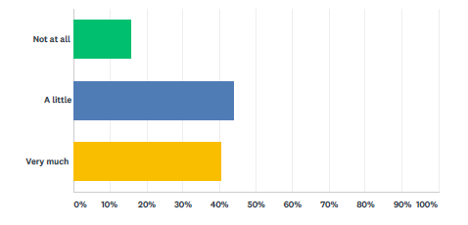
Further benefits of skills competitions
More than three quarters (79%) mentioned the skills competitions on their CV, 72% in an informal discussion with their employer and 58% at an interview or assessment centre.
Two-fifths of respondents (40%) said they felt that skills competitions had added very much to their likelihood of getting a job, and a further 44% agreed that it had added to this a little.

Slide 9
Reflections by local and regional competitors
I had an excellent experience on the day, I had a lot of build up to it, and would recommend the competition to anyone. Give it everything you have got, use all the tips and tricks of the trade and just show off what you can do.
My college lecturer had faith in me and I wanted to prove that I can do it. It is a test that you cannot fail – it is a good test. You have a good day out and a good story to tell.
I was half way through the time and the project, that’s when the pressure builds up and you start working faster. When you start working faster, you start to rush things and then you start making mistakes. So keeping calm was essential. I was taught at the training that keeping high standards of a project which is not quite finished is more important than a finished project but of lower quality.
I enjoy competing because it challenges me to do my best effort. I’m not going in to give half effort.
It was proper problem solving. I had no experience of this particular design to fall back on. I had to stay composed, follow instructions and approach it with a mechanical mindset. I remember my teacher at the time had a saying – the main thing to learn is knowing what to do when you don’t know what to do. That really hit home that day!
The competition made her realise: actually I can do this, I am good at what I do and that’s what pushed me to go in to my own business.
the whole 24 hours was like nothing else

Slide 10
Conclusion
Survey result suggest:
Expectations of skills competitions were overwhelmingly met: Young people improved technical skills, were able to demonstrate their existing skills and developed a stronger CV.
Young people developed a range of transferable skills, especially problem solving, confidence building, resilience, time management and working under pressure.
Young people mentioned their skills competition experience when applying for a job and 84% felt that this helped them a little or much to secure the job.
Further research is necessary to investigate the impact of local, regional and sector level competitions.

