Slide 1
International Reflections on TVET Governance
Chris Cooper
Principal Consultant, skills SYSTEMS

Slide 2
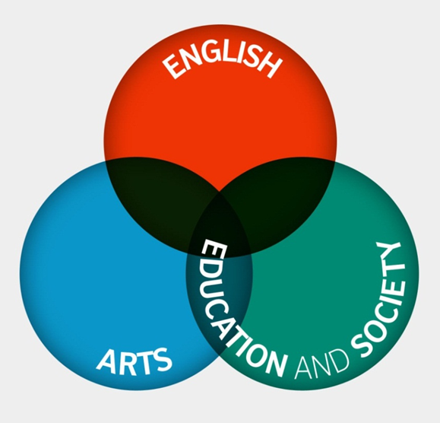
Our purpose
Using the cultural resources of the UK, the British Council creates friendly knowledge and understanding between the people of the UK and other countries.
We work with over 100 countries.
Our three core areas
Notes:
For those of you that don’t know us. The British Council is the UK’s international organisation for cultural relations and educational opportunities. We were founded in 1934 and are, perhaps a little unusual, as we are both a UK charity governed by Royal Charter and a UK public body.
Our role is to create friendly knowledge and understanding between the people of the UK and other countries. We do this by making a positive contribution to the UK and the countries we work with – changing lives by creating opportunities, building connections and engendering trust.
We work with over 100 countries across the world in the fields of arts and culture, English language, education and civil society. Last year we reached over 65 million people directly.

Slide 3
Our work in SKILLs
We aim to enhance the skills and employability of individuals, particularly young people and disadvantaged groups.
We do this by sharing the UK’s experience, knowledge and expertise and encouraging closer links between education, employers and policy makers in the UK and the countries we work in.
Notes:
CURDS (Centre for Urban and Regional Development Studies)

Slide 4
Governance review series
Notes:
‘The role of TVET governance at subnational levels’ looks at devolution of powers over skills development in six countries, England, Indonesia, Morocco, Nigeria, Pakistan and Serbia. The paper provides an important insight into the varied factors in policy making and implementation and analyses the impact of different models of devolved governance.
The survey was undertaken during November to December 2017 with representatives from Columbia, England, India, Kazakhstan, Morocco, Nigeria, Pakistan, South Africa and Vietnam generating 77 responses, with particular interest and engagement from respondents in England, Kazakhstan, South Africa and Vietnam

Slide 5
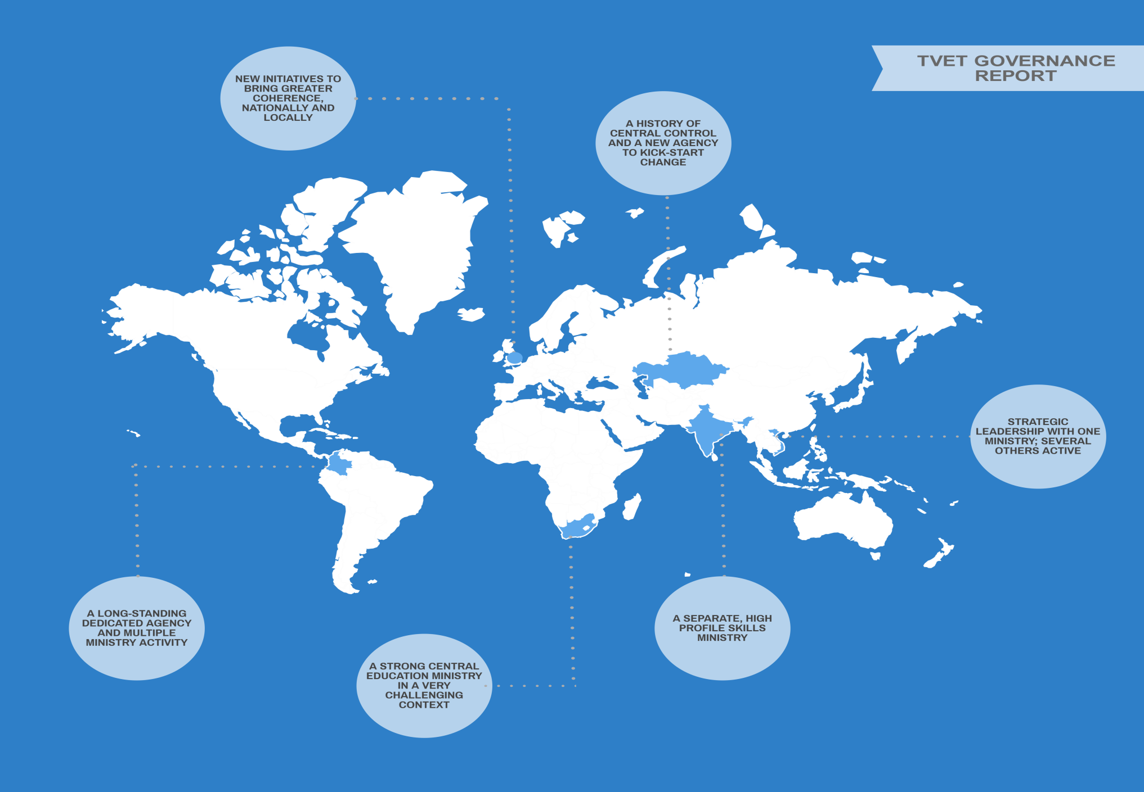

Slide 6
Why Devolution?
“Politicians and civil servants in national central government … don’t always know what’s best for local, regional and urban areas. Pulling levers centrally in a top-down ‘command and control’-style governance system doesn’t necessarily deliver the goods, leaves local knowledge untapped and does not respond well to diverse needs and aspirations.”
Pike et al (2016)

Slide 7
Main drivers of TVET devolution
Meeting the needs of a rapidly changing labour market and aligning with wider industrial strategy
Matching supply and demand
Engaging employers
Improving quality of outcomes, including more relevant curricula, higher quality teaching and clearer outcomes

Slide 8
Potential Benefits of TVET Devolution
Decision making as close as possible to delivery
Local autonomy to make effective decisions
Clarity about roles and responsibilities
Greater accountability for decision making
Improved flexibility, adaptability and ability to change
Innovation and impact
A reduction in bureaucracy

Slide 9
Current LEVELs of Institutional Autonomy
Most autonomy over….
The development of employer partnerships (79%)
Innovation (52%)
Strategic planning (51%)
Least autonomy over….
Size of enrolment (26%)
Setting fees (17%)
Borrowing funds (15%)
Setting salaries for teaching staff (9%)
Most: England
Least: SA and Vietnam

Slide 10
Change in Institutional Autonomy over last 5 years
Net Balance: % with more autonomy - % with less autonomy

Slide 11
Employer engagement with TVET Institutes
TVET leaders hampered by…
“Poor relationships”
“Skills and capacity of the teachers and managers”
Not speaking the same language
Lack of mechanisms to engage employers in skills development

Slide 12
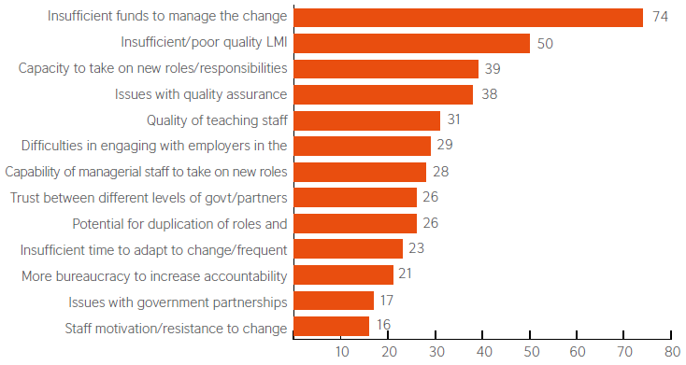
Challenges Posed by Devolution
Net Balance: % agreeing - % disagreeing

Slide 13
Expectations for autonomy in next 5 years

Slide 14
Leaders want more responsibility
They want to be able to….
Design curriculum (66%)
Invest in facilities and equipment (61%)
Tackle public perceptions of TVET (61%)
Monitor and evaluate (61%)
They need ….
Adequate financial and human resources (71%)
Long term strategic planning (65%)
Expansion/modernisation of our teaching capacity (60%)

Slide 15
Preparedness for greater autonomy
BUT over 75% still welcome external support in:
• Accessing finance • Engaging employers
• Staff development • Creating relevant curricula

Slide 16
Key messages
Devolution of TVET is a growing trend internationally
Context matters in terms of realities and perceptions
England (and the UK) have a lot to share in terms or lessons and current practice
BUT Institutions are grappling with the same issues and opportunities for international collaboration exist in areas such as:
Employer engagement and partnership working
Capacity building and development of leaders and staff
LMI and outcome monitoring systems
Building a system that incorporates trust, shared ownership and understanding
More information
www.britishcouncil.org/education/skills-employability

