Slide 1
Supporting Students From disadvantaged Backgrounds to Succeed At School and Beyond
July 2018
International Conference on Employer Engagement and Training
Dr Gillian Considine, The Smith Family Australia

Slide 2
Early intervention to support economic and social participation
OUR MISSION
To create opportunities for young Australians in need by providing long-term support for their participation in education.
Australia’s largest education related charity
Annually supporting over 150,000 children, young people and their carers
All are from financially disadvantaged backgrounds

Slide 3
LEARNING FOR LIFE PROGRAM

Slide 4
Learning for Life scholarship program - supporting over 40,000 children and young people
Financial support
Relationship with a Learning for Life program coordinator
Access to educational programs from early years to tertiary level
+
+
Parent and community engagement and relationship with individual sponsor

Slide 5
Learning for Life students, circumstances and characteristics
Highly disadvantaged
70% - parents not in the labour force or unemployed
57% - single parent families; 6% in grandparent, kin or foster families
56% - parents have not completed Year 12 or equivalent
40% - students and 50% of parents have a health or disability issue
30% - no computer and/or internet connection at home
20% - have been at 4 or more schools
20% - Aboriginal or Torres Strait Islander background

Slide 6
Key programs at different life stages
Early years
Primary years
Secondary years
Post-school years
Parents and carers
Let’s Count
Let’s Read
Student2student reading program
Learning Clubs
iTrack career mentoring
Creative enrichment
Career and post-school pathways
Work Inspiration
Aboriginal girls’ programs
Tertiary mentoring
Financial Literacy
Cadetship to Career
Tech Packs
Financial Literacy
Balanced intervention across young person’s life
Students can begin on Learning for Life scholarship in the first year of school and continue through to tertiary

Slide 7
Measures of effectiveness
LONGER-TERM OUTCOMES
Young people are in education, training, and/or work
Young people complete Yr 12 or equivalent
Young people stay engaged with learning
ENGAGEMENT
ADVANCEMENT
ATTENDANCE
SHORT-TERM OUTCOMES
Improved literacy and numeracy
Improved confidence (self-efficacy)
Improved motivation and aspiration
Enhanced networks and relationships
Improved knowledge/understanding
Improved or sustained school attendance
PROGRAMS
Build skills and knowledge and influence attitudes and behaviours
• Let’s Count • Let’s Read • Learning for Life
• Student2Student • iTrack mentoring
• Learning Clubs • Creative enrichment
• Careers/post-school options workshops
• Cadetship to Career • Aboriginal girls’ program
• Work Inspiration • Tertiary Mentoring
• Tech Packs • Financial literacy

Slide 8
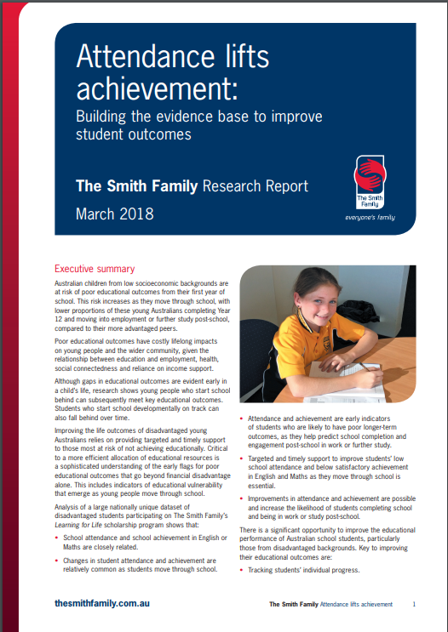
Attendance Lifts Achievement
Building the evidence base to improve student outcomes

Slide 9
In summary Learning for Life longitudinal data shows:

Slide 10
1. School achievement & School attendance

Slide 11
There is a relationship between English achievement and future school attendance
``
Attendance rates 2015 to 2016 by English achievement in 2014
%
5 fewer days attending
Lower English achievement grades in 2014 are a predictor of lower attendance in subsequent years.
decline in attendance greatest for students with ‘E’ grade
Converse applies - attendance predicts future achievement
Same relationships apply for maths

Slide 12
English achievement over time is satisfactory for majority but change is common
Majority had satisfactory or better achievement in 2014 and 2016
1 in 4 students experienced movement ↑ or ↓
Improvements are possible
Timely support to arrest ↓
Need ongoing monitoring through school
Changes in English achievement
2014 – 2016 (%)

Slide 13
There is a relationship between attendance over time and changes in English achievement
7 additional days not attended
Attendance rates in 2015 and 2016 by changes in English achievement 2014 to 2016
Students whose English achievement ↑ had stable attendance
Students whose English achievement ↓ had large drop in attendance

Slide 14
2. School Completion & Attendance (& Achievement)

Slide 15
Attendance rates in Year 7 are related to whether or not a student completes school
Highest level of school completed 2014-2016 by attendance rates in Year 7
Uses LfL 2014 – 2016 school completion data
Students with high attendance in Year 7 were much more likely to complete Year 12, cf students with low attendance (75% cf 48%)

Slide 16
Improving attendance rates as students move through high school increases likelihood they’ll complete school
Highest level of school completed 2014-2016 by attendance in Year 9 for students with ≤69% attendance in Year 7
6 in 10 students who had very low attendance in Year 7 but improved their attendance Year 9, completed Year 12 cf 35% of students who had very low attendance in both Years 7 and 9

Slide 17
3. Post-school engagement in work and/or study

Slide 18
There is a strong relationship between completing Year 12 and post-school engagement in work and/or study
Engagement rates in 2017 by highest level of school completed
82% of students who completed Year 12 were in work and/or study post school cf < 70% of those who only completed Year 10 or Year 11

Slide 19
Post-school engagement in work and/or study is related to school attendance
82% of students who had high attendance rates during high school were in work and/or study post-school cf 66% of those with very low attendance rates
High attenders were also more likely to be fully engaged
2017 Engagement rates by 2013 attendance rates

Slide 20
Summary
School attendance and school achievement in English or Maths are closely related
Changes in student attendance and achievement are relatively common as students move through school
Attendance and achievement are early indicators of students who are likely to have poor longer-term outcomes, as they help predict school completion and engagement post-school in work and/or further study
Improvements in attendance and achievement are possible and increase the likelihood of students completing school and being in work and/or study post-school

Slide 21
Policy and practice implications
Achievement and attendance are indicators of risk. They can be used to identify students needing additional support at particular times as they move through school.
Targeted and timely support to improve students’ low school attendance and below satisfactory achievement in English and Maths as they move through school is essential.
Support for high attenders and achievers should focus on widening learning experiences, sense of possibilities and expanding networks.
Support students at risk of early school leaving eg through new Early School Leavers pilot initiative.
Career coaching, setting goals, skills development including with employers
Unique Student Identifier needed for all Australian students.

Slide 22
gillian.considine@thesmithfamily.com.au
www.thesmithfamily.com.au

